Slide 1
Vireo 4 and More: Maturing an Open Source ETD Management System and Its Community
ETD 2025 Symposium | September 25-26, 2025
Notes:
Hello, My name is Christopher Starcher. I am the Digital Services Librarian at Texas Tech University. I am also the Product Owner, Product Manager, and a developer for the Vireo Project. I work closely with the Texas Digital Library which is the entity responsible for the Vireo Project.
I am joined by two of my TDL colleagues. Frank Smutniak, Senior Software Engineer and Vireo Technical Lead at TDL, and Courtney Mumma, Deputy Director of TDL.
I will be doing the presentation, but they are here to assist with the Q&A and conversation at the end of the presentation.

Slide 2
Overview
Introduction to Vireo
Evolution of the platform
Accessibility
Community
Sustainability
Vireo 4 highlights
Roadmap & future directions
Interactive discussion

Slide 3
What Is Vireo
Electronic Thesis and Dissertation (ETD) Management System
Supports entire ETD process:
  Student submission
  Graduate office approval
  Publication and repository deposit
Integrates with:
  DSpace (SWORD deposit)
  ProQuest (PQ export)
  Catalog (MARC export)
Notes:
Vireo is an electronic thesis and dissertation management system. It is more than just a submission system. It provides for the management of theses and dissertation through the entire lifecycle.
Vireo is able to integrate with several publishing platforms through deposit and export functionality.

Slide 4
Key Stakeholders
Students – simple online submission
Graduate Offices – streamlined review & approval
Librarians – repository deposit & metadata management
Notes:
There are three key stakeholder groups for Vireo.
The first is the students who interact with Vireo through the student submission interface. The students are able to fill out the required metadata, upload documents, and submit their theses and dissertations through this interface.
The second group is the graduate offices who interact with Vireo through the admin interface. Here the graduate offices are able to manage the system and workflows. They are also able to view and manage all submissions and to communicate with students.
The third group is the librarians who also interact with Vireo through the admin interface. Here they can assist the graduate office with administration and review and communication functions. They are also able to manage metadata and repository deposits through the use of export functionality.

Slide 5
Evolution of Vireo
Transitioned into a configurable, multi-workflow system
Community-led development
Improved repository management
Notes:
Vireo–both the software and the project–have evolved substantially over the years.
The software has evolved into a highly configurable, multi-workflow system as you will see later in the presentation.
The Vireo community has grown and matured into a collaborative, supportive community of dedicated users, developers, and institutions.
Repository management has also improved over the years. Issue and development management have been refined and streamlined.

Slide 6
Accessibility Enhancements
Implementation of accessibility recommendations
Support for ADA Title II compliance
Users Group - Task Force on Accessibility Resources
https://texasdigitallibrary.atlassian.net/wiki/spaces/VUG/pages/3890282503/Task+Force+on+Accessibility+Resources
Notes:
A while back, TDL commissioned an accessibility audit of Vireo. That audit identified accessibility deficiencies in the application.
We have done quite a bit of work over the past couple of years to remedy this and have made significant strides in supporting the ADA Title II requirements.
The greatest difficulty has been in retrofitting an application that was not designed as accessible from the outset. I will talk a little more about this later on.
I do want to point out that The Vireo Steering Committee created a user group task force to make recommendations for accessibility of content to be submitted to Vireo. At this link, you can view a one-page document to help institutions begin to address this. You can also find other resources that are linked there.

Slide 7
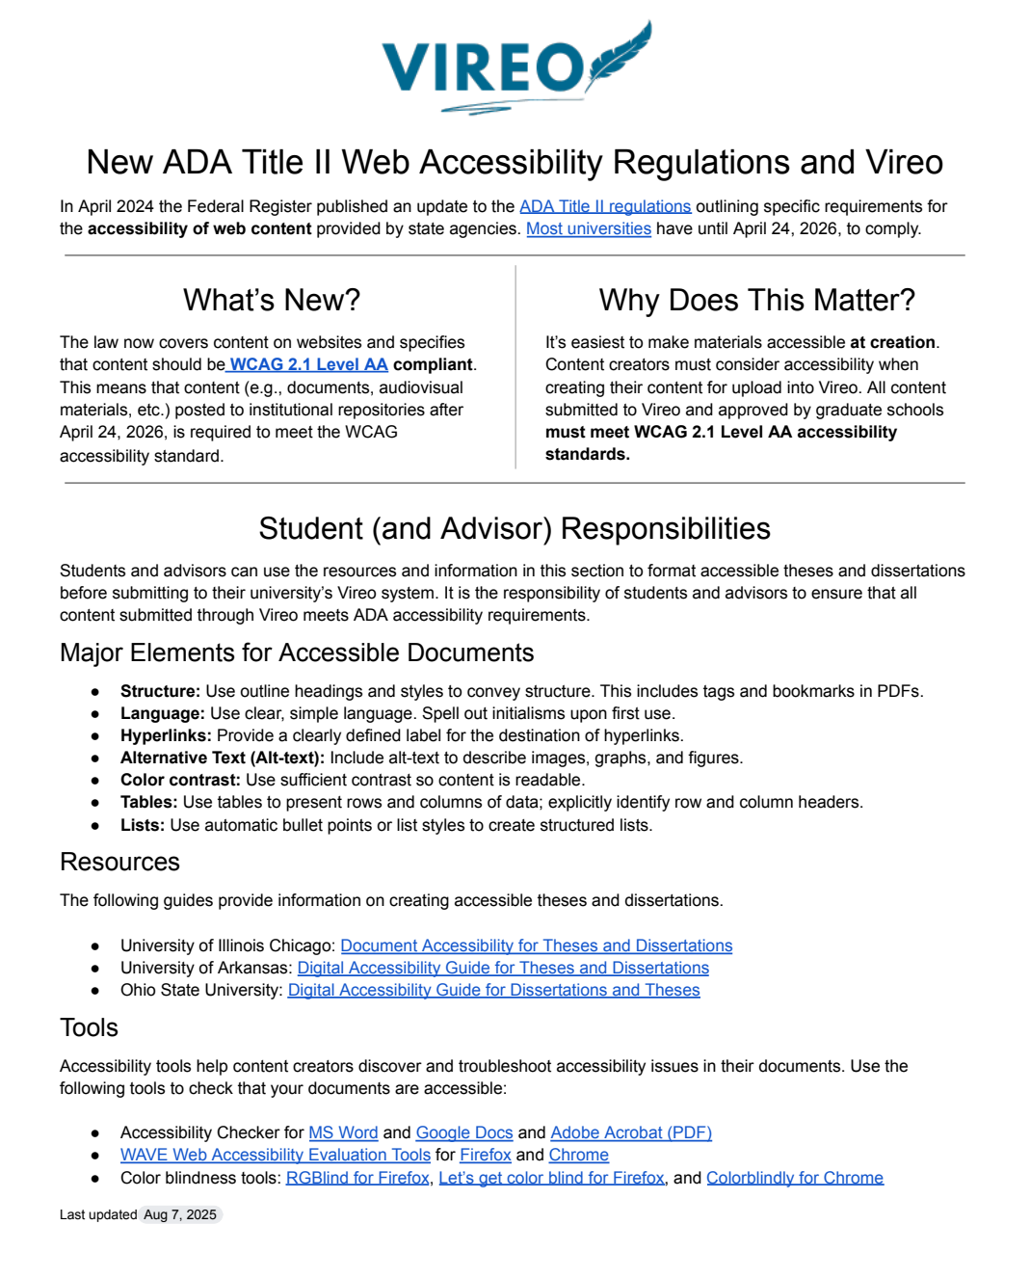
Notes:
https://texasdigitallibrary.atlassian.net/wiki/spaces/VUG/pages/3890282503/Task+Force+on+Accessibility+Resources
This is the on-page document.

Slide 8
Community
Lower barriers for new participants
  Improved technical documentation
  Clearer communication for contributors
Growing Vireo Users Group
Providing more feedback and participation opportunities
Notes:
We have focused on several areas of community support.
Several of these are in support of the development community to lower the barriers for new developer participants. We have tried to improve our technical documentation in an effort to make onboarding of new developers easier. We have also tried to improve our communication channels and processes to make communication amazon developers more efficient. We still have more work to do here, but we’ve made some good progress in these areas.
Of course, we are always trying to support growth of the user group community. As I mentioned earlier, this group has become a real community of support and collaboration. We have some ideas that we are looking onto to continue to support this growth including providing more opportunities for participation and feedback.

Slide 9
Sustainability
Consortium-based governance (TDL and Vireo User Group)
Long-term planning for development
Community task forces for strategic needs
Future planning
Notes:
One of the focuses of my work as Vireo Product Manager is the sustainability of the Vireo Project.
Without solid governance, an open source project is dead in the water. The Vireo Project is supported by TDL and is guided by the User Group and the User Group Steering Committee. These groups continue to improve and are stronger than they have ever been.
We have been working on long-term planning for development. I will discuss this a little further later on.
We rely heavily on the community to help with sustainability by involving them in strategic tasks. The Accessibility Task Force is the most recent example of this.
Outside of long-term development planning, we have been working on more general planning for the sustainability of the Vireo Project. An open source project is more than just code. It requires community and support to keep it going.

Slide 10
Vireo 4 Highlights
New features and key enhancements
  Expanded configurability
  Hierarchy and multiple workflows
  Controlled vocabularies
Notes:
There have been many advancements in Vireo 4, but I want to highlight a few of the more important ones here.
Vireo is a highly configurable system. From workflows to logos, it is possible to conform Vireo to your institutional needs.
Vireo 4 supports organizational hierarchy and inheritance. This allows for multiple workflows within a single institution.
Vireo 4 also supports controlled vocabularies. This allows for better metadata guidance and restrictions for input by students.
I’m going to show you some screenshots and discuss these features briefly.

Slide 11
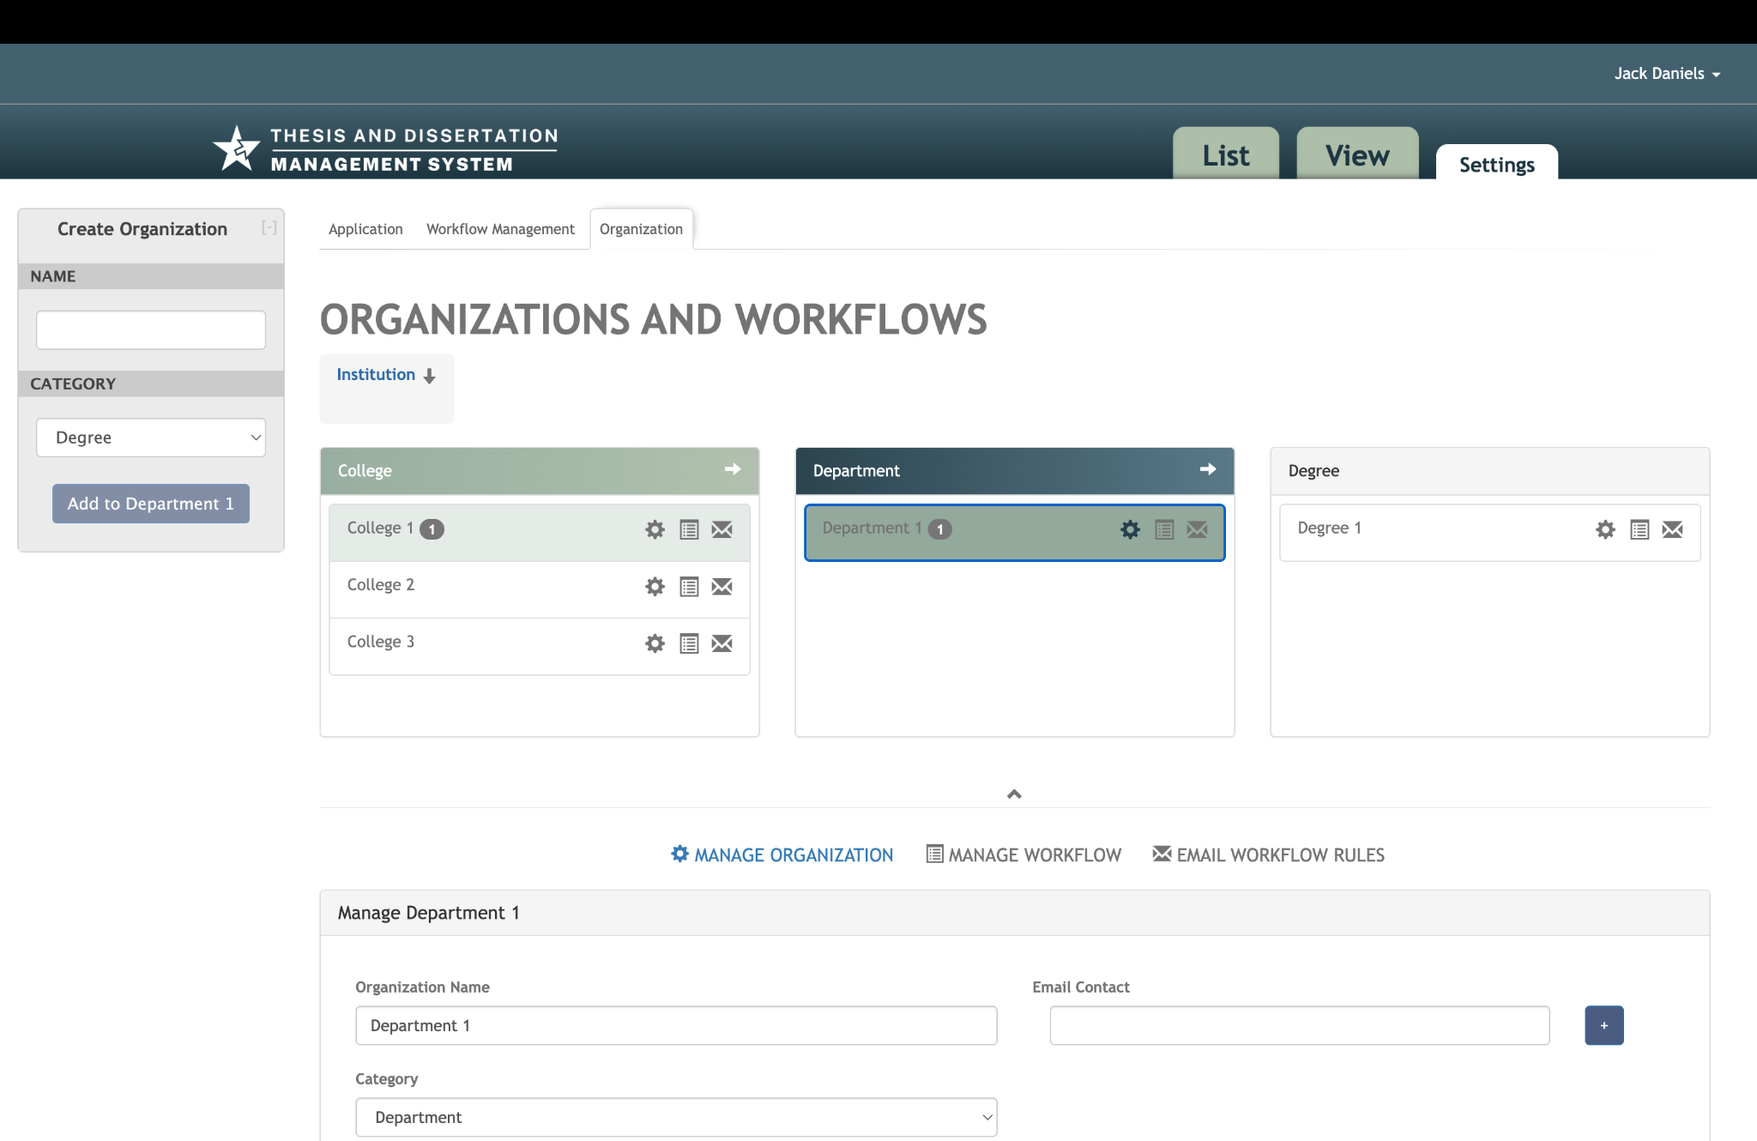

Slide 12
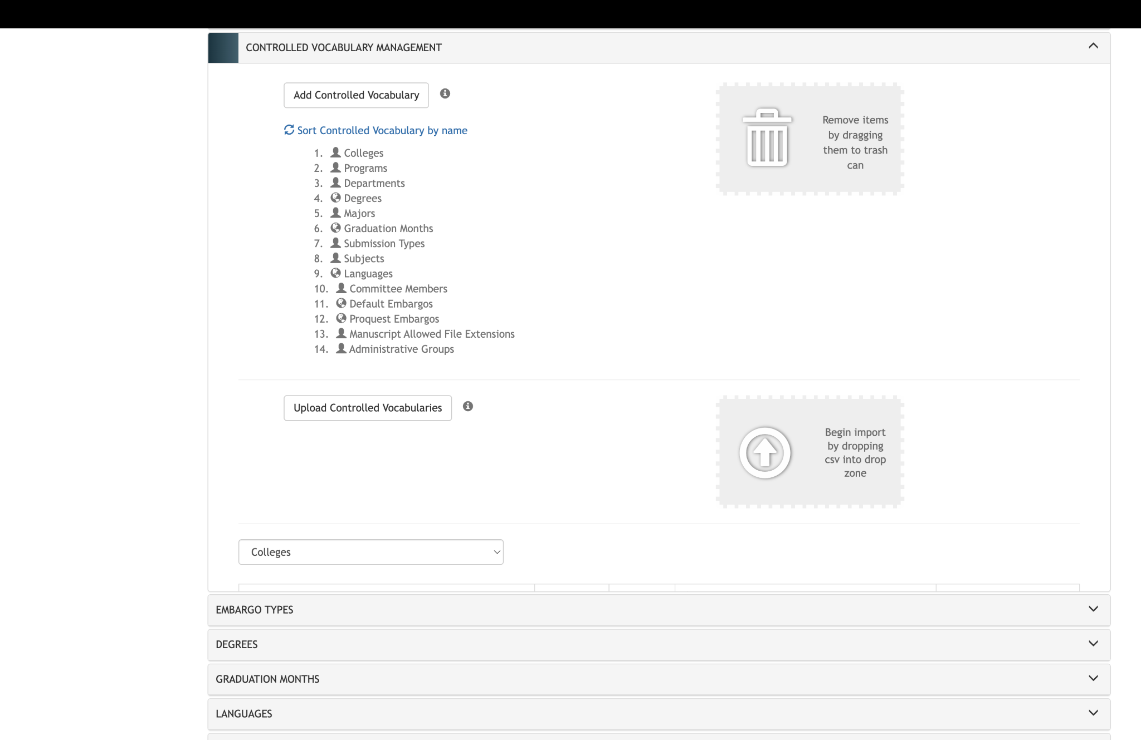

Slide 13
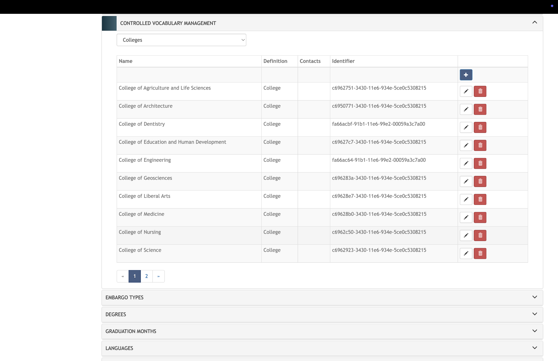

Slide 14
Roadmap and Future Directions
Creating a roadmap
Planning for future development
Planning for growth and sustainability
Notes:
We are in the process of creating an official roadmap for Vireo. The project has never had this type or level of planning.
We are planning toward development of a new version of Vireo. While I cannot give you timelines at this point, I thought it was important to point out that we are looking forward and are planning for Vireo’s future.
I made reference earlier to the difficulty of retrofitting an application to be accessible. This version will be built from the start with accessibility in mind.
And as mentioned before, we are actively planning for Vireo’s growth and for the sustainability of the project.

Slide 15
How to Get Involved
Join the Vireo community
Participate in development and documentation
Contribute feedback to shape the roadmap
Collaborate through TDL and Users Group
  Texas Conference on Digital Libraries
  Listserv
  User Group meetings
  Slack
Notes:
As part of that planning, we would like to encourage you to become involved. With you, Vireo is better. The more people who participate, the better Vireo becomes.
We are always looking to expand our developer team. If you or someone you know would like to be involved, I would love to speak with them.
If you are great with documentation, we could use your help.
If you have ideas for the Vireo Project, I would love to hear them.
You can collaborate through TDL and the User Group.

Slide 16
Discussion
What features and improvements matter most?
Open Q&A
Notes:
I know this format is not the most conducive to dialogue, but I would like to try to get some feedback from both users and non-users of Vireo about what features matter most to you.
As well, we are here to answer any questions you have about the Vireo Project.

Slide 17
2024 Vireo User Group Annual Meeting
October 6, 2025 10:00 AM - 12:00 PM CST
https://texasdigitallibrary.atlassian.net/wiki/spaces/VUG/pages/4160061441/2025+Vireo+User+Group+Virtual+Annual+Meeting+Agenda

Slide 18
Email:
christopher.starcher@ttu.edu
f.smutniak@austin.utexas.edu
c.mumma@austin.utexas.edu
Repository:
https://github.com/TexasDigitalLibrary/Vireo
User Group and Documentation:
https://texasdigitallibrary.atlassian.net/wiki/spaces/VUG
Listserv:
https://utlists.utexas.edu/sympa/info/tdl-vireo

