Slide 1
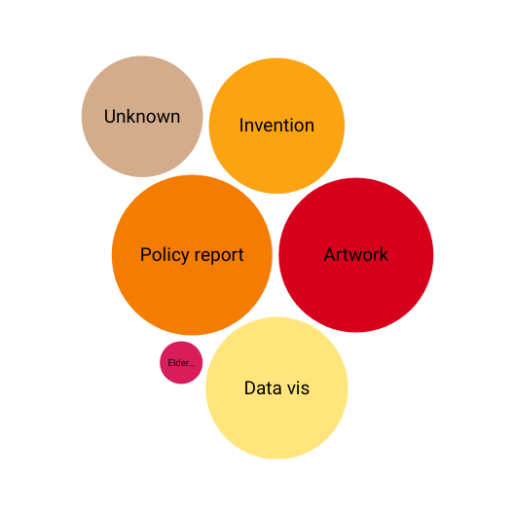
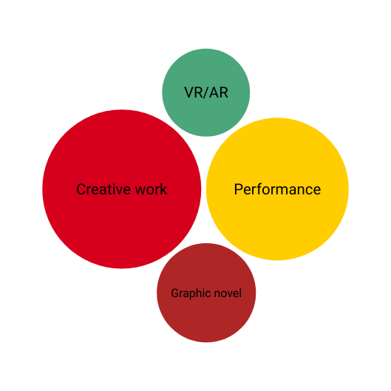

Expanding Knowledge Landscapes: Supporting Non-Traditional Theses at UCalgary
USETDA 2025, Community Engagement Flash Talk, September 26, 2025
03
Barriers
01
  Undefined processes
  Unclear approvals
  Limited supports
What
  Surveyed graduate students and supervisors, fall 2023
  Held focus groups to identify support needs and barriers, 2024
  Analyzed repository records to document existing examples
04
Needs
02
  Early and sustained encouragement
  Clear messaging that these forms are accepted
  Peer support
Why
  Rising student and faculty interest in non-traditional theses
  Need for institutional support of transdisciplinary scholarship
  Recognition of alternate forms of research and assessment
Kathryn Ruddock, Kathryn.Ruddock@ucalgary.ca, Director, Digital Services, University of Calgary
01

Slide 2
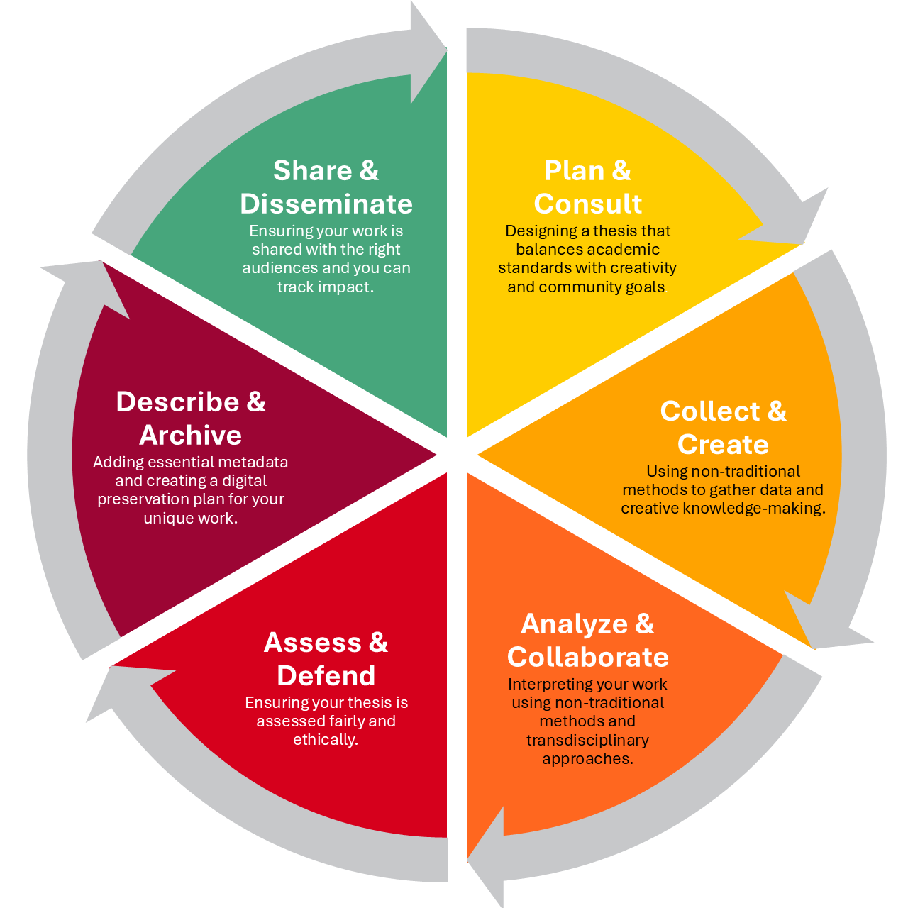
USETDA 2025, Community Engagement Flash Talk, September 26, 2025
Expanding Knowledge Landscapes: Supporting Non-Traditional Theses at UCalgary
Library’s Role & Impact
Connect students with resources
Subject librarian outreach and engagement
  Provide equitable support across disciplines
  Local LibGuide highlights resources across the thesis lifecycle
  https://libguides.ucalgary.ca/theses/non-traditional
  Bridge functional and subject expertise
  Surface examples of non-traditional theses
  Raise awareness of our support areas in description, discovery, archiving, and preservation
Enhanced repository description needs
Early preservation and access consultations
  Provide structured metadata for diverse formats and methods
  Enable cross-disciplinary discovery
  Support students in organizing deposits and supplying file-level metadata
  Proactive outreach so students engage with us early
  Work with them to plan archiving and description from the start
  Recommend sustainable platforms and formats for long-term access
Thank you to my research partners Mairi McDermott, Bart Lenart, Christie Hurrell, Laura Reid, Sefat Rimpu, Abigail Williams
02

