Slide 1

Migrating Digital Theses and Dissertations from a Locally Created Database to an Established Platform
Elizabeth McDonald
University of Memphis
ETD 2025 – USETDA 2025
September 25, 2025

Slide 2
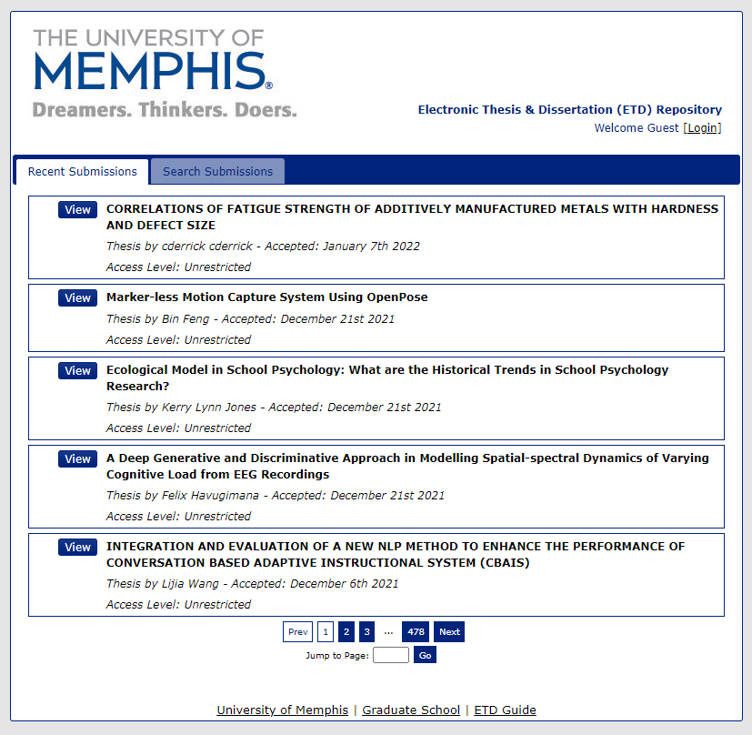
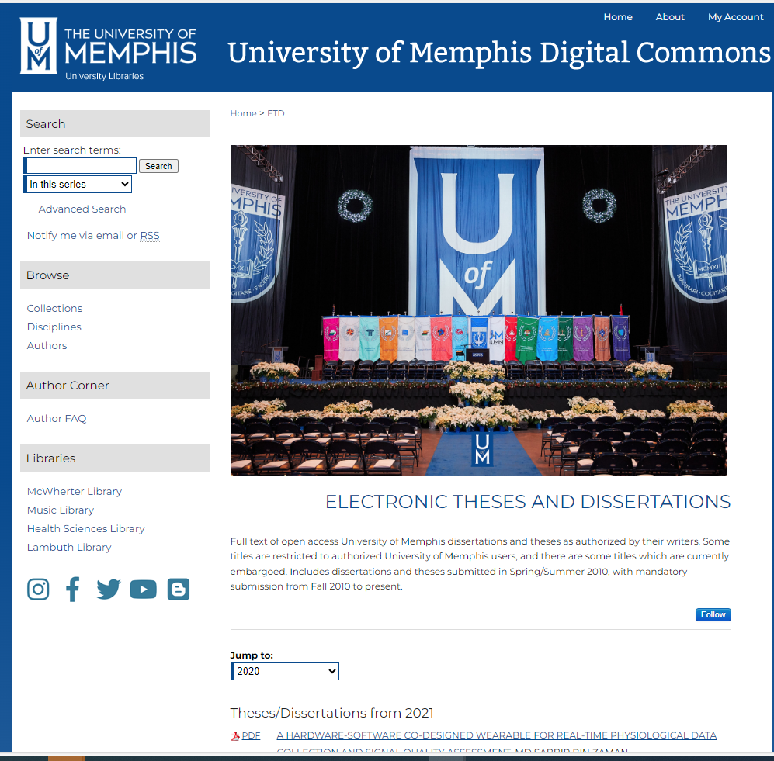

Slide 3
Background
Locally created/homegrown system
Created 2010 – Required Fall 2010
Committee
  Graduate school, IT, Library
Both Masters degrees and PhD/EdD/DMA
Complete system from student submission to the Graduate School through to online availability via the system –extract to create MARC records
Set up to interface with the Banner system and populate some fields
Notes:
I was able to get the extract data in the format to streamline our record creation project in the library

Slide 4
Overall Project
Load etds from local system into Digital Commons
Load ProQuest PhDs into Digital Commons
Update the Sierra ILS records
Update OCLC records
Ongoing processing of new etds

Slide 5
Project Issues
2017-18 Graduate School moved PhDs to ProQuest system
Dual system to migrate
ProQuest portion not covered here
Iterative process
Process initiated in Oct 2021
Most from local system loaded by April 2022
Team
  Digital Initiatives Coordinator, Director of Web and Mobile Services, me-Cataloger
Consulted with RAD (Research Assistance Desk)
Consulted with the Graduate School Analyst

Slide 6

Analyze Data
Individual who designed local system still with the University
Series of data extracts from the old system
How data was stored in old system -- what fields used – differences between extracts used to create MARC records
Missing fields
How embargoes were set up and functioning
Local fields … ETD numbers, major and concentrations
Formatting issues – abstract sometimes multiple lines
Etd numbering jumps
Notes:
For example I did not know that the release dates from embargoes were not retained after they had been met.

Slide 7

CLEAN DATA
Abstracts had &nbsp at front of text
URLS had % signs in front of them
Some fields were codes directly downloaded from Banner system our RAD (Reference Department) wanted spelled out
  Convert abbreviations to eye readable text
100 titles with URL file names created before file name restrictions imposed – had to be done manually
Most embargoed titles had to be loaded manually

Slide 8

Formatting Data for Bepress
Compared these extracts to fields list from Bepress for mapping
Extract data was different from their set up
Create new fields in Bepress
  Committee Chair and more advisor fields
  Major and concentration fields
Send Bepress lists of correct field information for major, concentration, and degrees for vetting purposes
Unique Bepress fields to account for
  Department
  Document type
Embargoes again University use only, and never released for use
Dates in YYYY format

Slide 9

Added Notes
BePress Three Different Fields
Data is provided by the student.
Dissertation or thesis originally submitted to the local University of Memphis Electronic Theses & dissertation (ETD) Repository.

Slide 10
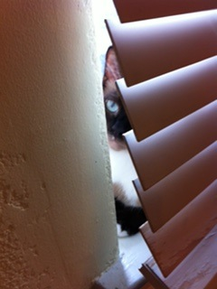
Behind the Scenes Data
ETD numbers – importance
  Field for our old ETD number
  New ETD number for the records in their system
Degree Abbreviations
Marc field for ILS record creation

Slide 11

Final Steps
Test and review results
All data transferred from the old system into the Digital Commons
Updated Sierra bibliographic records
Updated some OCLC records – redirect
Bepress crawl
Cross checked data
Graduate school back end data – eek
  We have needed it
Continuing to make changes as needed

Slide 12

Final Thoughts
Homegrown systems
Homegrown systems need excellent communication between silos
Homegrown-- are they too dependent on creators?
Homegrown customizable
How often are they updated
What if connected systems (Banner) change?
Do you have the staffing to support this
What might be missing
Migration issues

Slide 13
Final Thoughts
General
Make sure you have access to decision files going forward.
Note migrated records from those in new systems
Document decisions.

Slide 14
Questions?
THANK YOU
Elizabeth McDonald
emcdnld1@memphis.edu

