Slide 1
Digital Accessibility for LaTeX Theses and Dissertations
Kristin Terrill Senior Program Specialist for Graduate Scholarly Activities Center for Communication Excellence, Graduate College Iowa State University
Lily Compton Assistant Director of Programming Center for Communication Excellence, Graduate College Iowa State University
ETD-USETDA 2025 Symposium September 26, 2025. Virtual

Slide 2
Presentation Agenda
The State of Iowa State
Thesis & dissertation requirements
Digital accessibility requirements
LaTeX, PDFs, and Digital Accessibility
Promising Directions for LaTeX Theses & Dissertations
Current Recommendations for Iowa State LaTeX-User Graduate Students
Late-breaking Development: The Overleaf Update!!

Slide 3
2024 Thesis/Dissertation Audit
From 2022-2024, 24% of Iowa State theses and dissertations used our Overleaf/LaTeX template
None of these were compliant with the Iowa State Digital Accessibility Policy

Slide 4

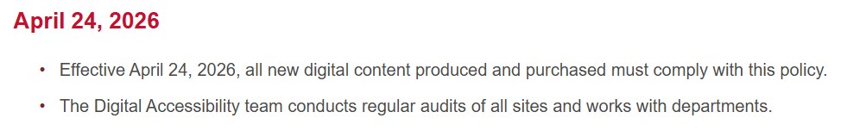
Thesis/Dissertation Requirements
Submit a PDF to ProQuest
Once accepted the PDF gets sent to the Institutional Repository
It is covered under the Iowa State University Digital Accessibility Policy
Notes:
"Effective April 24, 2026, all new digital content produced and purchased must comply with this policy. The Digital Accessibility team conducts regular audits of all sites and works with departments."

Slide 5
Thesis/Dissertation Support
Graduate College Thesis/Dissertation Templates
4 Word templates (updated 2024)
2 Overleaf/LaTeX templates (updated 2022)
Individual consultations
Events
Information session (3 per semester)
Formatting boot camps (2 per semester)
Digitally Accessible LaTeX PDF Workshop (1 per semester)
Retreat (1 per semester)
(continued on next slide...)

Slide 6
Thesis/Dissertation Support (Continued)
Thesis/Dissertation Canvas Organization
YouTube tutorial video playlist
LaTeX FAQ
Overleaf support
Troubleshooting from Iowa State librarian

Slide 7
Frank Mittelbach and the LaTeX Tagging Project
Using the LaTeX prototype for accessible PDF (as of 2025/06)
Tagging Status of LaTeX Packages and Classes
Key takeaway: some of the most popular packages that are used to customize templates, such as thesis/dissertation templates, are not compatible with the tagging code.
Examples:
tocloft—customize how headings are listed in the TOC
titlesec—customize how chapter titles appear on the page
Source code for standard document types, e.g., article, book, & report, can be downloaded from CTAN. Although the source code is documented, it is:
Hard to understand what code pertains to which document classes
Hard to predict effects of changes to source code on output PDF
Suggestions from the web all point to incompatible packages…it would take an experienced LaTeX programmer who understands the source code to develop a new template compatible with the tagging code!

Slide 8
LaTeX and PDFs
New kernel released 11/1/2024
It has not been integrated into Overleaf, but integration is in-progress
From Overleaf Success (tech support team):
"We haven't yet developed resources and documentation that will help provide easier to follow instructions for tagging for producing tagged pdfs, and don't provide any latex consulting services that would help transition existing documents to use the latest available tagging options" (personal correspondence, 11/15/2024)
Notes:
Note: This slide was prepared in May, 2025

Slide 9
Overleaf Updates (Sept. 4. 2025)
From Overleaf blog:
Key changes in TeX Live 2025
Creating tagged PDFs for accessibility
It's now possible to create tagged PDFs with TeX Live 2025. The LaTeX Tagging Project provides a comprehensive guide with examples, which can all be used on Overleaf. This brings LaTeX closer to producing PDFs that meet new accessibility standards with additional work ongoing. Tagging options include graphics, tables, lists, and math.

Slide 10
Overleaf and PDFs
Iowa State's LaTeX templates in Overleaf do not export digitally accessible PDFs.
Overleaf support has updated their basic template to output tagged PDFs.
The Iowa State template is not compatible with these updates
À la carte tagging packages are not compatible with the Iowa State template
Currently, personnel, time and resources are not sufficient for updating the Overleaf thesis/dissertation template

Slide 11
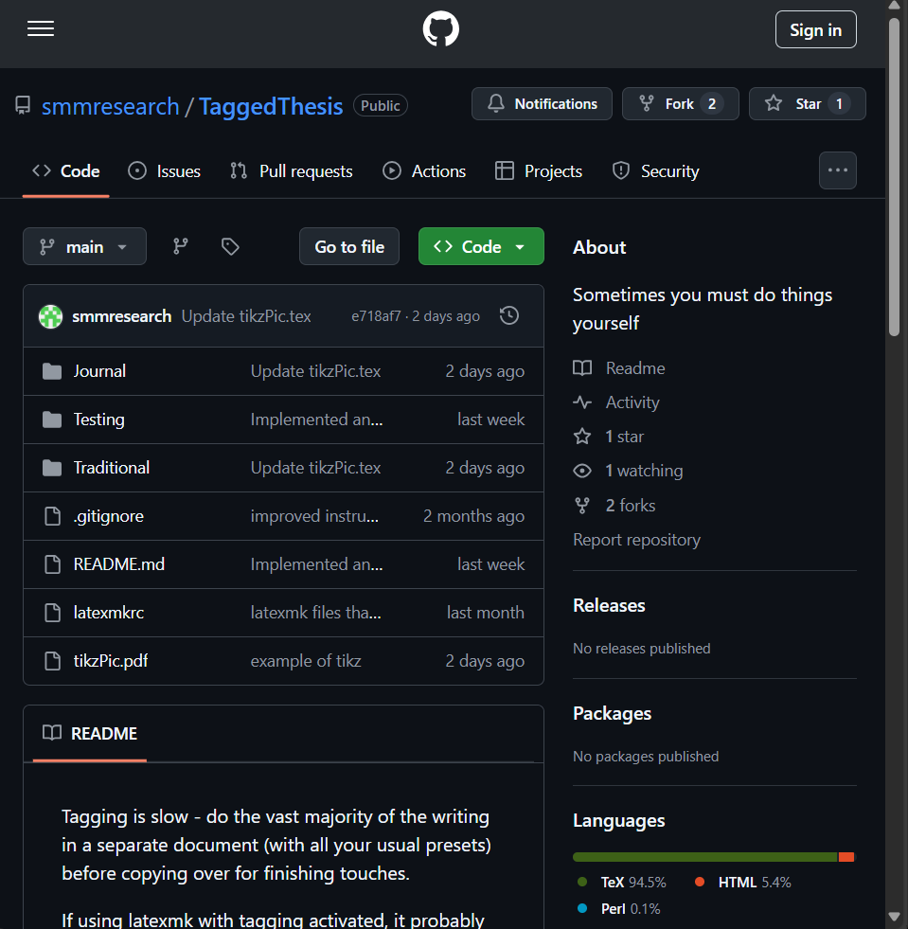
Notes:
Sarah McCarty project: https://github.com/smmresearch/TaggedThesis

Slide 12
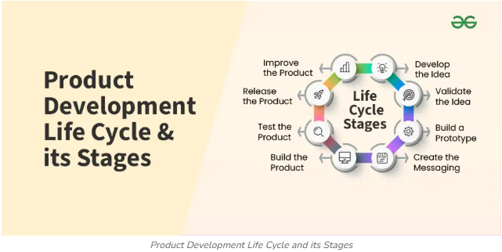
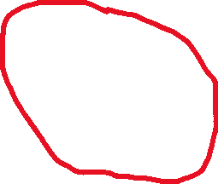
A Silver Bullet? No, Just a Prototype
We are somewhere around here
Notes:
Image credit: Geeks for Geeks--https://www.geeksforgeeks.org/product-development-life-cycle-and-its-stages/

Slide 13
PDFs and Digital Accessibility
PDFs can be made accessible with a PDF editor, such as Adobe Acrobat DC Pro
CCE thesis/dissertation consultants have been trained to remediate PDFs in Acrobat DC Pro
They are not trained to troubleshoot complex issues that affect LaTeX PDFs
Acrobat DC Pro Licenses
"Available" to Graduate Assistants and Teaching Assistants (how?)
Currently corresponding with IT regarding "check-out" licenses for non-GAs
Student access for some departments
AESHM (Apparel, Events, and Hospitality Management)
Design
Greenlee (Journalism)
Marketing
Notes:
Information Technology - Adobe Software & License Transition FAQ

Slide 14
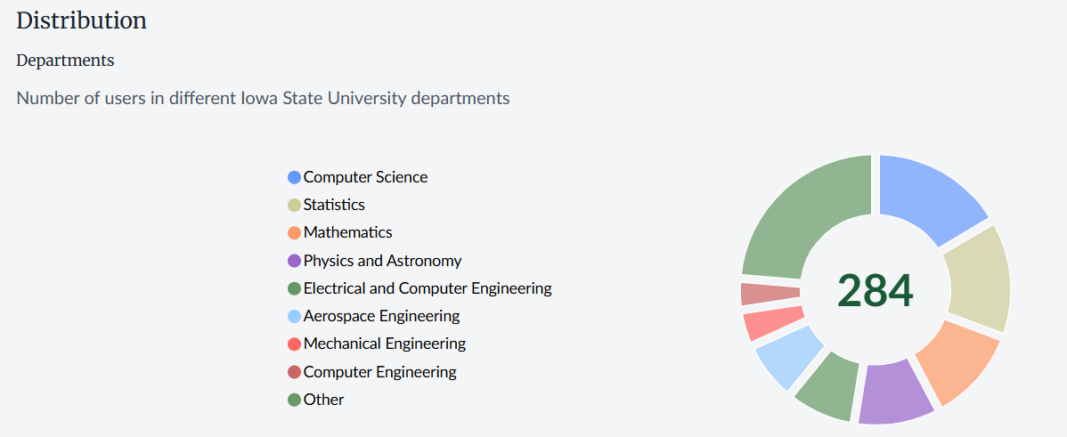
Overleaf User Statistics

Slide 15
Acrobat Pro Access Gap
Students who use LaTeX
Not currently on an assistantship
Not in a department with Adobe license

Slide 16
Additional Limitations
Acrobat automatic tagging is unreliable and glitchy
“Bug found in Autotagging (Accessibility)” Adobe Community Forum post by user C225172330nhr, January 24, 2022
Graduate College has minimal instructional support for
Digital accessibility, generally
Digital accessibility features in Acrobat
Other support sources
Digital Accessibility Team (IT)—currently two staff for all digital resources across the entire university
University Library—currently one staff informally providing time & expertise to help students remediate ETDs
Notes:
https://community.adobe.com/t5/acrobat-discussions/bug-found-in-autotagging-accessibility/m-p/12702683

Slide 17
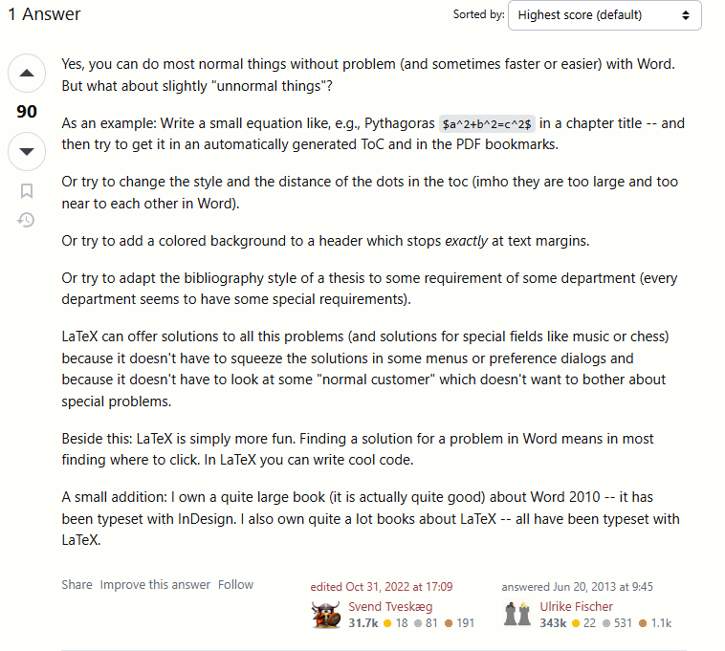
LaTeX vs. Word
Ulrike Fischer on what LaTeX can do:
https://tex.stackexchange.com/questions/120154/is-latex-nowadays-still-that-superior-to-word/120166#120166

Slide 18
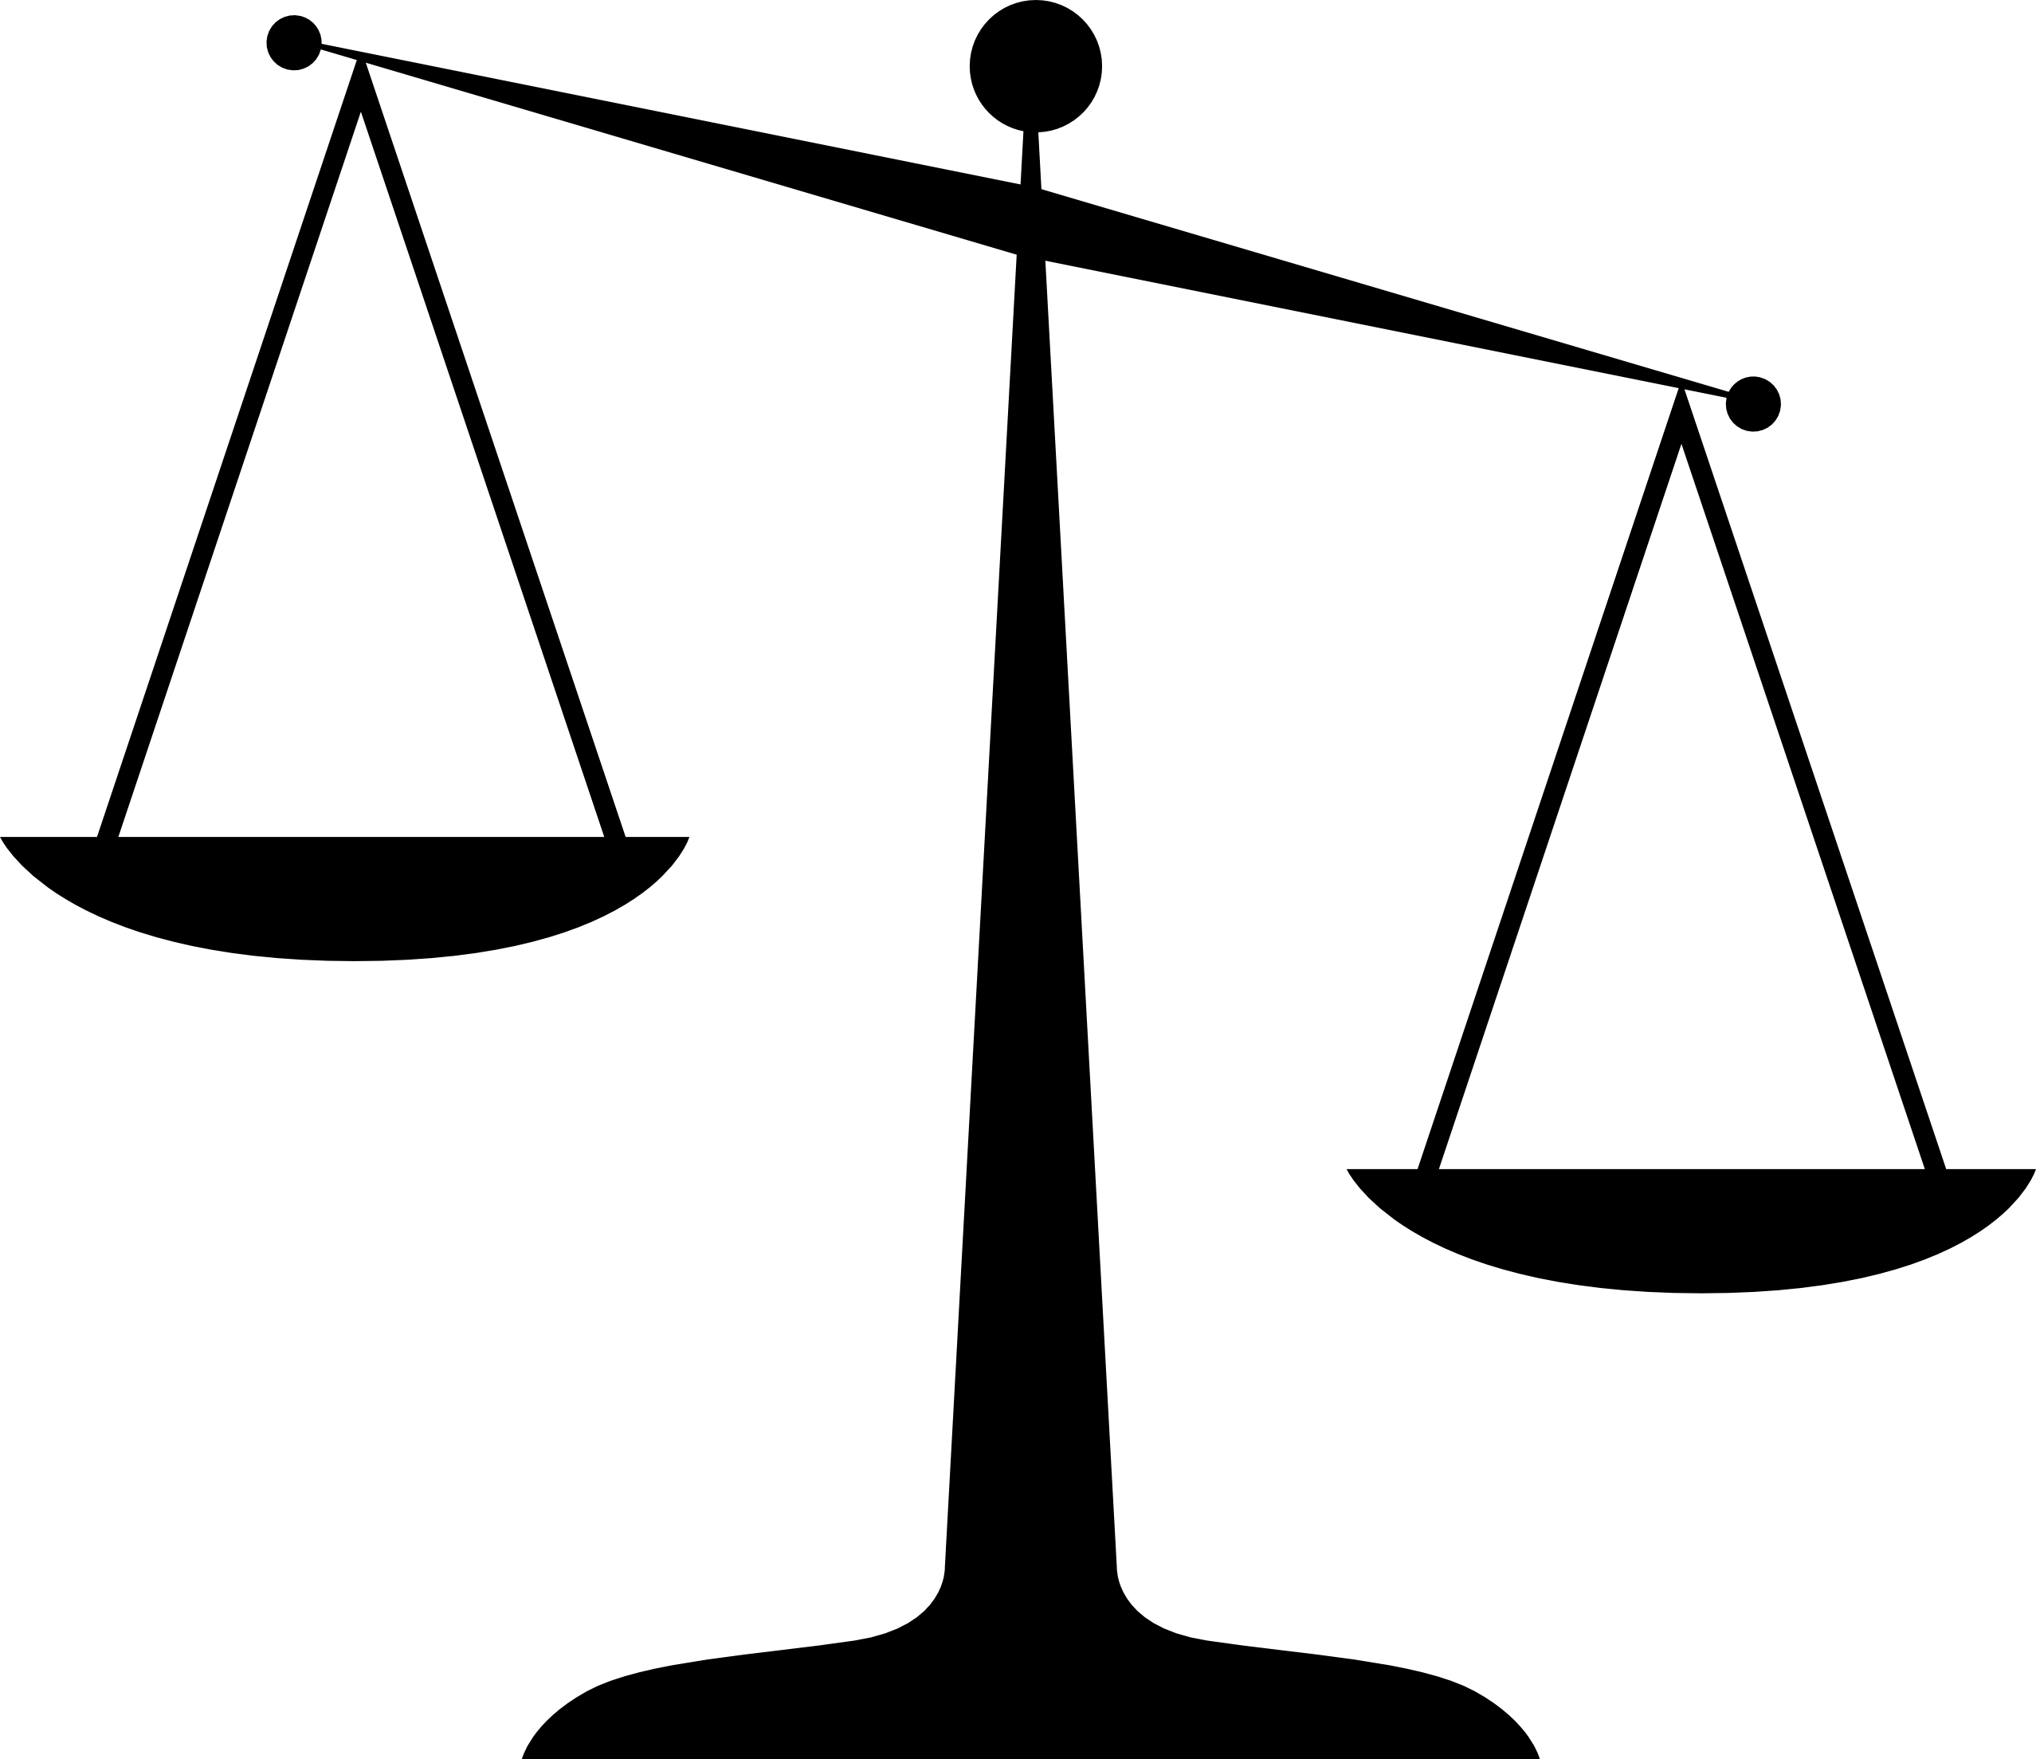
LaTeX vs. Word (my opinion)
Equations in headings & TOC
Re-size dot leaders in TOC
More fun
Exports digitally accessible PDFs

Slide 19
Word Resources
Chem4Word
Microsoft Mathematics

Slide 20
Recommendation
Reconsider the merits of promoting LaTeX/Overleaf for Thesis & Dissertation writing
Students face much more difficulty making their thesis/dissertation meet the Graduate College requirement for digital accessibility
There is an added expense of Adobe Acrobat licenses
Support for using Acrobat to remediate PDFs is insufficient
Explore affordances of Word for presenting equations
Involve subject matter experts from Computer Science, Math, Statistics, Physics & Astronomy, etc.

Slide 21
Late-Breaking: The Overleaf Update
September 12, 2025 Overleaf newsletter:
“We have released TeX Live 2025 on Overleaf. This new release provides some additional functionality for tagging PDFs to enhance accessibility.”

Slide 22
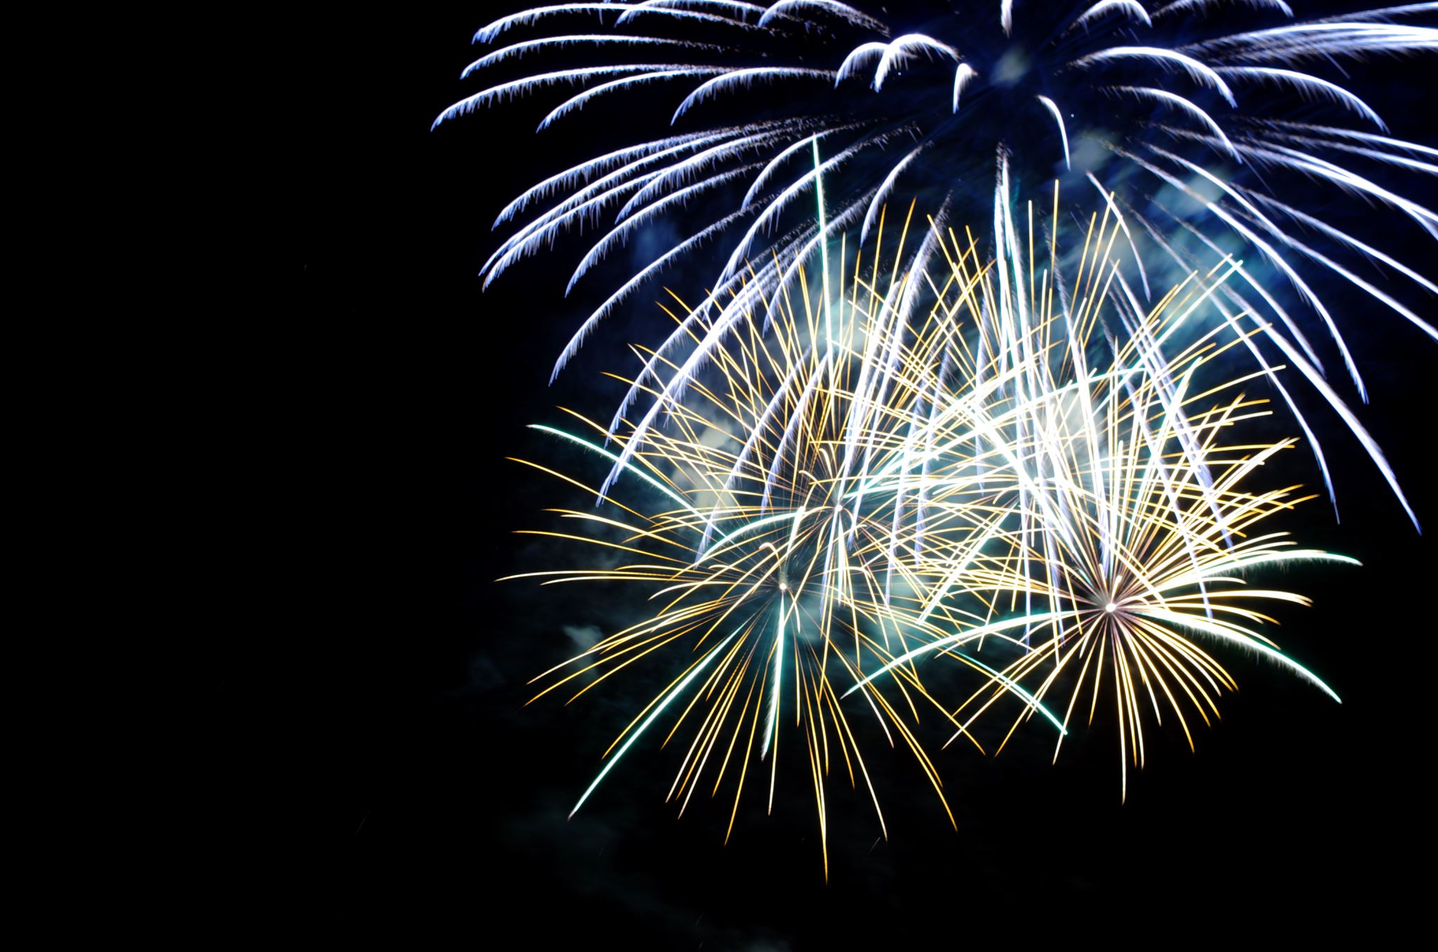

Slide 23
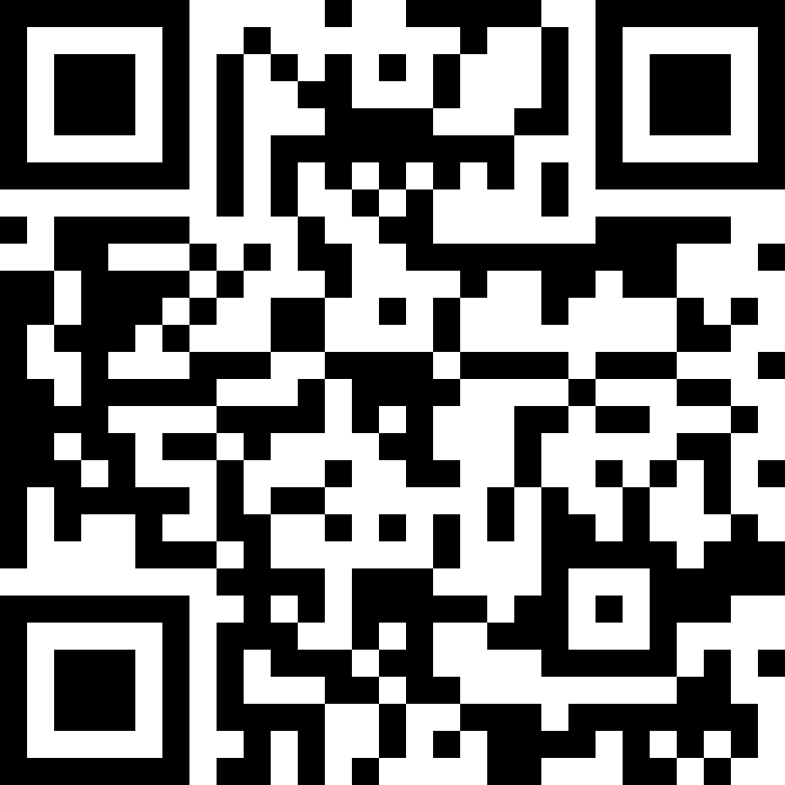
From what we have seen so far…
Iowa State’s current Overleaf templates are compatible with PDF tagging
Ph.D. Candidate (Computer Science) Duy Phuong Nguyen’s instruction manual:
Go.iastate.edu/SOMPVR
Notes:
https://iastate.box.com/s/zae497172wojxav4xcnq6dwihk6invm4

Slide 24
Next Steps
Test the tagging features in Overleaf template
Add the \DocumentMetadata{…} block to the template, so students do not have to do this extra step
Work with students, faculty, and Overleaf support to troubleshoot issues that come up in the future

Slide 25
Resources
Iowa State University Digital Accessibility Policy
Using the LaTeX prototype for accessible PDF (as of 2025/06)
Tagging Status of LaTeX Packages and Classes
Sarah McCarty’s LaTeX Template
Chem4Word
Microsoft Mathematics
Duy Phuong Nguyen’s Tagging Manual

