Slide 1
AI-Facilitated Literature Review Workshop: A Hands-on Demonstration of Elicit
Kristin Terrill
Senior Program Specialist for Graduate Scholarly Activities
Center for Communication Excellence, Graduate College
Iowa State University
Lily Compton
Assistant Director of Programming
Center for Communication Excellence, Graduate College
Iowa State University
Maryam Saneie
Ph.D. Student
Department of English
Iowa State University
ETD-USETDA 2025 Symposium
September 25, 2025. Virtual

Slide 2

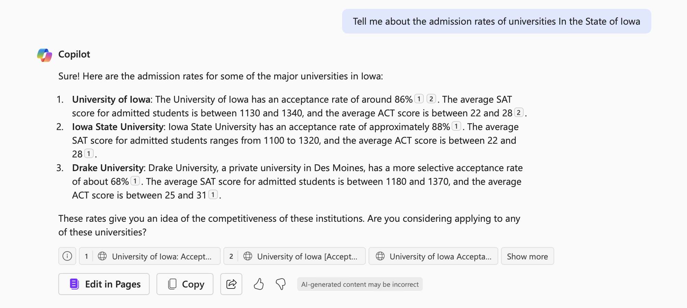
Activity 1
Ask the Co-pilot to:
a) Give you the admission rates for the Universities in the State of Iowa
Text only
Notes:
10:40

Slide 3
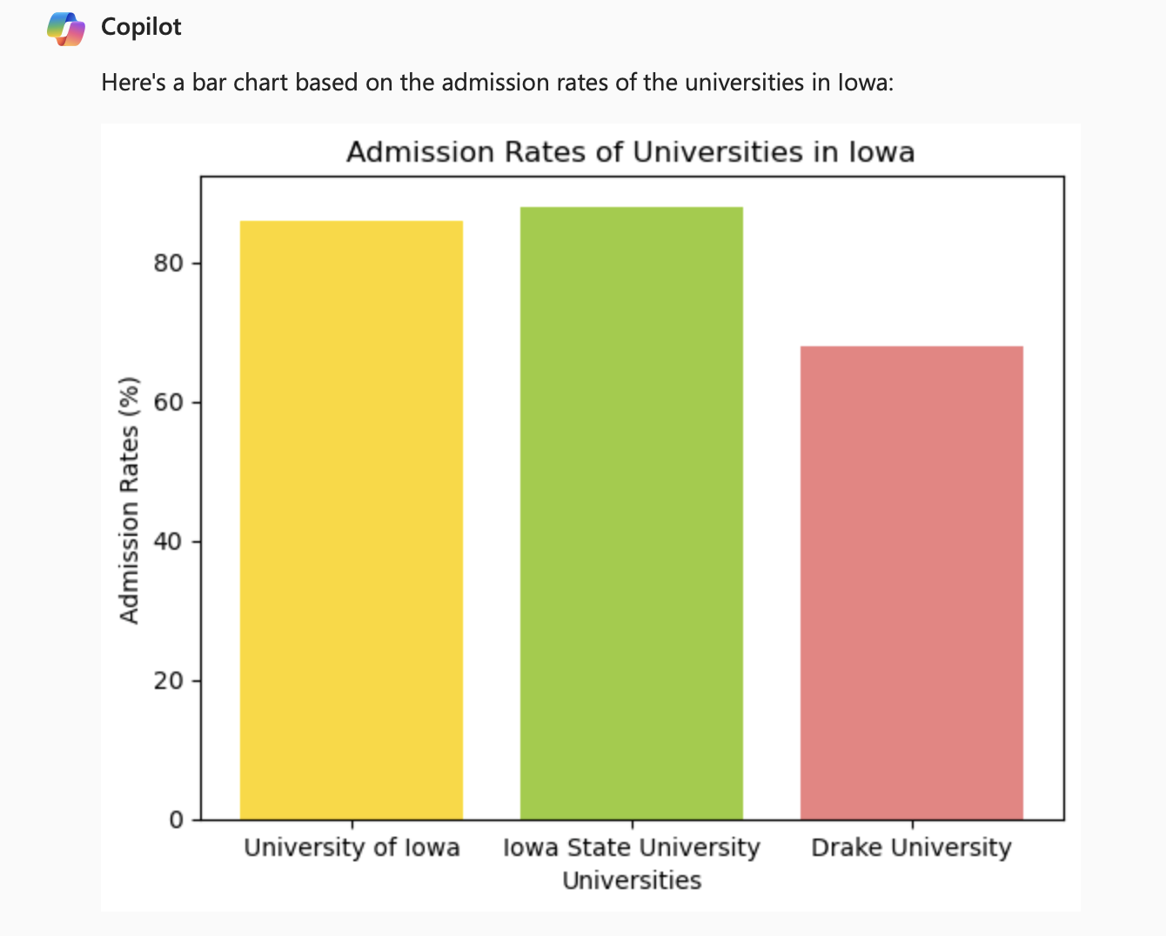
Activity 1
Ask the Co-pilot to:
b) Give you a bar chart for the admission rates for the Universities in the State of Iowa
Image only

Slide 4
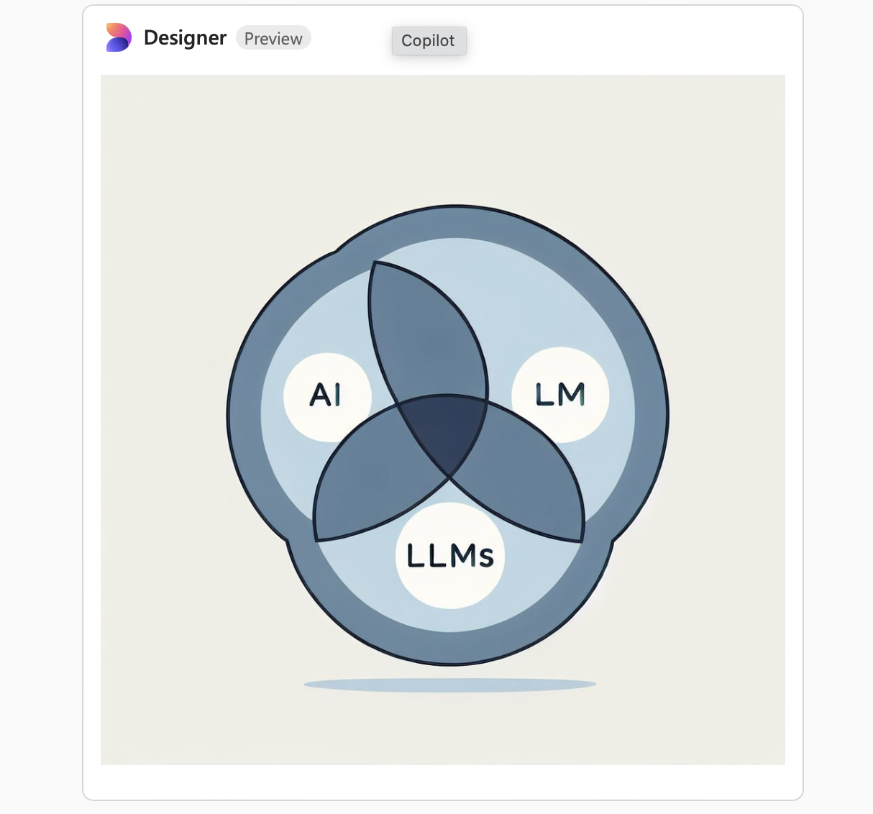
Activity 1
Ask the Co-pilot to:
c) Give you three overlapping charts showing the connections among AI, Gen AI, and LLMs
Image and text

Slide 5
Why is AI Literacy Important?
Studies reflect that the rise of AI will create many job opportunities in various industries, and AI will probably replace tomorrow’s workplace (Ng et al., 2024).
In a McKinsey report, Mayika et al. (2017) estimated that 15% of the global working hours will be automated, and 47% of American jobs will be at high risk of automation by 2030.
The situation could be worse among women since 160 million women worldwide may need to transition between occupations, often into higher-skilled roles.
AI literacy has emerged as a new skill set that everyone should learn in response to this new era of intelligence.
Notes:
Maryam: With AI reshaping education, corporations investing heavily, and workplaces rapidly integrating AI tools, mastering AI is key to staying competitive. Recent headlines confirm that graduate students who develop AI skills are better prepared for the evolving job market.

Slide 6


What is AI Literacy?
AI literacy is a set of competencies that enables an individual to
critically evaluate, communicate, and collaborate with AI
and use AI effectively and ethically (Long & Magerko, 2020; Ngo & Hastie, 2025).
Algorithmic Awareness
Procedural Competence
Evaluative Judgment
Notes:
Note that Workshop 2 is more procedural and evaluative; Workshop 1 focuses on algorithmic awareness and evaluative judgment

Slide 7


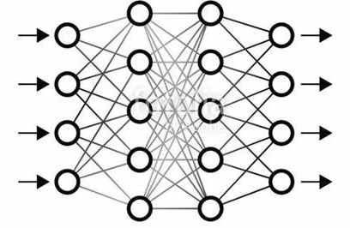

What is Gen AI?
Generative AI (Gen AI) is a type of artificial intelligence that can create new content such as texts, images, and videos.
Training data
Prediction based on statistical probability
Algorithm
User input
Users can input text or prompts to GenAI tools such as ChatGPT or Microsoft Co-pilot and quickly receive an entire essay. (Ngo & Hastie, 2024, p. 20).

Slide 8
AI and Gen AI
A large language model (LLM) is a kind of algorithm that enables computers to interact using natural language, enabling generation of text, code, and images.
AI
Gen AI
Text
Code
Image
Notes:
Think of AI as a broad category, like "vehicles," and Generative AI as a specific type, like "electric cars."
AI includes systems that analyze data, make decisions, and automate tasks. For example, a fraud detection system in banking uses AI to spot suspicious transactions, but it doesn’t create anything new.
Generative AI is a type of AI that creates new content—text, images, music, or code—rather than just analyzing data or making predictions. For example, ChatGPT generates human-like text, and DALL·E creates images from text descriptions. LLMs are like Teslas—specifically designed electric cars optimized for certain functions.

Slide 9
How Do LLMs Work?
If you type "The sun rises in the...", the model predicts the next word based on patterns it has learned from vast amounts of text.
For example:
It might predict "east" because that’s the most common completion.
If given more context, like "In the winter, the sun rises later in the...", it might predict "morning."
Notes:
Large Language Models (LLMs) are trained on vast amounts of text data to predict and generate human-like language. They use modeling techniques to analyze patterns in text and generate coherent responses based on context. By processing input as a series of tokens—words or subwords—LLMs predict the next most likely token, allowing them to generate text, answer questions, and assist with writing. Their effectiveness depends on the quality of training data, fine-tuning, and user prompts. Think of an LLM like a supercharged autocomplete. It doesn’t “know” facts but calculates the most likely next word based on its training data

Slide 10
Closed VS Open AI
Training data
Prediction based on statistical probability
Algorithm
Closed: code, architecture, and training data are available only within the developer organization
Open: code, architecture, and training data are publicly accessible
User input
Notes:
Maryam open AI prioritizes transparency and collaboration, while closed AI prioritizes security and proprietary control over the technology.

Slide 11


LLMs based on General Vs. Specialized Training Data
Training data
Prediction based on statistical probability
Algorithm
User input
Specialized, e.g., organizational database
General, e.g., worldwide web
Notes:
Maryam: Used to train models like GPT-4, which need to handle a wide range of topics and tasks.Includes internet text, books, Wikipedia, articles, and diverse datasets.The model learns general language patterns but may not be highly specialized in any single field.Example: GPT-4 → It can generate responses on almost any topic but may not be as precise as a domain-specific model in areas like medicine or law.

Slide 12
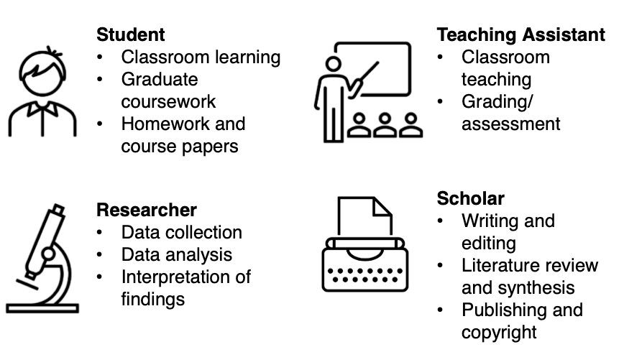
Affordances of Gen AI for Graduate Students
Terrill, K., Compton, L., & Graves, W. (2024)
Notes:
Maryam

Slide 13
Limitations of Gen AI
Some of the limitations of Gen AI include (Nah, et al., 2023):
the limitations of Gen AI include:
Bias
Quality of training data
Data privacy
Hallucination
Notes:
Maryam

Slide 14

Bias
In the context of AI, the concept of bias refers to the inclination that AI-generated responses or recommendations could be unfairly favoring or against one person or group (Ntoutsi et al., 2020).
Notes:
Maryam: LLMs can inherit societal biases present in their training data. For example:
Gender Bias: If an LLM is trained on text that associates certain professions with specific genders (e.g., "nurse" with women and "engineer" with men), it may reinforce these stereotypes. This bias can affect job recommendations, hiring practices, and even career guidance.
Example: When asked, "Who is the best doctor?", the model might generate a male name due to the overrepresentation of male doctors in historical data, reinforcing gender stereotypes.

Slide 15
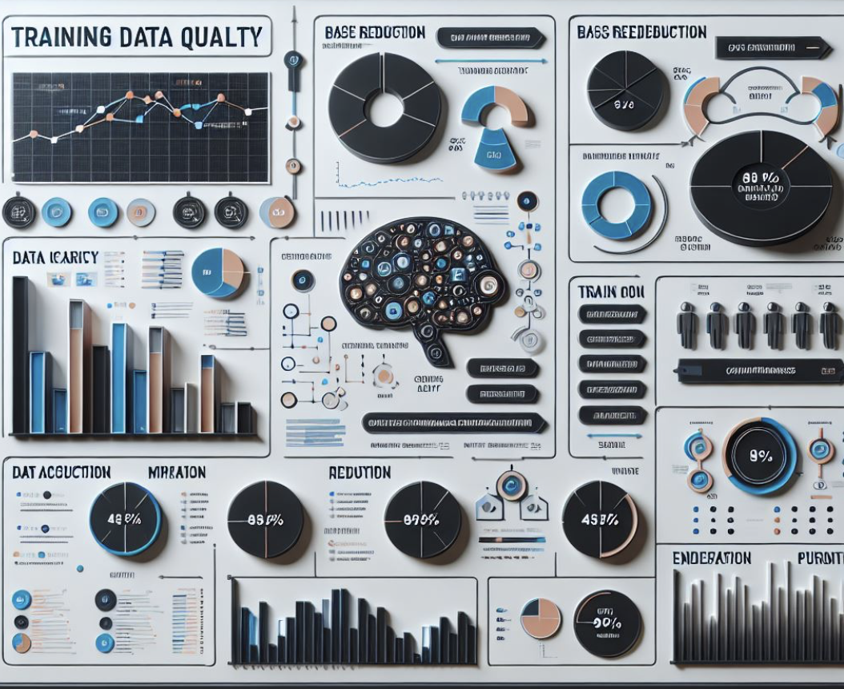
Gaps in the Training Data
The quality of generative AI models largely depends on the quality of the training data (Su & Yang, 2023).
Any factual errors, unbalanced information sources, or biases embedded in the training data may be reflected in the output of the model (Su & Yang, 2023).
Notes:
Maryam: Example: A model trained mostly on Western academic papers may underperform when asked about medical practices in indigenous cultures or the political system in a non-Western country. This leads to knowledge gaps and misunderstandings when the model encounters input from those areas.

Slide 16
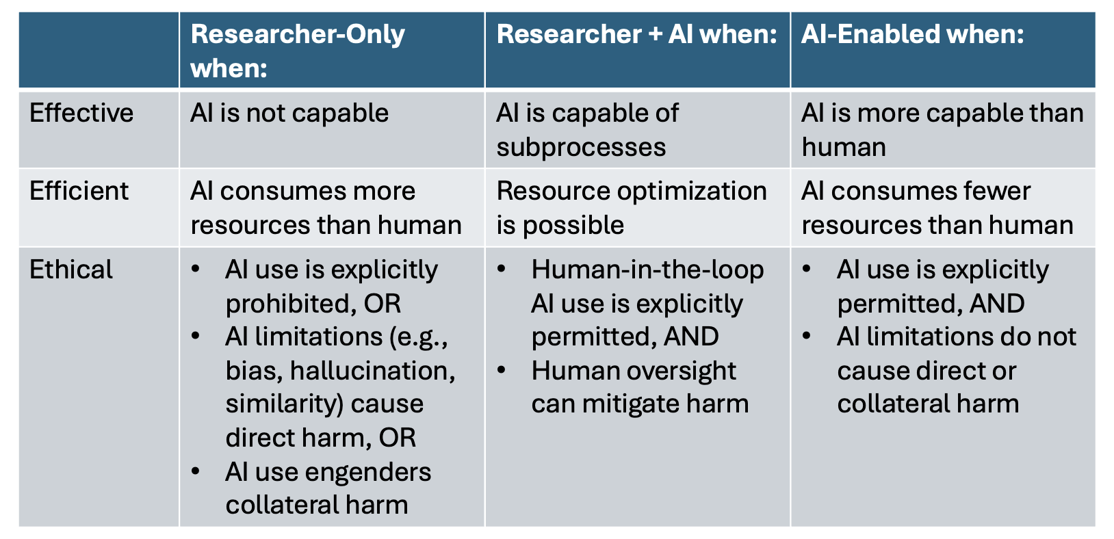
3Es: Determining Appropriateness of AI Use in Certain Tasks

Slide 17
Gen AI and Literature
Review Process
Notes:
11:20

Slide 18
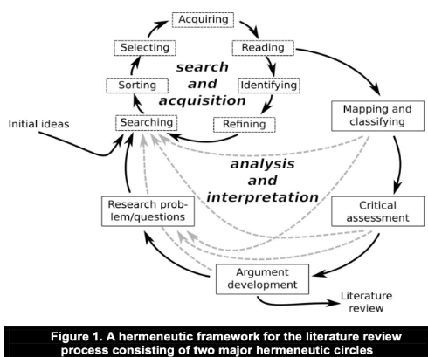
Looking into the Literature Review Process
Boell & Cecez- Kecmanovic (2014)

Slide 19






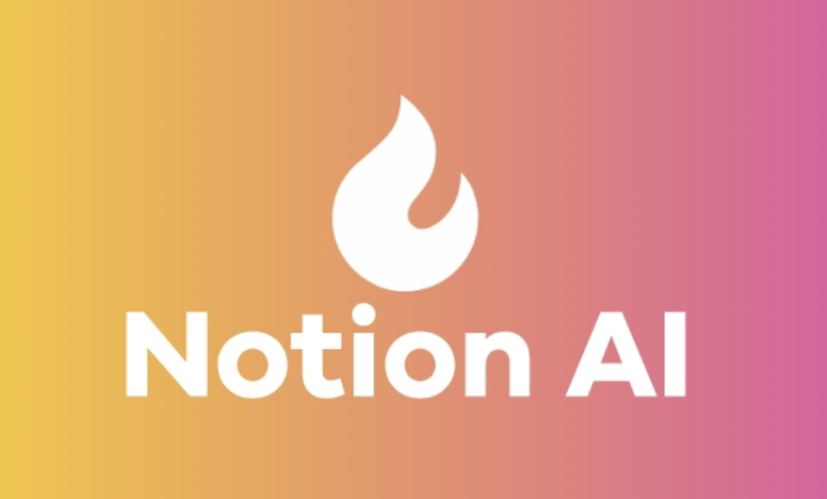

Looking into the Literature Review Process

Slide 20
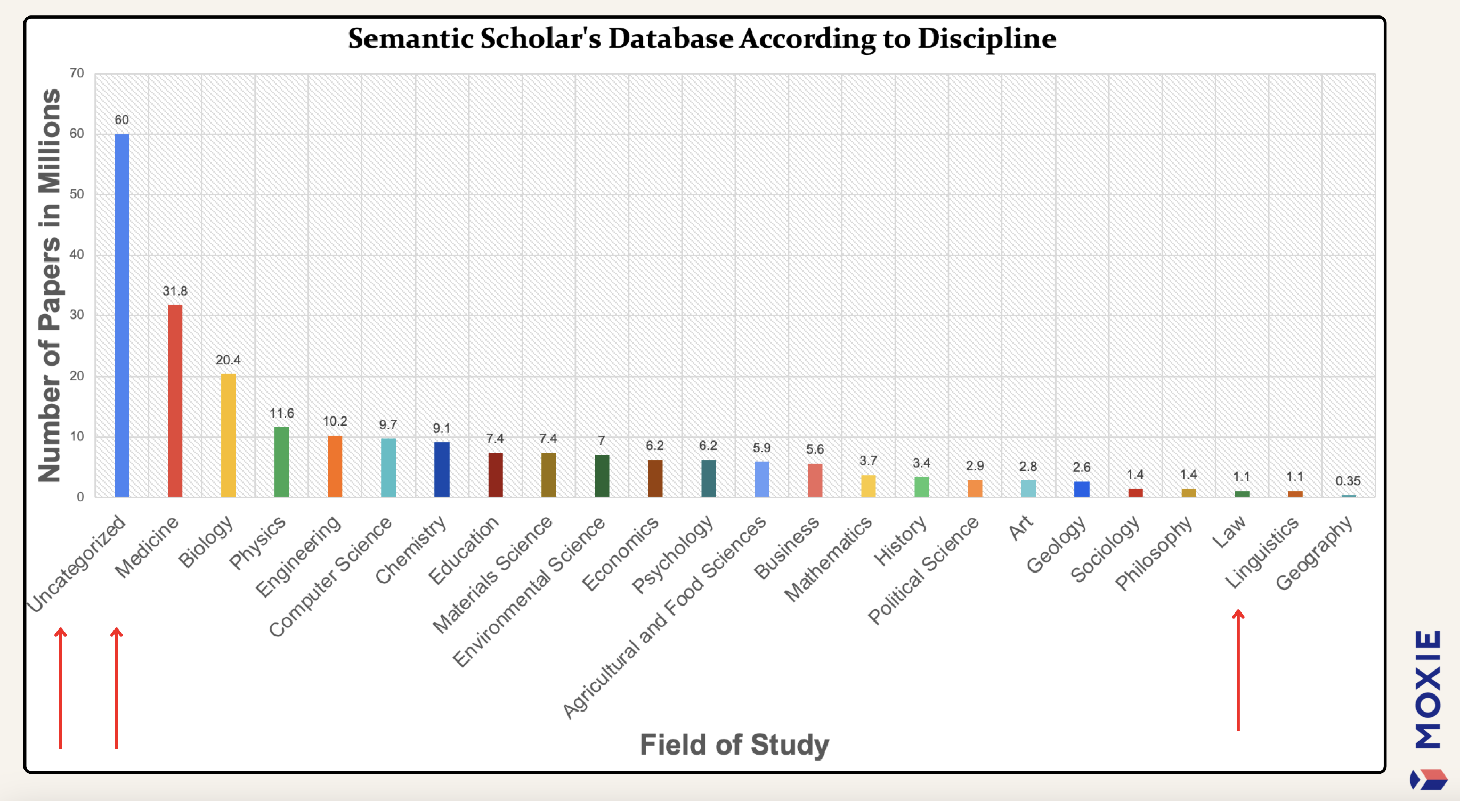
Gaps in the Training Data
Parker & Becker (2025)

Slide 21
What is the best way to learn how a GenAI tool works?
Prompt the tool to explain itself
Prompt ChatGPT to explain the generative AI algorithm
Search Google for an explanation
Read the developer’s documentation

Slide 22
What is the best way to learn how a GenAI tool works?
Prompt the tool to explain itself
Prompt ChatGPT to explain the generative AI algorithm
Search Google for an explanation
Read the developer’s documentation
Answer: Read the developer’s documentation!
LLMs, including ChatGPT are not reliable sources of technical information, even about themselves. Training data for LLMs includes abundant inaccurate information, which will bias the output toward inaccuracy.

Slide 23
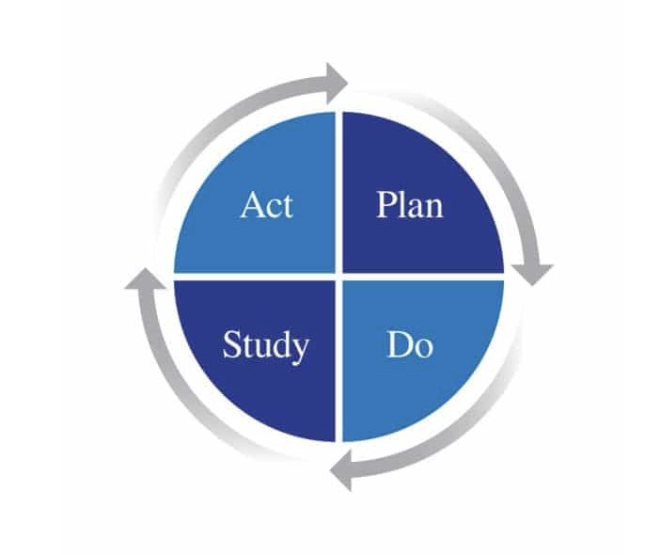
Validating AI Affordances
Establish performance standard, e.g., human-produced example
Test the AI tool
Assess the performance of the AI tool
Adjust prompt, try a different tool, add a 'human in the loop,' then re-assess the performance.
https://deming.org/explore/pdsa

Slide 24
3Es: Determining Appropriateness of AI Use in Certain Tasks

Slide 25

Featured GenAI Tool: Elicit
Notes:
https://www.elicit.com

Slide 26
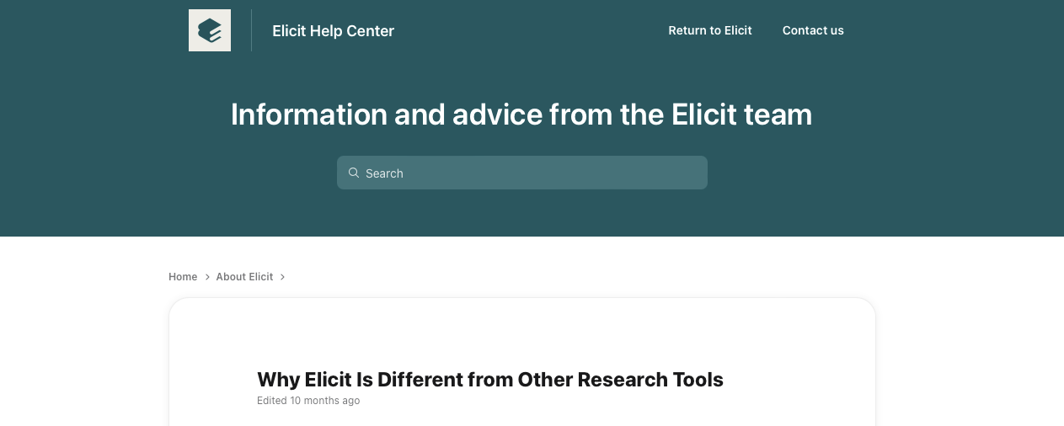
What Elicit can do?
Find relevant papers even if they don’t match keywords.
Combine the breadth of semantic similarity with the precision of keyword matching.
Read summaries of abstracts specific to your query.
Customize what you see about the paper and organize papers by that information.
Filter based on study type.
Export your work.

Slide 27
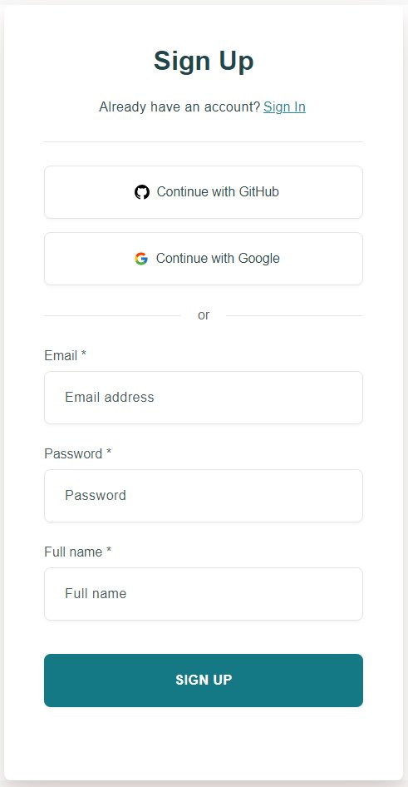
Elicit: Getting Started
Go to https://elicit.com​
​
Sign up for an account, ​
or sign in to your account

Slide 28
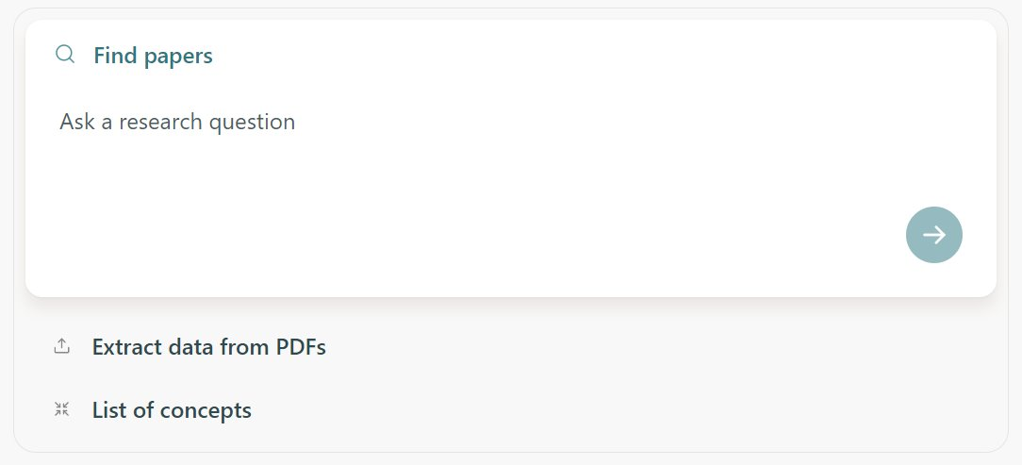
Demonstration 1: Introduction to Elicit

Slide 29
Reading and Identifying
Boell & Cecez- Kecmanovic (2014)

Slide 30
Activity 2. Extract Data from PDFs—Reading & Identifying
In Elicit, click Extract data from PDFs (under Quick tools).
  If you have article PDFs to upload, go ahead and upload one (or more).
  If you don’t have a PDF to upload, use “Find papers”
Click →
Add columns
  Purpose/thesis
  Paradigm/theoretical lens
  Major findings

Slide 31
Activity 2a. Extract Data from PDFs—Reading & Identifying
Evaluate and critique the output:
  Accuracy
  Comprehensiveness
  Relevance
  Bias
In Miro, use the Alignment scale (color shift band) to rate the Elicit output for each criterion
https://go.iastate.edu/VJC3TM
Notes:
Ask during oral discussion, for each criterion, does it relate to effectiveness, efficiency, or ethics?

Slide 32
Activity 2b. Evaluate the Appropriateness of Elicit for the Reading and Identifying Step of the Literature Review Process
Now, evaluate the effectiveness, efficiency, and ethicality of using AI for reading and identifying. Place a dot in the best column (based on your judgment) for each row (three dots/votes per person).
Color is not significant.
Boell & Cecez- Kecmanovic (2014)

Slide 33
Reading and Identifying—Conclusion and Next Steps
If using AI…
Disclosure of use may be expected/required
When disclosing, you will need to show that the use is
  Effective
  Ethical
Disclosure statements may draw language from this workshop:
  Specific evaluative criteria
  3E framework
AI users may be expected to validate the effectiveness empirically!

Slide 34
Mapping and Classifying
Boell & Cecez- Kecmanovic (2014)

Slide 35
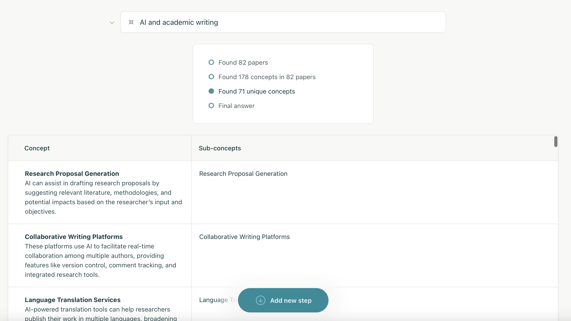
Demonstration 3: Lists of Concepts

Slide 36
Activity 3. List of Concepts—Mapping & Classifying
In Elicit, click List of concepts (under Quick tools)
Enter a concept prompt:
  Designate a concept type (plural noun), e.g.:
  effects
  techniques
  arguments
  examples
  State the topic, e.g., ‘retirement age’
Click →
It can take a few minutes to populate…

Slide 37
Activity 3a. List of Concepts—Mapping & Classifying
Evaluate and critique the output:
  How many total sources did Elicit identify?
  What date ranges are the sources from?
  How many citations are associated with each concept?
  How familiar are you with the journals cited?
In Miro, use the voting tools and alignment scale to record your evaluation and critique.
https://go.iastate.edu/VJC3TM

Slide 38
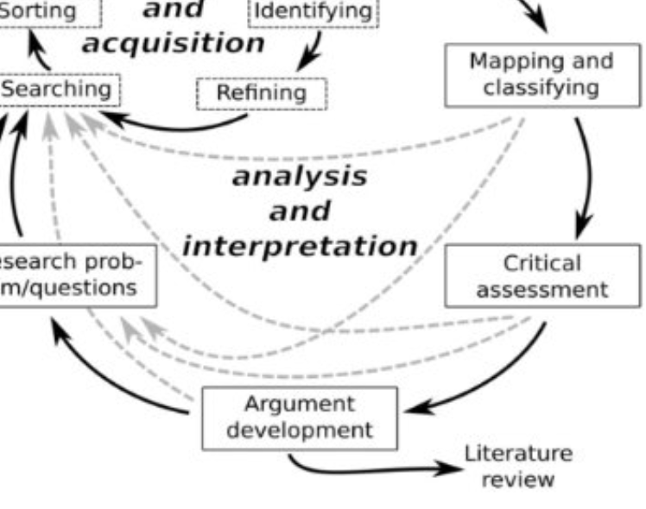
Activity 3b. Evaluate Elicit for the Mapping and Classifying Step of the Literature Review Process
Now, evaluate the effectiveness, efficiency, and ethicality of using AI for mapping and classifying. Place a dot in the best column (based on your judgment) for each row (three dots/votes per person).
Color is not significant.
Boell & Cecez- Kecmanovic (2014)

Slide 39
Mapping and Classifying—Conclusion and Next Steps
Triangulation of sources—one database/index has never been considered sufficient
Any AI-based interpretation or synthesis should be verified by the researcher

Slide 40
References
Boell, S. K., & Cecez-Kecmanovic, D. (2014). A hermeneutic approach for conducting literature review and literature searches. Retrieved from https://www.researchgate.net/publication/263580752_A_Hermeneutic_Approach_for_Conducting_Literature_Reviews_and_Literature_Searches
Bouter, L. (2024). Why research integrity matters and how it can be improved. Retrieved from https://pubmed.ncbi.nlm.nih.gov/36888916/
Parker, J. & Becker, K. (2025). How to ethically leverage AI research assistants. Moxie.
Long, D. & Magerko, B.(2020). What is AI Literacy? Competencies and Design Considerations. Retrieved from https://dl.acm.org/doi/proceedings/10.1145/3313831
Ngo, T. N., & Hastie, D. (2025). Artificial intelligence for academic purposes (AIAP): Integrating AI literacy into an EAP module. English for Specific Purposes, 77, 20-38.
Su, J., & Yang, W. (2023). Unlocking the power of ChatGPT: A framework for applying generative in education. Retrieved from https://doi.org/10.1177/20965311231168423
Terrill, K., Compton, L., & Graves, W. (2024). Establishing a practical framework for artificial Intelligence-facilitated literature review (AI-FLR). MAGS, St. Louis, MO.

