Slide 1
Oh, the Places You’ll Go with Your Scholarly Works!
Lily Compton Assistant Director of Programming Center for Communication Excellence, Graduate College Iowa State University
Kristin Terrill Senior Program Specialist for Graduate Scholarly Activities
Center for Communication Excellence, Graduate College Iowa State University
Megan O’Donnell Research Data Services Lead University Library, Iowa State University
ETD-USETDA 2025 Symposium September 25, 2025. Virtual

Slide 2
Introduction
Notes:
10 mins - Lily

Slide 3
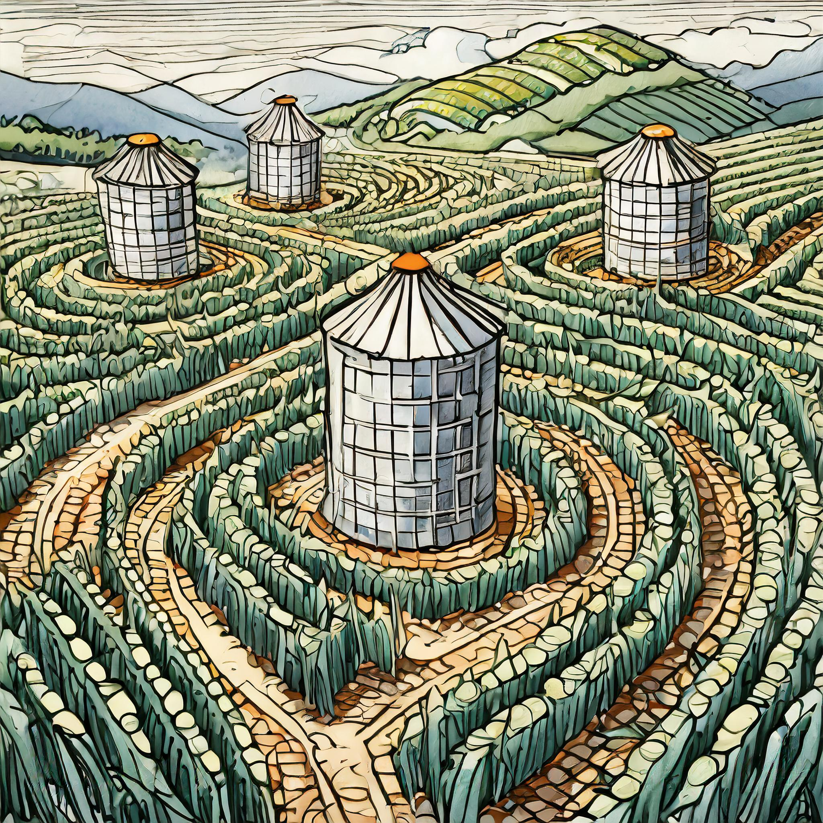
The Landscape: The “Corn Maze”
Similar concerns from graduate students regarding literature review, publishing, copyright, etc.
Guidance and resources available but not easy to find.
Expertise housed within different units, e.g. the University Library, the Office of Legal Counsel, the Graduate College
Information is siloed across a complicated bureaucracy presenting students with a limited views and a maze-like path toward their goal.

Slide 4

The Goal: The Garden Path
Creation of an efficient, centralized, and sustainable information source
Students can walk a cultivated path that guides them to the information they need, the people who can help. Most importantly, the end goal is clearly presented.

Slide 5
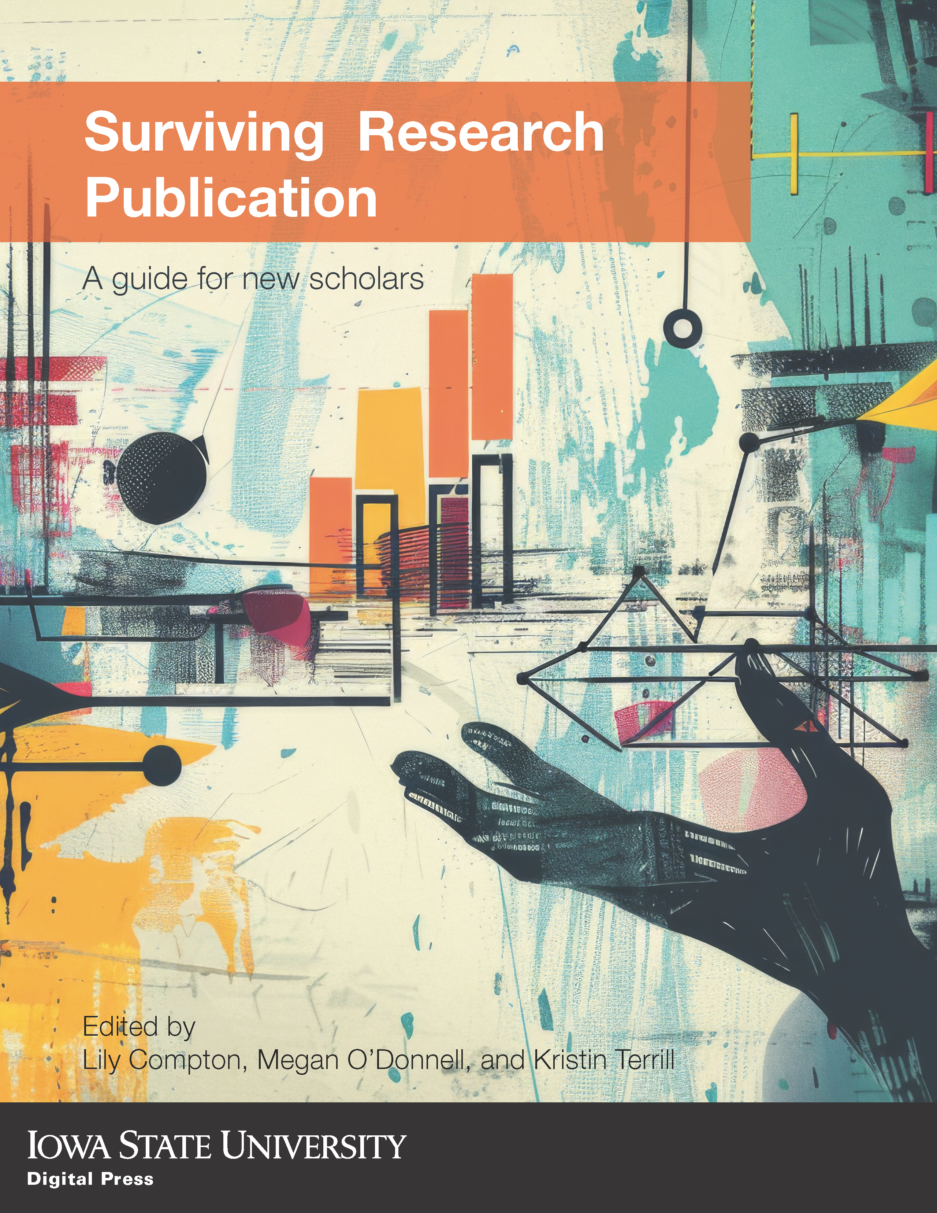
The Vision – One Book to Help Them All
Produce an open educational resource that empowers graduate students, postdocs, and early-career researchers to:
Understand their role as a new scholar
Streamline access to valuable information
Establish and protect professional credibility
Report and publish results with integrity
Prepare and complete electronic theses and dissertations that meet institutional, state, and federal guidelines

Slide 6
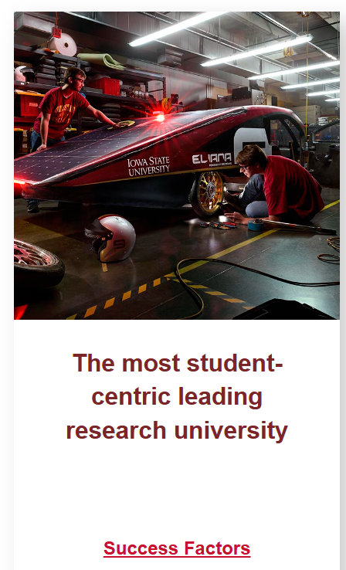
The Funding – Affordable Course Materials Jumpstart Initiative
Spring 2023
Grant Requirement and Our Project Goals
Enhance the affordability of course materials across the university
Open Educational Resource (no cost)
Focus on content
Knowledge gap for new scholars
Aligns with Iowa State University's Strategic Plan:
Iowa State University Strives To Be: The most student-centric leading research university - Success Factor > Accessibility and Affordability

Slide 7
The Organization
Organized as a survival guide
Self-contained chapters with cross-references
Starts with familiar topics and transitions to more complex topics
Generative Artificial Intelligence is integrated but not listed as a chapter
Basics
Ethics
Technology
Generative Artificial Intelligence

Slide 8
Part 1. Basics
Notes:
Megan O’Donnell (15 mins)

Slide 9
What’s basic?
Ch 1: Literature Reviews
Ch 2: Citations
Ch 3: Literature Searches
Ch 4: Demystifying the Publishing Process
Ch 5: Research Impact
Notes:
We struggled to name part 1 a little but settled on "basics" because it starts with things every grad student will have some level of familiarity with.
Part 1 introduces topics – like citations – that have to be understood before proceeding to more advanced topics – like plagiarism – in later sections.
This is why we settled on calling it "basics" despite containing some fairly complex concepts and topics.

Slide 10
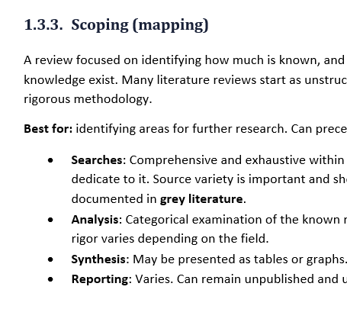
Ch 1: Literature Reviews
A written output and an act of research
Differences and similarities of different reviews types
How AI tools intersect
Literature search tools are poor matches for systematic and systematized reviews.
Author AI use checklist from Cheng, Calhoun, and Reedy (2025).
Notes:
One of the guiding principles behind this book is that we couldn't assume what knowledge students are bringing with them.
While literature reviews are something everyone writing a thesis or dissertation has to do, what do they know about them?
Do they know that they are an act of research as well as a written output?
Do they know that there are many types of literature reviews?
Do they understand that some types have very rigorous rules that you have to observe from the start in order to be successful?
Probably not.
So for this reason we start by introducing the literature review as an act of research that grounds your writing that links it to the work of others.
Next we move on to literature review types – what possibilities are out there, what are they good for, and what are their limitations. I didn't include every possible type – but enough to show that different methods work best for different research goals. For example, a scoping review can be used to explore what already exists and can be used as a pre-stage for further research.
We also included a note about AI tools interact with the literature review process and how these tools are currently incompatible with systematic and systematized reviews because they lack transparency and reproducibility.

Slide 11
Ch 2: Citations (and citation management)
Function as dialogue between works of scholarship and act as an evidence trail
e.g., beyond plagiarism
Anatomy of citations and style guides
Shared core components, different configurations. Many examples.
Citation management
FAQ section added and enhanced with help from an expert librarian
Notes:
Chapter 2 – citations
This was a fun chapter to write, probably because I'm a librarian and I love looking at how information is linked together.
However, it was also tricky to write because there are so many different things associated with citations.
We know grad students come with different levels of writing experience and education and their experience with citations up until now has primarily been about how to avoid plagiarism. So I took a step back from that grounded the act of citation as a way to link our work to the work of others. Once you understand that citation is a type of evidence chain, explaining where the information came from, it becomes much easier to determine when to cite. Plagiarism also becomes easier to understand - it's denying attribution and omitting evidence.
Next we move on to how citations are made and how regardless of the citation style, citations always have the same key information. Examples of different types citations are provided as well as examples of the same citation using three different style guides.
Last the chapter closes with how to manage citations. I'm a data management librarian and this was a topic really close to my heart and is always one of the things I encourage new grad students to start early. No one software solution was endorsed in this area, instead the focus was on how it works, the benefits of using it, and answering common questions students have once they start using the software, like how to import citations and store full-text.

Slide 12
Ch 3: Literature Searches (and using the library)
Information literacy!
How and where to search for information
How databases differ and how to use
Advanced search techniques
Boolean, nesting, truncation, etc.
Accessing full-text
Getting the thing to read
How to read an article for relevance
AI for literature searches
Notes:
Chapter 3 is librarian bread and butter territory and firmly entrenched in information literacy concepts.
I co-wrote this chapter with a coworker, Kate Garretson, who developed and teaches our undergraduate course on information literacy.
Unlike that course, this chapter could go into details about advanced search techniques because we know they're more relevant to grad students. So there's a lengthy section on Boolean searches, nesting, truncation, proximity searching and more along with practice exercises to help students obtain these skills for themselves.
Also included in this chapter is a section on how to obtain full-text as many beginning scholars don't understand that databases are primarily indexes and don't contain the articles themselves.
We included information on how to read an article for relevance while performing your searches and included a short discussion of the two main kinds of AI tools available for literature discovery and mapping.

Slide 13
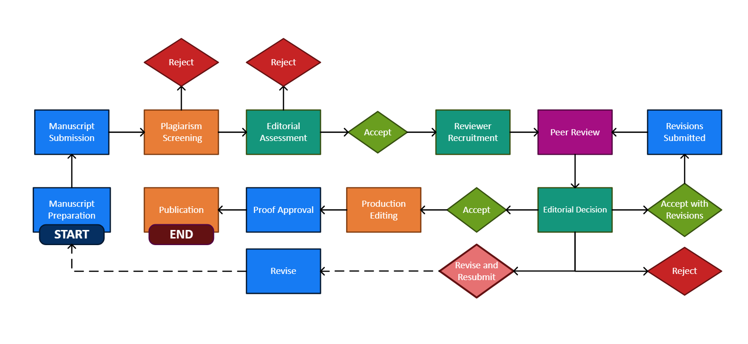
Ch 4: Demystifying the Publishing Process
What is scholarly publishing
Peer review
Economics
The publication process
Working with editors, taking feedback
Where to publish
Locating a good match
Open access publishing
Green and gold
Avoiding predatory publishers
A nuanced approach
Notes:
Chapter 4 was the chapter I thought would be simple and instead it ended up being the most complex.
Just defining scholarly publishing was hard because there are so many varieties available – from university presses to independent publishing.
In the end two things stood out: peer review and economics, so we built the discussion around these attributes.
We also decided to concentrate on journal articles because they are most attainable publication type for a new scholar. This helped focus the chapter but there was still a lot to cover.
One of the things that I think is special about this chapter is that we include details about how to work with editors, from submitting a cover letter to defending revision decisions.
There's also a short section on how to find a journal that matches your research topic and we of course had to cover open access – both green and gold – as paying for publishing is common practice and we wanted new scholars to know up front why that is and what to expect.
The chapter closes with the topic of predatory publishing. Because we cover open access and the economics of scholarly publishing it was easy to explain why predatory publishers exist – the demand to publish is greater than the demand to read! Because this is a contentious topic we took the "buyer beware" approach and encourage scholars to do their own research; to learn for themselves what their expectations and quality markers are.

Slide 14
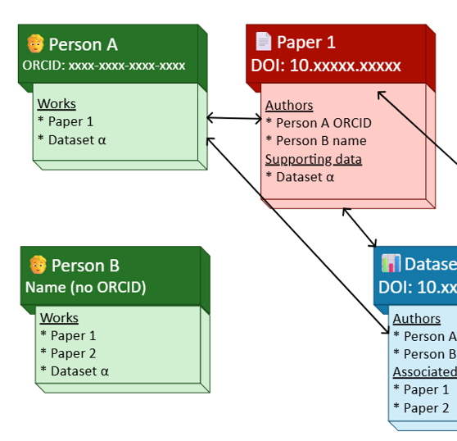
Ch 5: Research Impact
Measures of “impact”
Journal Impact Factor, citation counts, H-index
Open access publishing advantages
Persistent identifiers (PIDs)
Scholarly social networks
Platforms and audience
Being professional online
Promoting yourself
Notes:
The last chapter of the Basics section focuses on research impact. Because I'm a librarian and a data person it was very important that scholarly measures of impact be well explained and contextualized.
For each measure examined an explanation of how it's calculated, where to find it, and how to use them. I also included examples of their misuse and pushes to reform research metrics and altmetrics.
Since the last chapter covered open access it was natural to place a short discussion about the advantages of publishing open access in the next chapter.
We also included PIDS because it's important for new scholars to establish their research identity and PIDS, which link people and works together, is an excellent way to start that process.
Closing out chapter 5 is a discussion of scholarly social networks – social media, LinkedIn, and more specialized platforms like Research Gate and Knowledge Commons.
Most of the time is spent on how to use these networks to connect with peers and promote your work.

Slide 15
Key Findings
Basic is not the same as "simple"
Notes:
So what did I learn from the process of writing these five chapters?
First, while this should have been self-evident, I quickly learned that basic is not the same as simple.
Boiling down complex concepts into easy to digest reading was hard.
As an example... I wanted to make include a scholarly publishing flow chart in chapter 4. I searched for good charts online and all of them were too simplistic, they were missing steps and not imparting the information we wanted. So I thought, no problem, I'll make my own...

Slide 16
Publishing Flowchart
Notes:
And I did.
And while I'm pleased with the end result, it was revised multiple times and is not all encompassing.
It's a BASIC scholarly publishing workflow, not the simplest, not the most complex, but somewhere in the middle.
More importantly it contained all of the steps that we wanted to include, from plagiarism screening to reject and resubmit.

Slide 17
Key Findings
Basic is not the same as "simple"
There is no consensus on some topics
Sometimes being an expert makes things harder
Scholarly publishing is full of ethical landmines and disciplinary conventions
Grad students must quickly obtain fluencies that are both academic and professional even if they don’t realize it
Notes:
The other key findings I learned is that there just really is no consensus on some of these topics.
Something as simple as "what kinds of literature reviews exist?" Turned into a multiweek research project as I waded into new territory.
I also learned that being an expert sometimes makes things harder, not easier. For example, I find the economics of scholarly publishing fascinating but you know who probably won't? Our readers. I had to revise, simplify, and shorten the story in order to stick with the goal of providing a basic introduction, not an exhaustive treatment.
There were also many ethical landmines and disciplinary conventions to dodge, sidestep, or acknowledge. Deciding what to keep and what had to go was difficult.
For example, Journal Impact Factor is not a measure of quality but it's used as one. How much do I steer students towards or away a common metric?
I found myself questioning my own objectivity but in the end I stuck to the facts and I think we present a balanced and informed information on a lot of important topics.
Lastly, grad students must quickly obtain fluencies that are academic and professional, even if they don't realize it, and bad habits forme din grad school can quickly become lifelong bad habits.
For this reason we really wanted this handbook to be both a source of general knowledge and to include some important scholarly life lessons that not every student receives in school themselves.

Slide 18
Key Findings: collaboration
Working with experts was essential
Instruction librarian (co-author and coworker)
Medical librarian (friend)
Open access librarian (co-author and coworker)
Collections director (coworker)
Scholarly publishing librarian (coworker)
Library EndNote specialist (coworker)
Zotero specialist (friend)
Lily and Kristin
Notes:
Added details that would have been missed
Helped check my assumptions
Added common student questions

Slide 19
Q & A

Slide 20
Part 2. Ethics
Notes:
Lily Compton (15 mins)

Slide 21
What’s ethics?
Ch 6: Research Ethics, Regulations, and Protocols
Ch 7: Copyright Basics for Article Publication
Ch 8: Authorship: Rights, Responsibilities, and Embargoes
Ch 9: Plagiarism Tools

Slide 22

Ch 6: Research Ethics, Regulations, and Protocols
Types of Ethics
Ethics vs Regulation
Institutional Compliance
Research Misconduct
Falsification
Disciplinary
Legal but unethical
Illegal but ethical
Personal
Institutional/organizational
Committees and Trainings
Impact on theses/dissertations
Fabrication
Plagiarsm
Scenario
Graduate student research with or without an approved/exempted IRB
ThePhoto by PhotoAuthor is licensed under CCYYSA.

Slide 23
Ch 7: Copyright Basics for Article Publication
Copyright for Authors
Copyright in Journal Publishing
Negotiating publishing contract
Impact on theses and dissertations
Copyright for Users
Copyright vs Publishing Licenses
Ownership of Rights
Open Access Publishing (e.g. Creative Commons)
Fair use
Copyright infringement
Ownership of rights
Permission to reuse
Scenario
ISU publishing agreement for theses/dissertations
ProQuest $75 copyright fee
Scenario
Publishing a manuscript and using the publication in a thesis/dissertation
Scenario
Using images, figures, and tables in a thesis/dissertation

Slide 24
Ch 8: Authorship: Rights, Responsibilities, and Embargoes
Authorship
Embargoes
Sponsored Research
Credit vs Acknowledgement
Rights
Responsibilities
Order
Publisher Policies
Institutional Policy
Patent/Commercialization
Call Out
Authorship and GenAI
Call Out
Power Dynamics, Authorship Negotiations, and Dispute Resolutions
Call Out
Authorship and Publication Expectations for ISU Graduate Students

Slide 25
Ch 9: Plagiarism Tools
Explaining Plagiarism
Detection Tools
What it is
Provides similarity report
Highlights copied text and provides a link
Calculates overall percentage
IThenticate
One of the three reasons for research misconduct
Folders and folder settings
Uploading files
Similarity report
Content tracking
Summary report
Document viewer
Unintentional or intentional
Includes limitations
Requires critical thinking
Call Out
When to quote, paraphrase, and summarize
Call Out
Detection tools and GenAI
Scenario
Early Thesis Draft

Slide 26
Key Findings
Lack of understanding about the impact of theses/dissertations - not just another class paper
Ethics is not emphasized in graduate education
Not understanding their authorship rights
Not being taught citation skills – unintentional plagiarism
Not understanding what a detection tool is and how to use it critically

Slide 27
Q & A

Slide 28
Part 3. Technology
Notes:
Kristin Terrill (15 min)

Slide 29
What’s technology?
Ch 10: Applications for Writing
Ch 11: Applications for Formatting
Ch 12: Formatting Text
Ch 13: Formatting Figures
Ch 14: Formatting Tables
Ch 15: Final Formatting

Slide 30





Ch 10: Applications for Writing
Word Processor
Proofing tools
Viewing and editing modes
File management and version management
Creating files of other types
Grammarly
Research Writing Tutor
Academic Phrasebank

Slide 31


Ch 11: Applications for Formatting
Word
Digital accessibility
Citations & bibliography
Math
Integrations
Support & Documentation
LaTeX
Digital accessibility
Citations & bibliography
Math
Integrations
Support & Documentation
Adobe Acrobat Pro DC
Digital accessibility
Document composition and editing
Support & documentation

Slide 32
Ch 12: Formatting Text
Text and its Affordances
Conveying information electronically
Relating information logically
On outlining
Overview of outlines
Structure of outlines and headings
Logical rules for outlines and headings
Format Attributes and Style
Character attributes
Hyperlinked text
Paragraph attributes
Page attributes
Default attributes and Normal style
Recommended Styles for Research Publishing
Body style
Heading styles
Caption styles
Numbering tables and figures
Reference styles
Block quotes

Slide 33
Ch 13 : Formatting Figures
Figure Attributes
Size
Arrangement
Styles
Accessibility
Integrating figures into body text
Figure Numbering and Captions
Separated Graphic Content

Slide 34
Ch 14 : Formatting Tables
Anatomy of a Table
Table Attributes
Inserting a table in Word
Design attributes
Table style options (table tagging)
Table styles
Shading
Borders
Layout attributes
Gridlines and nonprinting characters
Cell size
AutoFit
Alignment
Table Numbering and Captions
Table Accessibility

Slide 35
Ch 15 : Formatting Strategically
Electronic Format Accessibility
Applications for Document Accessibility
Word
Acrobat DC Pro
Format Editing from Top to Bottom
Accessibility Checkers

Slide 36
Key Findings
Students use multiple technologies to prepare their ETD
Graduate students' technology skills vary widely
Technology documentation may not suit the specific constraints of ETDs
These chapters contain the knowledge I've accumulated from years of technical writing and ETD administration

Slide 37
Q & A

Slide 38
Core competencies to enhance careers
Copied Basics encompasses the basics of research and the basics of academia
Examples
There are different kinds of literature reviews with different levels of rigor.
Citations are indications of many thing, not just an anti-plagiarism device
Searching databases beyond Google Scholar will save time and get better results
It is common to have at least one unfavorable peer reviewer
You don’t have to accept every suggestion the reviewers make
Impact factor is not an indicator of the prestige or quality of a journal

Slide 39
Conclusion
Notes:
5 mins

Slide 40
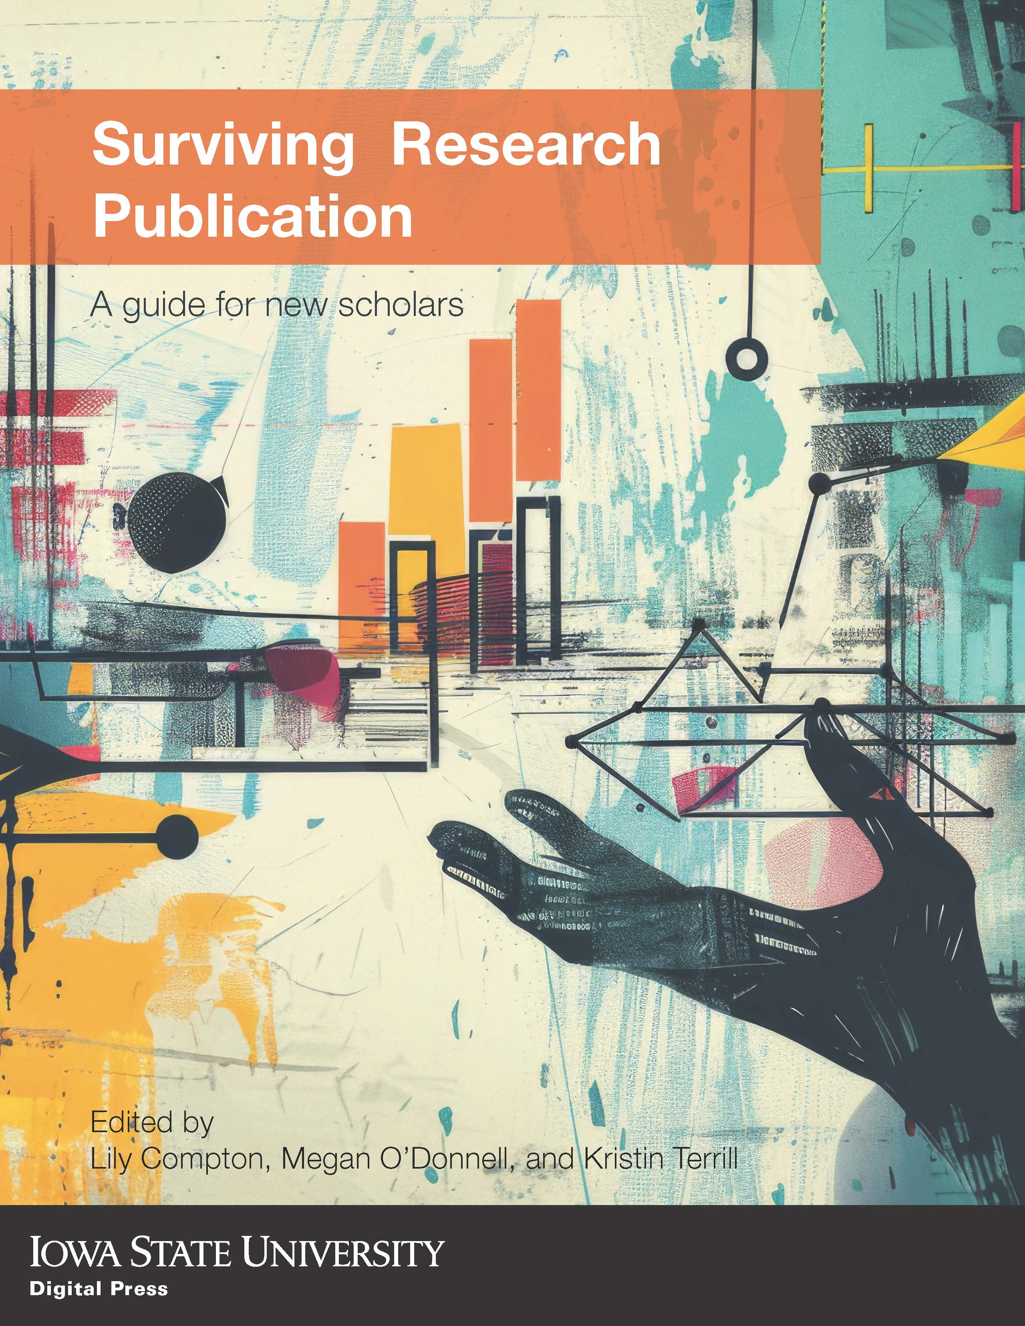
The E-Book Release
Anticipated release date:
Link: go.iastate.edu/PNBVC9
ISU integration
GR ST 5320: Mapping Graduate School Trajectory
GR ST 5330: Sustaining Productivity through Accountability in Graduate School
GR ST 5340: Attaining Success in Graduate School
LIB 5600: Advanced Research Skills for Graduate Students
Non-credit Canvas course for ETD preparation

Slide 41
Acknowledgements
Kerry Agnitsch (ISU IRB Co-Chair)
Abbey Elder (ISU open access and scholarly communications librarian)
Kim Fleshman (Bowling Green State University Coordinator, Thesis & Dissertation Services)
John Fudrow (University of Pittsburgh Repository Librarian)
Kate Garretson (ISU Instruction Librarian)
Jesse Garrison (ISU Science and Technology Librarian)
Paul Gregory (ISU Commercialization Manager)
Tina Griffin (Medical librarian, Associate professor, UIC)
Sarah Kaatz (ISU Director of the Office of Research Ethics)
Dianah Ngonyama (ISU Research Integrity Officer)
Robin Sinn (ISU Director, Collections and Open Strategies)
Erin Thomas (Science & Engineering Librarian, UUW-Madison)

Slide 42
Q & A

Slide 43
Questions for The Audience
Where do you see the need for this OER at your institution or organization?
Who could you recommend this OER to?
How could you promote the integration of this OER?
What topics could we include in the future edition?
What other feedback, suggestions, questions do you have?

Slide 44
Q & A

