Slide 1

ProQuest ETD Administrator
User Group Meeting Mark Dill, Product Manager, Dissertations September 26, 2025

Slide 2

Introductions
What’s new in ETD Admin? Roadmap Review
Questions

Slide 3



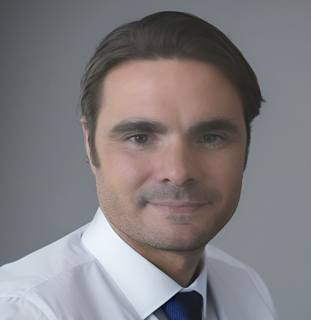

Your ProQuest Team
April Dawn
Senior Director, Product Management
april.dawn@clarivate.com
Austin McLean
Senior Director, Partnerships
austin.mclean@proquest.com
Gilia Smith
Director & Partnerships Manager
gilia.smith@clarivate.com
Mark Dill
Product Manager, Graduate Solutions
mark.dill@clarivate.com
© 2023 Clarivate
3
3
3

Slide 4
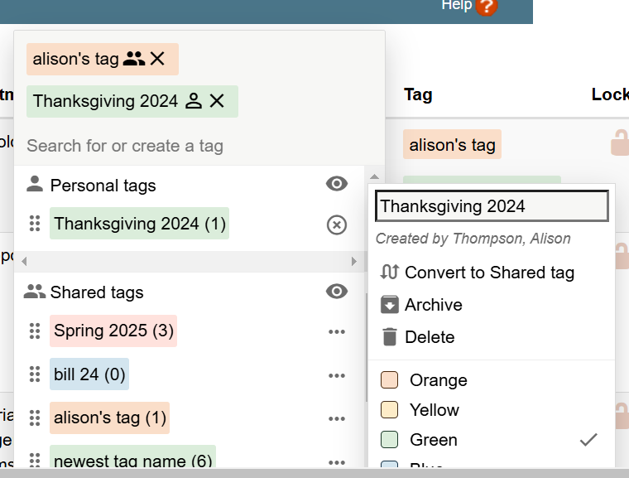
New Shared Tags feature in ETD
Streamline admin workflows, and provide consistent visibility across users
1
Search for existing tags or create new ones, helping to improve visibility and streamline workflows for admins
1
Convert personal tags to Shared tags, providing all administrators for a site with the same experience
2
2
Archive existing tags that will no longer be used, but retain the information for each submission
3
3
4
4
Delete tags that are not being used or were created inadvertently

Slide 5

XML Delivery Enhancements
Graduate Solutions Product Releases and Highlights​
Providing new information in the XML sent to universities
1
Added Publication Date
2
Added new URL for accessing the title on ProQuest platforms
3
Added ISBN
4
Developing Hyku delivery format
5
Set Delivery Cadence
6
Provide MARC records as part of delivery zip

Slide 6
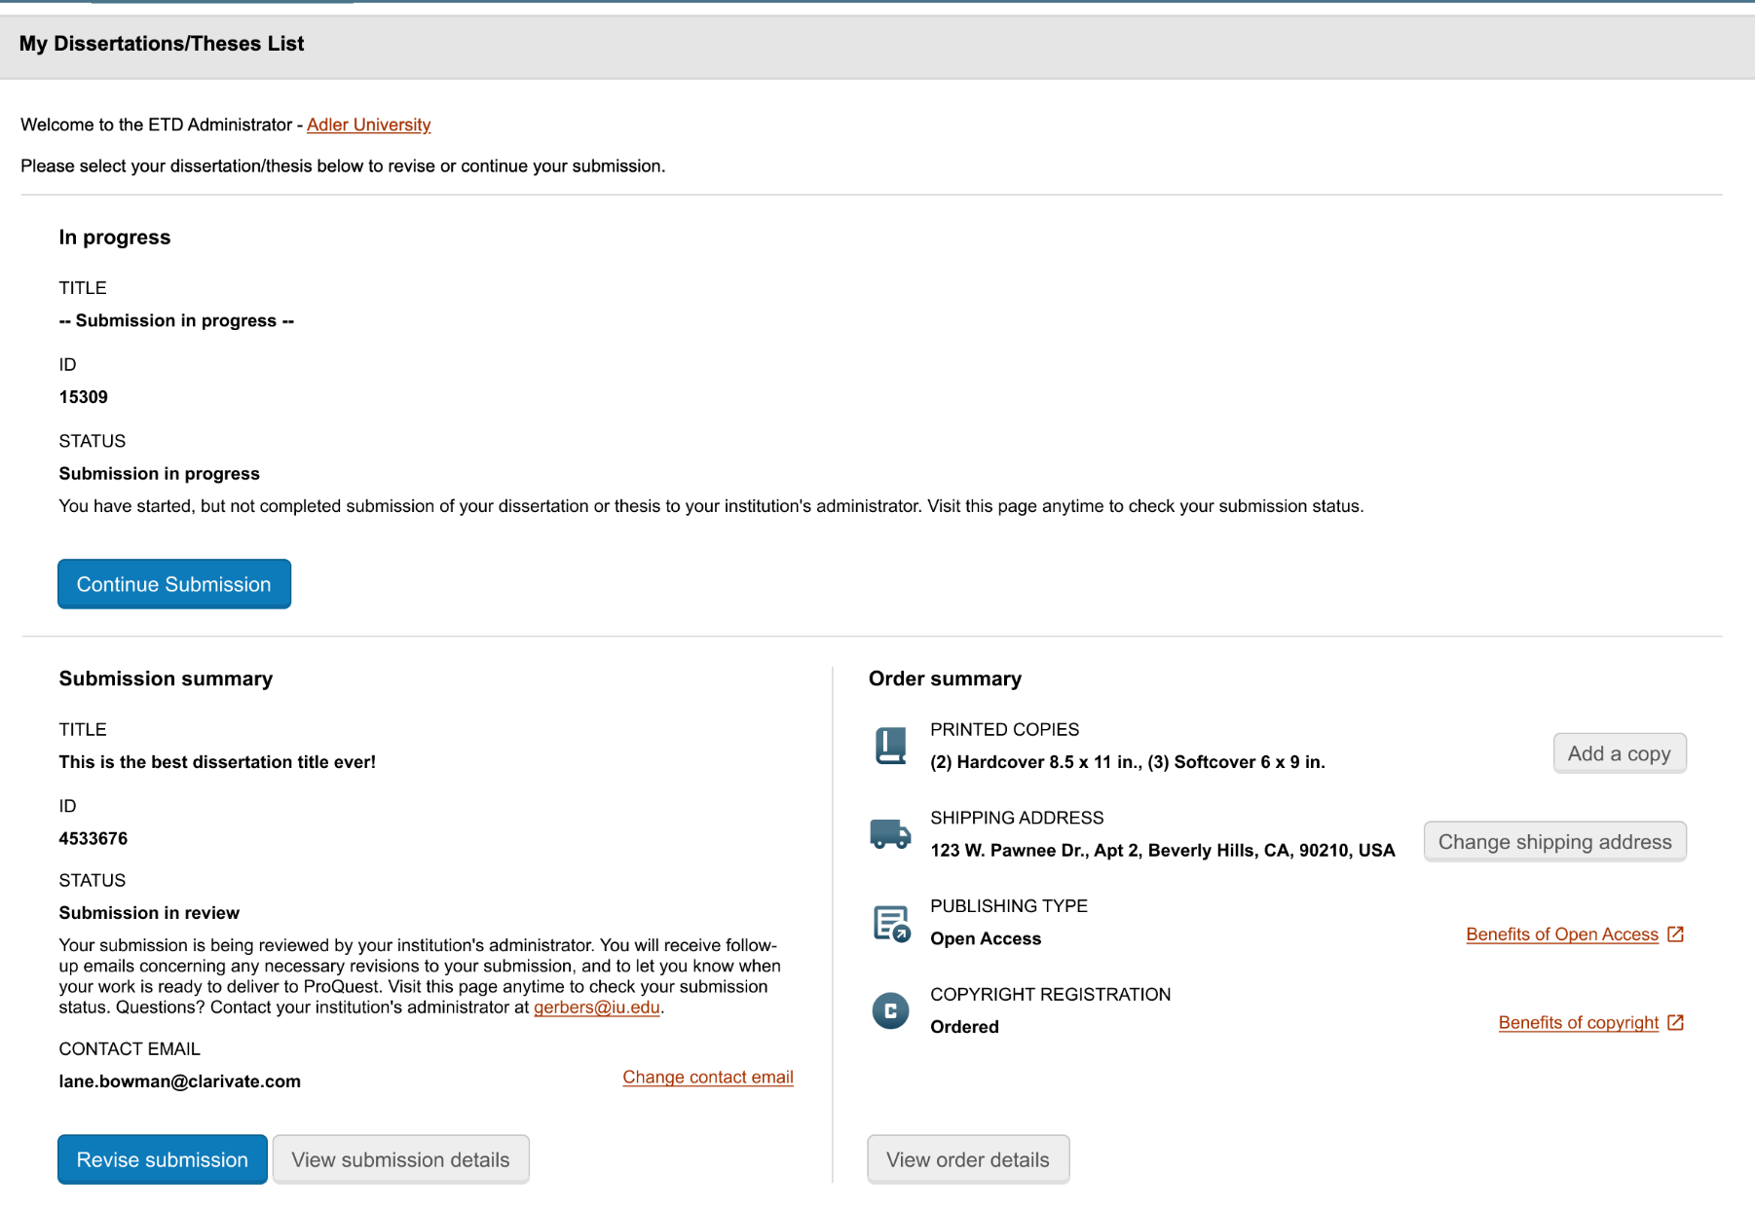
Coming Soon!
Author Self Service
Providing Authors with the ability to make updates to their details:
Contact Email
Shipping Address
Modify publication type
Request Copyright Registration
Change personal order
© 2023 Clarivate
6

Slide 7
ETD Administrator Roadmap – 2025/2026
SOON
NEXT
LATER
???
XML Delivery Enhancements
IR Deposit Only (undergrad, etc.)
se
Embargo Management
.6
Workflow solution that allows students to request an embargo extension with updates passing to IR
Ability to share tags with other admins on a site
Usage of ETD Admin tool for undergrad and other non-PQDT eligible works
Author self-service
Accessibility Review
Author self-service for shipping address & contact info (prior to ETD publication)
Tool that provides Admins with information on the accessibility of the PDF
*Working document, enhancements/timelines subject to change

Slide 8




Challenges in Higher Education
What are the biggest challenges you face related to ETDs?
Copyright & IP
Access & Preservation
Discovery & Accessibility
Policy & Compliance
Which of these affects you most?
Are there other areas of concern?
© 2023 Clarivate
8

Slide 9



Discovery Community
Help improve the ProQuest ETD Administrator experience
Get early access to new features and help inform timeline and product roadmap
Participate in regular virtual community workshops to:
Review new ideas and test new features
Discuss your application needs through user stories
Participate in other product discovery activities
Be part of a national community of colleagues
Please let us know if you’re interested in the Discovery Community!
9

Slide 10
Questions?
Mark Dill
Mark.dill@clarivate.com

