Slide 1
VisualMind AI: Revolutionizing ETD Research Through
AI-Powered Knowledge Visualization
Flash Talk
USETDA 2025
Manmeet Kaur
Uttarakhand Sanskrit University Library, Haridwar, India
(Virtual Presentation)

Slide 2
The ETD Challenge: Beyond the Digital Shift
ETDs are the cornerstone of open-access scholarship.
Yet, the shift from print to digital hasn't solved core problems:
❌ Structural Disorganization: Complex literature reviews, weak abstract/keyword generation.
❌ Content Integrity: Citation errors, plagiarism risks, factual inaccuracies.
❌ Static Engagement: PDFs fail to visualize the dynamic connections within research. In addition to PDF, VisualMind can become helpful for a researcher that, whether he/she is on the correct path?
The AI Intervention: Introducing VisualMind AI
A next-generation tool from Asana Rebel GmbH (2024).
Core Innovation: A dual-mode interface that adapts to your learning style.
🤖 Generative AI Engine: Powers both modes for intelligent output.
🗨️ Conversational Chat: For interactive Q&A and deep dives.
📊 Visual Mind Map: To transform text into dynamic knowledge structures.
Goal: To make research comprehension, organization, and creation deeper and more intuitive.

Slide 3
Key Features & Capabilities
1: Dual-Mode Learning
For the Visual Learner: Mind Map Mode
Auto-generates interactive knowledge structures from text.
Ideal for outlining chapters, structuring arguments, and connecting theories.
For the Linear Learner: Chat Mode
Acts as a 24/7 research assistant.
Explains concepts, suggests sources, and clarifies methodologies.
2.📝 AI-Powered Summarization: Digests entire ETDs into concise, structured abstracts.
3. 🎥 YouTube Integration: Captures knowledge from academic videos, generating instant summaries or mind maps from lectures.
4. 🎯 Personalized Assistance: Offers discipline-specific prompts for history, CS, marketing, etc.
5. 🔄 Cross-Platform & Evolving: Features editing, sharing, and history management for collaborative research.

Slide 4
Disciplinary Applications: A Tale of Two Fields
Humanities & Social Sciences | STEM Fields
✅ Use Cases: Thematic clustering, paraphrasing texts, visualizing theories. | ✅ Use Cases: Methodology drafting, data viz, explaining complex code.
⚠️ Limitation: Cannot replace critical argumentation. AI is an organizational aid | ⚠️ Limitation: Risk of "hallucinations". Technical content requires rigorous verification.
The Path Forward: Priorities for Responsible Integration
🛠️ Develop Policies & Training: Clear guidelines on AI disclosure and ethical use.
🔍 Implement Verified Workflows: Mandatory checkpoints (e.g., supervisor sign-off, source verification) to counter hallucinations.
📈 Conduct Longitudinal Studies: Assess the quality and impact of AI-assisted ETDs over time.
🏷️ Audit Metadata Quality: Ensure AI-generated metadata enhances repository discoverability.

Slide 5
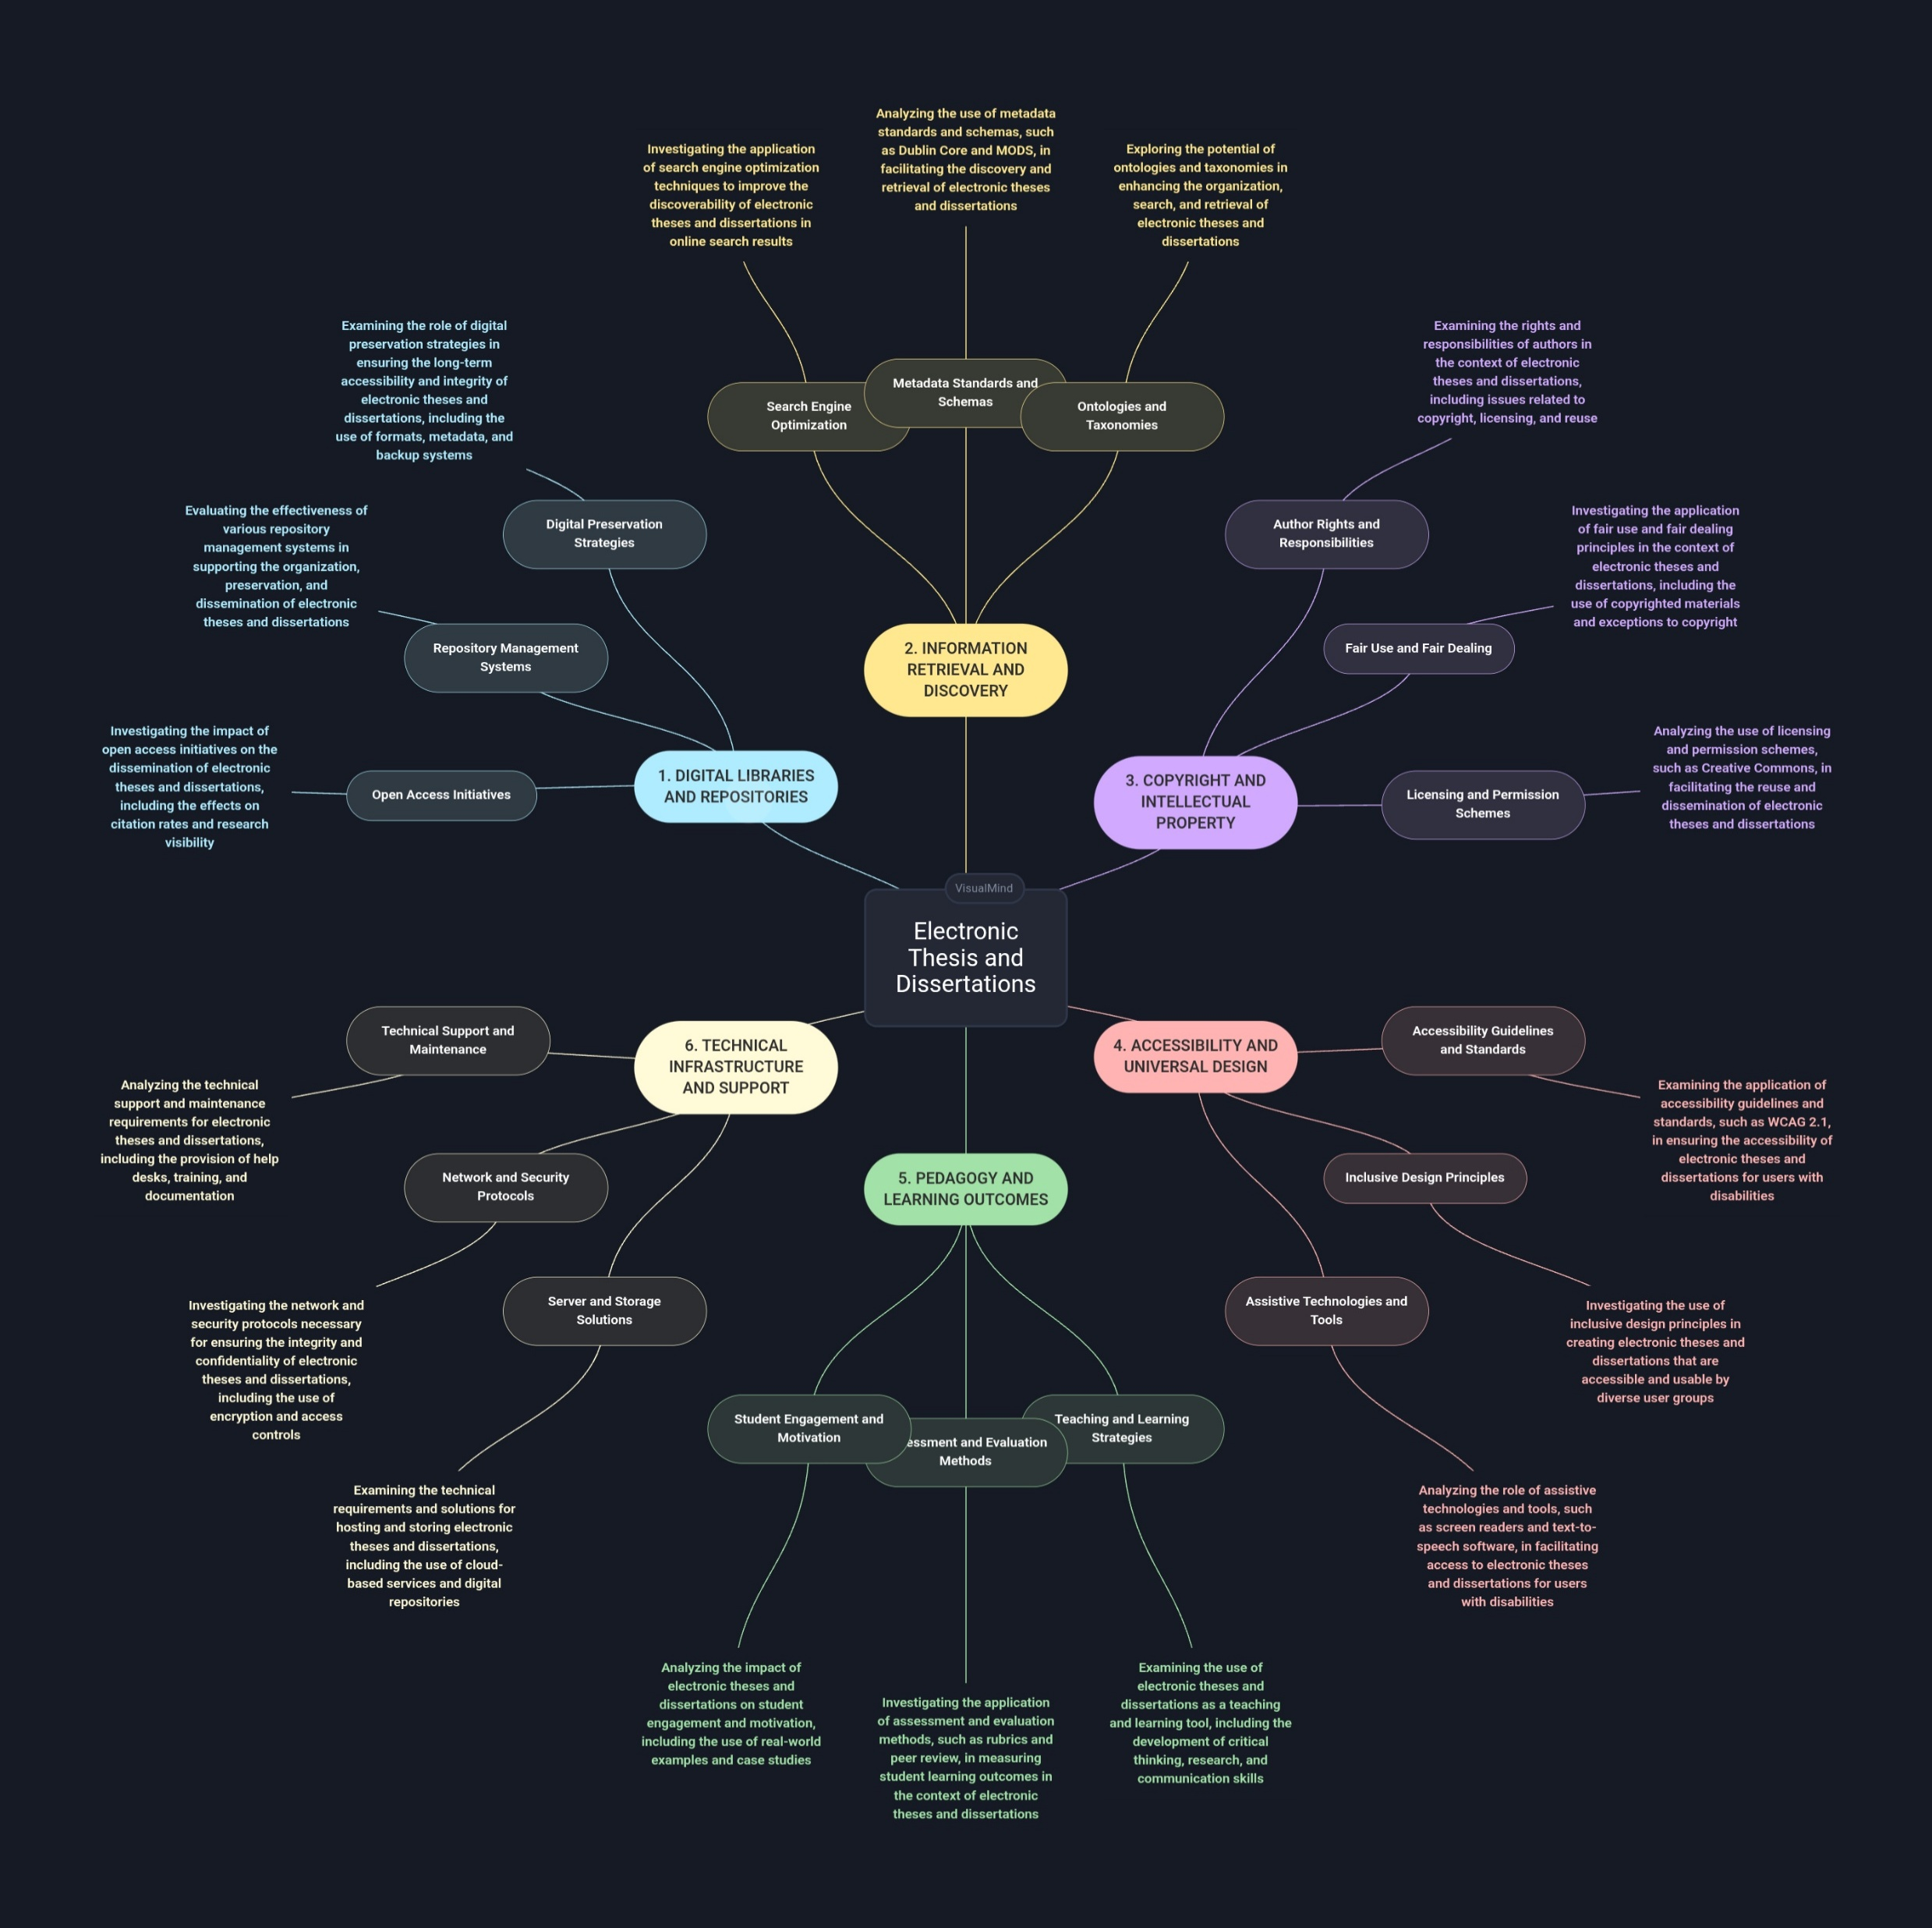

Slide 6
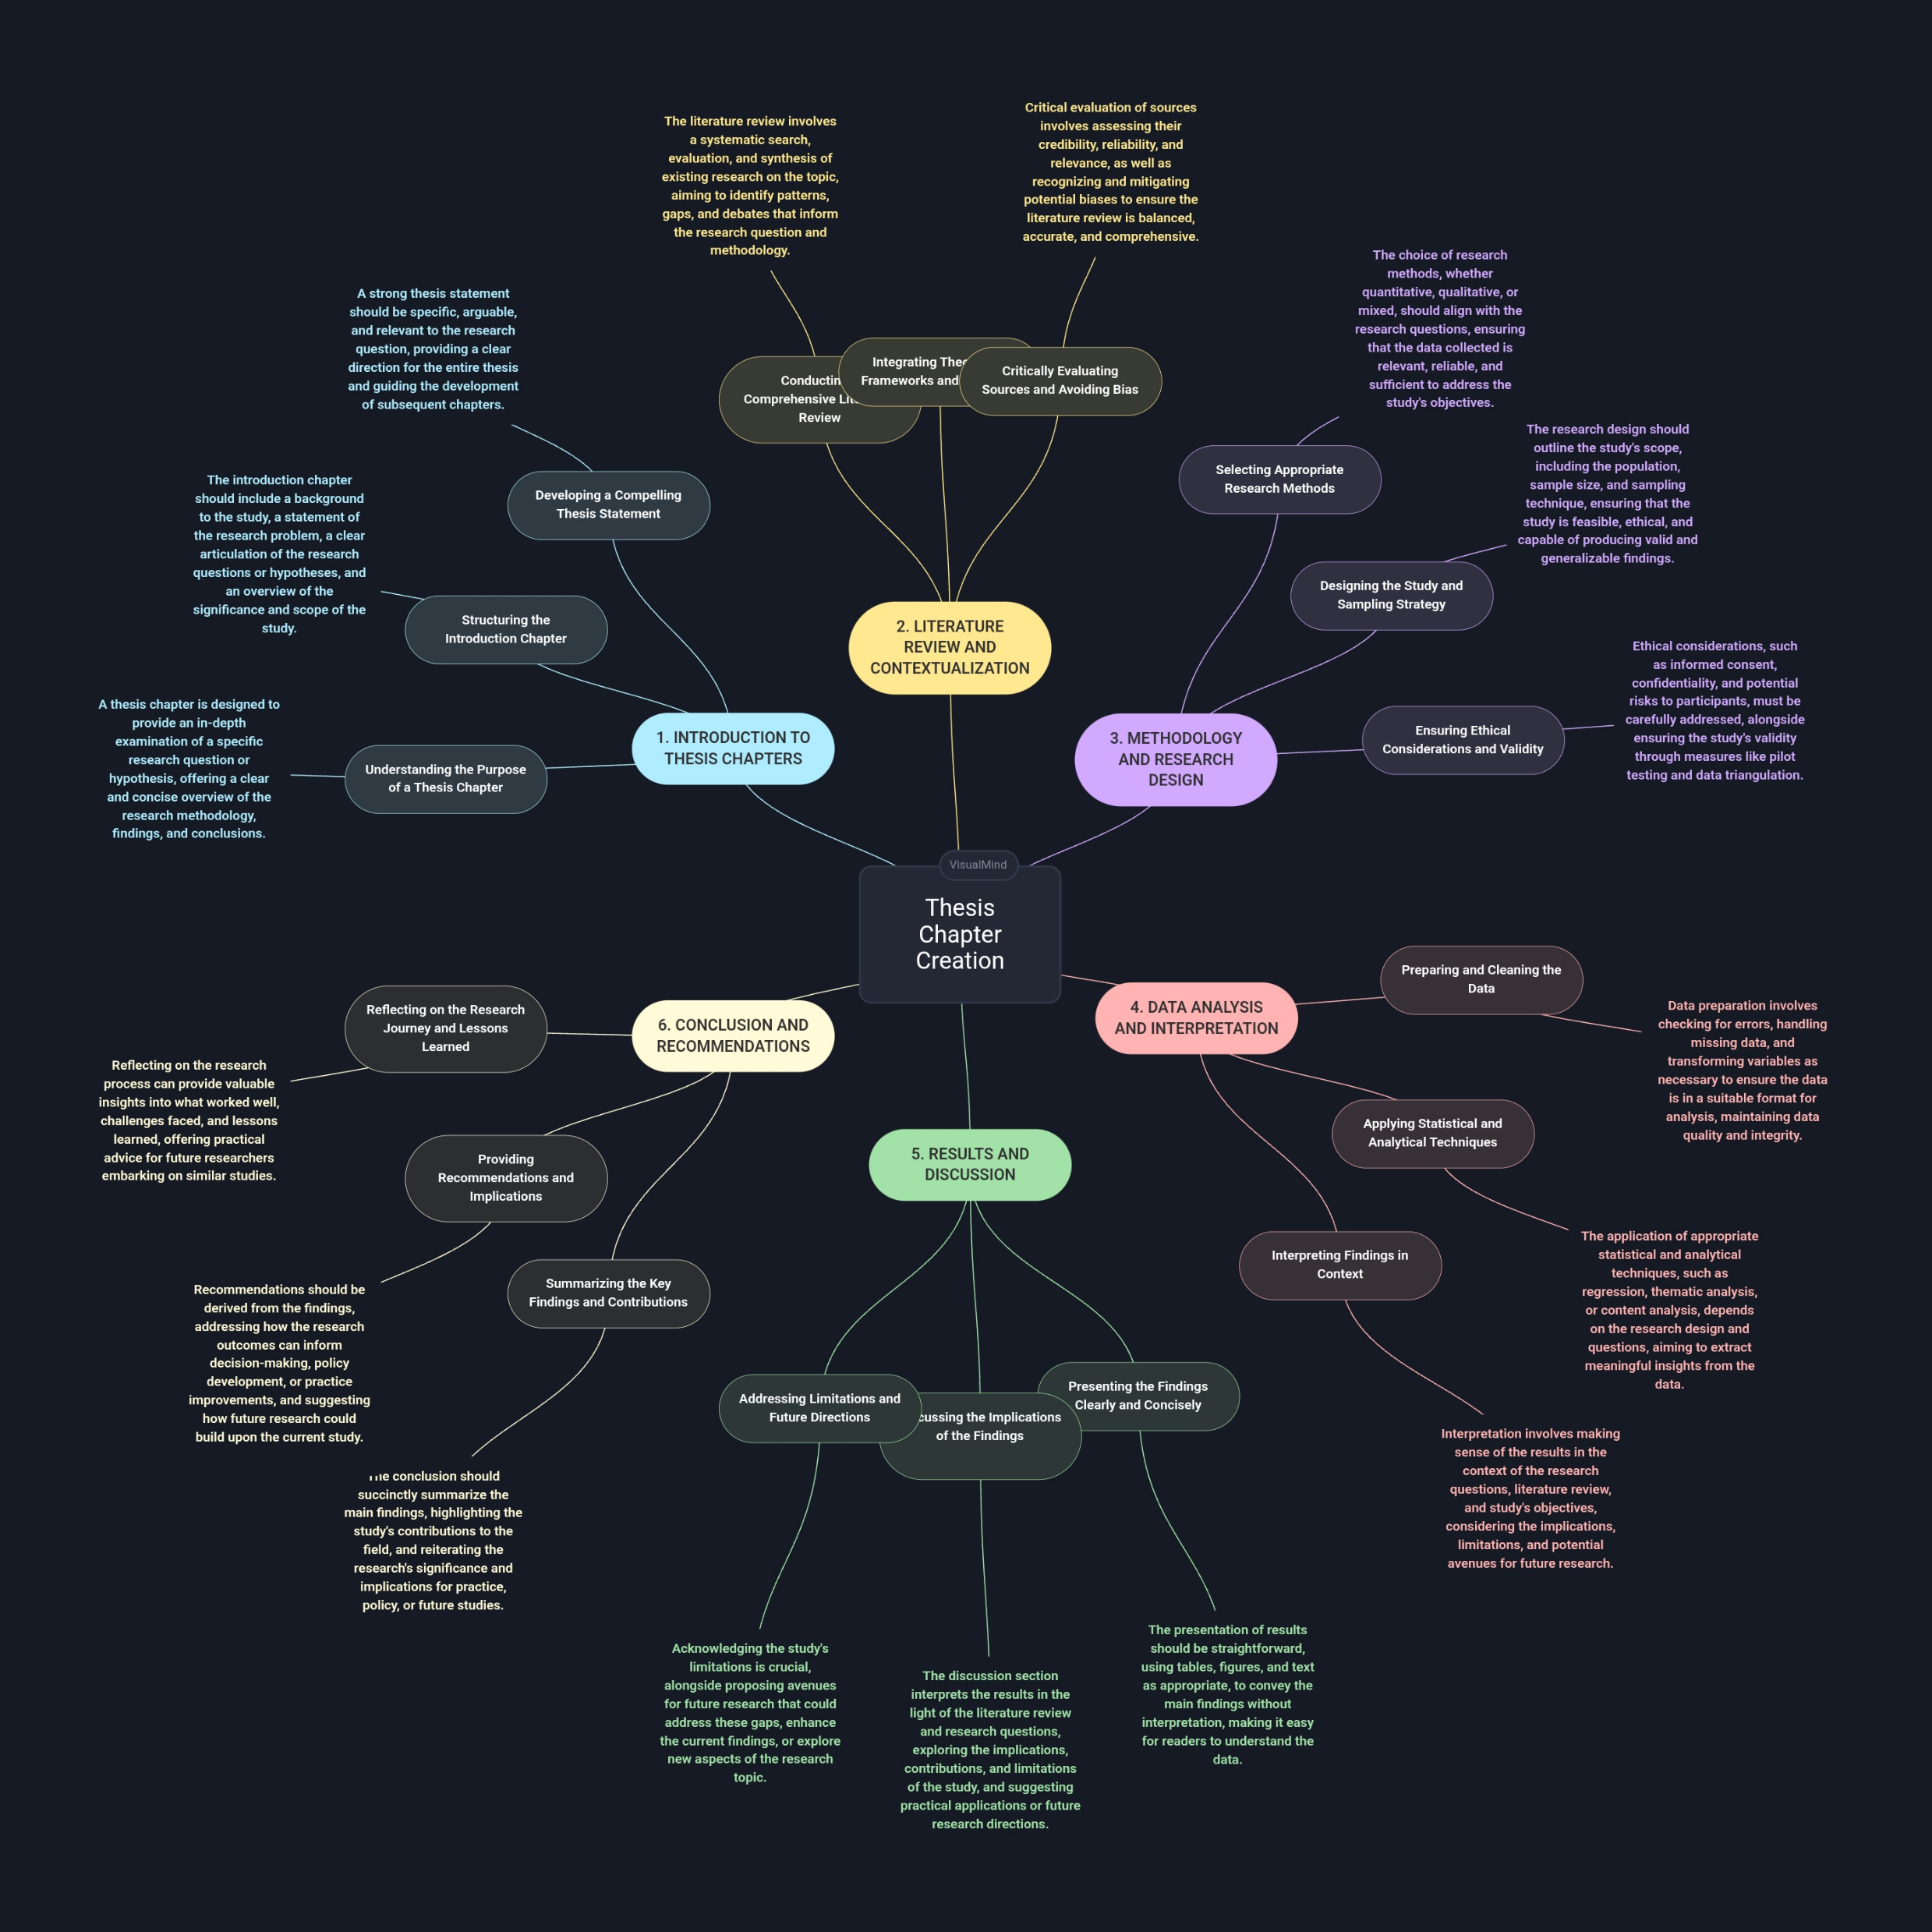

Slide 7
Conclusion
“Augmenting Scholarship, Not Replacing It”
In conclusion, the core academic distinction is that the traditional ETD is a passive repository of information that requires the user to perform the cognitive work of synthesis. Conversely, an ETD with a visual mind map is an active knowledge platform that leverages principles of cognitive science and data visualization to proactively assist the user in discovering, comprehending, and synthesizing complex scholarly information.
The Future: The ETD could provide a thoughtful tool for discovery, not just a static document.
Our Responsibility: To ensure careful oversight to mitigate risks of loosing creativities, plagiarism and over-reliance on AI.

Slide 8
Thank You

