Slide 1
Open Science Across Borders: An Indian Perspective
Nabi Hasan, PhD, PDF, FNEB, FSLA
Head Librarian
Indian Institute of Technology Delhi
https://web.iitd.ac.in/~hasan | hasan@library.iitd.ac.in

Slide 2
Coverage
Background
Open Science
Open Science Initiatives in India
Open Science at IIT Delhi
Open Research Data
National Research Data Repository
Research Data Repositories in India
Preprint Repositories in India
Benefits of Open Science
Challenges in Adopting Open Science
Conclusion

Slide 3
Background
  India is in the forefront of the developing world in terms of both economic growth and scientific productivity.
  India is the world’s 3rd producer of scientific publications (Scopus) and 9th as per the WoS.
  India ranks number 15 and 17 globally for OA journals and OA repositories (OpenDoar), with a 23.44% proportion of OA publications as per the Web of Science and a 20.60% proportion of OA publications as per Scopus.
  The contribution of India to open access journals in the world is 2.57% (DOAJ).
  SCImago Journal and Country Ranking Portal show that India is represented by 469 journals, with 190 (40.5%) being OA journals.
  Institutional Repositories, Open Access Journals, Open Courseware are growing rapidly.
  India has taken several initiatives in the adoption and implementation of Open Science in scholarly communication.

Slide 4
Open Science
Open science is a set of principles and practices that aim to make scientific research from all fields accessible to everyone for the benefit of scientists and society as a whole.
Open science represents a new approach to the scientific process, based on collaborative work and new ways of disseminating knowledge, using information technologies and new collaboration tools.
Open science is different from open access, though some open access features themselves as open science.
Open science increases scientific collaborations and sharing of information for the benefit of science and society.
Makes multilingual scientific knowledge openly available, accessible and reusable for everyone.
Opens the processes of scientific knowledge creation, evaluation and communication to societal actors beyond the traditional scientific community.

Slide 5
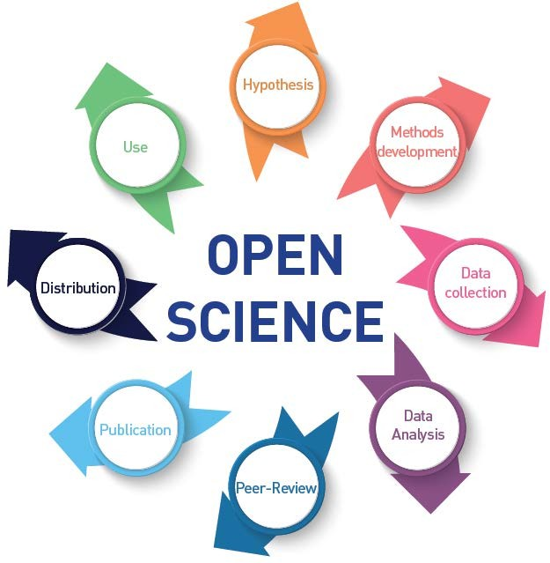

Open Science for the People, Planet & Prosperity
By making science more connected to societal needs and by promoting equal opportunities for all (scientists, policy- makers and citizens), Open Science can be a true game-changer in bridging the science, technology and innovation gaps between and within countries and fulfilling the human right to science.
Open Science has the potential of increasing the quality of science and making the entire scientific process more transparent, collaborative
Source: UNESCO Recommendation on Open Science

Slide 6
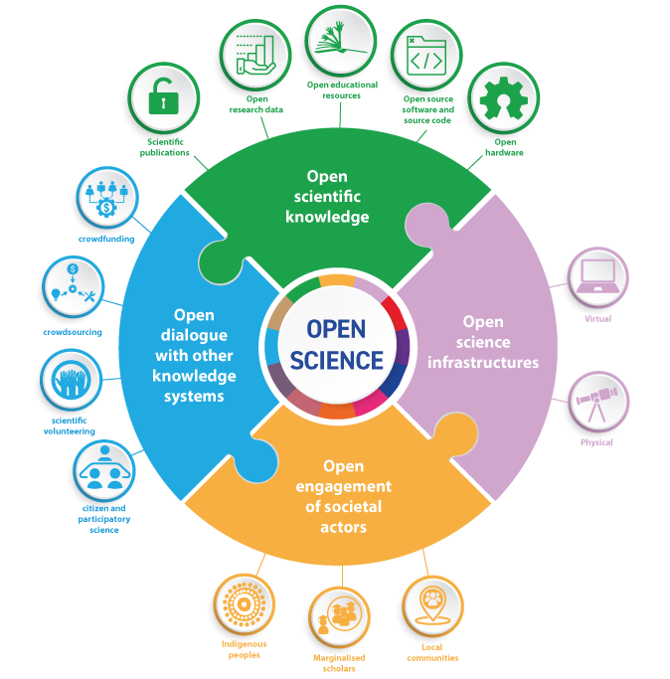
Key Pillars of Open Science
Open Scientific Knowledge: scientific publications, research data, software, source code and hardware available in the public domain or under the copyright that has been released under an open license.
Open Science infrastructures: scientific equipment or sets of instruments, knowledge-based resources such as collections, repositories, archives and scientific data, open computational and digital infrastructures, needed to support Open Science and serve the needs of different communities.
Open engagement of societal actors: citizen and participatory science and other extended collaboration between scientists and societal actors beyond the scientific community, opening up practices and tools that are part of the research cycle and by making the scientific process more inclusive and accessible to the broader inquiring society.
Open dialogue with other knowledge systems: recognition of complementarities between diverse epistemologies, including indigenous knowledge systems
Source: UNESCO Recommendation on Open Science

Slide 7
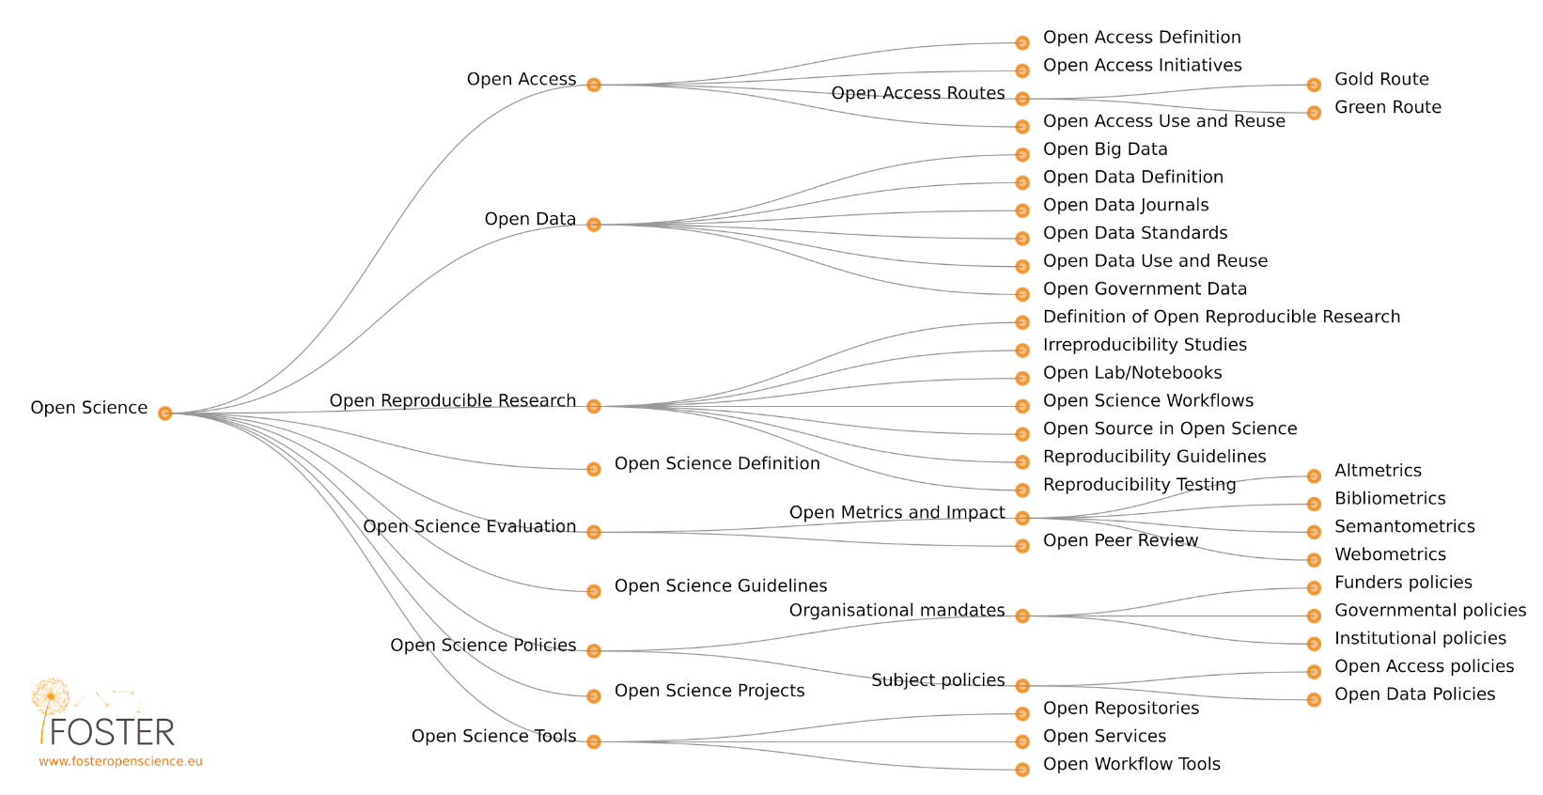
Open Science Taxonomy

Slide 8
The Practice of Open Science aims to
Open the processes and products of knowledge creation to people outside of the traditional research community.
Encourage collaboration and information-sharing to benefit science and society.
Make knowledge from all scientific disciplines and aspects of scholarly practices—including basic and applied sciences, natural and social sciences and humanities—available and accessible to everyone in multiple languages.

Slide 9
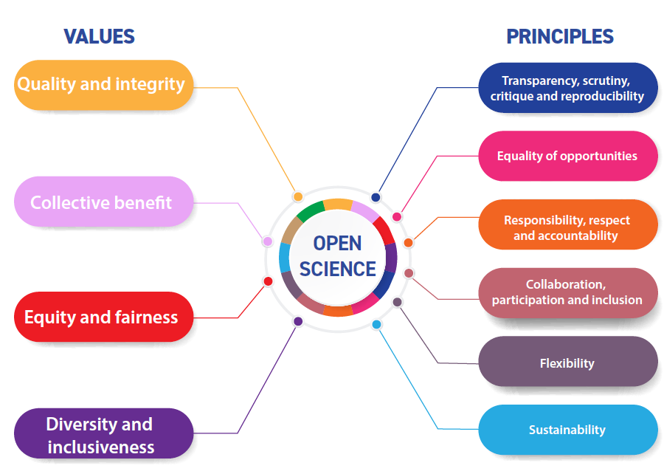
Core Values and Guiding Principles
Source: UNESCO Recommendation on Open Science

Slide 10
Areas of Open Science Services
Promoting a common understanding
Developing an enabling policy environment
Investing in human resources
Investing in open infrastructures
Promoting cooperation
Fostering a culture of Open Science
Promoting innovative approaches
Notes:
Promoting a common understanding of open science, associated benefits and challenges, as well as diverse paths to open science
Developing an enabling policy environment for open science
Investing in open science infrastructures and services
Investing in human resources, training, education, digital literacy and capacity building for open science
Fostering a culture of open science and aligning incentives for open science
Promoting innovative approaches for open science at different stages of the scientific process
Promoting international and multi-stakeholder cooperation in the context of open science and with a view to reducing digital, technological and knowledge gaps

Slide 11
Development of Open Science Policy at the Institute Level…
Open science policies can be defined as a set of guidelines, rules, regulations, laws, principles or directions to put open science values and principles into practice.
Open science policies can be used to:
  mandate or incentivize open science practices;
  manage the conduct of open science;
  address misconduct in open science;
  secure or enhance funding for open science;
  build capacity for open science;
  support the cultural changes needed to enhance open science practices;
  guide organizational changes needed to foster open science practices; and
  monitor open science and its impacts.

Slide 12
Development of Open Science Policy at the Institute Level
A strong open science policy addresses:-
  costs for implementation of and compliance with the policy
  equitable provision of support
  costs resulting from (new) open science responsibilities that need to be supported with new/additional funds
  costs resulting from open science practices that need to be integrated as ‘good practice’ within the existing funding framework
  skill development for the necessary expertise within the organization(s) in order to implement the policy
  recommendations and monitoring systems
  clear pathways to long-term sustainability of investments in open science, recognizing that resourcing for open science is not only about additional investments but also about spending the existing resources more efficiently, such as for shared infrastructures or collaborative practices and
  incentives and rewards to perform open science.

Slide 13
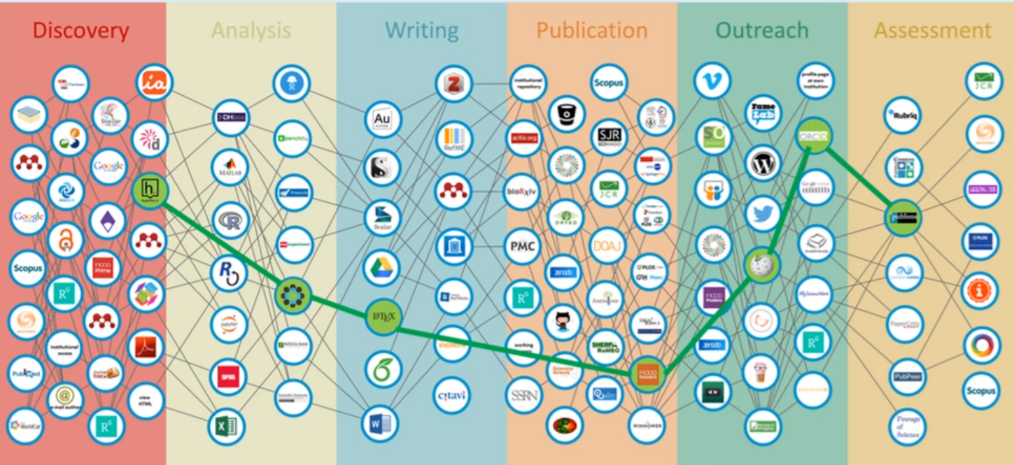
Promotion of Open Science Platforms in Research
Source: Innovations in Scholarly Communication, Open Science Workflow

Slide 14
Collaboration with key stakeholders of Open Science
Academia
Industry
Government
Researchers
Administrators and research managers
Research performing organizations
Institutions / Universities and other higher education establishments
Libraries
Open science platforms, tools (developed by universities)
Startups, SMEs
Large industrial organizations
Private funding bodies
Individual entrepreneurs
Experts from private sector
Commercial publishers
Private research institutions
Open science platforms, tools (commercial)
Scholarly publishers
Civil Society
Funding organizations
Higher education departments
Professional organizations
Public health organizations
Environmental organizations
Public funding agencies
General public
Individual citizens
Citizen scientists
Non-Governmental Organizations (e.g. UN, OECD)

Slide 15
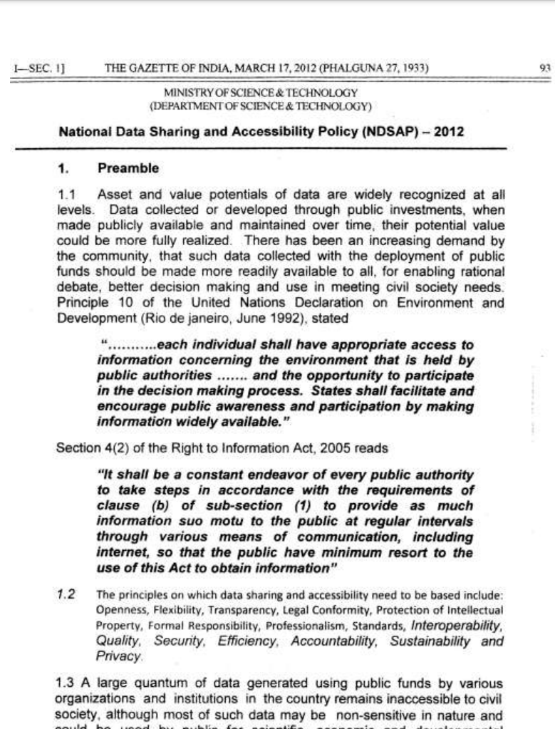
DST, National Data Sharing and Accessibility Policy (NDSAP), 17th Mar. 2012.
A policy by a DST (Department of Science & Technology), Govt. of India.
To promote data sharing among government departments/organizations and make public data more usable for national planning, development, awareness etc.
To facilitate access to Government of India–owned shareable non-sensitive data, both in human-readable and machine-readable forms.
To enable proactive release of data (rather than reactive, e.g. under RTI) so that data is more available, timely, and useful.

Slide 16
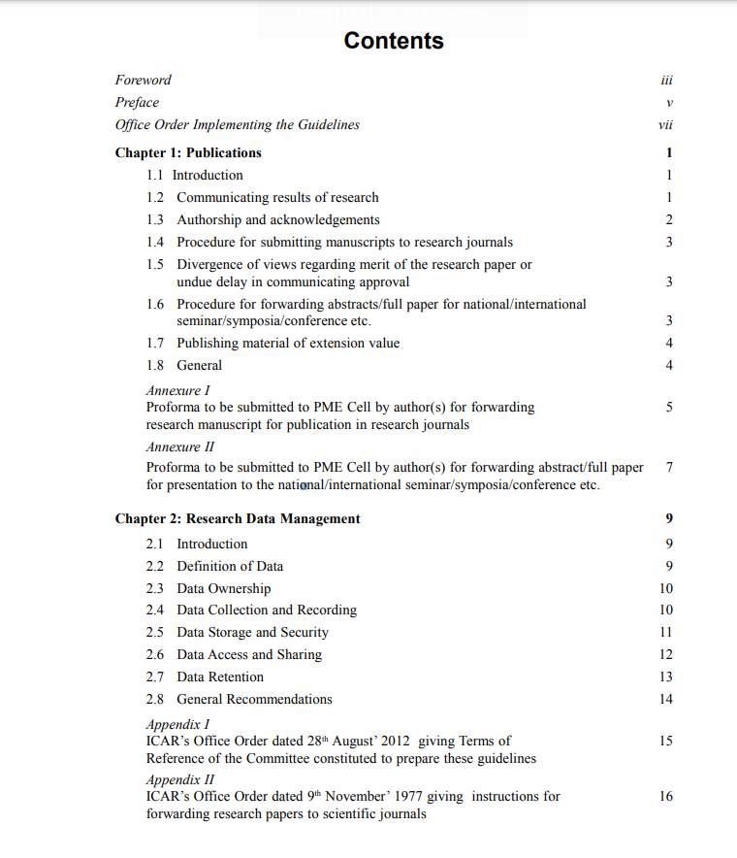
ICAR Guidelines for Internal Evaluation and Forwarding Research Papers to Scientific Journals and Data Management in ICAR Institutes, Oct. 2014.
ICAR adopts Open Access Policy
These guidelines are a comprehensive set of standards for effective management of research data in the Institutes.
It ensure uniform procedures in all ICAR Institutes for (a) internal evaluation and forwarding of research papers to scientific journals, and (b) research data management.
These cover how ICAR expects institutes to handle research data, to ensure integrity, security and availability

Slide 17
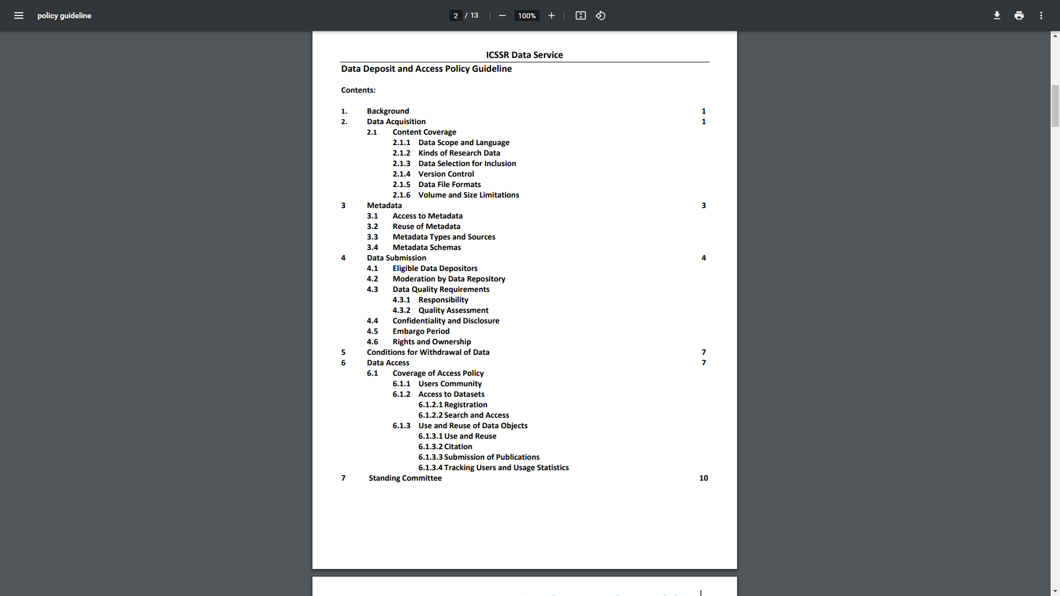
ICSSR Data Deposit and Access Policy Guideline, 2015
Outline the process for researchers to deposit their social science research data into the ICSSR Data Service for long-term preservation and wider reuse.
The “ICSSR Data Service” is culmination of signing of Memorandum of Understanding (MoU) between ICSSR and Ministry of Statistics and Programme Implementation (MoSPI).
ICSSR Data Service aims to facilitate data sharing, preservation, accessibility and reuse of social science research data collected from entire social science community in India & abroad.
URL: http://www.icssrdataservice.in/

Slide 18
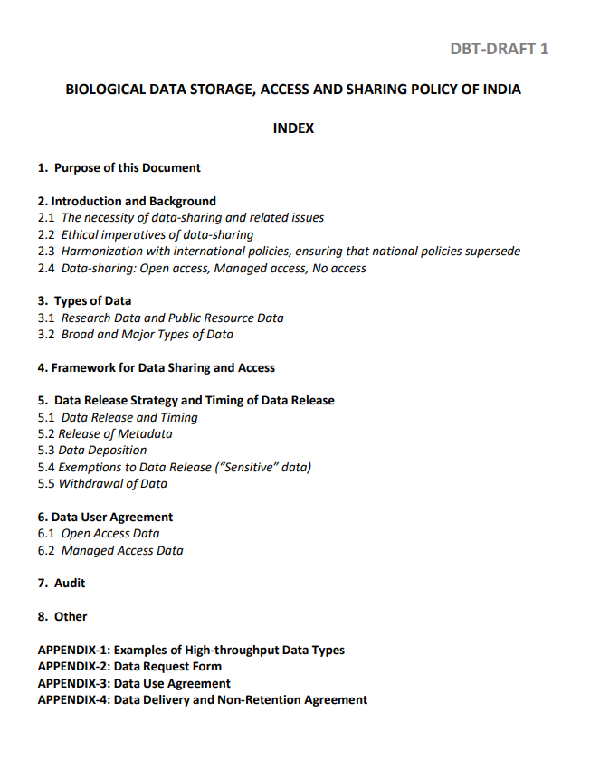
DBT Biological Data Storage, Access and Sharing Policy of India (BDSASP), 2019
BDSASP aimed to provide a framework for the storage, access, and sharing of biological data, especially high-volume, high-throughput data, generated within India.
Developed by the Department of Biotechnology, Govt. of India.
Developed the ‘Indian Biological Data Centre (IBDC)’, which is the first national repository for life science data in India.
URL: https://www.rcb.res.in/indian-biological-data-center-ibdc

Slide 19
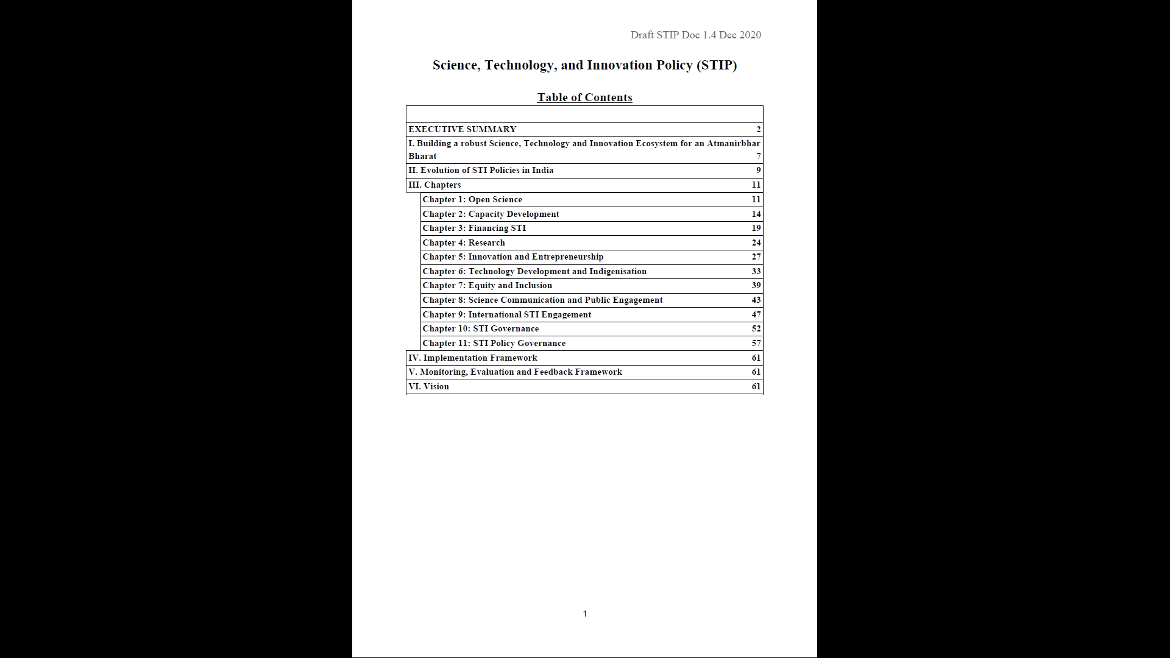
Adoption & Promotion of Open Access Policies of Government & Funding Agencies
STIP – 2020 by the Government of India has a focus on:
  National STI Observatory – a central repository
  Open science
  Open data policy
  Open Access (OA)
  Open Educational Resources (OER)
  One Nation One Subscription (ONOS)
STIP wants to make scholarly knowledge openly accessible to all.
Other Indian Govt. agencies like DST, DBT, CSIR, ICAR, CFTIs, ICRISAT, are already pioneer for public funded research.

Slide 20
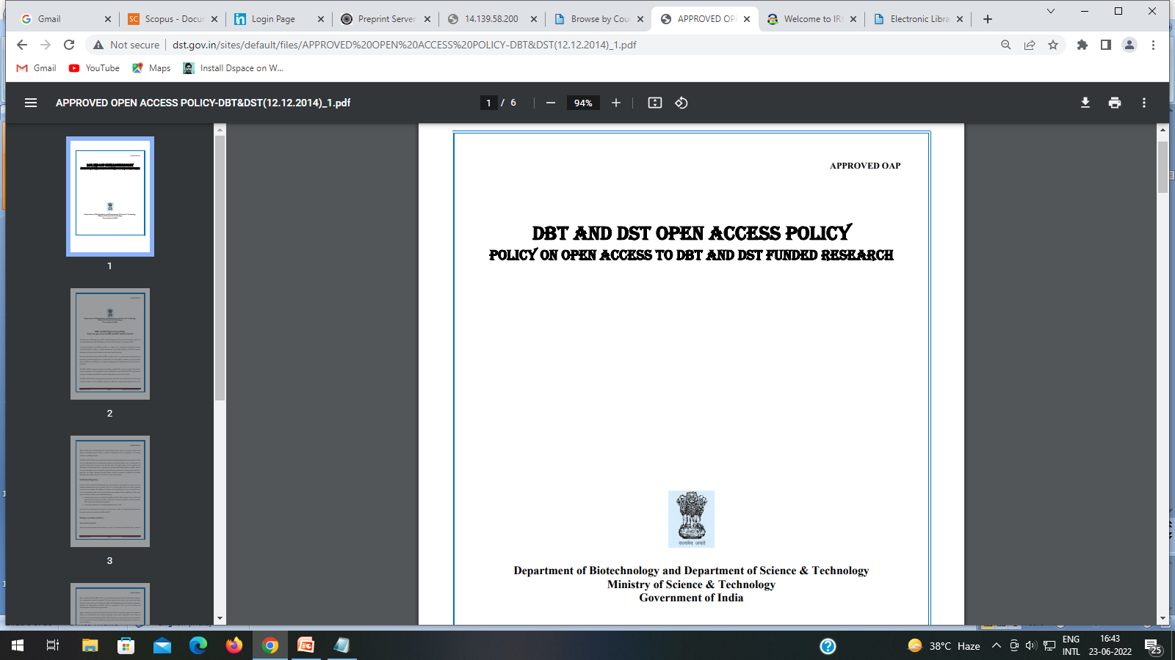
DBT and DST India Open Access Policy for funded research
  Institutions that receive core funding from DBT and DST will be required to have an IR.
  Such institutions that currently do not have an IR will be required to create one as soon as possible. There will be help available for this purpose.
  For all other institutions, it is recommended that they have an IR.

Slide 21
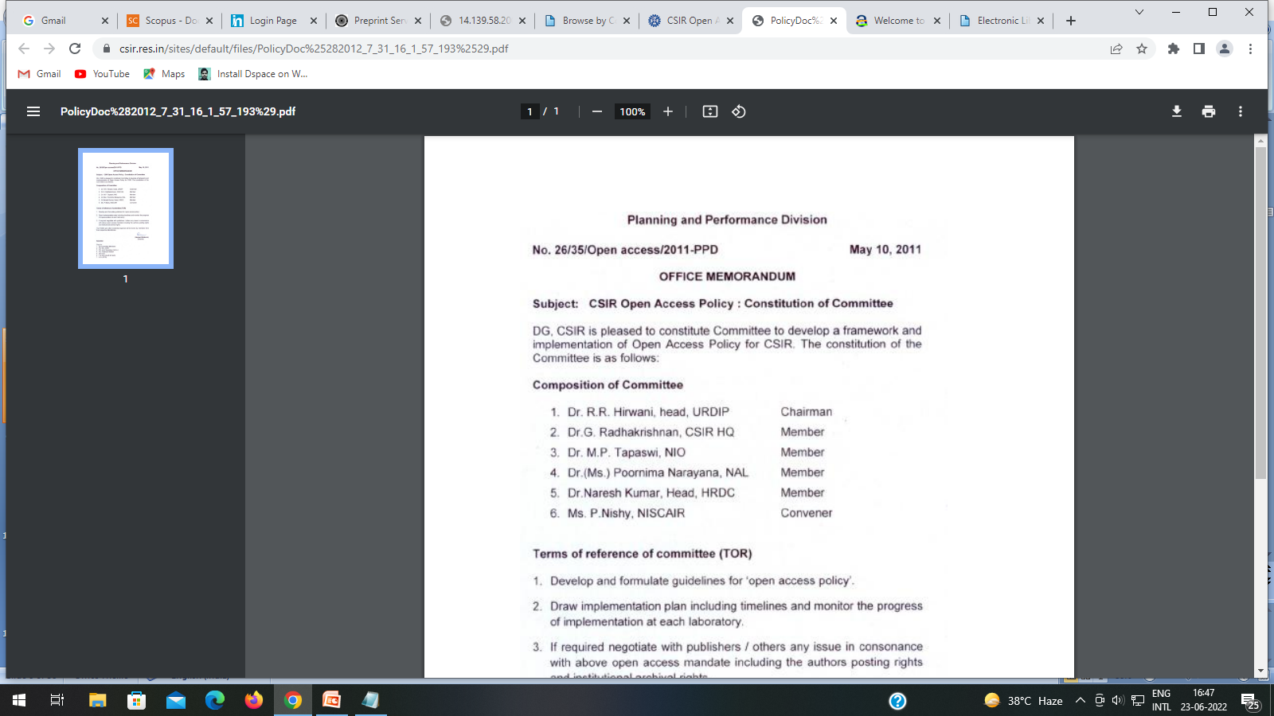
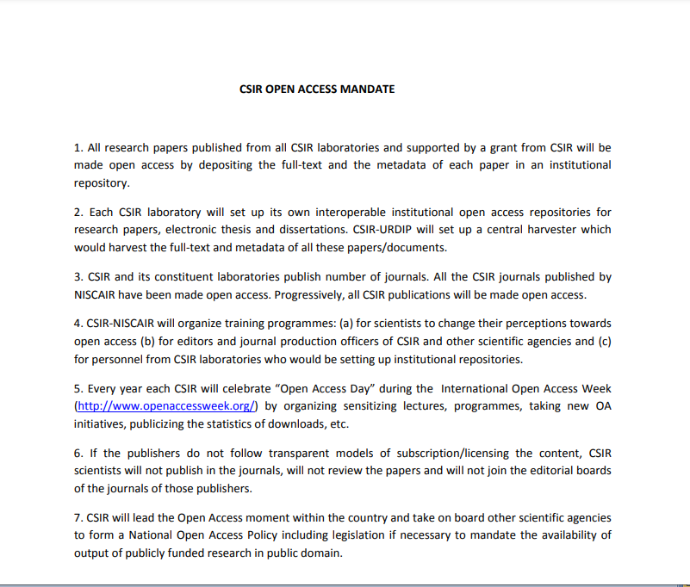
CSIR India Open Access Mandate

Slide 22
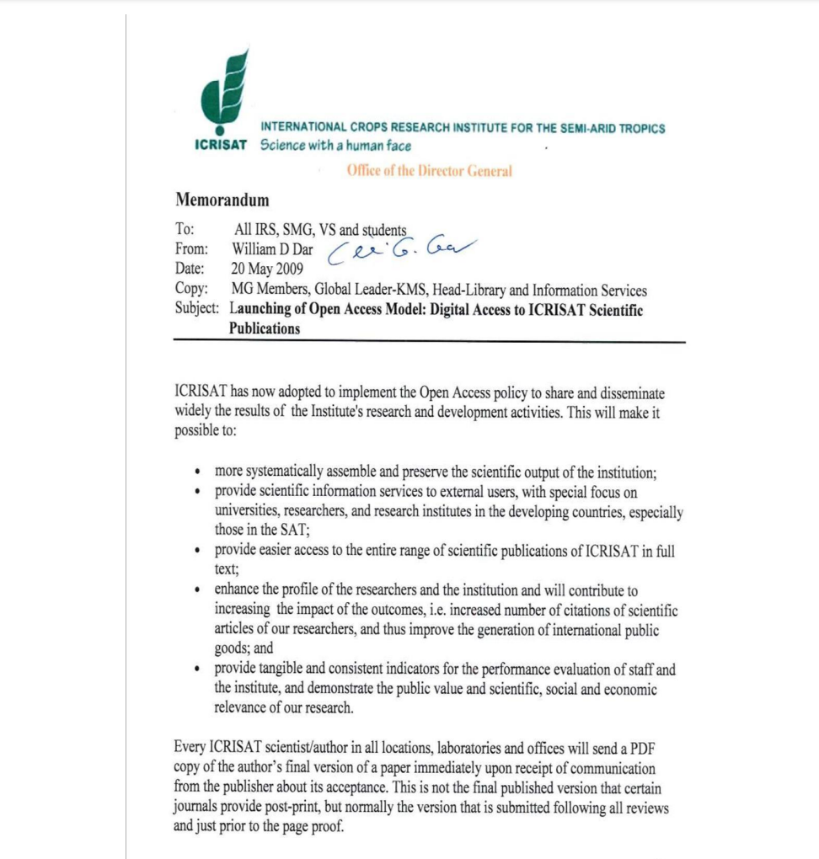
ICRISAT, Open Access and Data Management Policy
  International Crops Research Institute for the Semi-Arid Tropics (ICRISAT) has implemented Open Access Policy.
  To share and disseminate the research information related to agriculture.
  It promote greater distribution of knowledge, enhances potential for innovation and has a greater influence on science and scholarship.

Slide 23
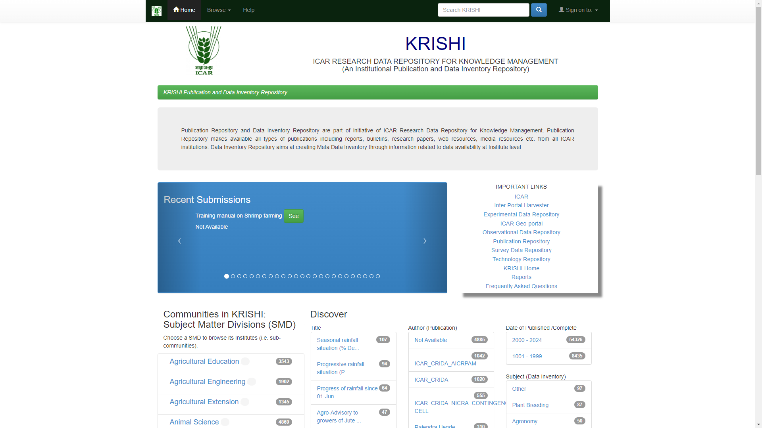
ICAR adopts Open Access Policy
  Each ICAR institute has an Open Access Institutional Repository.
  ICAR has a central harvester to harvest the metadata and full-text of all the records from all the OA repositories of the ICAR institutes
  All publications viz., research articles, popular articles, monographs, catalogues, conference proceedings, success stories, etc with the institutes to be placed under Open Access.

Slide 24
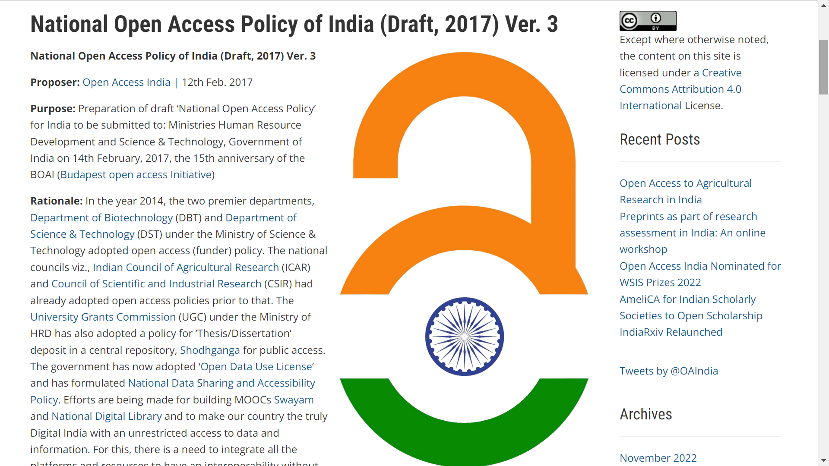
National Open Access Policy of India (Draft, 2017) Ver. 3

Slide 25
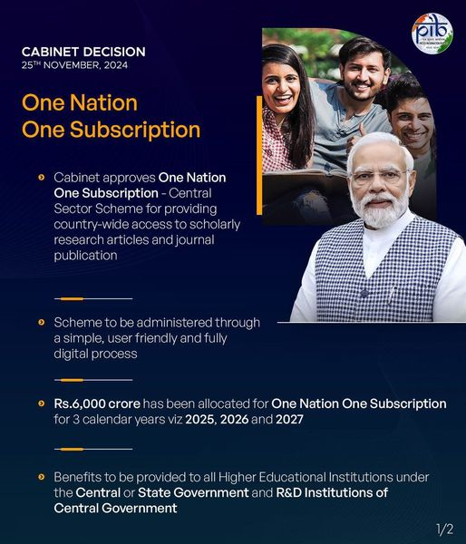
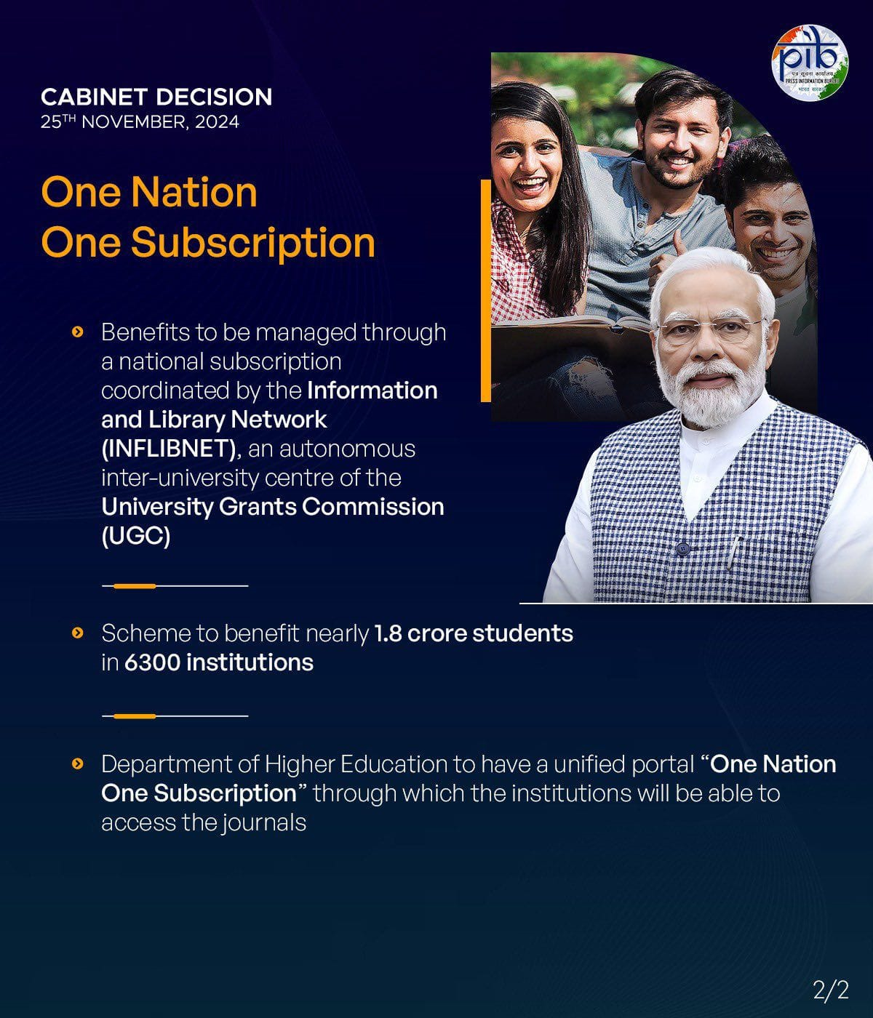
One Nation One Subscription (ONOS)

Slide 26
ONOS – Implementation
Phase-I, implemented from 1st January 2025
Phased implementation
  Phase-1 (3 years) – Merge all library consortia and bring in more institutions
  Phase-II – include Private academic institutions through a public-private partnership model
  Phase-III – universal access – designated access points at public libraries
Cover all streams of STEMM, management, social sciences and humanities.

Slide 27
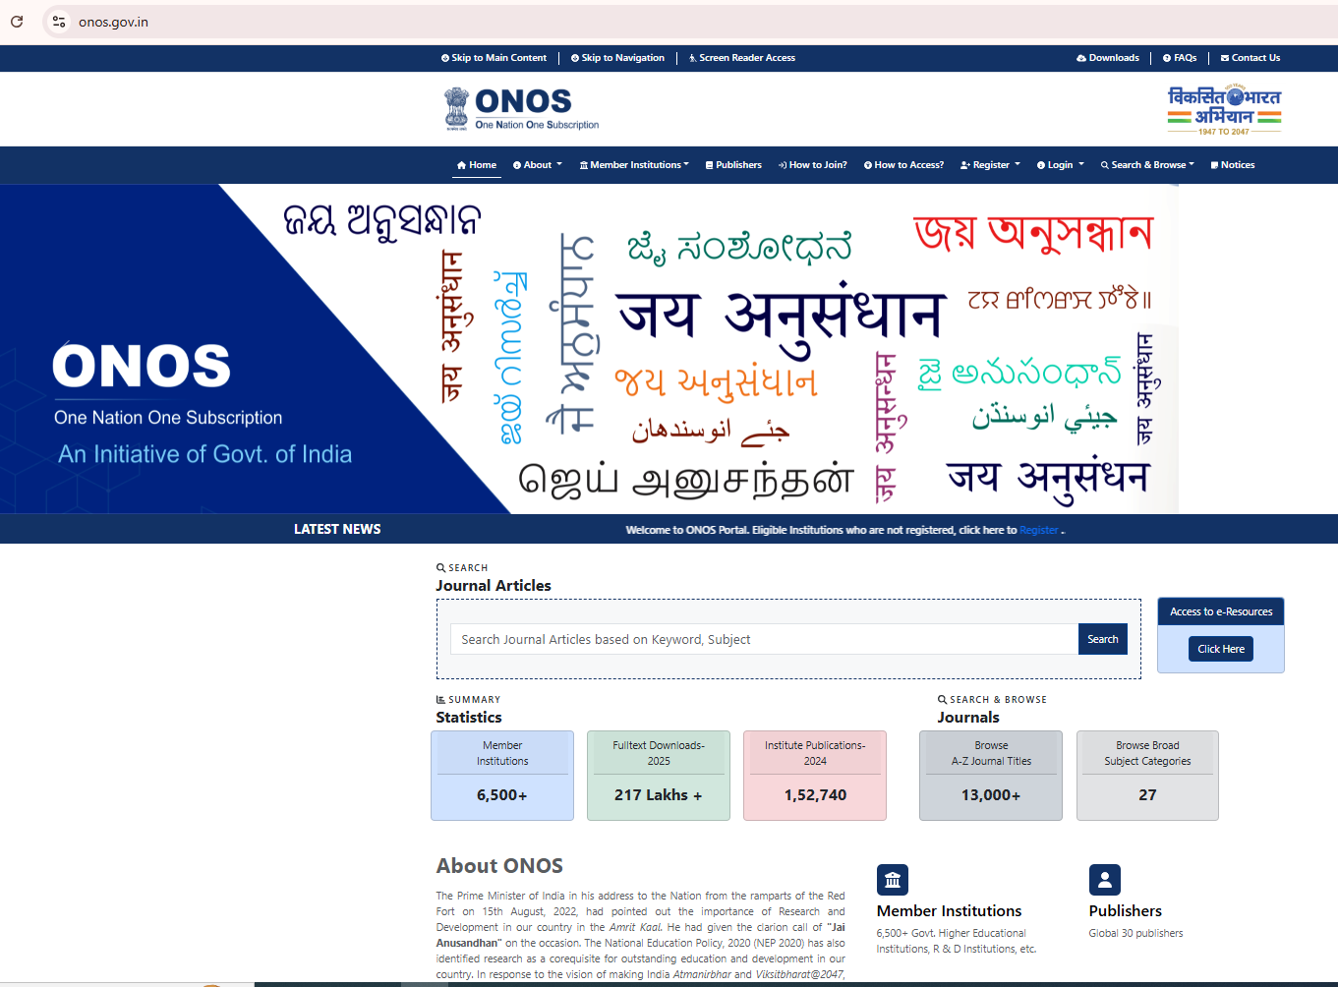
ONOS Portal

Slide 28
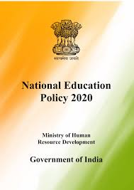

Open Access - ONOS Initiative
Outcome
To bring the global best knowledge and scholarship to the last mile in the country at negligible cost
Aligns
With the vision of the National Education Policy 2020 (NEP)
Aligns with the Atmanirbhar and Viksitbharat@2047 by fostering a robust research and innovation ecosystem in India.
Jai Anusandhan
Reverberates
The vision of the National Research Foundation (NRF)
Source: PSA/https://onos.gov.in

Slide 29
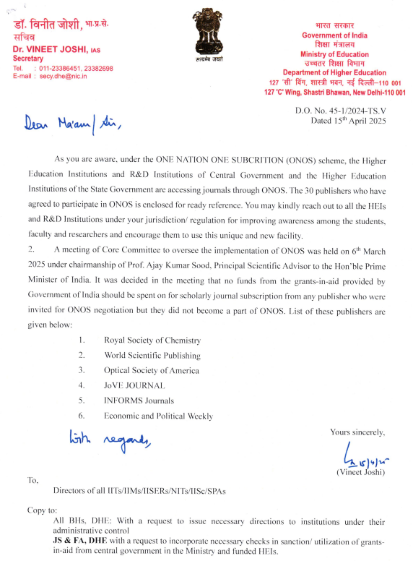
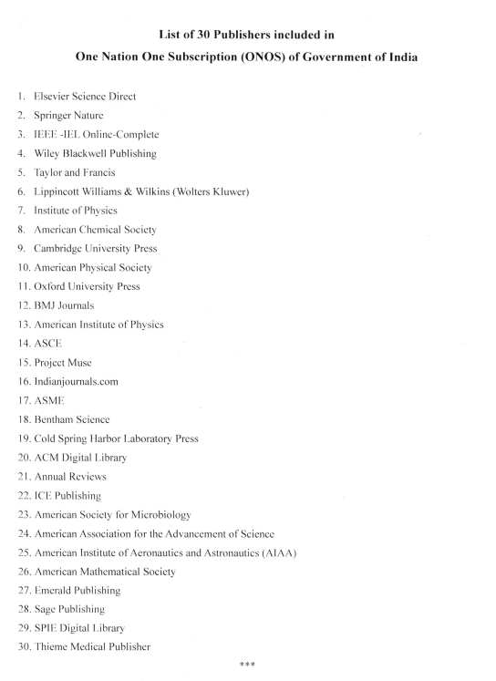

Slide 30
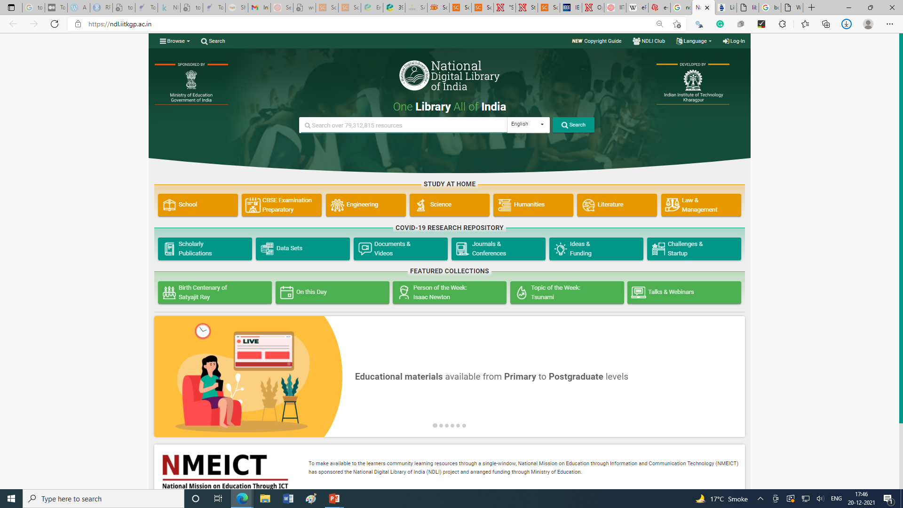

Slide 31
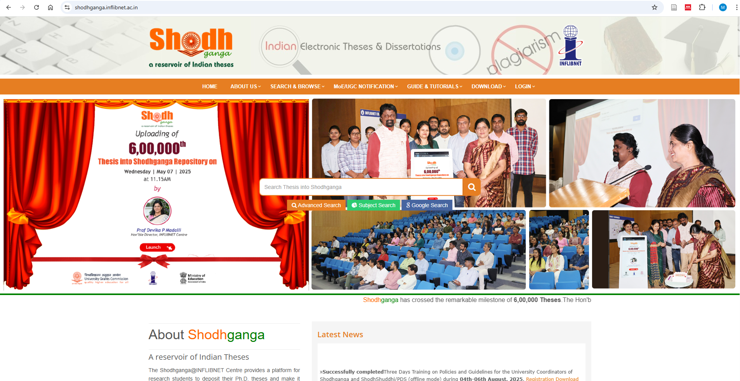

Slide 32
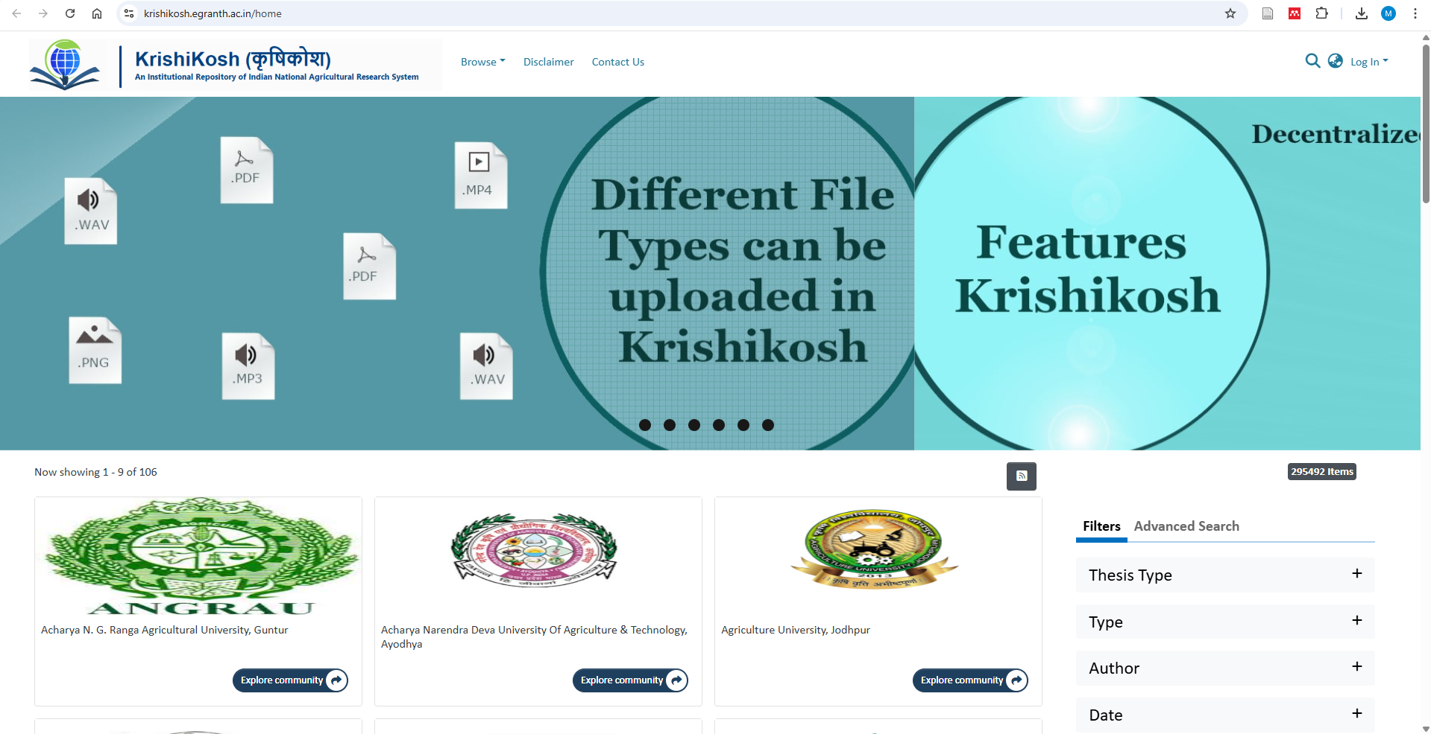
https://krishikosh.egranth.ac.in/

Slide 33

Open Access in G20: Recommendations
Recommendations in the G20-CSAR Outcome Document & Chair’s Summary
  We recognize the importance of evolving approaches to providing immediate and free access to appropriate publicly funded research publications.
  We recommend establishing interoperability standards that would allow interlinking among various national as well as international repositories to expand access to publicly funded research outputs.
  Frameworks for research assessment and evaluation that take into consideration the holistic contribution of research outputs, including both their intrinsic merit as well as the broader impact, are desirable and deserve further development.

Slide 34
Global Trends in Open Access Publishing
The ONOS initiative comes at a time when Open Access publishing is gaining momentum worldwide. Many countries are moving towards free-to-access models, reducing dependency on expensive journal subscriptions. Some important trends include:
Plan S Initiative: A European coalition promoting Open Access mandates for publicly funded research to be freely available immediately upon publication.
US Open Access Policies: The US has mandated that from 2026, federally funded research must be freely accessible without embargo.
China’s Open Science Strategies: China has adopted policies favouring Open Access to enhance the global reach of its research.
SPARC (Scholarly Publishing and Academic Resources Coalition): Many universities, including MIT and Harvard, have cancelled expensive journal subscriptions in favour of pay-per-view or open-access models.
Other Countries: Egypt, Uruguay: National OA Agreements and negotiating country-wide access

Slide 35
Vision for Open Access transformation in India
One Nation One Subscription
Expanding access through a national consortium
Indian journals and repositories
Increase visibility and access of Indian research
New Research Evaluation Methods
Lesser dependence on Journals
Diamond OA and Green OA

Slide 36
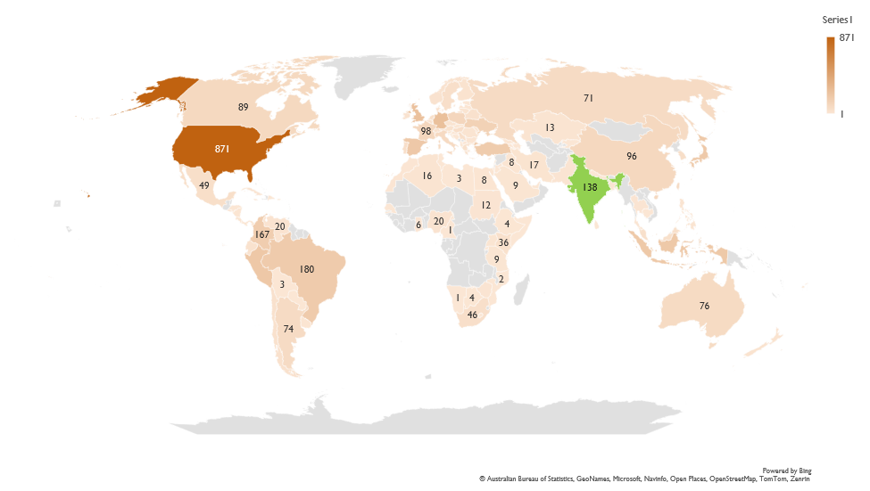
Growth of Institutional Repositories in India (138 repositories)
Source: ROAR, as on 17th September 2025

Slide 37
Open Access is also picking Momentum in India
Source: Scopus, as of 17st September 2025

Slide 38
Open Access Total Publications at IIT Delhi (14.95% of total publications are OA)
Source: Scopus, as of 17st September 2025

Slide 39
Growth of Open Access Journals in India
Source: DOAJ, as of 17st September 2025

Slide 40

Open Access Engagement at IIT Delhi
Building and maintaining open access institutional repositories to provide self-storage service
Raising awareness of open access among researchers and advocate for their participation
Publishing open access journals and providing open publishing services
Providing information support on open access resources
Assisting researchers to understand funders and publishers’ policies related to open access
Funding for open access work efforts
Digitizing historical collections and providing open access
Participating in the development of open access policies
Managing and monitoring the institute’s APC fees
Supporting the management of authors’ rights

Slide 41
Open Access Publishing
Awareness of open-access publishing modules of publishers and their APC information.
Read and Publish / Subscribe to open (S2O) agreements with publishers
Reduction of Open Access and Article Processing Fees for the reputed journals
Developing funding mechanisms for Open Access Publications
Changing publication models
National and international data sharing portals
Developing a unified social scientific media
Dissipation of scientific information through genuine social media handles

Slide 42
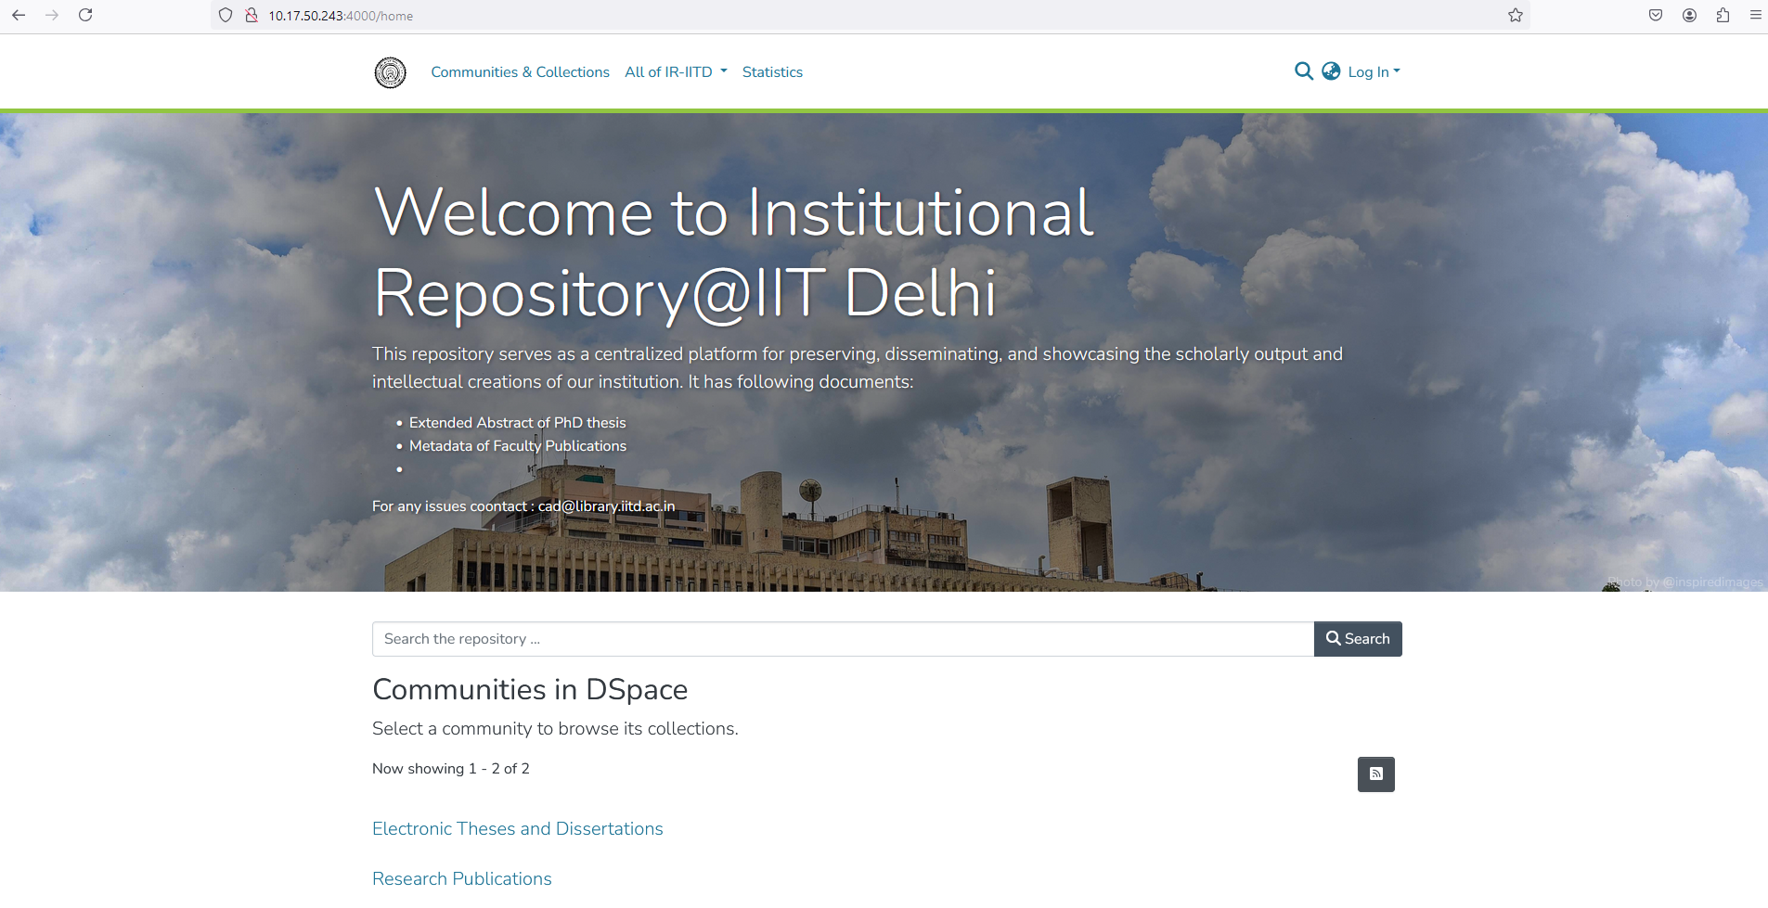
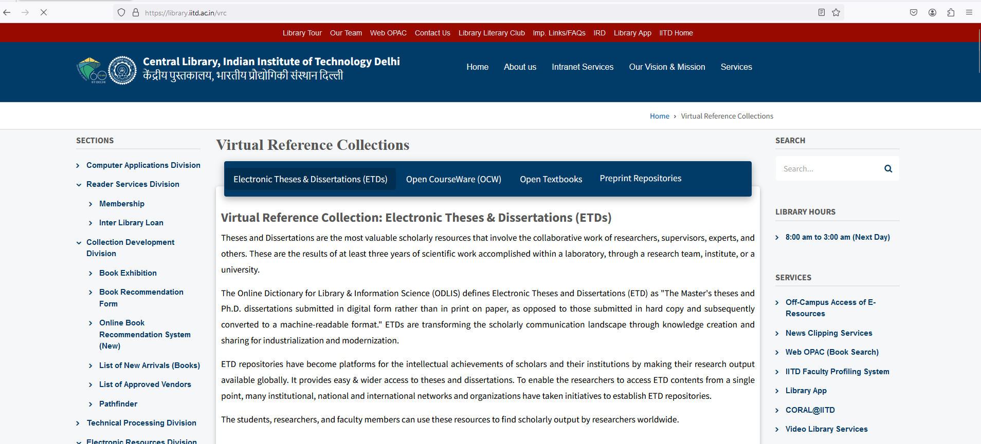
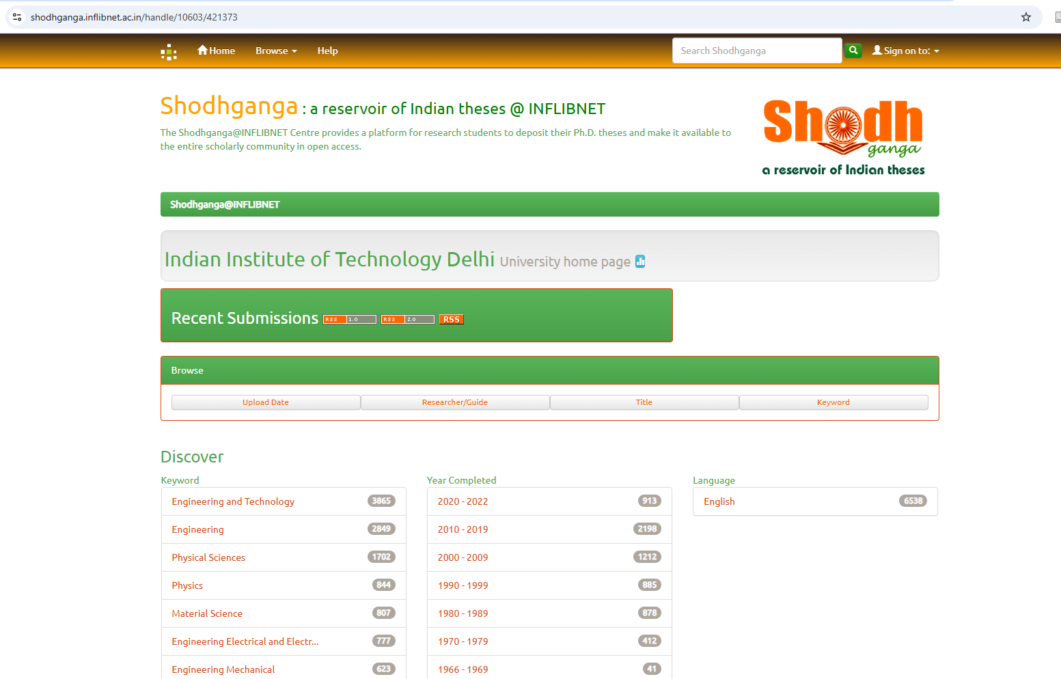
Open Access Publishing Services
Transformative agreements or Read and Publish with Cambridge University Press and APC waiver on publications by IIT Delhi.
Institutional Repository with DSpace 8
Uploading the Ph. D. theses of IIT Delhi into Shodhganga, a national-level digital repository of Indian Electronic Theses and Dissertations (ETD).
Regular outreach activities on open access resources, open access solution, open access publishing, author workshops, etc.
Promotion of open access resources such as Virtual Reference Collection <https://library.iitd.ac.in/vrc>

Slide 43
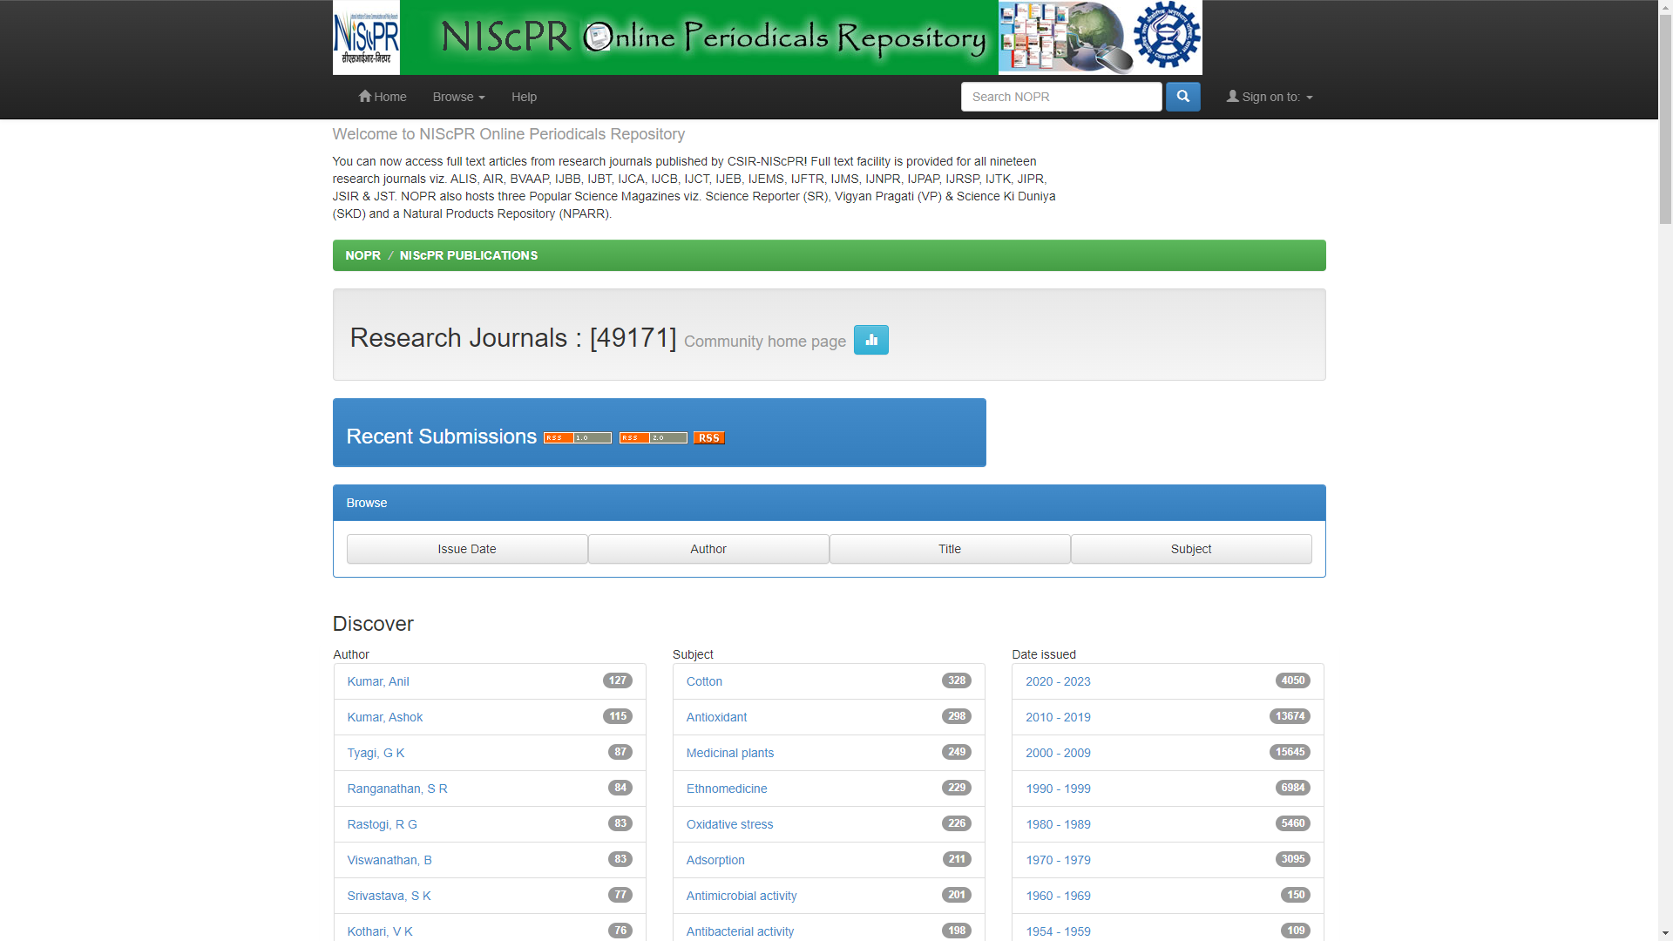
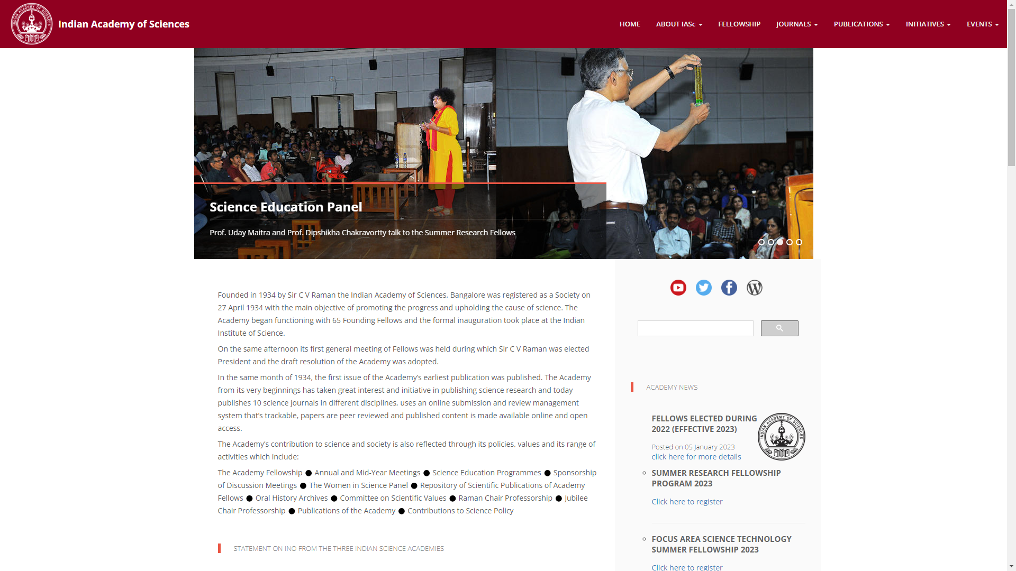
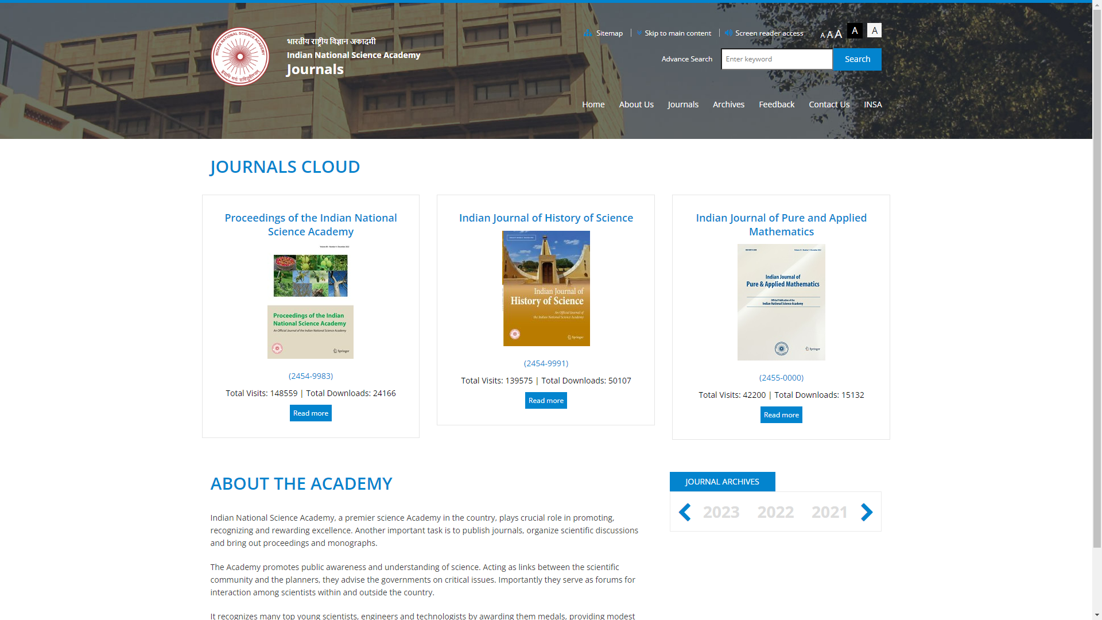
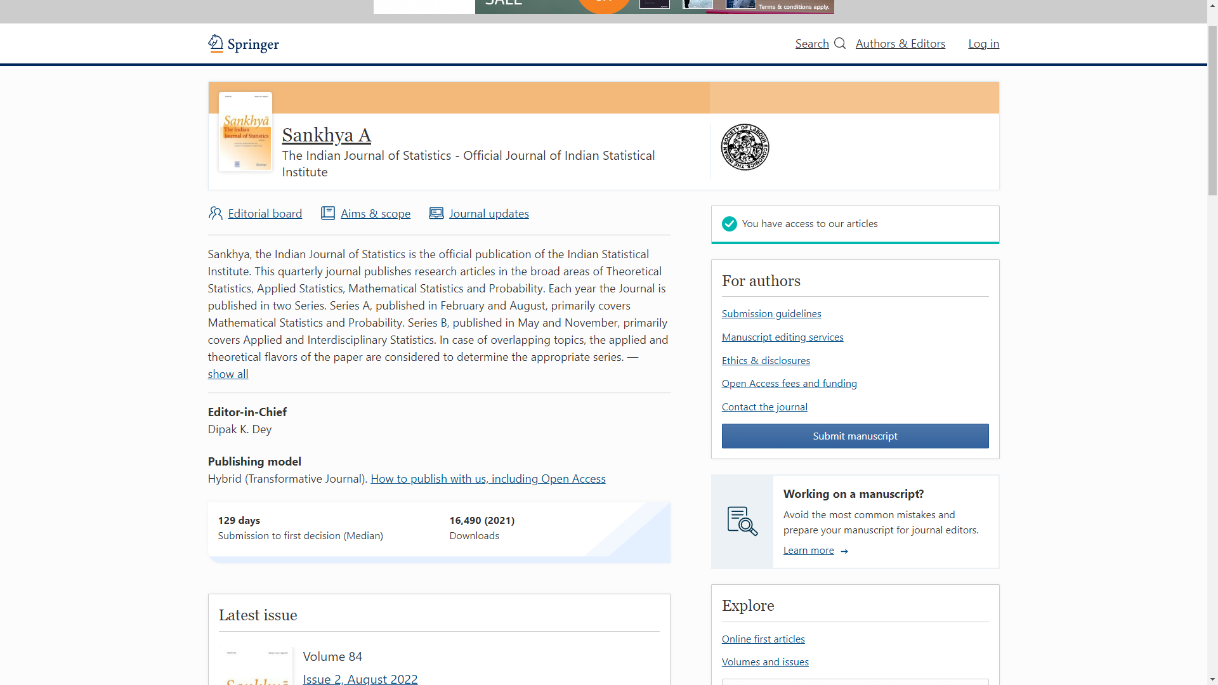
Open Access Journals in India

Slide 44
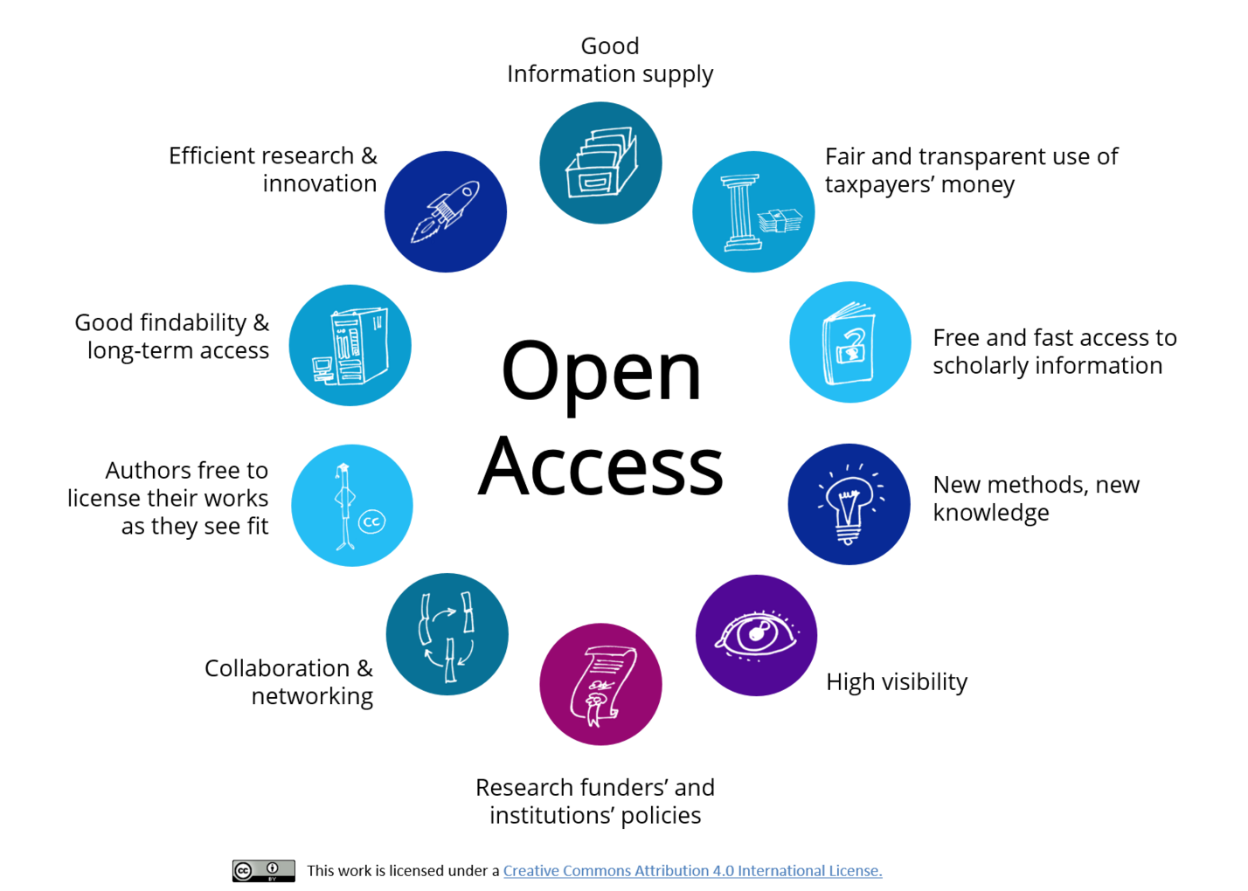
The Reasons for Open Access
Source: Brinken, H. (2021). 10 Gründe für Open Access

Slide 45
Alternative Open Access Modules
Non-Commercial Models:- Non-commercial approaches for scientific publications by publishers
Federal Publisher Model:- Federal government or agencies which are responsible for the funding of research can adopt a publisher route and keep them open and free to publish, read and download.
One Nation One Subscription model: - Government negotiates a subscription fee on behalf of the individual institutions and ensures access to scientific publications to all citizens including concessions on Article Processing Charges (APCs) for open access publications.
An OTT-type subscription model: - Small subscription charge-based models like OTT (over-the-top) entertainment platforms.

Slide 46

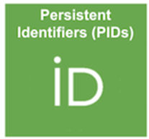

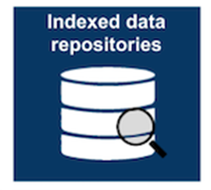
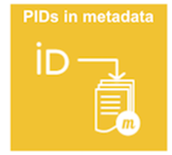

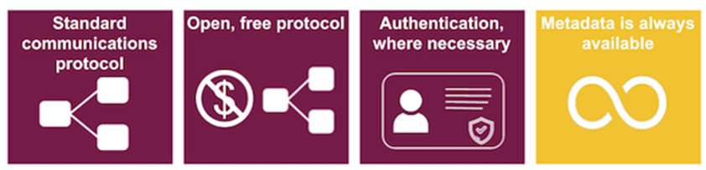

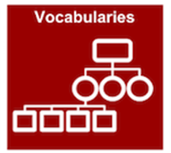

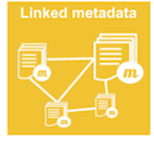

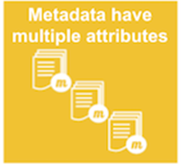
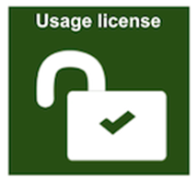
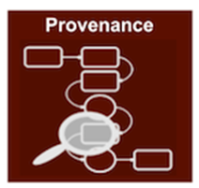
FAIR Open Data
Source: The FAIR-principles | Staff Portal. (n.d.). Retrieved 25 June 2024, from https://staff.ki.se/research-support/research-data-management/plan-your-research-data-management/the-fair-principles

Slide 47



Research Data Management
Allows easy access
& sharing
Enhances visibility of research data
Helps in data management of an individual researcher/institute
Data Citation
Funding agencies mandatory requirement
Avoid duplication
of research work
Validation of Research Results
Data Availability Statement by Publishers
Value for reuse

Slide 48
Building a Trustworthy Research Data Repository
A data repository (also referred to as a research data repository) is a searchable interface that allows the storage, management, maintenance, and curation of data.
Data repositories are tools for sharing and preserving research data.
Provides a platform for the data to be accessible, discoverable and citable.
Provide long-term access to Research Data.
A repository contains data sets and their description (metadata).
A data repository is a system or service where researchers can deposit their research data.
It provides embargo arrangements to control data access
Repositories may be called data centres, data archives, or scientific databases.

Slide 49
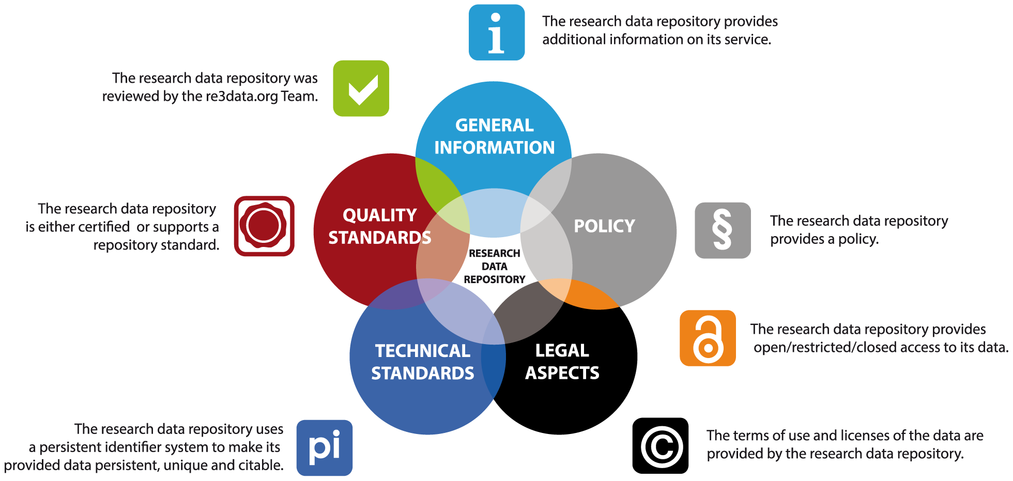
TRUST Principles for Data Repositories
Source: Pampel H, Vierkant P, Scholze F, Bertelmann R, Kindling M, et al. (2013) Making Research Data Repositories Visible: The re3data.org Registry. PLoS ONE 8(11): e78080.
Notes:
Data IRs serve the needs of researchers from across the institution, and so they host a variety of different data formats and types.
The services provided by Data IRs will naturally vary by institution; however, most Data IRs provide the following services:
Providing a Digital Object Identifier (DOI) or other globally unique, permanent and resolvable identifier so that research data is citable by others.
Enabling research data to be widely discoverable by ensuring they are indexed by search engines such as Google, Bing, etc.
Providing a means to link your data to the resulting paper.
Library staff to guide researchers in preparing and submitting research data to the Data IR

Slide 50




Finding Research Data Repositories
3
Creative Common Licenses
Notes:
Registry of Research Data Repositories Re3data is a registry of data repositories, covering a wide range of disciplines from around the world. It allows researchers to search for repositories in their discipline and to identify relevant polices and terms of use.
FAIRSharingCatalogFAIRSharingis a curated catalog of databases, along with associated standards and policies. It also includes standards and databases recommended by journal or funder data policies.
Scientific Data Recommended Repositories A list of disciplinary and open repositories evaluated to ensure that they meet the data access, preservation and stability requirements of Nature's Scientific Data journal.​

Slide 51












Research Data Repositories - Platforms
3
Creative Common Licenses

Slide 52








Research Data Repositories – Software (Selected)
3

Slide 53
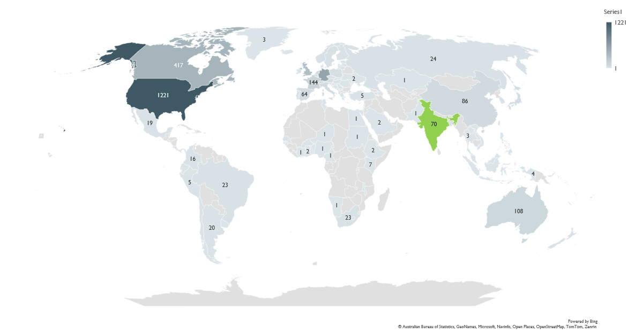
Open Research Data Repositories
Source: Re3data.org as on 17 September 2025

Slide 54
Development of Open Research Data Repositories in India
Development of interoperability repositories network
Development of data policy at the institutional level
Creating awareness, openness practical and benefits of repositories
Implementation of FAIR open data repositories
Establish a robust data curation process in Repositories
Preparation for data curation
Understanding the need for data curation
Data receiving and acquisition
Data cleaning and appraisal
Data documentation and metadata
Long-term data preservation
Data publishing in the repository
Data access and reuse
Re-evaluation of data and Troubleshooting
Analyzing data usage
National level or centralized data repositories
Institutional data repositories
Ministries / higher education Department data repositories
Disciplined data repositories

Slide 55
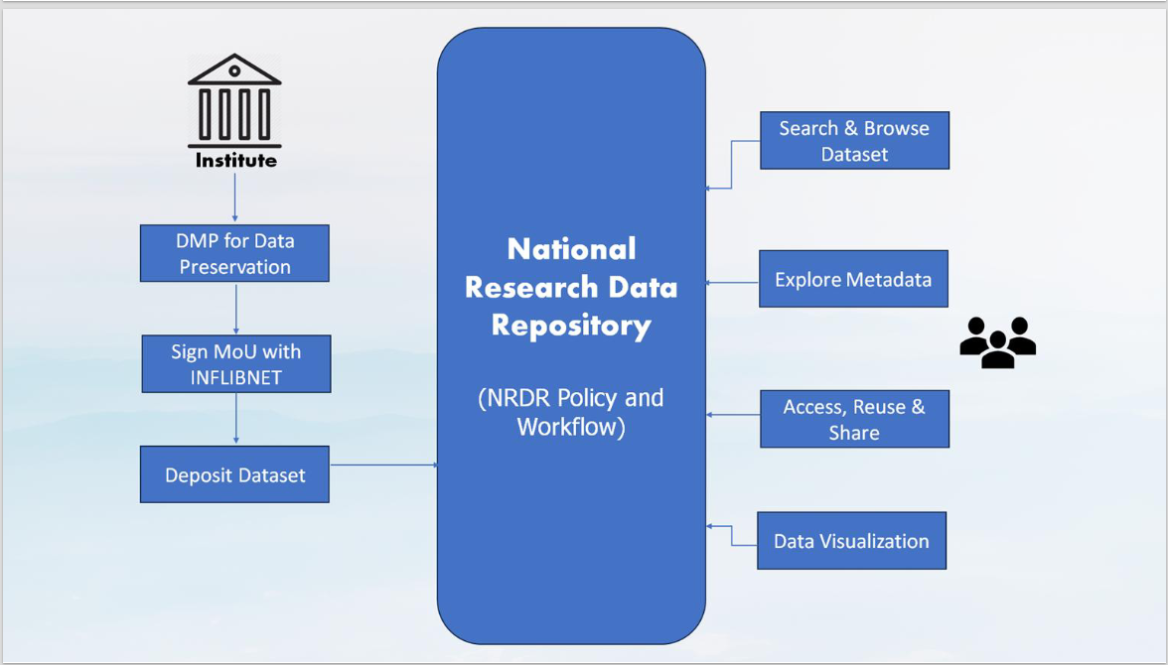
National Research Data Repository, An Initiative by INFLIBNET Centre
The National Research Data Repository (NRDR) is a centralized platform for managing, storing, and sharing research data.
It allows institutions to create a Parent Dataverse, customize their home page, and organize data through Sub-Dataverses.
Researchers can submit metadata and deposit datasets in various formats like CSV, TSV, RData, and SPSS.
NRDR also provides usage statistics and COUNTER reports to track dataset engagement.

Slide 56
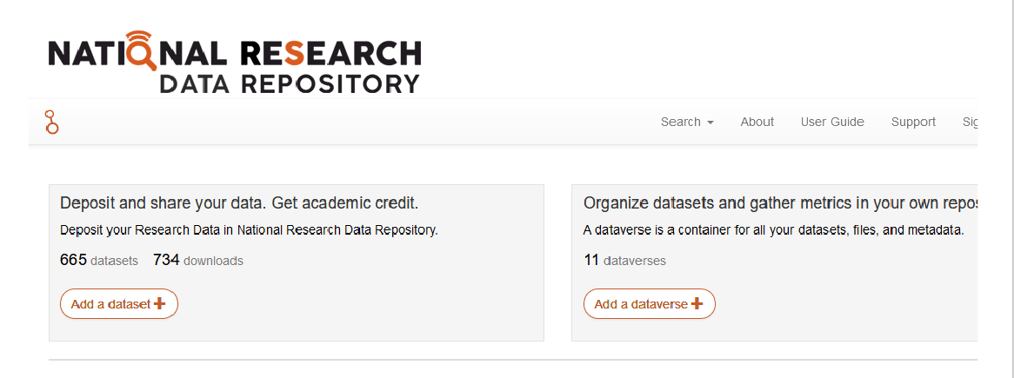
National Research Data Repository, An Initiative by INFLIBNET Centre

Slide 57
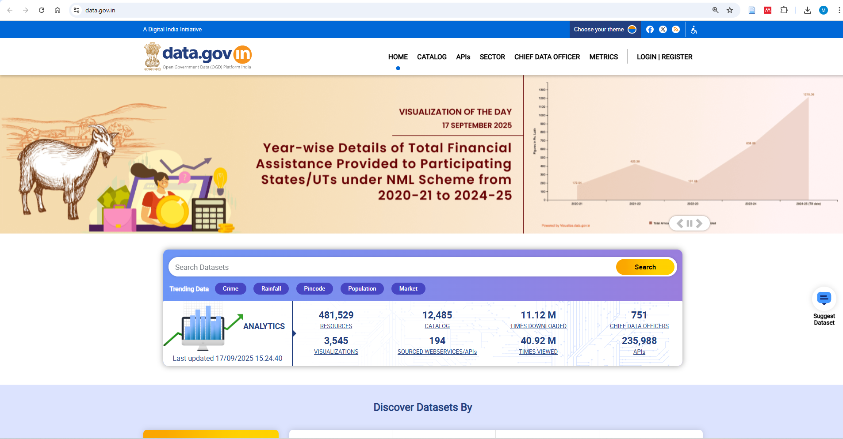
Data.gov.in

Slide 58
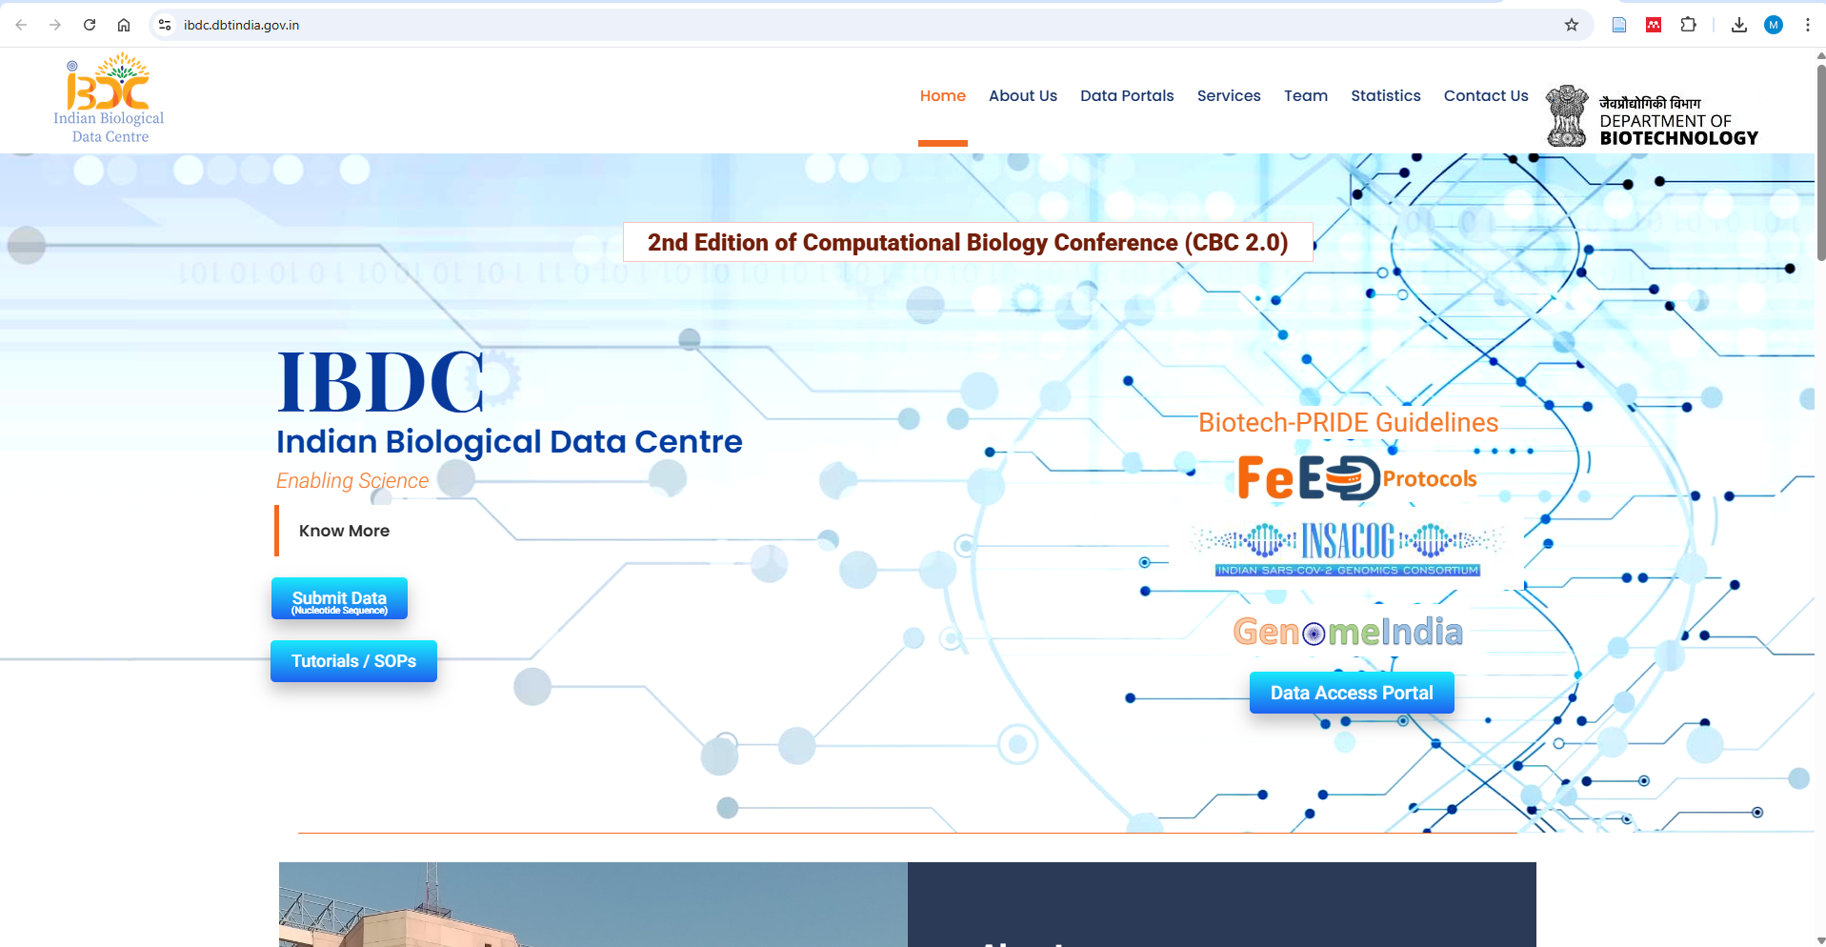
Indian Biological Data Center (IBDC)

Slide 59
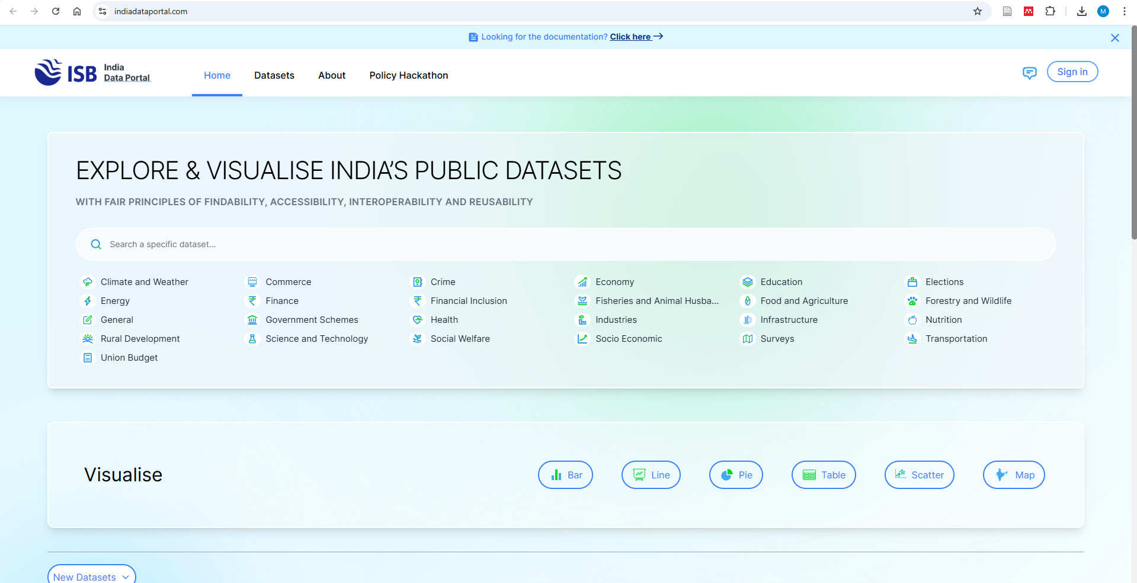
India Data Portal

Slide 60

India Data Portal

Slide 61

ISRO's Geoportal | Gateway to Indian Earth Observation

Slide 62
Promotion of Preprints Repositories/Archives
Preprint server allows immediate sharing of research results and can provide quick feedback to help in the revision and preparation of a manuscript. It facilitates wide and free dissemination of research.
Preprints are seldom considered as part of research assessment frameworks.
A preprint is a scholarly manuscript posted by the author(s) to a repository or platform to facilitate open review.
It assists in improving researchers’ work through the feedback they get from their peers.
Preprints are indexed in search engines like Scopus, Google Scholar, Dimensions, Lens, OSF preprints, etc. (Scopus Indexed Preprints arXiv; ChemRxiv; bioRxiv; medRxiv; SSRN; TechRxiv; Research Square)
authors post their paper under a Creative Commons license which allows reproduction and reuse of the material if attribution is given to the original authors.

Slide 63

IIT Delhi Preprints indexed by Scopus.
Notes:
IIT Delhi Preprints indexed by Scopus.

Slide 64

Promotion of Preprints Repositories/ Archives
Source: Hettne, K. (2021, October 27). A Practical Guide to Preprints: Accelerating Scholarly Communication
Notes:
These are some of the popular globally available Preprint Repositories in different domains.
Scooping risk: Risk of someone copying the contents and publishing with his/her Mostly there are benefits, but there are challenges as well while using the Preprint Servers
me (academic or research risk).

Slide 65





Preprint Repositories in India

Slide 66

Celebration of International Open Access Week
International Open Access Week is a global, community-driven week of action to open up access to research.
The way to increase the visibility of open access among scientists, researchers, librarians, university faculty members, and students.
An opportunity to learn about the benefits of Open Access and its implications.
Key opportunity for the higher education community and the general public to understand more clearly the opportunities of wider access and use of content.
https://www.openaccessweek.org/

Slide 67


OAW @ IIT Delhi
Involvement of faculty members and research scholars.
Creating Awareness of Open Access through Presentations.
Poster display & poster presentations on open-access resources, open-access publishing & licensing modules.
The theme for OAW 2024, is “Community over Commercialization” and prioritizes approaches to open scholarship that serve the best interests of the public and the academic community.

Slide 68
Implementing Responsible Research Assessment in India
Towards Responsible Research Assessment (RRA).
Shifting from quantity to quality-based assessment.
Recognizing diverse research outputs beyond journal articles.
Training assessors to apply fair evaluation practices.
Increasing and strategically aligning research funding.
Reforming hashtag #NIRF
Responsible use of international university ranking frameworks.
https://sfdora.org/2025/06/17/rra-in-india-2/
Notes:
https://sfdora.org/2025/06/17/rra-in-india-2/

Slide 69
Benefits Open Science
Increasing the impact and visibility of research outcomes
Ensuring validation, reproducibility and reusability of research results
Avoiding duplication of work through reusing scientific results
Accelerating knowledge sharing, findability and permanent access to research information
Increasing (interdisciplinary) scientific discourse and widening cooperation
Supporting the recognition of new/alternative research assessment criteria
Safe costs and minimising efforts due to no licencing fees and the freedom to reuse research output
Meeting the requirements of research funding agencies and research assessment criteria
Providing valuable resources for learning and skills development
Enhancing science- and knowledge-based decision making
Promoting the public good and democratising access to scientific knowledge and output

Slide 70
Challenges in Adopting Open Science
Developing an open science ‘mindset’
Lack of skills and competencies
Quality issues—concerns with predatory publications
Subscription-based access of resources
Publication inequality
Publication biases—How to encourage researchers to share all outcomes
Notes:
Open mindset:
Inner attitude towards transparency and cooperation
Willingness to contribute and share with others
Responsibility and sensitivity for societal needs and well-founded decision making
Adaptational skills
Critical mind and willingness for discourse
Openness towards the cultural change in research and research assessment criteria

Slide 71
India vs. USA: Comparative Snapshot
Policy Drivers: India – STIP 2020, ONOS, NDSAP | USA – OSTP 2022 Memo, NIH OA Policy, FAIR Principles
Repositories: India – Shodhganga, NDLI, KrishiKosh, IBDC | USA – PubMed Central, Dryad, Dataverse, NIH Repositories
OA Share: India ~23% (WoS), ~20% (Scopus) | USA – Higher OA compliance by 2026
Strengths: India – Democratization, accessibility, national consortia | USA – Transparency, innovation, strong infrastructure
Challenges: India – Funding, awareness, repository sustainability | USA – Equity, APC costs, cultural adoption

Slide 72
Role of Libraries & Leaders in Open Science
Advocacy & Awareness → Promoting open access policies, FAIR data, author rights.
Infrastructure & Repositories → Building/maintaining IRs, negotiating transformative agreements.
Global Collaboration → Cross-border knowledge exchange, supporting equitable access.
Closing: India prioritizes democratization, the US emphasizes transparency — together, these models strengthen the global open science ecosystem.

Slide 73
Conclusion
India has taken a bold step to adopt open science with several initiatives
Strengthening India's open-access publishing model with ONOS
Changing research evaluation metrics
Encouraging data sharing and collaboration
The global academic community is moving rapidly toward collaborative, transparent, and publicly accessible research.
ONOS provides India with a rare opportunity to leapfrog traditional barriers and position itself as a leader in open science rather than a passive participant in the existing system
India must become an active contributor to the open science movement.
3
Creative Common Licenses

Slide 74
Disclaimer/Acknowledgements
The Presentation/Lecture has been prepared from different resources to help the attendees understand the topic for academic and research use.
I duly acknowledge the scholars and the website content providers whose materials have been used in my presentation/lecture.
3
Creative Common Licenses

Slide 75

Thank You, IITD
nabihasan@gmail.com
http://web.iitd.ac.in/~hasan

