Slide 1
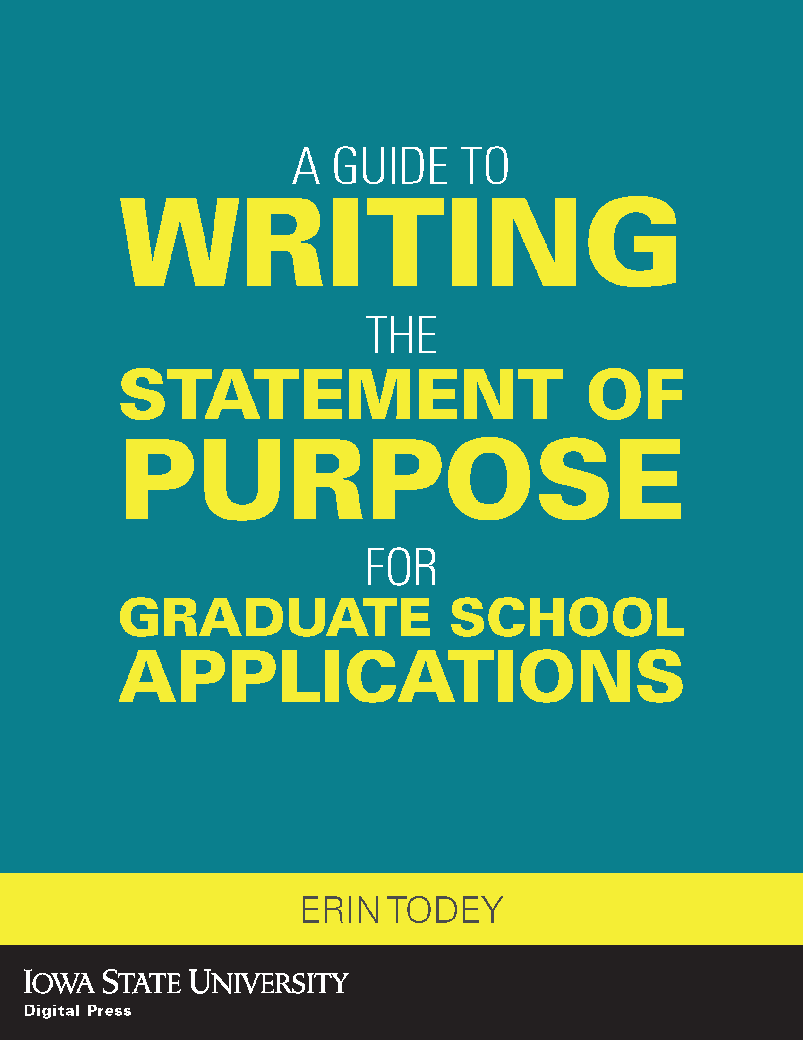
https://www.iastatedigitalpress.com/plugins/books/199/
This book guides applicants through writing the statement of purpose (SoP) for graduate school applications. It discusses the conventions and expectations of the SoP and the writing process, and includes example SoPs written by students who have been accepted into a graduate program as models.

Slide 2
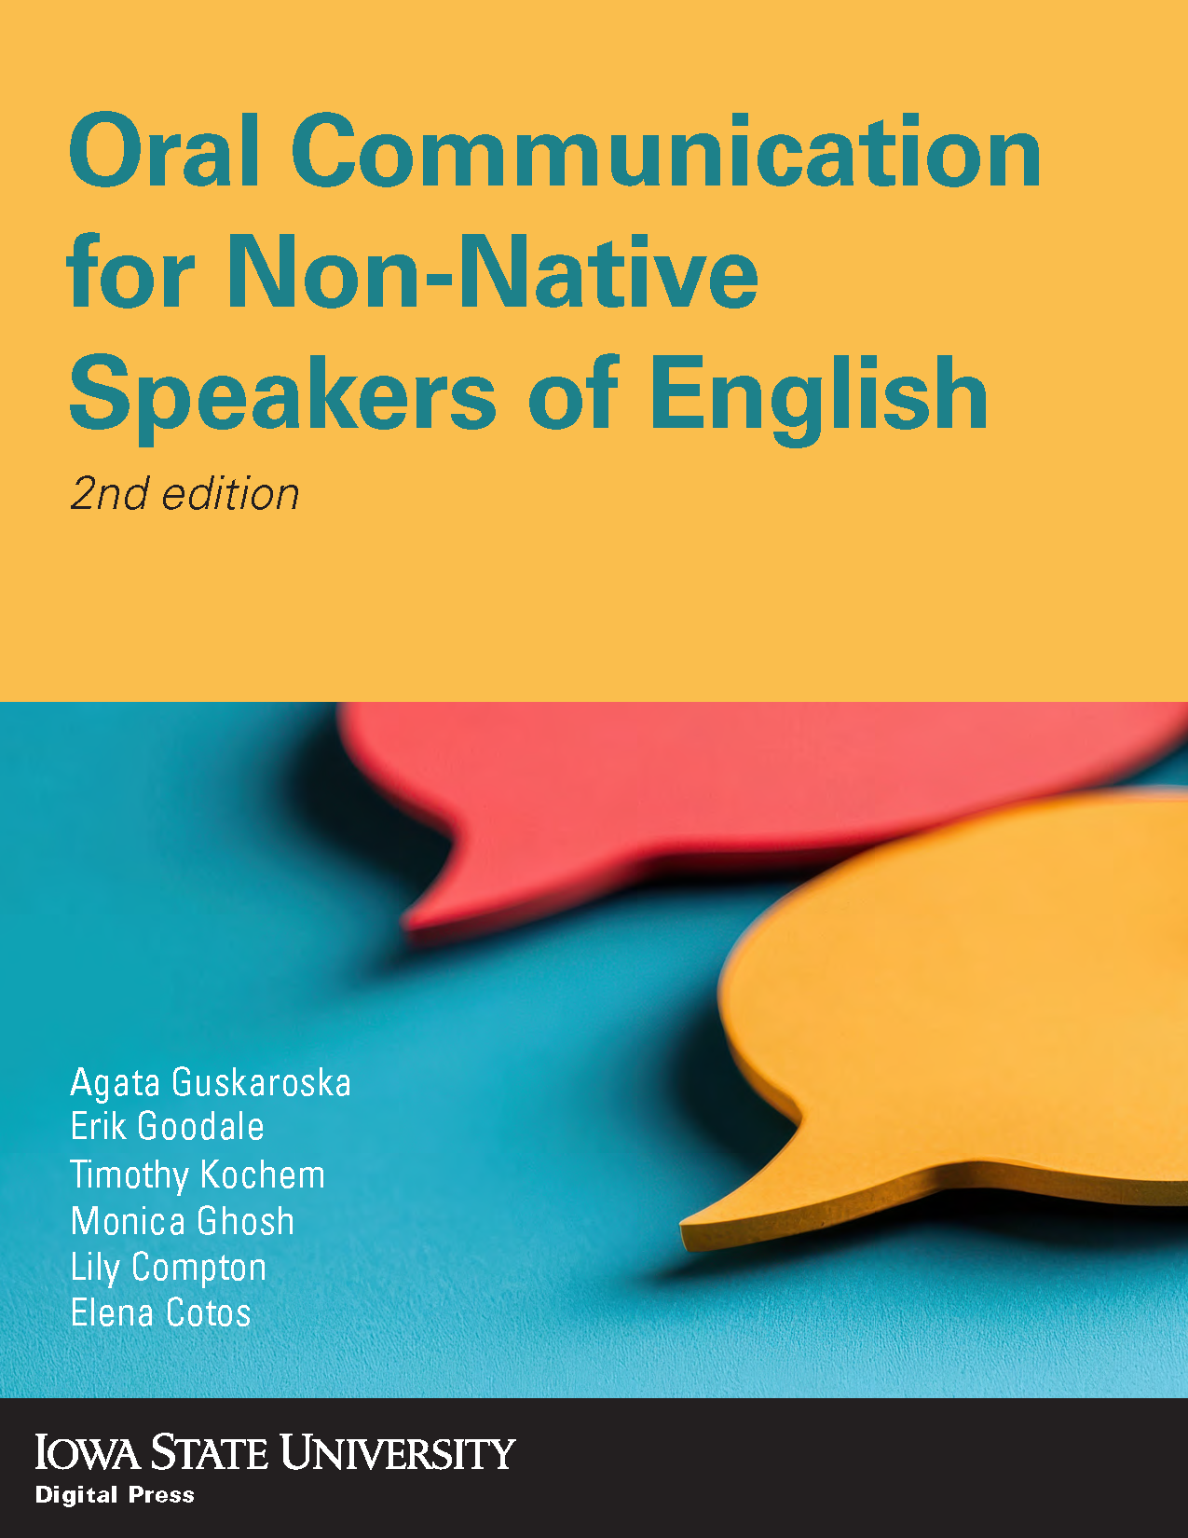
https://www.iastatedigitalpress.com/plugins/books/163/
This book is an essential instructional tool for developing oral communication skills in academic settings, specifically designed for international graduate students, teaching assistants, postdoctoral researchers, and those preparing to enter academia. The second edition introduces dedicated chapters on developing effective pronunciation, listening skills and speaking fluency. Through its wide array of interactive H5P activities, suitable for both classroom teaching and individual practice, learners can actively develop the skills needed for success in English-speaking academic environments.

Slide 3
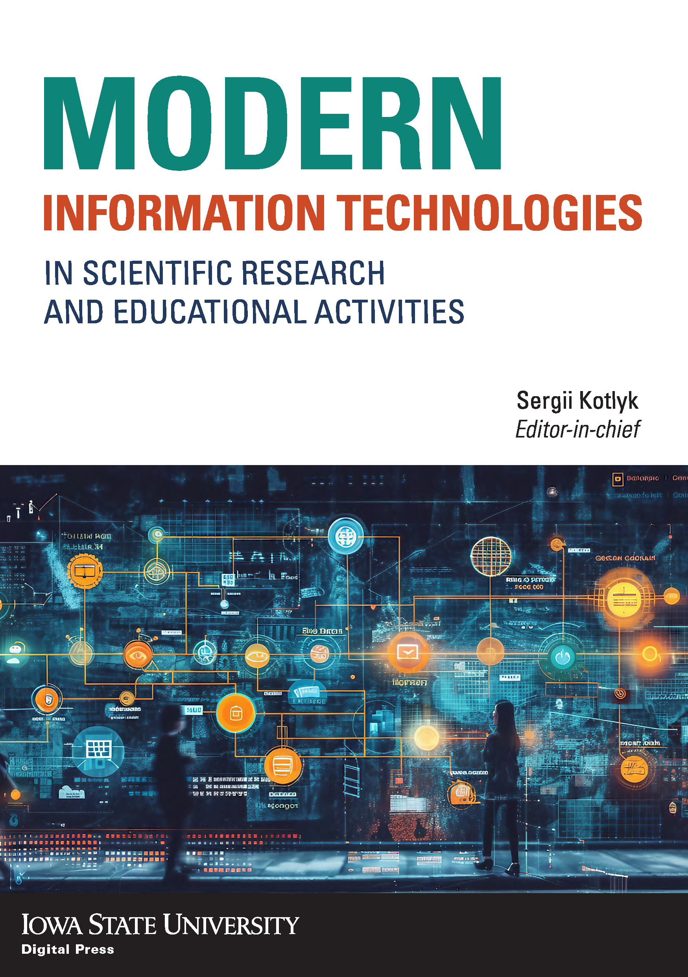
https://www.iastatedigitalpress.com/plugins/books/151/
The monograph summarizes and analyzes the current state of scientific research in the field of interactive artificial intelligence systems, text generation systems, diagnostics of the competitiveness of specialists, in the areas of correct color rendering in image formation, informatization of the work of graduate students, accessible technology for creating three-dimensional 3D models.
The monograph will be useful both to specialists and employees of companies working in the IT field, as well as teachers, masters, students and graduate students of higher educational institutions, as well as anyone interested in issues related to information technology
The monograph was compiled based on the results of the XVI international scientific and practical conference “Information technologies and automation — 2023”, which took place in October 2023 at Odessa National University of Technology

Slide 4
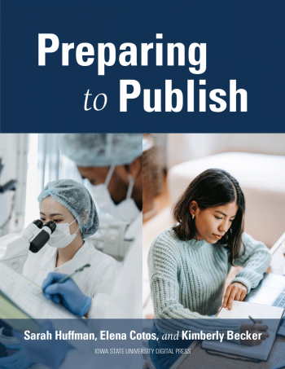
https://www.iastatedigitalpress.com/plugins/books/132/
This book offers a wealth of instructional material on the topic of research article writing for publication and thesis or dissertation completion. The text provides graduate student writers with helpful information, strategies, and tips on navigating disciplinary writing in their fields and how to understand, dissect, and ultimately, construct their own research article. The text is organized according to a standard research article format, breaking down each section of the empirical research in a simple and straightforward manner to help graduate students build a quality, argument-driven manuscript as they write up their empirical study findings.

Slide 5
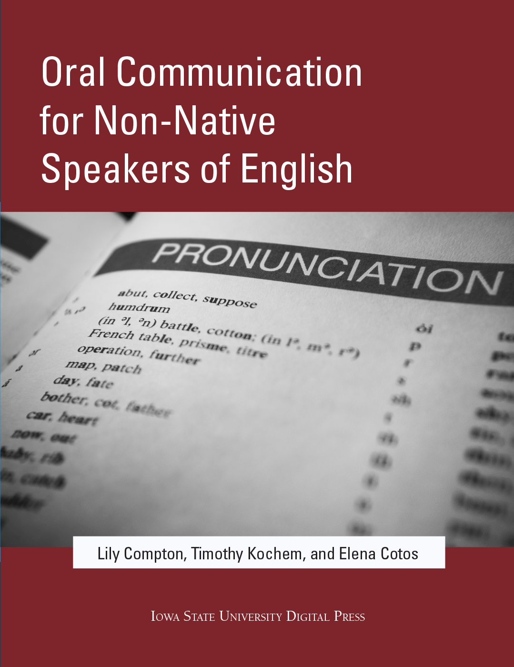
https://www.iastatedigitalpress.com/plugins/books/29/
This textbook includes materials on listening, speaking, lexicogrammar, pragmatics, and pronunciation.

Slide 6
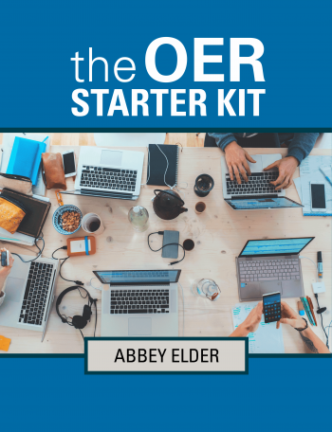
https://www.iastatedigitalpress.com/plugins/books/139/
This starter kit has been created to provide instructors with an introduction to the use and creation of open educational resources (OER). The text is broken into five sections: Getting Started, Copyright, Finding OER, Teaching with OER, and Creating OER. Although some chapters contain more advanced content, the starter kit is primarily intended for users who are entirely new to Open Education.

