Slide 1

National ETD Repositories of G20 Countries in Relation to NDLTD's Global ETD Metadata Repository
Dr. Sukanta Kumar Patra
Librarian
VIDYASAGAR COLLEGE FOR WOMEN
Kolkata , West Bengal , India

Slide 2
Research Abstract
Open Access Growth
Quality Assurance
Research Transformation
Electronic Theses and Dissertations on open access platforms significantly enhance research services and global knowledge accessibility
PhD awards now mandate plagiarism and similarity reports, ensuring academic integrity and research authenticity
ETDs effectively convert hidden research into explored, discoverable scholarly contributions for the global academic community

Slide 3
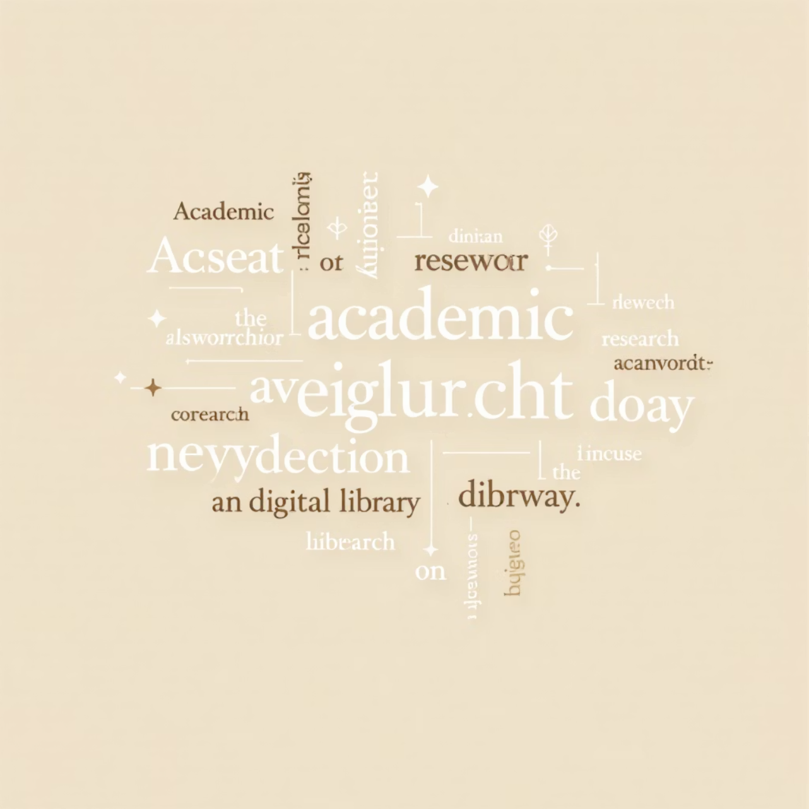
Key Research Terms
Electronic Theses and Dissertations (ETD)
Digital scholarly works submitted for academic degrees
Shodhganga
India's national digital repository platform
G20 Countries
Major economies driving global research initiatives
NDLTD
Networked Digital Library of Theses and Dissertations

Slide 4




Research Foundation
Information as Development Driver
Information serves as the cornerstone for socio-economic development across nations and academic institutions
Research Integration
Research repositories systematically integrate and organise scholarly output for enhanced discoverability
Stakeholder Benefits
Essential resources for researchers, librarians, and academicians pursuing advanced scholarly work

Slide 5



Global Context and Alignment
G20 Summit 2023 Theme
Strategic Alignment
"One Earth, One Family, One Future"
Perfectly aligned with United Nations 2030 Sustainable
Development Goals framework

Slide 6
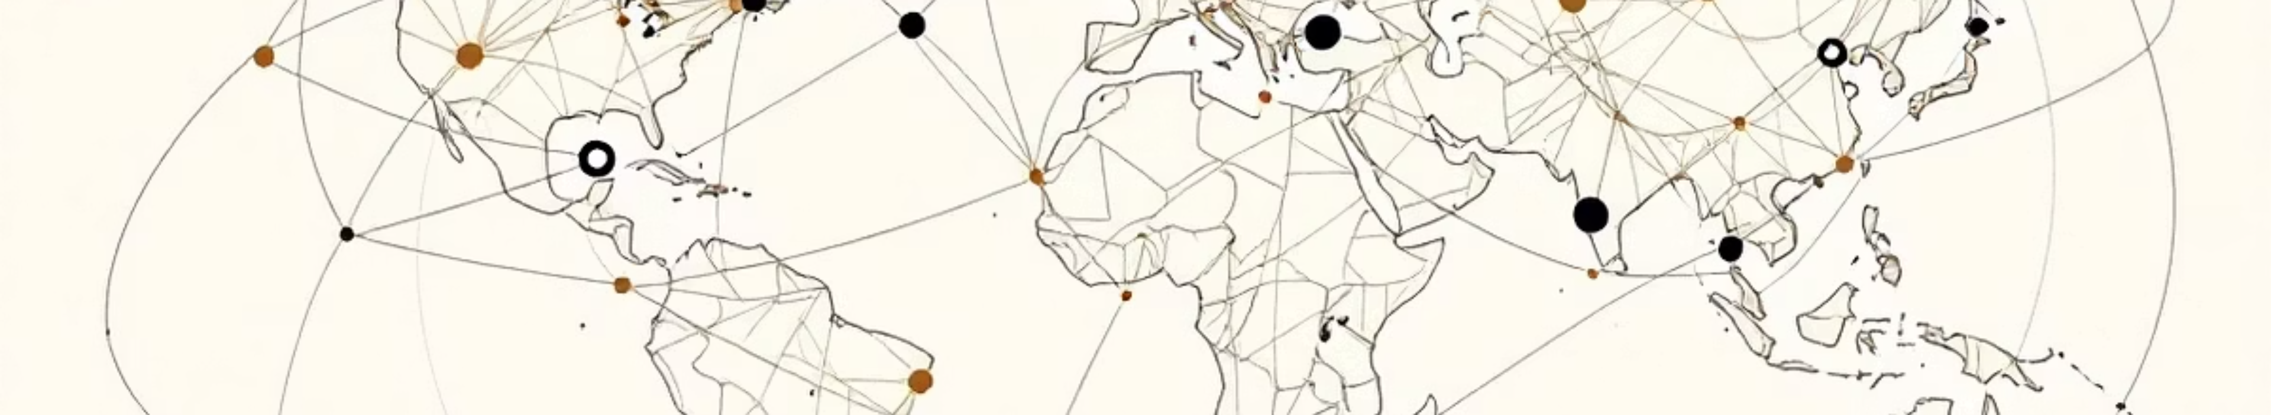
Primary Research Objective
Connection Discovery
Global ETDs & G20 Integration
To identify and analyse the strategic connections between Global Electronic Theses and Dissertations repositories and G20 member countries' national research infrastructure

Slide 7


Secondary Research Objectives
Global Context Analysis
To comprehensively analyse the importance and impact of Electronic Theses and Dissertations within the broader global research ecosystem
Comparative Assessment
To systematically compare ETD initiatives across G20 countries with established NDLTD repository standards and best practices

Slide 8
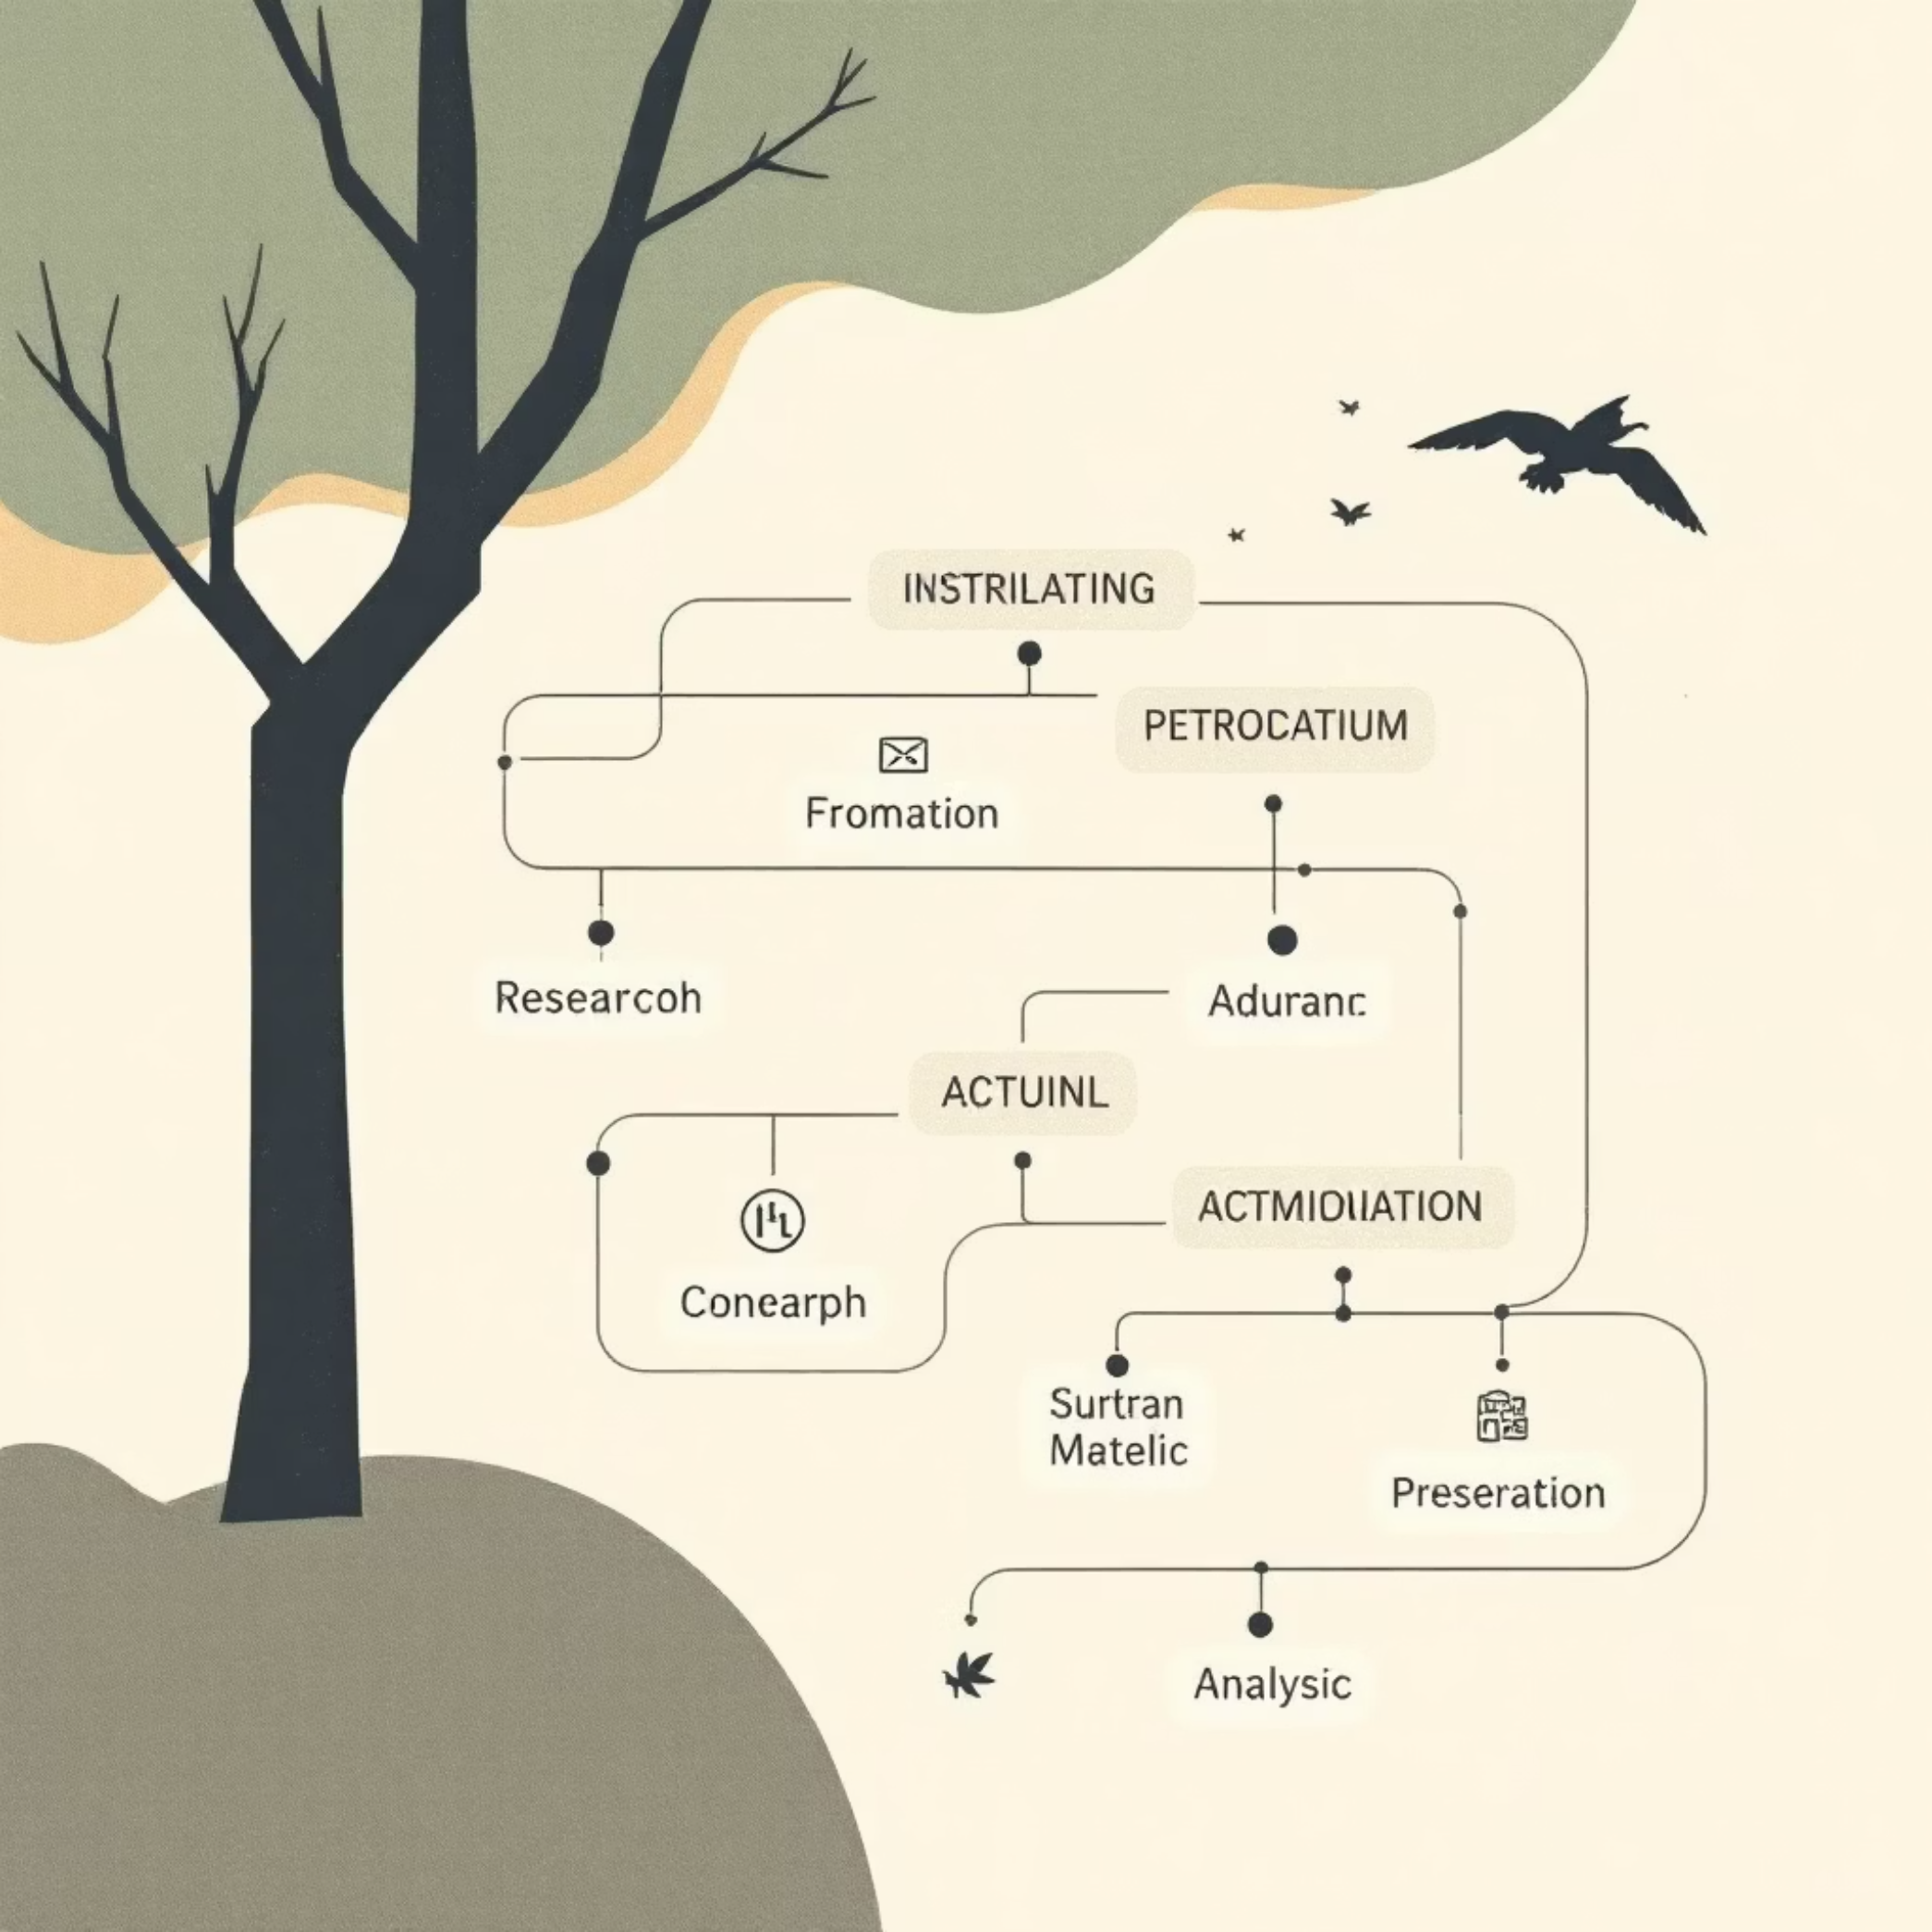
Research Methodology
01
Webometric Analysis
Systematic evaluation of digital repository metrics
02
Quantitative Data Analysis
Statistical examination of ETD repository data
03
Sample Selection
G20 national repositories as primary data sources

Slide 9








NDLTD Global Participation
Twenty G20 countries actively participate in the NDLTD global open access movement, contributing to worldwide scholarly knowledge sharing
Australia
Brazil
Germany
Canada
France
China
Additional participating nations include India, Italy, Japan, South Africa, United Kingdom, United States, and others

Slide 10



National ETD Repository Examples
Australia
Brazil
Canada
Trove
BDTD
Theses Canada
National digital repository providing comprehensive access to Australian research theses and dissertations
Biblioteca Digital Brasileira de Teses e Dissertações - Brazil's centralised thesis and dissertation portal
National repository collecting and preserving Canadian graduate research through digital archives

Slide 11
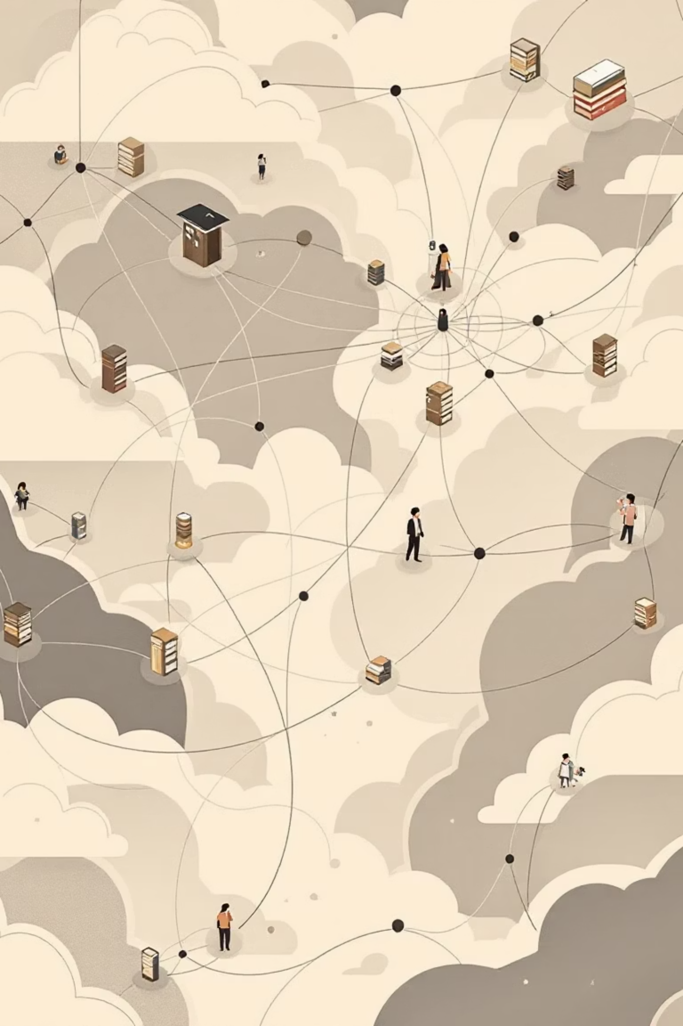
Global ETD Repository Landscape
Major international repositories showcase diverse approaches to Electronic Theses and Dissertations preservation and access across continents.
China
Doctoral Dissertations Database serves as the comprehensive national repository for Chinese doctoral research
France
Theses France provides centralised access to French doctoral dissertations with robust metadata standards
Germany
Deutsche Nationalbibliothek maintains rigorous quality control and long-term preservation protocols
India
Shodhganga represents India's commitment to open access scholarly
communication infrastructure

Slide 12
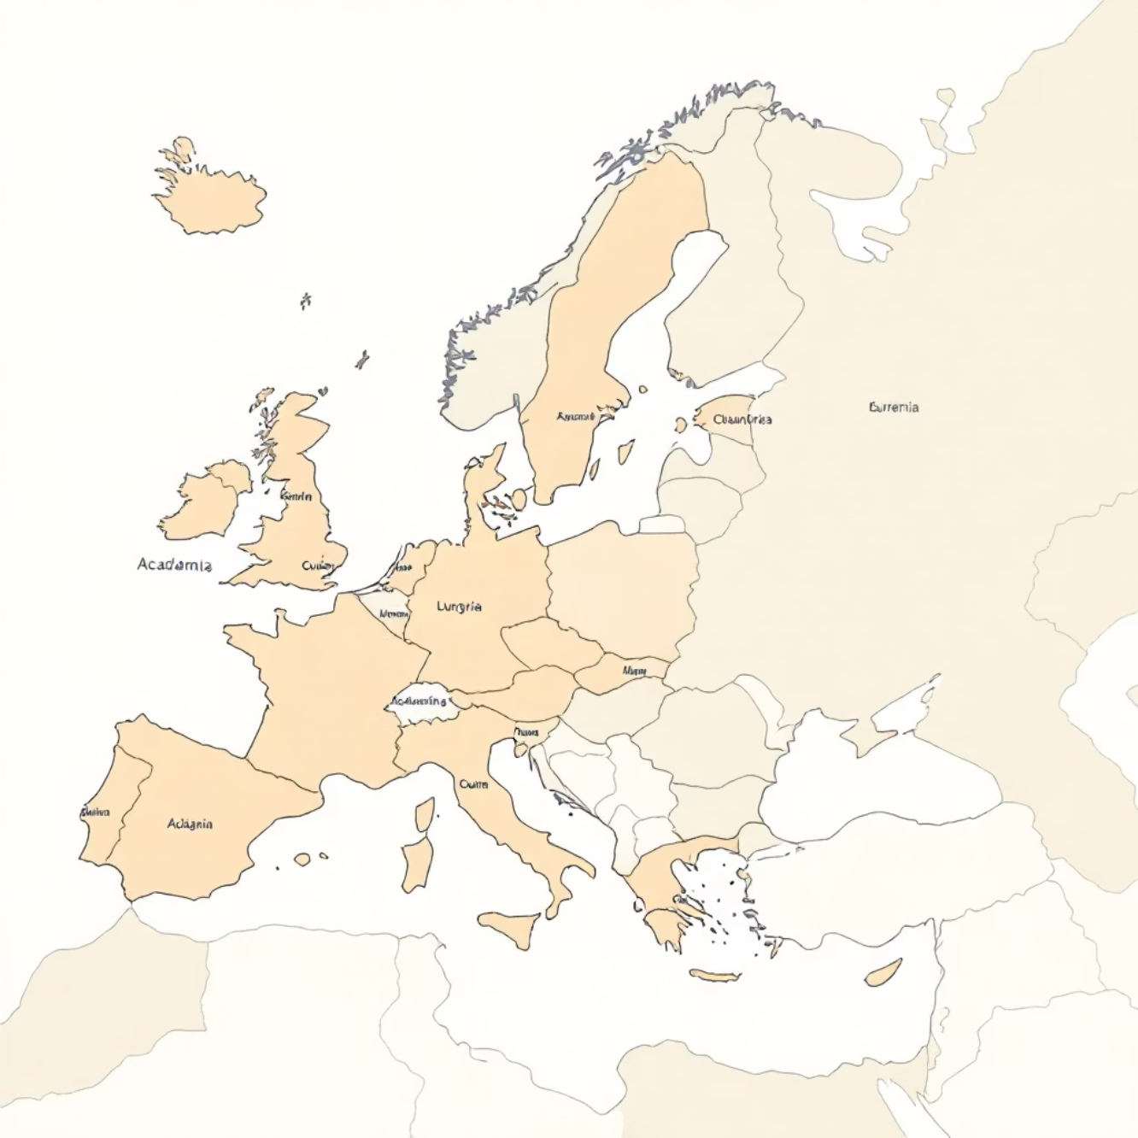







European Union ETD Contributions
DART-Europe Consortium
Seven EU nations collaborate through DART-Europe, creating a unified European approach to ETD management and discoverability.
Belgium
Finland
Ireland
Netherlands
Portugal
Spain
Sweden
France, Germany, and Italy maintain individual national repositories while contributing to broader European initiatives.

Slide 13
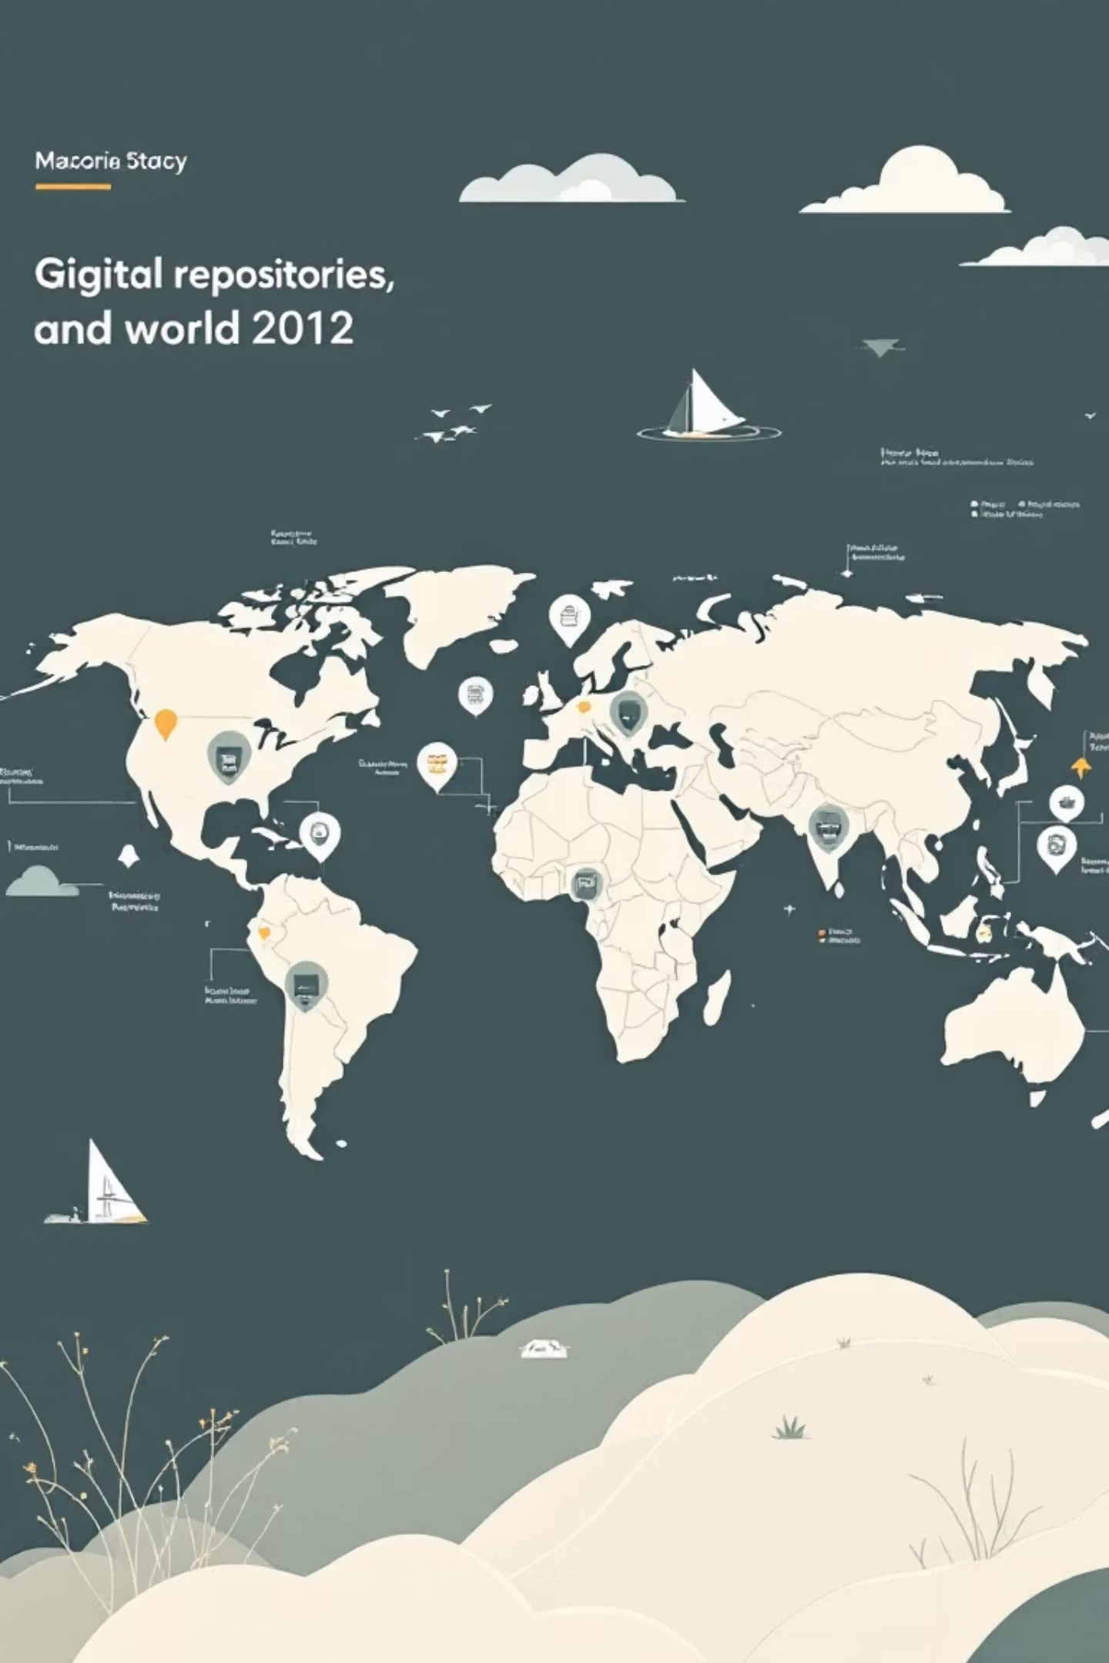




Worldwide ETD Network Expansion
The global ETD ecosystem extends far beyond traditional academic powerhouses, encompassing diverse regions and emerging scholarly communities.
Armenia
Developing national repository infrastructure with focus on regional language preservation
Bangladesh
Growing participation in South Asian academic collaboration networks
Latin America
Regional consortiums promoting Spanish and Portuguese language scholarship
Taiwan
Advanced digital infrastructure supporting multilingual academic content

Slide 14


G20 NDLTD Participation Gap
Only 13 of 20
G20 member nations actively participate in the Networked Digital Library of Theses and Dissertations, revealing significant gaps in
global scholarly collaboration.
65%
35%
G20 Participation Rate
Missing Opportunities
13 out of 20 member nations contribute to NDLTD infrastructure.
Seven major economies remain outside the collaborative network.
This participation gap represents missed opportunities for global knowledge sharing and academic collaboration among the world's largest
economies.

Slide 15
Non-Participating G20 Nations
Seven G20 members have yet to join the NDLTD collaborative framework, representing significant potential for network expansion.
Argentina
Indonesia
Latin America's second-largest economy with substantial research output
Southeast Asia's largest nation with rapidly growing higher education sector
Mexico
Russia
North America's third-largest country with extensive university system
Major research power with strong STEM and humanities traditions
Saudi Arabia
South Korea
Turkey
Gulf region leader investing heavily in research infrastructure
Technology powerhouse with world-class universities
Bridge between Europe and Asia with growing academic output

Slide 16

Leading ETD Contributors
The top three contributors demonstrate the scale and impact of national ETD initiatives in preserving scholarly knowledge.
1.5M
625K
600K
United States
Brazil
United Kingdom
Massive collection reflecting decades of digital repository development and comprehensive university participation
Latin America's largest contributor, showcasing strong institutional commitment to open access principles
Robust collection representing excellence in research supervision and digital preservation standards

Slide 17

Major European Contributions
European nations demonstrate strong commitment to scholarly preservation through substantial ETD collections.
82%
France
525,386 ETDs representing comprehensive national coverage
75%
India
483,399 ETDs showcasing multilingual scholarship
70%
China
450,000 ETDs from world's largest higher education system

Slide 18




Emerging ETD Powerhouses
Mid-tier contributors showcase diverse approaches to national ETD strategy and implementation across different continents.
Germany: 284,000
Canada: 200,000
Rigorous quality control and comprehensive metadata standards drive German ETD excellence
Bilingual repository infrastructure supporting French and English academic traditions
South Africa: 151,150
Leading African contributor with multilingual content representing diverse research communities

Slide 19
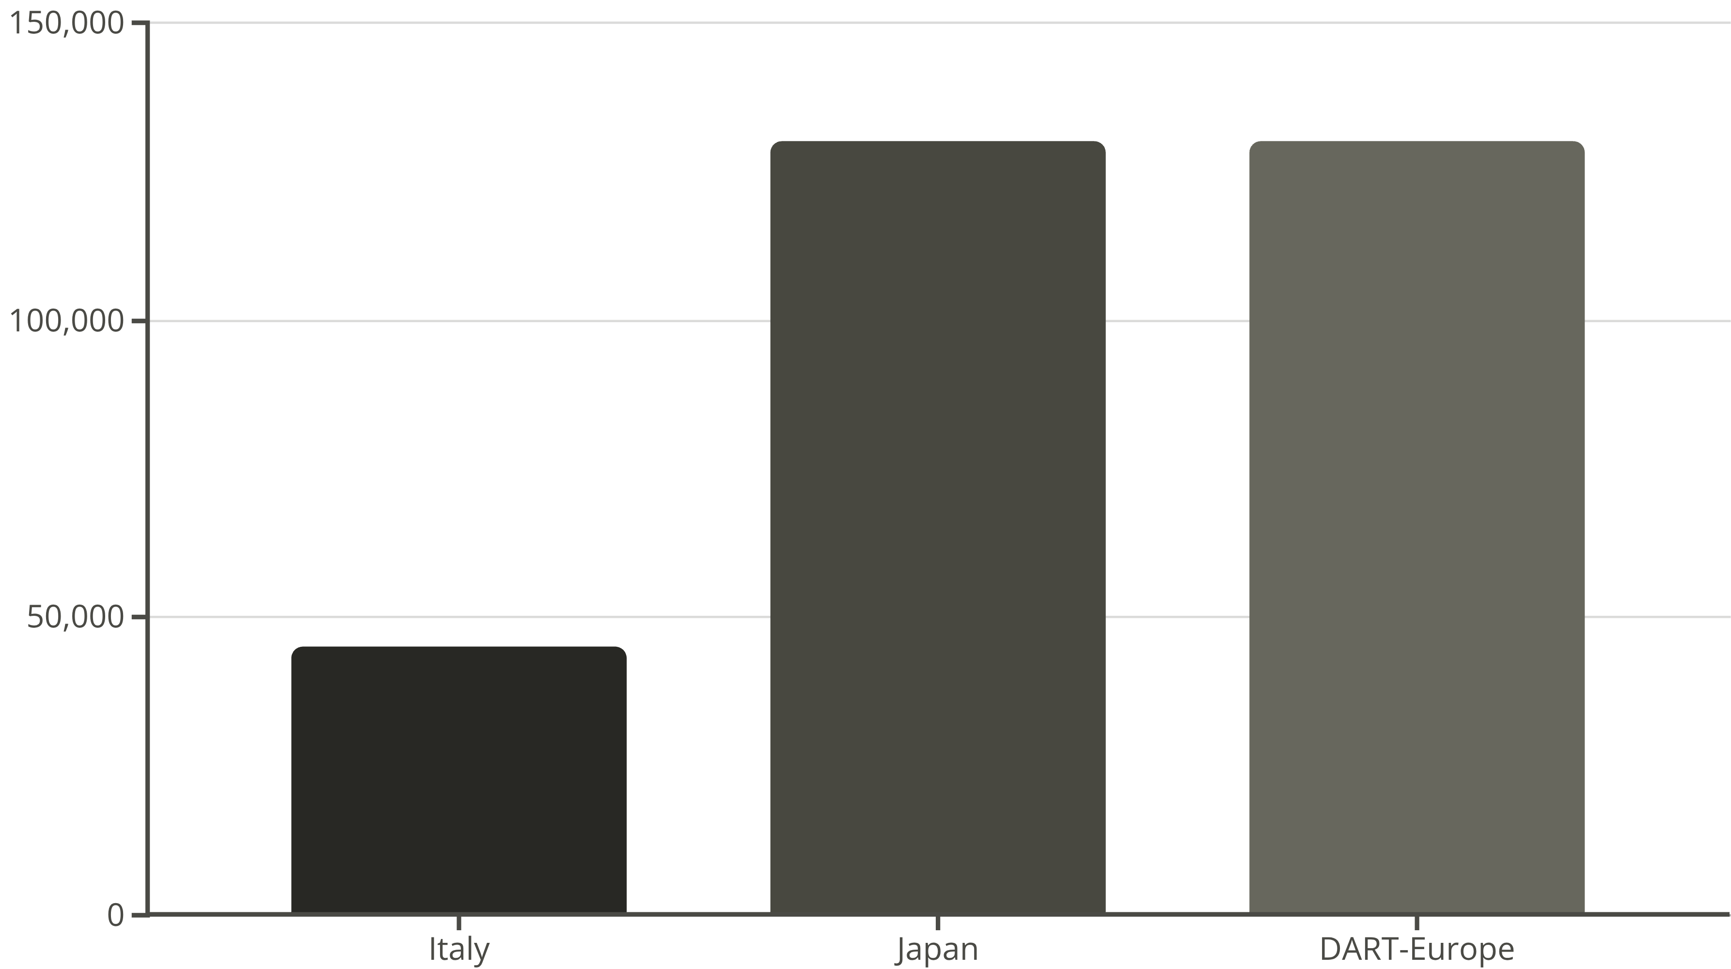
ETD Upload Distribution Analysis
Regional consortiums and individual nations demonstrate varying approaches to ETD collection
and preservation strategies.

Slide 20



NDLTD Global Impact
6.4 Million ETDs
The Networked Digital Library of Theses and Dissertations represents the world's largest collection of doctoral research, with G20 nations contributing the vast majority.
89%
G20 Contribution
5,713,224 ETDs from G20 member nations demonstrate the concentration of global research output
11%
Other Nations
726,664 ETDs from non-G20 countries showcase diverse global scholarship
This unprecedented collection preserves humanity's doctoral research heritage while enabling future discovery and innovation across disciplines.

Slide 21

G20 Dominance in Global ETD Repositories
Examining the overwhelming contribution of G20 nations to the world's electronic thesis and dissertation collections through comprehensive metadata analysis.

Slide 22
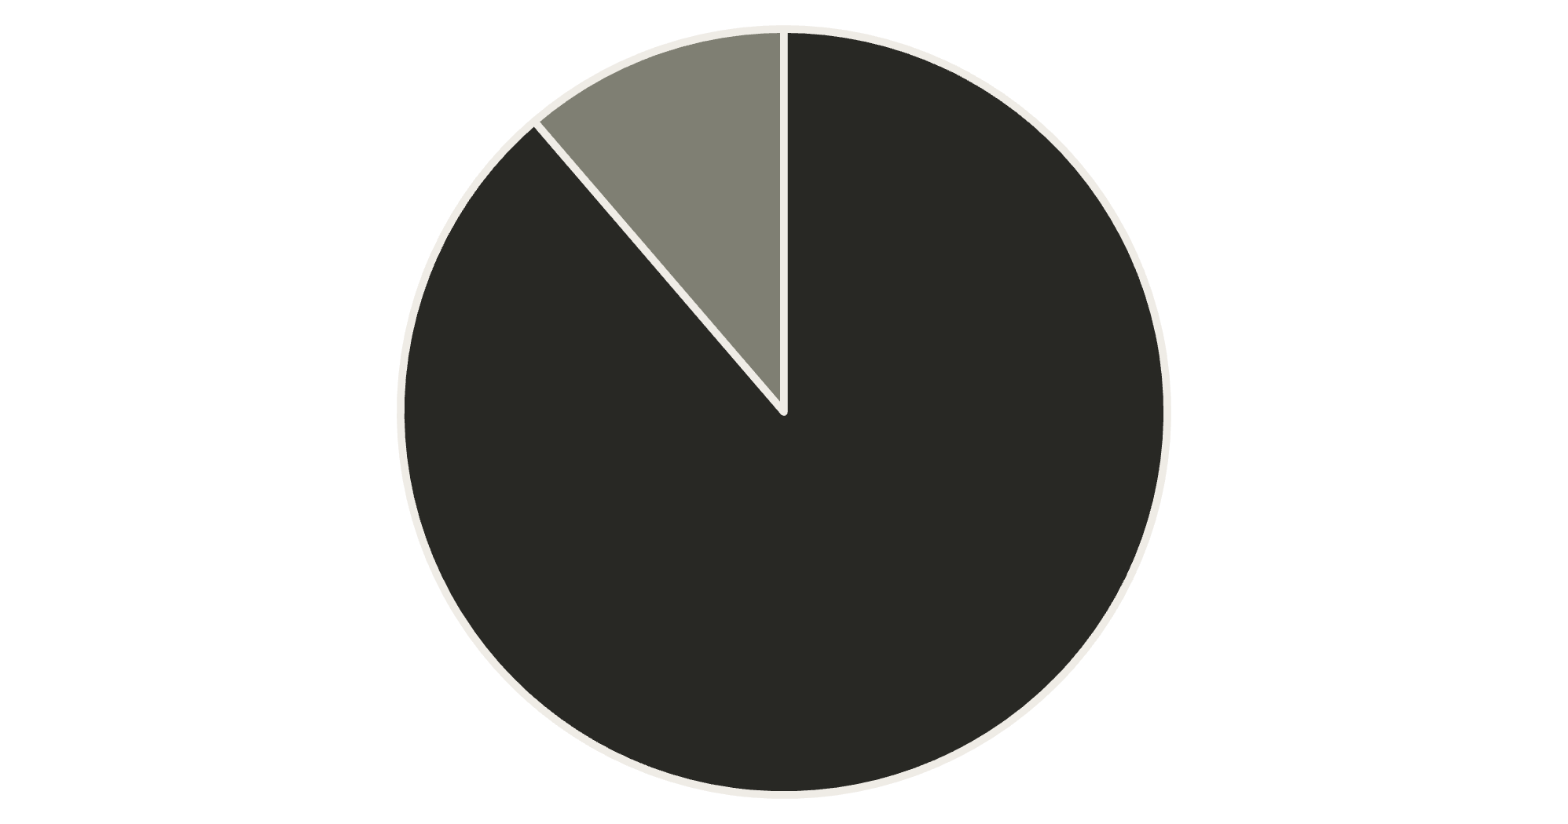
NDLTD Metadata Repository Overview
6.4M
Total ETDs
Complete collection in NDLTD repository
89%
G20 Share
G20 Nations
Non-G20 Nations
Overwhelming majority contribution from G20 countries

Slide 23

G20 Participation in ETD Ecosystem
The participation percentage reveals significant disparities between G20 and non-G20 countries in electronic thesis and dissertation submission rates, highlighting the digital divide in academic research accessibility.

Slide 24
Metadata Harvesting Patterns
89%
11%
G20 Contributions
Non-G20 Share
Massive repository presence from developed economies
Limited participation from developing nations
The stark contrast in metadata harvesting reveals systematic differences in digital infrastructure and institutional capacity between economic blocs.

Slide 25
Economic Power Drives Repository
Dominance
Global GDP Control
Trade Leadership
ETD Repository Share
G20 countries represent 85% of world's gross domestic product
75% of international trade flows through G20 economies
89% of global electronic theses and dissertations
The correlation between economic strength and research repository presence demonstrates how financial resources directly impact academic visibility and knowledge dissemination capabilities.

Slide 26

Research Visibility Reflects Economic Influence
The Numbers Tell the Story
G20 countries contribute approximately 89% of all electronic theses and dissertations globally, creating a powerful correlation between economic influence and research visibility in digital repositories.
This concentration suggests that financial resources, technological infrastructure, and institutional support systems play crucial roles in academic knowledge preservation and dissemination.

Slide 27

Strategic Recommendation: Expand MPhil Inclusion
Current Gap
Many national repositories exclude Master of Philosophy theses, creating incomplete academic records and limiting research accessibility for emerging scholars.
Including MPhil theses would significantly enhance repository comprehensiveness and provide broader access to intermediate-level research contributions across disciplines.

Slide 28
Enhance Bibliographic Standards
01
02
03
APA Format Integration
MLA Compatibility
ISO Standards Compliance
Implement standardised American Psychological Association citation formats
Ensure Modern Language Association formatting for humanities research
Adopt International Organisation for Standardisation bibliographic protocols
Standardised bibliographic records facilitate seamless integration across different academic databases and improve research discoverability for global scholarly communities.

Slide 29

Mandate Electronic Submission Protocols
Implementation Strategy
Establishing mandatory electronic submission requirements for all theses and dissertations ensures comprehensive digital preservation whilst reducing administrative burdens on academic institutions.

Slide 30


Building Awareness Through Academic Engagement
Professional Development
Knowledge Transfer
Organise targeted workshops and conferences to promote ETD awareness amongst academic administrators, librarians, and research communities globally.
Foster international collaboration through specialised training programmes that demonstrate best practices in electronic thesis and dissertation management.
Conclusion: Leadership and Sustainability
G20 countries demonstrate clear leadership in ETD initiatives, with NDLTD serving as the crucial foundation for open access and research management. Electronic theses and dissertations remain fundamental to sustainable academic growth and global knowledge sharing.

Slide 31

Thank You
Questions & Discussion
We welcome your insights and feedback on this research

