Slide 1

Variation in the Dissertation Writing across Applied Science Disciplines
USETDA 2025
Febriana Lestari
febri@iastate.edu
September 26, 2025

Slide 2
Dissertation Writing
What is a dissertation text?
Lengthy and complex scientific text
Highest level of academic literacy and doctoral-level research
A gateway for professional careers
Demonstrating disciplinary knowledge
(Thompson, 2013; Freeman, 2018; Rogers; 2015; Bunton, 2002)
How are the graduate students prepared to write this text?
How is the writing training in graduate school?
Is the dissertation writing today still the same as it was 20 years ago?

Slide 3
Research Motivation
Addressing the linguistic challenge
Addressing the methodological challenge in dissertation writing research
Motivating corpus-based studies to consider the principles of representativeness
Motivating the pedagogical implications for research-based dissertation writing that accounts for disciplinary variation

Slide 4
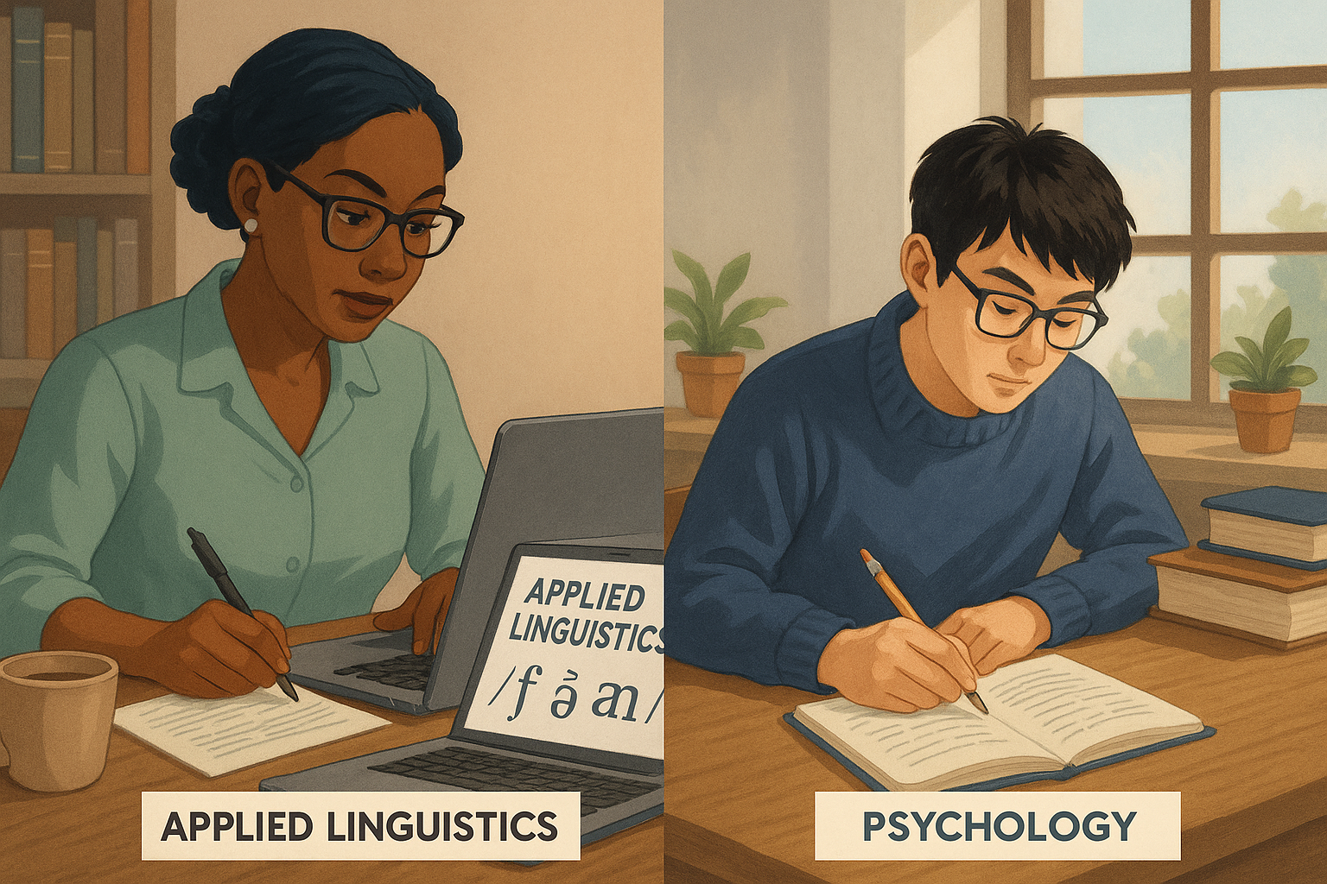


Goal of the Talk
Identifying the variation in the dissertation writing across applied sciences:
How the situational and textual characteristics are similar/ different across disciplines
How the linguistic patterns are similar/ different across disciplines

Slide 5
Research Questions
What are the situational and textual characteristics of dissertation writing in the applied science fields, and how can those be used to identify sub-register within and across disciplines?
What are the patterns of linguistic variation in dissertation writing in the applied science fields, and how is this variation related to the situational characteristics of different sub-registers and disciplines?

Slide 6
Text-Linguistics (TxtLx) Approach to Register Variation
Situational Context
Communicative Functions
Frequent and Pervasive Lx Features
Goal:
Identifying variation in the dissertation writing at the text-level
Situational and textual characteristics among texts
Linguistic (co-)variation among texts
“strong co-occurrence patterns of linguistic features mark underlying functional dimensions. Features do not randomly co-occur in texts” (Biber, 1988:13).

Slide 7
Method Domain Analysis Procedure
Learning about the target language:
Dissertation writing across applied sciences
1. Describing the domain
Collecting and reviewing information from the university
Asking expert informants
Reviewing the departmental websites across fields
Synthesizing findings about dissertation writing from the previous studies
Observing actual dissertation texts in the applied science fields
2. Operationalize the domain: Operationalizing dissertation writing register in the applied science fields
3. Sampling the corpus for situational and textual analysis purpose
(Egbert et al., 2022)

Slide 8
Domain Analysis
Learning about the target language:
Dissertation writing across applied sciences
Highlights:
Under one university that share some institutional rules, dissertation writing varies!
Existing ‘macrostructure’ framework does not really portray the existing dissertation writing texts
(Potential) variables that characterize the variation motivates the development of the situational and textual characteristics framework

Slide 9
Method Dissertation Register Corpus (DRC)
Discipline | Text | Words
Applied Linguistics | 43 | 2,617,973
Psychology | 43
Engineering | 43
Veterinary Medicine | 43

Slide 10
Method Analysis of Situational and Textual Characteristics
Developing situational and textual analysis framework based on the domain analysis
Piloting and revising the framework
Each dissertation text is annotated for the situational and textual characteristics
6 situational characteristics, such as:
Authorship
Disciplinary/ interdisciplinary collaboration
Publication time frame
Research practice approach
13 Textual characteristics, such as:
Presentation of abstract(s)
Presentation of references
General macrostructure patterns
Coding process (two coders)
Analysis
Analysis of coding results:
Counting the frequency
Counting the percentage
Clustering the codes
primary codes
secondary codes
sectional descriptors
Interpretation

Slide 11
Method Linguistic Analysis: Additive MDA
Selecting the MDA analysis model (the pilot study used Gray’s (2011) study on the AJRC)
Choosing the dimensions of interest
Identifying the linguistic features for the dimensions of interest
Calculating normed occurrence per text in the pilot DRC corpus (the corpus developed for this dissertation)
Standardizing the rates of occurrence to a z-score, using the means and standard deviation of AJRC
Compute dimension score for each text in DRC
Compare new (sub) registers of DRC to AJRC
Visualizing the results using R (2024.09.0+375)
Functional interpretation

Slide 12
Method Linguistic Analysis: Additive MDA
Additive MDA means adding a new group of texts, or plotting a new group of texts into a previous MDA.
An additive MDA allows for comparisons against a range of studies that have also applied the same dimensions to different registers
This pilot study used AJRC (Gray, 2011)

Slide 13
Analysis of Situational and Textual Characteristics on Dissertation Register Corpus (DRC): Applied Linguistics, Psychology, Engineering, & Veterinary Medicine
Research Question 1

Slide 14
Existing Framework on the Dissertation Macrostructure
Macrostructure | Characteristics
Traditional simple | Reports on a single study Composed of Introduction-Methods-Results-Discussion/ IMRD structure
Traditional complex | Reports on more than one single study Usually starts with an introduction and literature review, followed by a general methods section for each study, and ends with an overall conclusion section
Topic based | Begins with an introductory chapter, followed by several chapters titled according to sub-topics of the main topic, and concludes with a chapter on overall conclusion
Manuscript style | Consists of already published or publishable journal articles Usually includes separate introduction and conclusion chapters and a number of manuscript
Hybrid topic manuscript | Topic-based structure with previously published sections or chapters
Hybrid simple manuscript | IMRD structure with previously published sections or chapters

Slide 15
Results of the Present Study
Variation is found in each of the two major sub-registers!
Discipline | Monograph |  | Article-based |  | Total
 | Monograph | Hybrid Monograph | Hybrid Article-Based | Article-Based
Applied Linguistics | 28 | 9 | 4 | 2 | 43
Psychology | 23 | 3 | 17 | 0 | 43
Engineering | 0 | 2 | 17 | 24 | 43
Veterinary Medicine | 0 | 0 | 3 | 40 | 43
Total | 51 | 14 | 41 | 66 | 172

Slide 16
Results of the Present Study Two Major Sub-registers Found
Common Major characteristics of monograph and article-based dissertation sub-registers
Primary Codes | Monograph | Article-based
Authorship | Graduate student is the solo author of the dissertation | Frequently collaborative
Disciplinary/ interdisciplinary collaboration | Primarily single discipline, indicating low to no interdisciplinary collaboration | Strong collaborative work, disciplinary and interdisciplinary
Presentation of abstract(s) | One abstract in the dissertation | Multiple abstracts and consistent in each main IMRD
Presentation of references | References are almost always as one consolidated reference list at the end of the dissertation | The chapter-level references are dominant
Presentation of appendices | Consolidated appendices at the end of the dissertation | Appendices are mostly distributed across chapters, especially the IMRD chapters.
General macrostructure | Dissertation generally consists of at least 4 chapters, and each chapter represents I, M, R, and D. The complete dissertation is one consolidated study. | Dissertation generally consists of more than 3 chapters, and each chapter does not typically follow IMRD. The dissertation consists of several different research projects.
Publication timeframe | Dissertation does not link to publication | Dissertation is generally tied to publication.

Slide 17
Sub-register 1: Monograph
Monograph | Authorship: solo Disciplinary/ interdisciplinary collaboration: departmental Macrostructure: book-like flow/ continuous IMRD (well spread in each individual chapter of the dissertation) Presentation of abstract(s): single dissertation abstract Presentation of references: end-only references Publication timeframe: no publication/ not linked to journal publication Presentation of appendices: consolidated appendices (if any) | Internal structure: continuous IMRD Introduction: individual consolidated chapter Literature Review: individual consolidated chapter Methods: individual consolidated methods Results: individual consolidated chapter Discussion: global discussion (for the entire dissertation) Conclusion: global conclusion (for the entire dissertation) Appendices: minimal or absent Nature of chapter title: generally generic

Slide 18
Sub-register 2: Hybrid Monograph
Hybrid Monograph | Authorship: solo Disciplinary/ interdisciplinary collaboration: departmental Macrostructure: transitional or partially article-style (additional/ repetitional element of IMRD) Abstracts and references: chapter-level appears Internal structure: mixed continuous and modular *Modular means article-style structure at the chapter level | Introduction: individual consolidated introduction chapter is often retained Literature Review: slightly shorter or redistributed/ combined with Introduction Methods: sometimes one consolidated method chapter and sometimes distributed across chapters Results: sometimes global and sometimes per chapter Discussion: often mixed (integrated or partial global and chapter-level) Conclusion: global conclusion (for the entire dissertation) and sometimes shorter. Presentation of appendices: can be at the end of dissertation, in each article-style only, or mix in every chapter Appendix materials: either research practice or result practice oriented Titles: often mix of generic and topic-based titles

Slide 19
Sub-register 3: Hybrid article
Hybrid article-based | General macrostructure: more than 3 chapters and does not follow a continuous IMRD article-style Internal structure: partial modularity, or mixed global and modular Presentation of abstracts and references: inconsistent (some global, some chapter-level). | Introduction: typically short introduction chapter; or combined with a brief literature review Literature Review: typically spread across modular chapters Methods and Results: partly per chapter, partly consolidated. Discussion: mixed global and chapter-level. Presentation of appendices: typically present and at the chapter-level Appendix materials: research practice or result oriented Nature of chapter titles: typically specific but not consistently modular. Publication timeframe: sometimes not indicated, unpublished, or mix of published and unpublished

Slide 20
Sub-register 4: Article-based
Article-based | Authorship: collaborative with varying degree of graduate student as the first author; could be solo but rare Disciplinary/ interdisciplinary collaboration: frequently across department and multiple institutions; moderately across department within one institution or only within one department General macrostructure: dissertation does not follow a continuous IMRD (> 3 chapters; not IMRD) Internal structural pattern: IMRD repeated per chapter Presentation of abstract(s) and/or references: at the chapter-level. Publication timeframe: could be all unpublished work and typically indicated, published work and typically indicated, mix of unpublished and published | Introduction: typically, short individual chapter Literature Review: typically embedded within the short individual Introduction chapter or embedded within IMRD chapters Methods, Results, and Discussion chapters: frequently repeated per chapter. Conclusion: minimal or short global wrap-up Presentation of appendices: frequently across chapters; one single consolidated appendix is rare Appendix materials: typically research result oriented or mix of research practice and results Nature of chapter titles: topic-based/ chapter-related

Slide 21
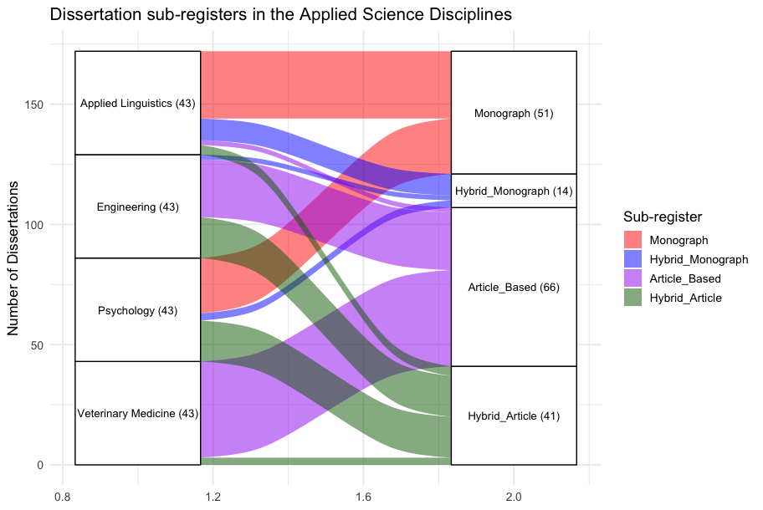
Results: The Trend
Monograph: strongest Applied linguistics and Psychology)
Hybrid forms mark transitional spaces
(Psychology and Engineering)
Article-based: strongest in Vetmed and Engineering
Notes:
The flow of variation moves from fields where the monograph tradition remains strongest (applied linguistics and psychology) toward fields where article-based formats predominate (engineering and veterinary medicine). Hybrid forms mark transitional spaces in this flow: hybrid monographs appear alongside monographs in applied linguistics and psychology, while hybrid article-based dissertations become more visible in psychology and engineering. Veterinary medicine, by contrast, is situated at the far end of this continuum, where the article-based format overwhelmingly dominates. Overall, these findings underscore the central role of disciplinary conventions in shaping dissertation writing practices. Even within a single institution that operates under one set of general guidelines, clear disciplinary differences emerge.

Slide 22
Additive Multi-Dimensional Analysis (MDA) Results on Applied Linguistics Dissertation Sub-Corpus
Research Question 2

Slide 23
Dimensions in AJRC (Article Writing)
Dimension
Dimension 1 | Academic Involvement and Elaboration vs. Informational Density
Dimension 2 | Contextualized Narration vs. Procedural Discourse
Dimension 3 | Human vs. Non-Human Focus
Dimension 4 | ‘Academese’

Slide 24
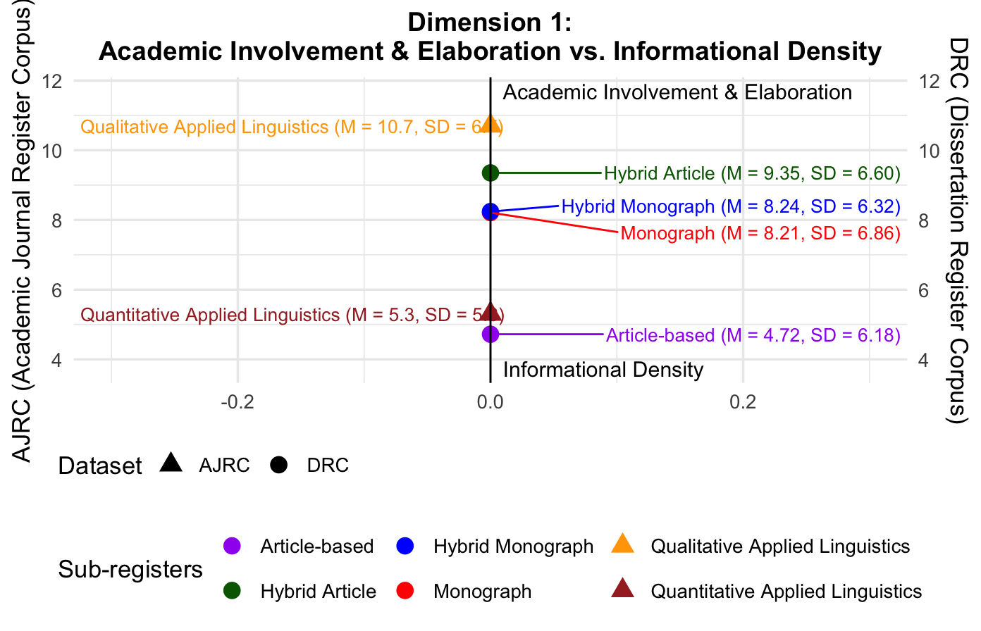
Dimension 1
Highlight:
Dissertation writing is distinct from RA writing
Article-based uses less academic involvement features (packaging information more densely than other sub-registers)
Notes:
Among the sub-registers, the article-based dissertation is the most informationally dense, with the lowest dimension score (-7.63). Monographs and hybrid monographs cluster closely together (mean score of -5.65 and -5.64) and align with the quantitative applied linguistics research article (-6.00), suggesting that they share similar informational density features. By contrast, the hybrid article sub-register is somewhat less informationally dense than the other dissertation sub-registers and is positioned slightly closer to the positive side of the dimension. However, the hybrid article still reflects a predominantly informationally dense profile, standing in clear contrast to the qualitative applied linguistics register in Gray’s (2011) study.
Dissertation writing and research article writing are distinct in the Applied Linguistics field
All dissertation sub-registers indicate more academic involvement than informational density
Article-based has the most dense language of all
Monograph and hybrid monograph are similar (more involved than article-based)
Hybrid article has the most elaboration

Slide 25
Linguistic Features in AJRC
Dimension 1:
Academic Involvement and Elaboration vs. Informational Density
Positive features: Pronouns: nominal pronouns (.69), pronoun it (.62), 1st person pronouns (.58), demonstrative pronouns (.52) Nouns: nouns of cognition (.57) Adjectives: predicative adjectives (.70), evaluative attributive adjectives (.33) Verbs: verb be (.79), verb have (.67), causative verbs (.34) Modal Verbs: modals of prediction (.69), modals of possibility (.66), modals of necessity (.65) Adverbs: general adverbs (.54), stance adverbials (.47), adverbials of time (.34) Conjunctions: Subordinating conjunction – conditional (.83), adverbial conjuncts (.48), subordinating conjunctions (.39) Finite Clauses: that-clauses controlled by nouns of likelihood (.65), that-clauses controlled by verbs of likelihood (.59), that-clauses controlled by factive adjectives (.48), that-clauses controlled by attitudinal nouns (.47), that-clauses controlled by factive nouns (. 44), wh-clauses (.34) Non-Finite Clauses: to-clauses controlled by stance adjectives (.37), to-clauses controlled by verbs of probability Negative features: Nouns: nouns (-.75), process nouns (-.40) Verbs: past tense verbs (-.67) Passives: passive postnominal modifiers (-.53), agentless passive voice verbs (-.32) Other: prepositions (-.39), type-token ratio (-.35), word length (-.31)

Slide 26
Text Excerpt: Dimension 1
A small (n=32) isolexical (Oakey, 2009) collection of screencast video (called video in much of the rest of the study) and text feedback was obtained with informed consent under university IRB approval as part of a larger study of student use and perceptions of screencast and text feedback. The subset of feedback used in the present study consisted of 16 text and 16 video files created by a single reviewer (the researcher) for eight students on practice Test of English as a Foreign Language (TOEFL) essays in an intermediate ESL writing course taught by a cooperating instructor. The reviewer and the students had not interacted prior to the study; thus, the reviewer-student relationship was not built through class interaction as it might be with an instructor.
[article-based]
The result of the Krusal-Wallis Test indicated that the scores of previous English 101C students were not significantly different from those of American students or international students exempted from English 101C. Based on this statistical analysis, it can be inferred that satisfactory performance on English 101C assessments indicates readiness to take English 150. However, how students felt about their own readiness for English 150 or what their instructors thought about their writing performance was not evident in the grade data, which also constitutes an essential piece of information in terms of deciding if such interpretations of English 101C assessment results are valid. Thus, interviews were conducted to identify the perceptions of students and instructors, and the results of analysis will be discussed in the following section.
[Monograph]

Slide 27
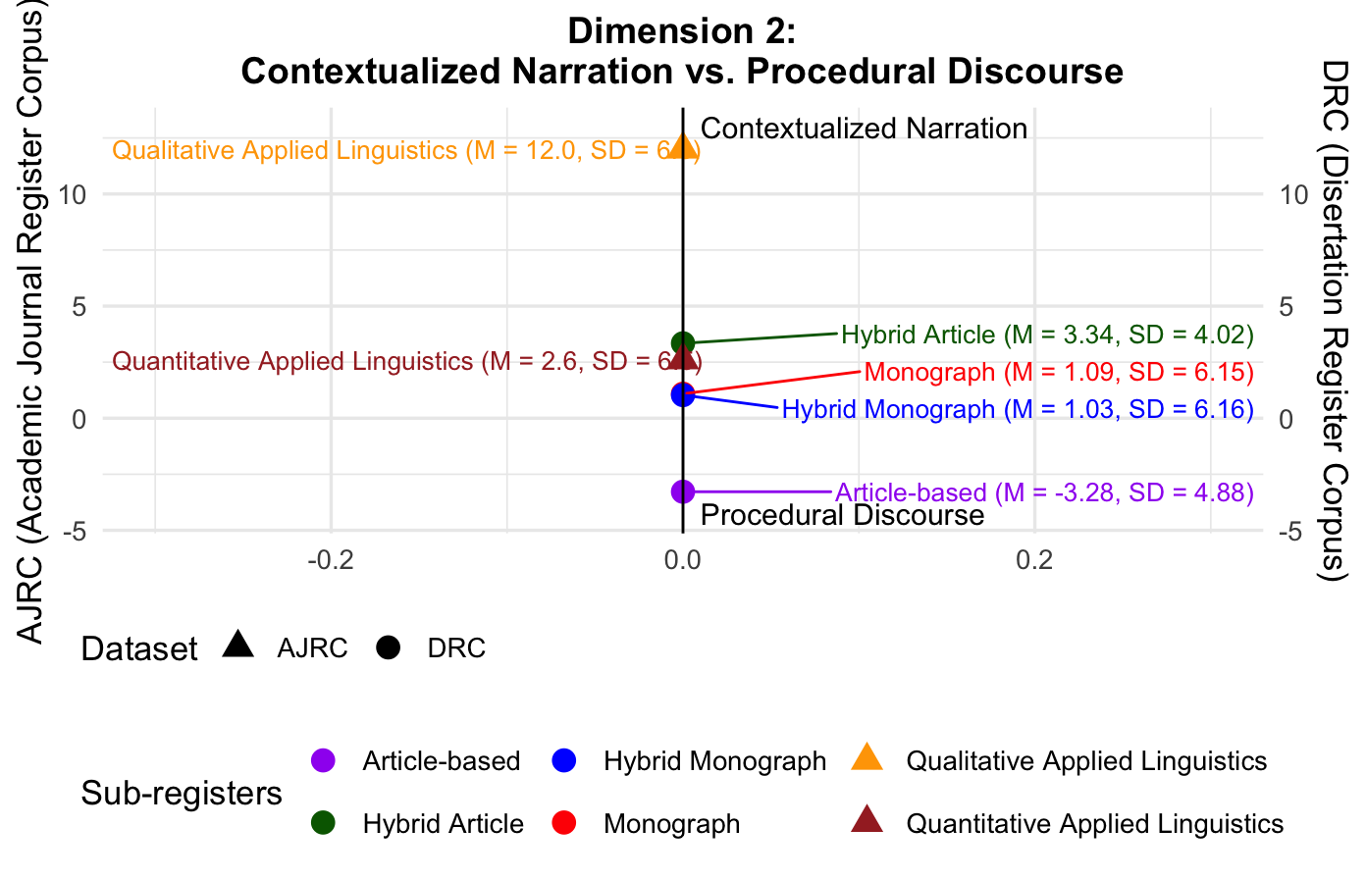
Dimension 2
Highlight:
The article-based dissertation is the only sub-register with a negative dimension score (M = -3.28), positioning it more strongly within procedural discourse than the other sub-registers

Slide 28
Linguistic Features in AJRC
Dimension 2: Contextualized Narration vs. Procedural Discourse
Positive features: Pronouns: 3rd person pronouns (.65) Nouns: group nouns (.49), nominalizations (.32), animate nouns (.43) Adjectives: topical attributive adjectives (.53), attributive adjectives indicating time (.47) Verbs: past tense verbs (.55), aspectual verbs (.52), perfect aspect verbs (.48), communication verbs (.47), present progressive verbs (.42) Conjunctions: phrasal coordinating conjunctions (.51), clausal coordinating conjunctions (.35) Finite Clauses: that-relative clauses (.46), that-clauses controlled by non-factive verbs (.45), wh-questions (.32) Non-Finite Clauses: to-clauses controlled by verbs of modality, causation and effort (.57), to-clauses controlled by verbs of desire (.41), to-clauses controlled by stance nouns (.35) Other: word length (.52), word count (.36), type-token ratio (.31) Negative features: Nouns: technical nouns (-.61), quantity nouns (-.46), concrete nouns (-.37) Adjectives: attributive adjectives indicating size (-.37) Passives: agentless passive voice verbs (-.52), passive voice verbs with by-phrases (-.47)

Slide 29
Text Excerpt: Dimension 2
Before coding, the instructor comments were de-identified and extracted from the
feedback files. Text feedback comments in comment bubbles and end comments were
extracted and pasted into plain text files with samples of highlighted text in brackets. In-
text actions were noted in brackets using the following notation [notation was removed]. The audio from video feedback files was extracted and sent to Rev.com for verbatim transcription. Each transcript was checked for accuracy by the researcher. The researcher de-identified the transcripts, fixed any inaccuracies, added emphasis and inserted timestamps and pause lengths using the transcription software F5. Transcripts were then exported as plain text files for coding.
[Article-based]
A multitrait-multimethod matrix was implemented to examine the extent to which rating
criteria order is associated with construct and discriminant validity of rating criteria and the halo
effect. Campbell and Fiske (1959) proposed a multitrait-multimethod matrix of correlations
wherein correlations among multiple rating criteria are nested within each method. Correlations
among these traits and methods are arranged in a manner that allows the evaluation of
convergent and discriminant validity of the four rating criteria in this study.
[Monograph]

Slide 30
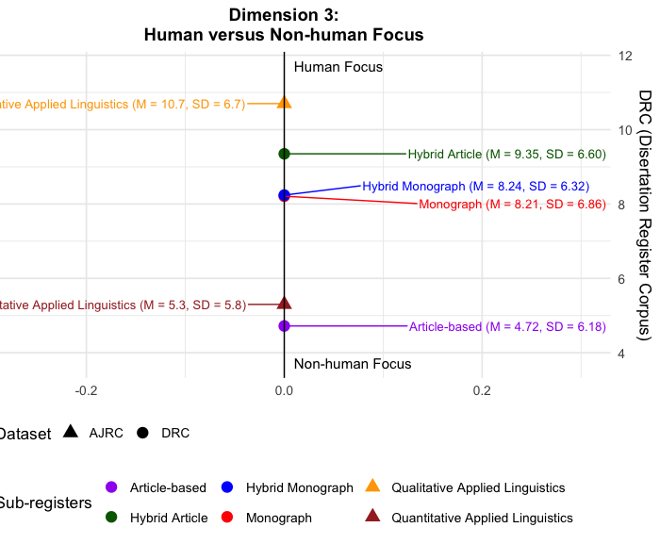
Dimension 3
Highlight:
Dissertation writing and RA in applied linguistics indicate more of human focus
Article-based is less human focus of all

Slide 31
Dimension 3
Dimension 3: Human vs. Non-human Focus
Positive features: Pronouns: 2nd person pronouns (.40), 3rd person pronouns (.35) Noun: process nouns (.50) Verbs: mental verbs (.65), activity verbs (.60), communication verbs (.51), present progressive verbs (.49) Finite Clauses: that-clauses controlled by factive verbs (.42), wh-clauses (.33) Non-Finite Clauses: to-clauses controlled by verbs of desire (.46), to-clauses controlled by speech verbs (.45) Negative features: Adjectives: attributive adjectives (-.54), attributive adjectives indicating topic (-.42) Adverbs: general adverbs (-.31) Other: prepositions (-.35)

Slide 32
Text Excerpt: Dimension 3
Article-based
Until support for the tonal DIS hypothesis is found, e.g., possibly with other more phonetic measures, I use Occam’s Razor to argue that the boundary-induced modulation of maximum f0 values was due to declination reset consistent with Li (2015). However, unlike in Li (2015), the reset was likely partial reset, or declination within declination, which occurs when declination is not fully reset, as seen in midsentence (O’Shaughnessy & Allen, 1983, elaborated by Ladd, 1988). Given that DIS may play a role in word recognition (Cho et al., 2007; Fougeron & Keating, 1997), the partial reset may have been chosen over full reset to signal the listener that the phrase was not finished (cf. Delattre et al., 1965). Such signaling may have been especially necessary to counter the effects of the pause before the reset, which, if the reset was absent, may have signaled to the listener that the phrase was finished
Monograph
[Diana], a teacher of level C students, indicated that the text book includes sections for vocabulary exercises, “But [they] do not spend time on it because [they] do not have enough time”. [Nancy], a teacher of B level, however, pointed to the insufficiency of vocabulary related exercises covered by the textbook stressing that “it is not enough at all”. The lack of focus on vocabulary expansion activities was also attributed to the lack of motivation on the part of learners. [Diana], indicated that vocabulary development is important, yet she believes that “vocabulary development is quite possible with motivated students, the majority of our students are not motivated. [They] are taking a required course because [they] have to, it was not their lucky day when they took the EPT”.

Slide 33
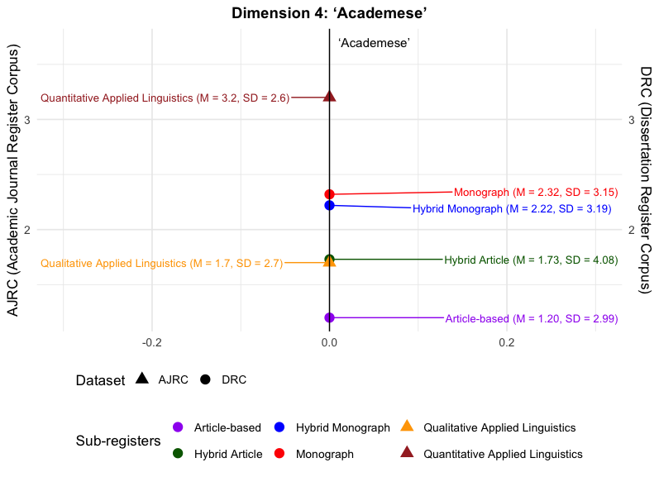
Dimension 4
Highlight:
Dissertation writing and RA in applied linguistics indicate more academese, with article-based being the least
Quantitative applied linguistics sub-register in AJRC intersects with the hybrid-article dissertation in DRC
Article and hybrid article-based share closer characteristics in Dimension 4, unlike in other dimensions

Slide 34
Linguistic Features in AJRC
Dimension 4: ‘Academese’
Positive features: Nouns: nominalizations (.43), process nouns (.38), other abstract nouns (.32) Adjectives: relational attributive adjectives (.45) Verbs: existence verbs (.37) Finite Clauses: that-clauses controlled by likelihood adjectives (.38), to-clauses controlled by stance adjectives (.33) Other: word length (.58) Negative features: Adverbs: time adverbials (-.47)

Slide 35
Discussion
Disciplinary variation plays an important role in shaping both situational and textual characteristics, as well as the patterns of linguistic variation.
Monograph and hybrid monograph dissertations share similar characteristics across dimensions.
Article-based and hybrid article-based sub-registers do not always share similar characteristics.
Notes:
ApLing texts generall more clausal in nature……reflects disciplinary patterns we have observed in published RAs
MORE elaborated, discursive (will show some examples later)

Slide 36
Implication
Dissertation writing and research article writing are distinct.
Internal variation within discipline exists
TxTLx approach to register variation shows more careful analysis and reveals the roles of text in shaping the variation
Guidelines on dissertation writing need to highlight features that are shaped by disciplinary variation.

Slide 37
Further Research
Designing corpus that represents the sub-register of dissertation writing
Full MDA on the DRC

Slide 38


Thank you!
Questions and Discussion
Febriana Lestari
febri@iastate.edu
38

