Slide 1

ETD For Beginners:
ProQuest IR Promotion Program
Austin McLean, Senior Director, Partnerships Surname | Month 00, 0000
ETD 2025 / USETDA 2025
September 25, 2025
Notes:
Hi everyone! Thank you so much for being here today—it's a real pleasure to connect with you.
Before we dive in, I’d love to start with a quick round of introductions. If you could each briefly share your name, your role, and your connection to Oxford’s graduate research or repository, that would be great.
(Pause for introductions)
Thank you all—it's wonderful to have such a knowledgeable group here.
Today, I’m excited to share how Oxford can enhance the visibility and impact of its graduate research through an exciting new initiative at Clarivate: the Institutional Repository Thesis Discovery Service, or IRTDS.
Andy – Partnerships Manager
Austin Mclean – Senior Director – Partnerships
April Dawn - Senior Director, Product Management Academia & Government
Emma Dennis – AM
James Dodd – Librarian Collections
Jason Partridge – Open Access Services Development Lead
Ruth Mallalieu - Head of Open Scholarship Support - academic librarian and legal information specialist
Andrew Bonnie - ‘Chief of Digital Operations’, at the Bodleian Library

Slide 2
ProQuest: 85 Years of PhD Theses Expertise
Relied on by more than 3,100 libraries globally, including 80% of top universities
The Association of Research Libraries (ARL) teams with ProQuest to microfilm theses
ProQuest Research Assistant launches for PQDT, opening dissertations to novice researchers
PQDT expands to provide global theses coverage
ProQuest launches the ETD Dashboard
1939
1951
1997
2000
2016
2020
2023
2025
ProQuest begins under the name UMI, disseminating dissertations & theses
ProQuest creates ProQuest Dissertations & Theses (PQDT)
ProQuest ARC Program (harvesting) was created
Dissertations & Theses indexed in the Web of Science
Notes:
ProQuest, part of Clarivate has been working in the area of dissertations for over 80 years. As you can see, we started as far back as 1939 with the technology of Microfilm and the paper index, and we have moved through the decades innovating and making university’s graduate research – PHD’s and their Master’s works more accessible. Our most recent development, which we are very excited to announce is that the Dissertations and theses through ProQuest which is now part of Clarivate will appear in the Web of Science. This is a major milestone for us and researchers around the world in terms of broadening the reach and impact of graduate research.

Slide 3








ProQuest Dissertations & Theses Global
The premium collection of global, multi-disciplinary graduate research
The most expansive, quality source of metadata, citations, and full-text for graduate theses.
Reviews records for accuracy and completeness
Enhances records via additional subject indexing, keywords,
Extracts additional metadata fields
Extracts cited references and manually reviews to 98% accuracy
Translates abstract and title to English for enhanced discoverability
WoS indexing adds Research Areas, Citation Indexing and analytics
6.3M+
curated metadata records
4M
full-text documents
4,100+ institutions
75
countries
60+
languages
2.8M+
non-US theses

Slide 4
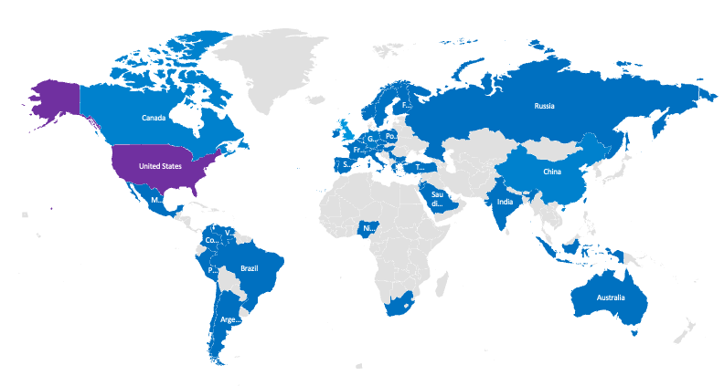
Expanding world-wide coverage
ProQuest Dissertations & Theses Citation Index delivers discovery of graduate research across the globe.
United Kingdom | 946,900
Republic of Ireland | 28,249
France | 48,554
Portugal | 82,260
Spain | 17,082
Greece | 11,379
Italy | 1,288
Austria | 5,096
Belgium | 4,736
Germany | 211,726
Netherlands | 20,211
Switzerland | 16,151
Norway | 2,329
Finland | 9,184
Sweden | 51,863
Serbia | 1,942
Poland | 2,409
Czech Republic | 1,070
Slovenia | 943
Hungary | 869
Bulgaria | 658
Russia | 1,503
India | 46,723
China | 422,041
Hong Kong | 14,298
Singapore | 3,310
Taiwan | 2,427
United States | 3,158,682
Canada | 426,089
2.8M+
non-U.S. theses
Turkey | 66,093
Israel | 11,567
Saudi Arabia | 2,740
Lebanon | 1,238
Qatar | 854
Jordan | 483
Indonesia | 1,155
Australia | 14,748
Nigeria | 1,658
South Africa | 30,942
175k+
Chile | 4,379
Peru | 6,773
Argentina | 326
Colombia | 105
Venezuela | 39
Brazil | 109
Mexico | 3,206
non-U.S. theses added each year

Slide 5


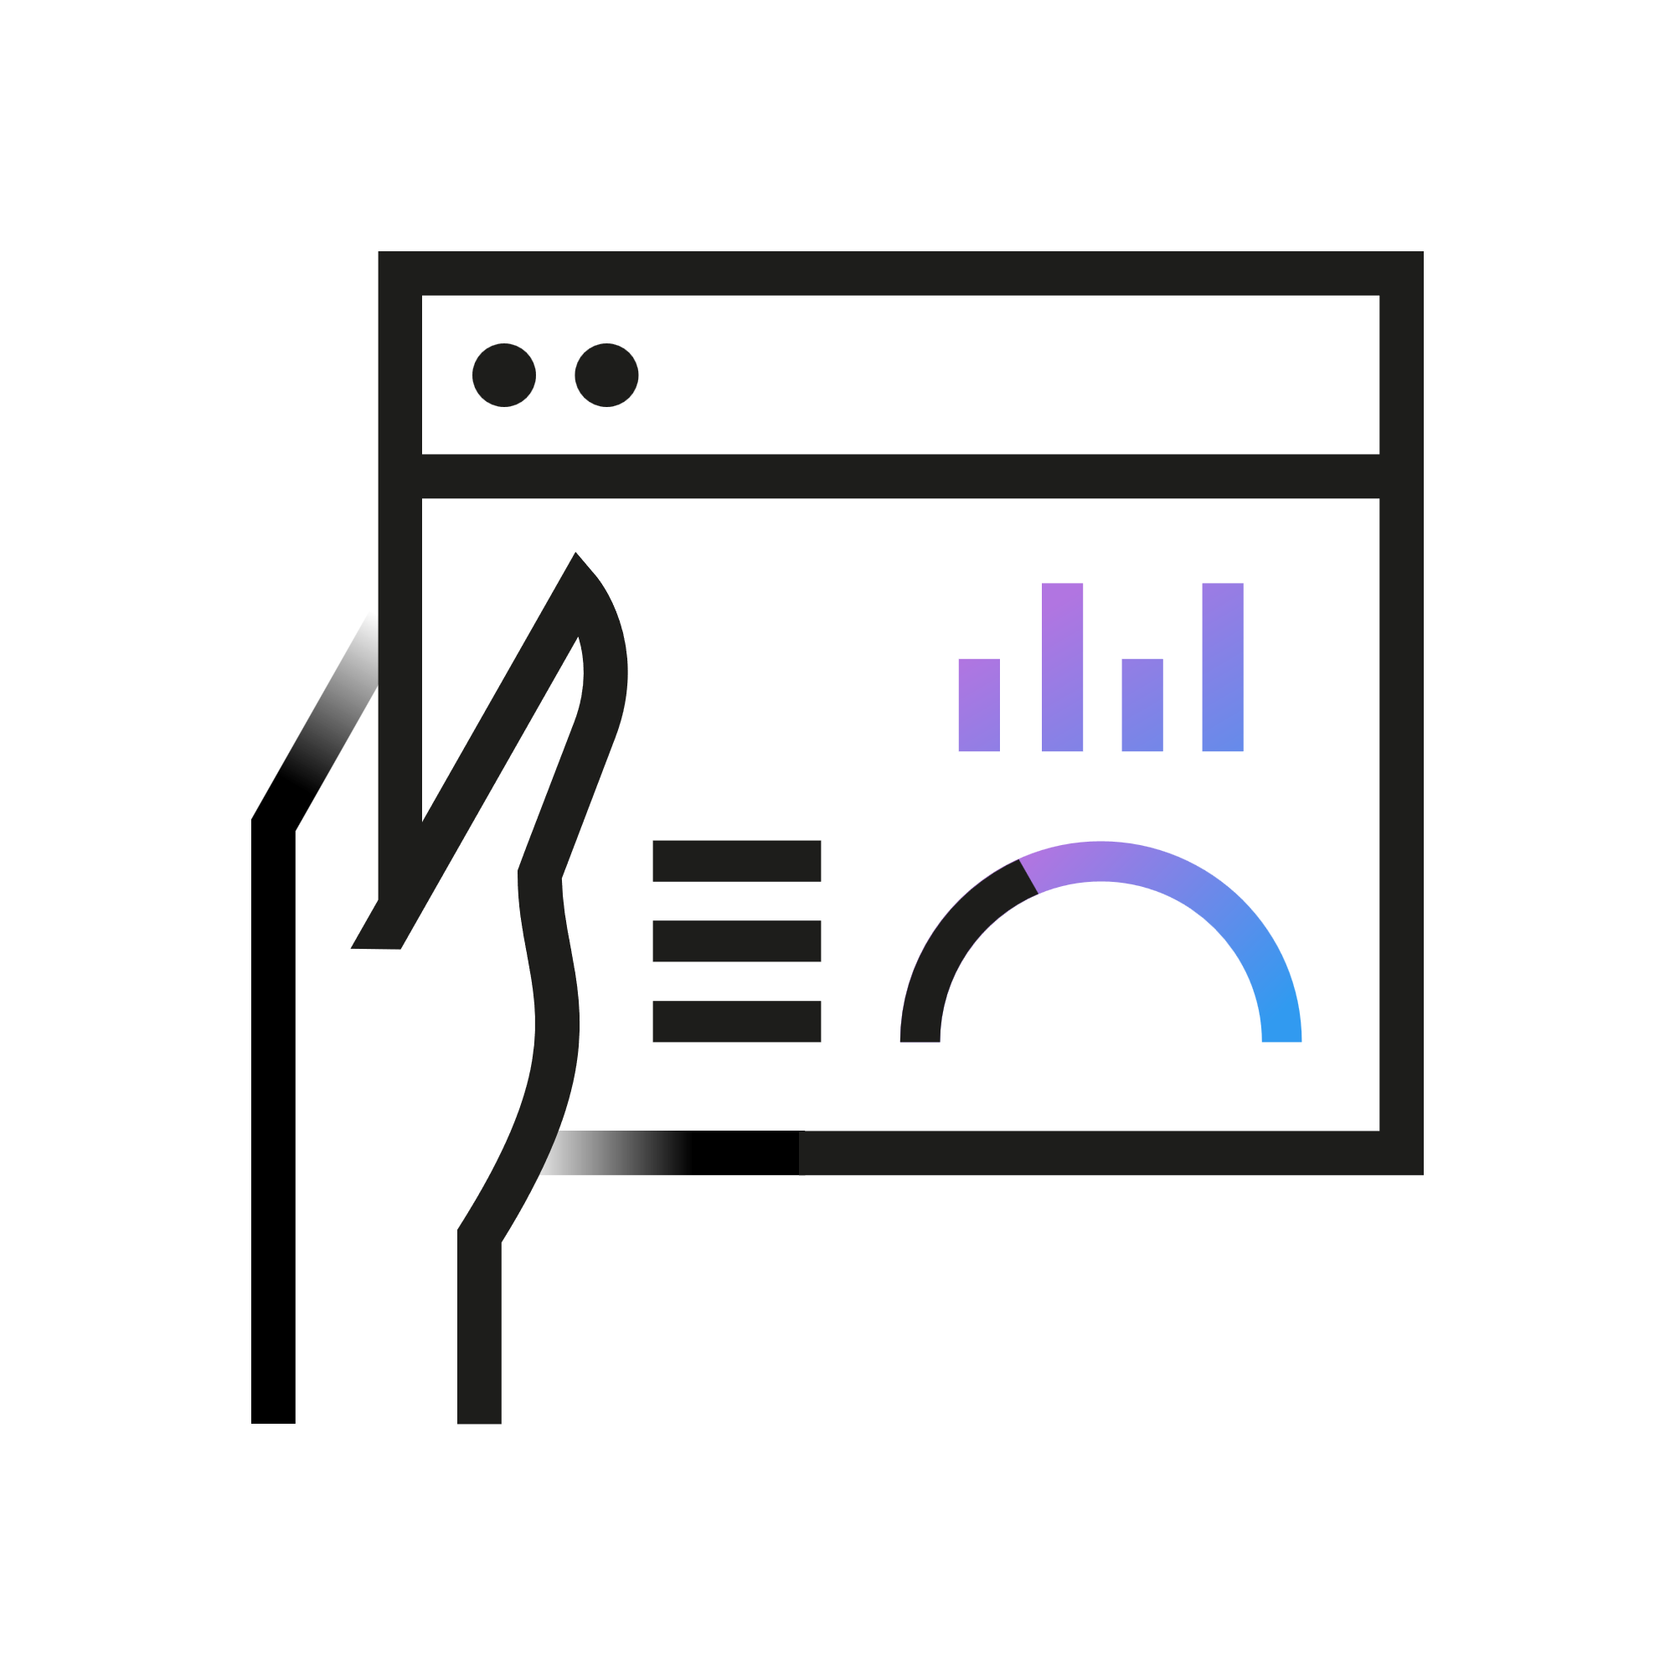


PQDT Global is where to find the innovators of tomorrow
The future of innovation begins with doctoral research
2024 Nobel Laureates
Medicine
Chemistry
Physics
Economics
Victor Ambrose
David Baker
John J. Hopfield
Kamer Daron Acemoglu
The Protein Covalently Linked to the 5’ End of Poliovirus RNA
MIT, 1979
Reconstitution of Intercompartmental Protein Transport in Yeast Extracts
UC Berkeley, 1989
A Quantum-Mechanical Theory of the Contribution of Excitons to the Complex Dielectric Constant of Crystals
Cornell University, 1958
Essays in microfoundations of macroeconomics: Contracts and macroeconomic performance
London School of Economics, 1989
Gary Ruvkun
Demis Hassabis
Geoffrey E. Hinton
Simon Johnson
The Molecular Genetic Analysis of Symbiotic Nitrogen Fixation (NiF) Genes From Rhizobium meliloti
Harvard University, 1982
Neural Processes Underpinning Episodic Memory
University College London, 2009
Relaxation and Its Role in Vision
University of Edinburgh, 1977
Inflation, Intermediation, and Economic Activity
MIT, 1990
John M. Jumper
James Robinson
New Methods Using Rigorous Machine Learning for Coarse-Grained Protein Folding and Dynamics
University of Chicago, 2017
The Dynamic Enforcement of Implicit Labor Contracts Under Asymmetric Information
Yale University, 1993
Notes:
Where Innovation Begins
The future of innovation starts with doctoral research—and PQDT is where you’ll find the innovators of tomorrow.
Real-World Impact
Take the 2024 Nobel Laureates as an example. Each one was previously named a Clarivate Citation Laureate—recognized not by the Nobel Committee initially, but by the measurable influence of their research.
These individuals were identified years in advance as “Nobel-class” researchers, based on their exceptional contributions to science and society.
The Role of PQDT
What’s notable is that all of these Nobel Laureates had their early scholarly work—often their dissertations—published in PQDT. This highlights the critical role PQDT plays in showcasing emerging talent and fostering recognition for groundbreaking research from the very start of a scholar’s career.

Slide 6
PQDT Global Integration
Dissertations & theses
Preprints
Conference papers
Journal articles
Shared datasets
Patents
Books
ProQuest Dissertations & Theses Global
+
Web of Science
Visibility by 9,000 Universities in >100 countries annually
Research with a single platform that streamlines discovery of millions of post-graduate works alongside journal articles, conference papers, preprints, patents, and books.
Notes:
A Major Milestone in the Dissertation Journey
Earlier, I mentioned a major step forward in the evolution of how dissertations are discovered. That milestone came in 2023, when ProQuest Dissertations & Theses Global was integrated into the Web of Science platform.
What Does This Mean for Researchers?
Now, millions of graduate works—PhDs and Master’s theses—are discoverable directly within Web of Science. They appear alongside journal articles, conference papers, patents, preprints, and books.
Why It Matters
This integration significantly improves the research experience. Instead of switching between databases, users can find all relevant content in one place. It saves time, simplifies workflows, and ensures that graduate research is part of the core academic conversation—right where researchers already look.
TAKE A PAUSE

Slide 7
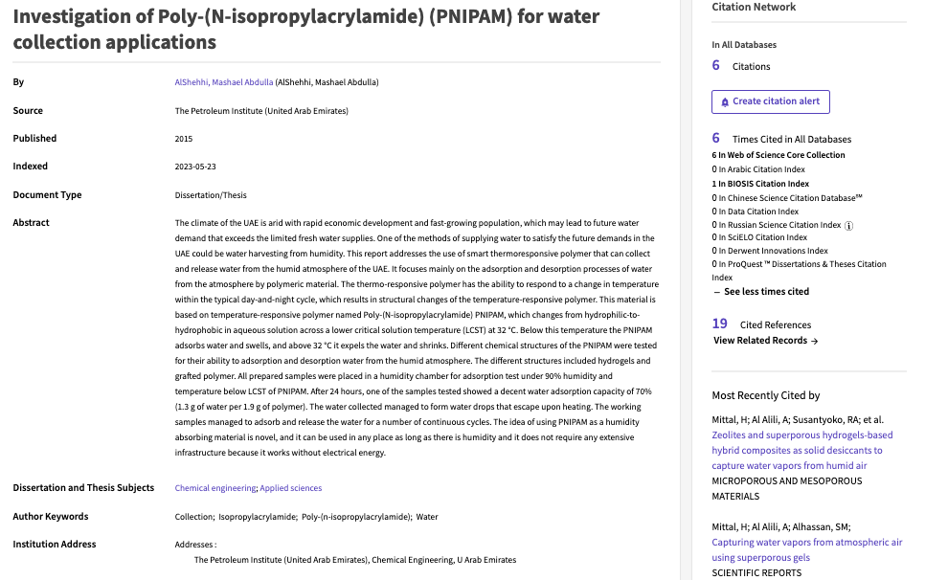

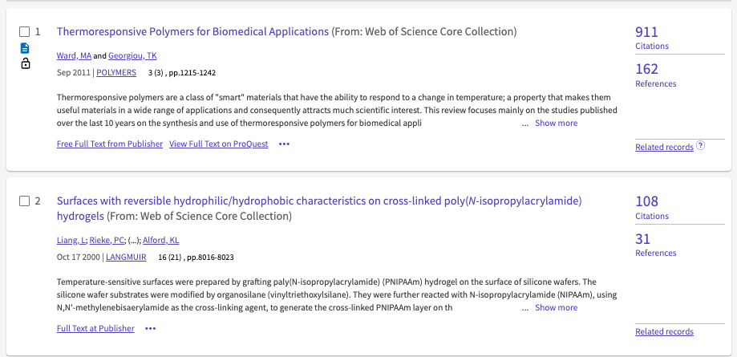

Integration with the Web of Science Citation Network deepens the connection of your post-graduate research to related scholarship
📈 Boost Discoverability
🔗 Improve User Experience
📊 Enable Citation Tracking
🌐 Connect Across Disciplines
🏷️ Enriching Metadata
📍 Strengthen Global Research Integration
Notes:
Deepening Discovery: Integration with Web of Science
Let’s take this one step further by looking at how Web of Science strengthens the impact of your graduate research.
Through integration with the Web of Science Citation Network, your postgraduate works are more deeply connected to the broader body of scholarly literature—enhancing their visibility, value, and scholarly relevance.
Why This Matters: Key Benefits of Enhanced Metadata
Boost Discoverability – Makes theses more visible and easier to find across major academic platforms.
Improve User Experience – Enables smooth navigation from a thesis to related, foundational research—helping users explore more deeply and efficiently.
Enable Citation Tracking – Supports citation analysis and helps demonstrate the research impact of your graduate work within Web of Science.
Foster Cross-Disciplinary Connections – Highlights research linkages across departments, subjects, and countries—encouraging collaboration and innovation.
Enrich Metadata, Free of Charge – ProQuest extracts and reviews cited references as part of the editorial process, enhancing discoverability without additional cost.
Strengthen Global Research Integration – Embeds your institution’s work within the global scholarly network, showcasing Oxford’s research at the heart of international academia.

Slide 8

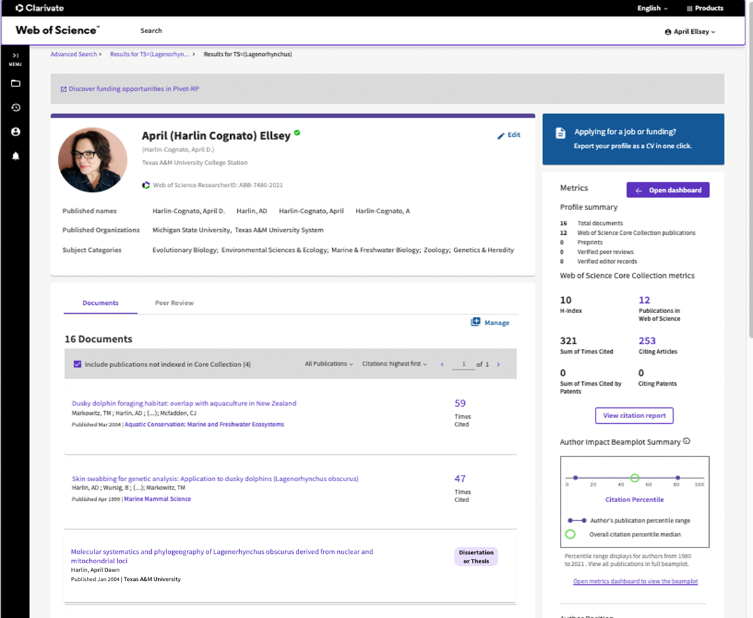
New post-graduates can showcase early-career milestone to peers and evaluators in their Web of Science Researcher Profile
Boost Early-Career Visibility: Authors can seamlessly add their dissertation or thesis to their Web of Science Researcher Profile, showcasing their foundational research to a global audience—including researchers and decision-makers at over 9,000 organizations worldwide.
Track Impact Effortlessly: Receive real-time citation alerts to monitor how your dissertation is being cited, helping you track your scholarly influence and demonstrate research impact over time.

Slide 9
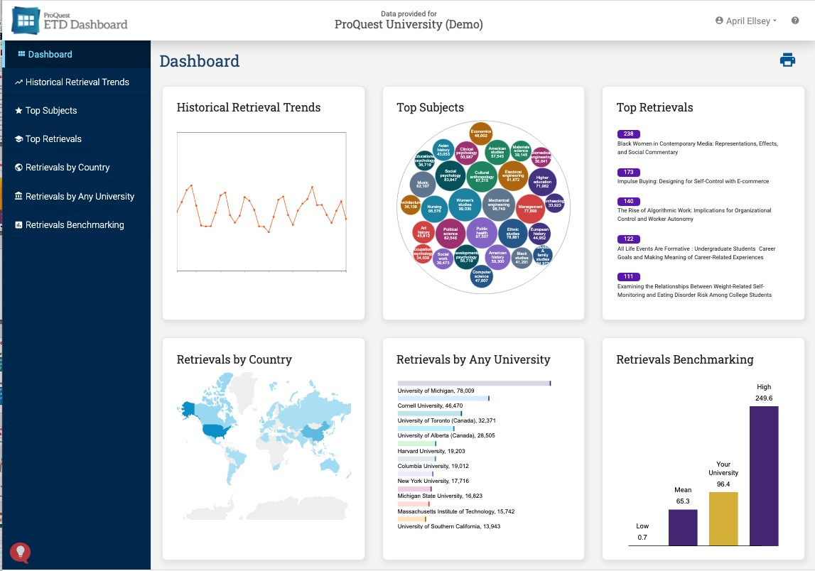
ETD Dashboard Provides Insights to Graduate Programs
6 Report Options for Data-Driven Decision-Making
HISTORICAL RETRIEVAL TRENDS Understand usage over time to plan future promotion and investment TOP SUBJECTS Identify areas of research strength within the university TOP RETRIEVALS Identify, recognize, and promote the most popular alumni authors and titles RETRIEVALS BY COUNTRY Understand the global reach & impact of graduate research RETRIEVALS BY ANY UNIVERSITY Identify potential collaboration opportunities with other institutions RETRIEVALS BENCHMARKING Track performance against other institutions
Notes:
All of ProQuest’s submission partners gain FREE access to the ETD Dashboard.
The ETD Dashboard provides a visual summary of your institution’s electronic theses and dissertations usage insights from subscribers to PQDT all around the world – those 3200+ institutions, so you can measure and validate the success and impact of opening your research to the world.
The Dashboard allows you to benchmark against other institutions, measure subject-area performance, identify popular authors/titles, and discover collaboration opportunities with other universities.
This can really compliment the usage insights from your ORBI and build up a complete picture of usage and downloads of your scholarly output.

Slide 10
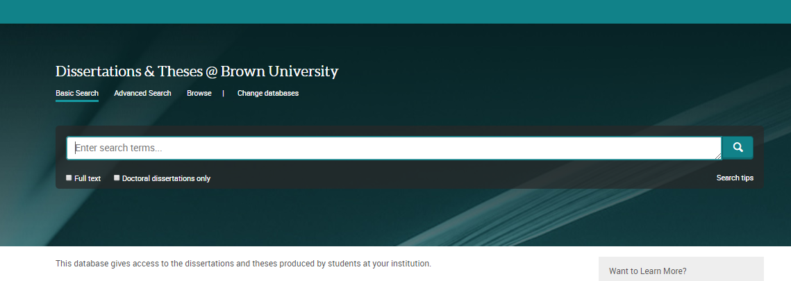
Your University Website hosted for free
Dissertations&Theses@
Free website access to Full Text PDF, citations, abstracts, and page previews of your university’s content.
Access is based on the IP ranges associated with the university campus
Dissertations&Theses@ can be searched in conjunction with PQDT
Notes:
(Only include for Smaller schools that don’t have an IR or don’t have the funds for a subscription.)

Slide 11
ETD Administrator
Notes:
Hi everyone! Thank you so much for being here today—it's a real pleasure to connect with you.
Before we dive in, I’d love to start with a quick round of introductions. If you could each briefly share your name, your role, and your connection to Oxford’s graduate research or repository, that would be great.
(Pause for introductions)
Thank you all—it's wonderful to have such a knowledgeable group here.
Today, I’m excited to share how Oxford can enhance the visibility and impact of its graduate research through an exciting new initiative at Clarivate: the Institutional Repository Thesis Discovery Service, or IRTDS.
Andy – Partnerships Manager
Austin Mclean – Senior Director – Partnerships
April Dawn - Senior Director, Product Management Academia & Government
Emma Dennis – AM
James Dodd – Librarian Collections
Jason Partridge – Open Access Services Development Lead
Ruth Mallalieu - Head of Open Scholarship Support - academic librarian and legal information specialist
Andrew Bonnie - ‘Chief of Digital Operations’, at the Bodleian Library

Slide 12
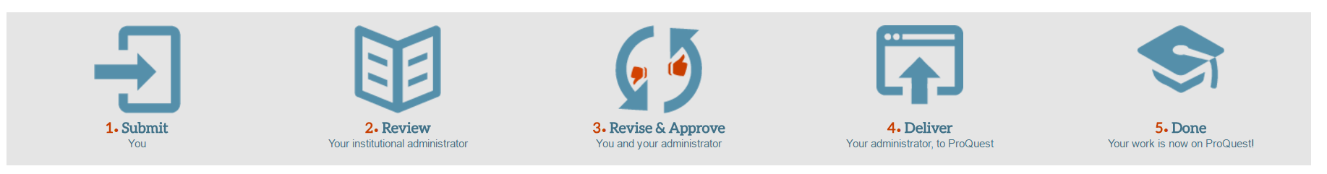
ETD Administrator: A FREE and easy way to manage content
Easy and fast online submission process
Customizable workflow to meet your approval needs
Notes:
The ProQuest ETD Administrator is a no-fee web based submission and management system.
Each ETD Administrator site is configured specifically for the university
Populates the Institutional Repository and is Hosted and supported by ProQuest

Slide 13
University Benefits
Author Submission
Format Review
Committee Review
Delivery to IR
Delivery to PQDT
A digital process that improves the experience and provides support
Customized workflows and alerts for administrators and students
NEW! Committee review feature can provide added efficiencies to workflows
Revisions
APPROVED
Revisions
Flexibility for non-traditional submissions. ETD Admin can house supplemental files, PDFs, video, and audio files.
NEW! Single sign-on feature works with Shibboleth to allow students and admins to use their university logins to access the ETD Admin system
University copies are an option for their print collection
Be supported by a responsive PQ customer service team

Slide 14
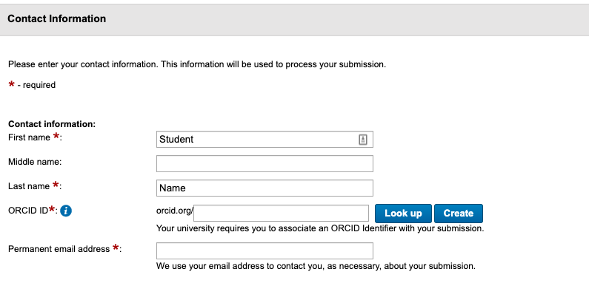
Author Benefits
Protect authors’ intellectual assets
Securely host content
Authors retain copyright
Embargo needs accommodated
Author royalty payments
Print copy options
Other Author services
Copyright registration, OA options
Use the ORCID ID you already have or generate one
Notes:
Dissertations and theses represent your institution’s most valuable intellectual assets. Promote and protect them with ProQuest Dissertations and Theses. ProQuest has been disseminating and archiving dissertations and theses since 1938 and have the technology in place to guard your authors’ work through restrictions, usage tracking, and royalty payments.

Slide 15
Next Steps and to Learn More:
Join the ETD Administrator User Group meeting tomorrow, Friday September 26, at 5:40 p.m. Eastern
To learn more, email: academic.relations@clarivate.com

