Slide 1
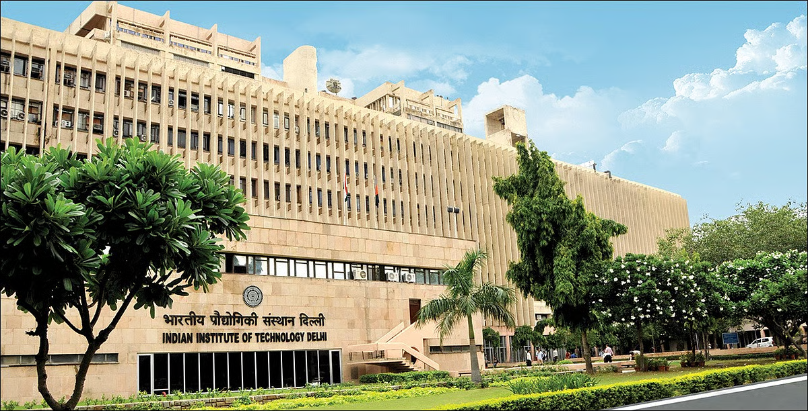

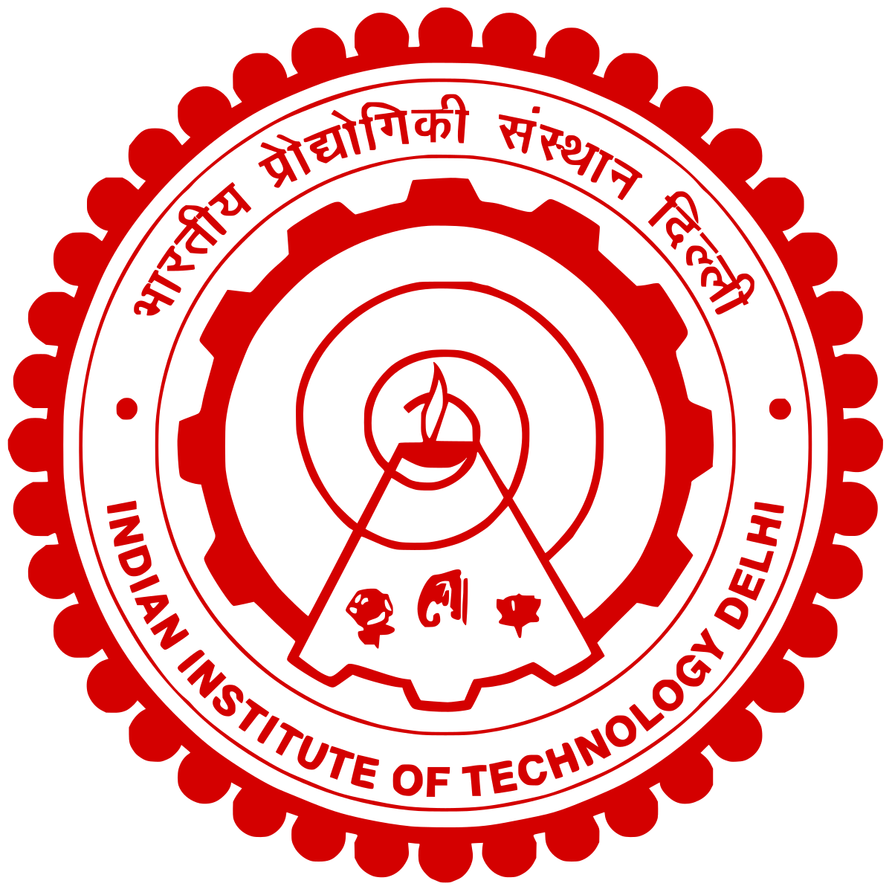

Welcome to
Indian Institute of Technology Delhi
(IIT Delhi)
Nabi Hasan
Head Librarian, Central Library
Indian Institute of Technology Delhi
https://web.iitd.ac.in/~hasan hasan@library.iitd.ac.in

Slide 2
About Nabi Hasan
Dr. Nabi Hasan, is the Head Librarian at the Indian Institute of Technology Delhi. With over three decades of professional experience, he is internationally recognized for his leadership in scholarly communication, digital transformation, ETDs, and open science.
He has successfully hosted and chaired major international and national conferences, including as Co-Chair of the SLA Annual Conferences in the USA, and Organizing Chair of one of India’s biggest LIS event, KEDL 2019 at IIT Delhi (https://project.ndl.gov.in/stm_event_category/kedl-2019).
He is a skilled facilitator who brings together academia, industry, government, and global agencies to build sustainable partnerships.
India’s first Norman E. Borlaug Fellow (Cornell University), he has received global honours such as Fellow of the Special Libraries Association, Bonnie Hilditch International Librarian Award, SLA Asia Excellence Award, IEEE Appreciations, Engineering Librarian of the Year and the Royal Society of Chemistry Librarians’ Choice Award.
Having played a pivotal role in transformative initiatives like One Nation One Subscription, NDLI, INDEST, ARPIT, and NPTEL, and through collaborations with the World Bank, UCL, and the European Union projects, Dr. Hasan together with IIT Delhi, a top-ranked Indian QS 2026 institution, and a Library Team of 40 dedicated people, offers proven capacity to design, host, and deliver ETD 2026 as a landmark global conference.
More details at: https://web.iitd.ac.in/~hasan

Slide 3
Indian Institute of Technology Delhi (IITD) https://iitd.ac.in
Established in 1961, IIT Delhi stands as a cornerstone of India's technological education landscape.
Main Campus - Hauz Khas
Sprawling 325-acre campus in the heart of New Delhi
123
2
2018-24
Sonipat Satellite Campus
QS World Rank 2026
NIRF Engineering Rank
Institution of Eminence
Expanding research and academic outreach.
Emerges as No.1 Education Institute in India
Consistently holding this position since 2023 in India
IIT Delhi was selected as an Institution of Eminence(IoE) by the MoE, Govt. of India
Jhajjar Extension
13,000
700
200+
Additional campus space dedicated to cutting-edge research projects and industry collaborations.
Students
Faculty Members
Active Startups
Technology & Infrastructure:
High-speed campus networks, videoconferencing, and IT support.
Proven capacity to host large-scale international and national conferences.
IIT Delhi Abu Dhabi
International Campus, offering BTech, MTech and PhD

Slide 4
Indian Institute of Technology Delhi (IITD) https://iitd.ac.in
Infrastructure
  Modern lecture halls, auditoria, classrooms, and state-of-the-art laboratories.
  Hostels & Guest Houses: Student hostels, faculty/visitor guest houses, and accommodation for delegates.
  Sports and recreation facilities (stadium, fields, indoor sports complexes).
Conference & Event Venues
  Main auditorium, seminar halls, library committee rooms and multiple smart classrooms.
  Hybrid event facilities enabling global participation.
Location Advantage
  Situated in New Delhi, India’s capital, with excellent air connectivity, hotels, and cultural attractions – making it ideal for an international conference.

Slide 5
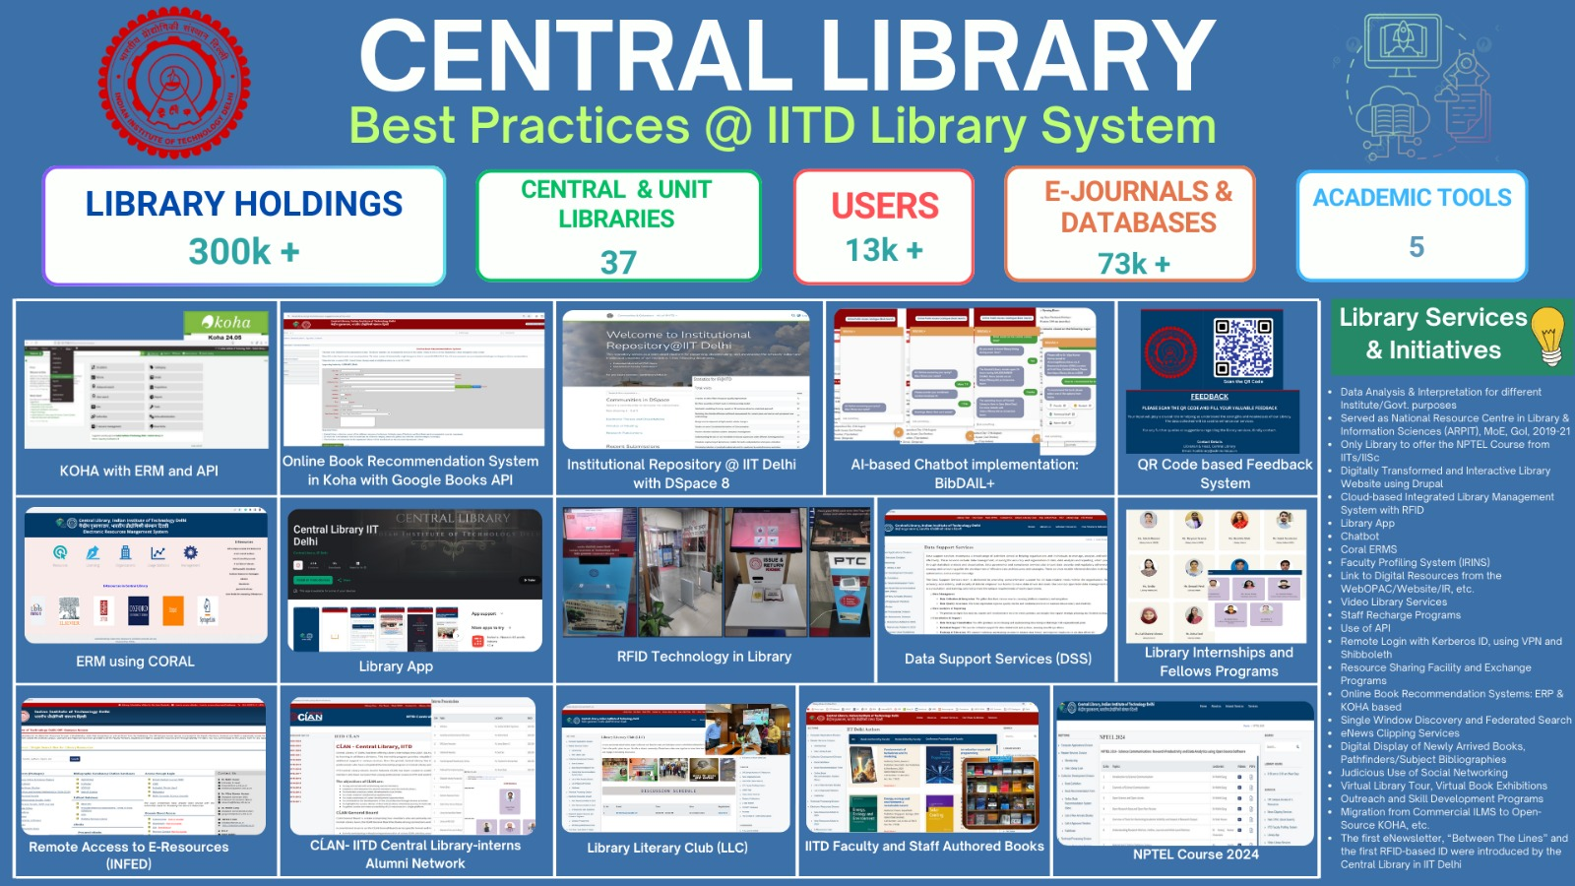

Slide 6
Hotels/Accommodations
Apart from Campus Guest House Accommodations for this In-Person Event, Delhi offers:
Hotel | Star Rating & Highlights | Distance / Advantages
JW Marriott Hotel New Delhi Aerocity | 5★ — Luxury, excellent dining, spa, meeting/banquet facilities. (expedia) | Very close to IGI Airport, good for delegates with flights.
Andaz Delhi (Hyatt) | 5★ — High-end luxury, modern amenities. (Hyatt) | In Aerocity, convenient for airport & conference venues.
Pullman New Delhi Aerocity Hotel | 5★ — Business facilities, comfortable rooms. (expedia) | Proximity to airport, good service.
Holiday Inn New Delhi Aerocity by IHG | 5★ — Reliable international brand, good facilities. (expedia) | Aerocity; easy access to both airport & city.
Aloft New Delhi Aerocity | 4-5★ — Trendy, modern design, good amenities for younger guests. (expedia) | Close to airport; less formal but high quality.
Novotel New Delhi Aerocity | 4-5★ — Good option for mid to upper-range guests, solid services. (expedia) | Centrally located within Aerocity.
Roseate House | 5★ — Boutique-luxury feel, more exclusive. (expedia) | Quiet, high comfort; still near the airport.
Hotel / Guest House | Star Rating & Highlights | Neighborhood & Advantages
Sheraton New Delhi Hotel | 5★ — Full luxury, large banquet facilities, excellent services. (expedia) | Hauz Khas area, good connectivity, scenic surroundings.
Hilton Garden Inn New Delhi/Saket | 4★ — Modern, comfortable, good amenities. (expedia) | Saket, which has shopping, restaurants, and easier transit.
The Grand New Delhi, Vasant Kunj | 5★ — Luxury resort-like, high standards, good meeting/banquet spaces. (thegrandnewdelhi.com) | Vasant Kunj — fairly close to airport and Aerocity; more tranquil area.
The Lodhi, New Delhi | Ultra-luxury — highly rated, prestigious hotel for international guests. (The Lodhi Hotel) | Lutyens’ Delhi area; excellent for high-profile delegates.
Leela Palace, New Delhi | Ultra-luxury / five-star legacy hotel. (Condé Nast Traveller India) | Central Delhi; iconic and very prestigious.
Eros Hotel New Delhi | 5★ — Established hotel with good amenities and banquet facilities. (Five Star Alliance) | Connaught Place area; more centrally located.

Slide 7
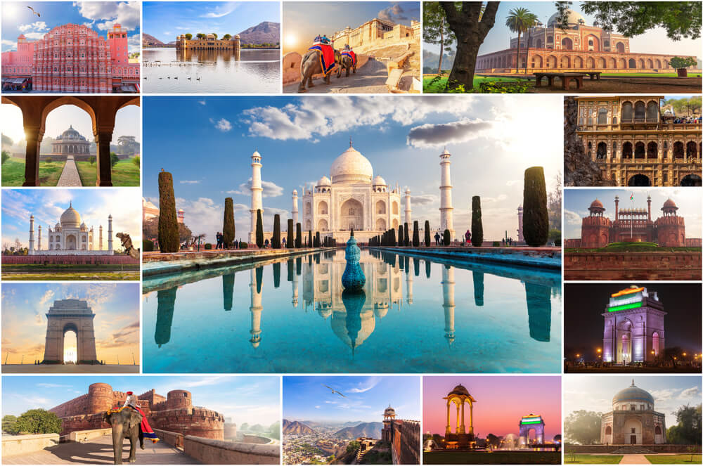
Places of Interest, in and around Delhi
Historical & Heritage Sites
Qutub Minar (UNESCO World Heritage Site) – 12th century victory tower, iconic Indo-Islamic architecture.
Humayun’s Tomb (UNESCO) – A Mughal masterpiece and precursor to the Taj Mahal.
Red Fort (UNESCO) – Majestic 17th century Mughal fort and former seat of power.
India Gate & Rajpath (Kartavya Path) – War memorial and ceremonial boulevard.
Lotus Temple (Baháʼí House of Worship) – Modern lotus-shaped architectural marvel open to all faiths.
Jama Masjid – One of the largest mosques in India, built by Shah Jahan.
Purana Qila (Old Fort) – With light-and-sound shows narrating Delhi’s history.

Slide 8
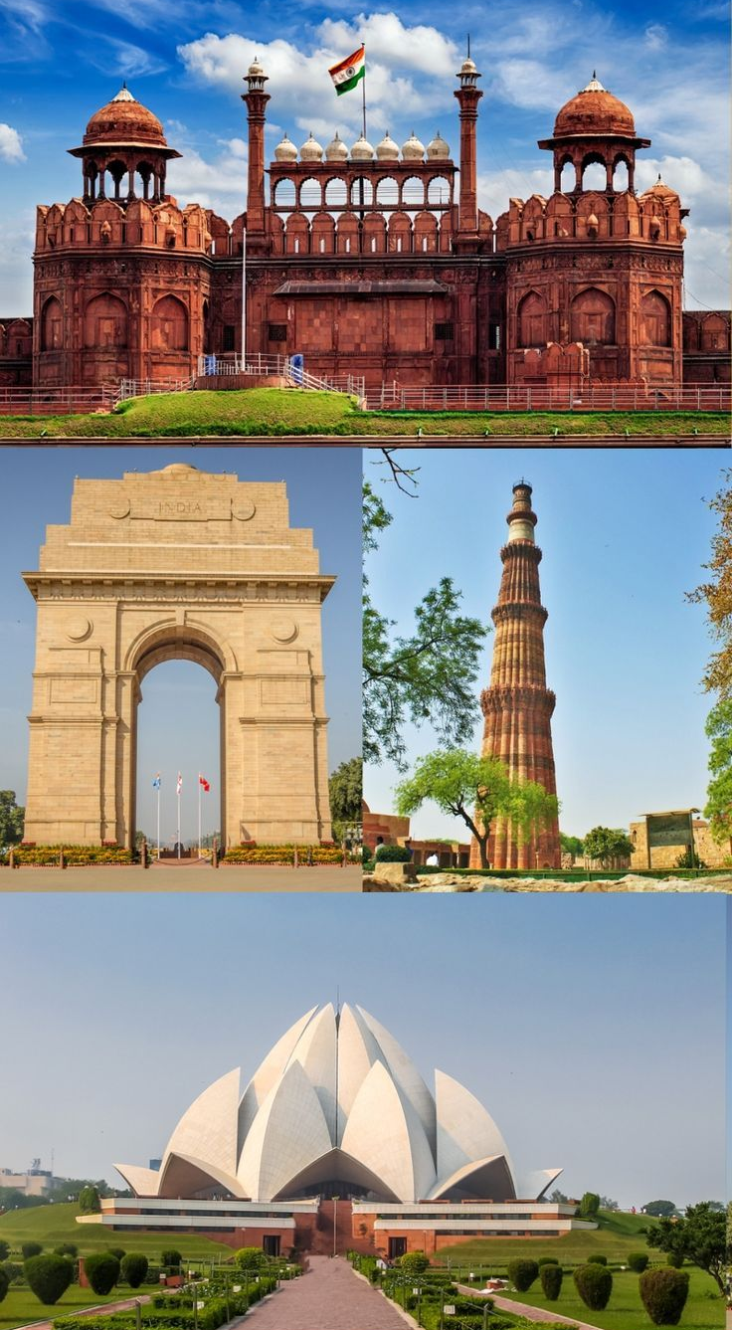
Places of Interest, in and around Delhi
Museums & Cultural Spaces
National Museum – Rich collection of Indian art, history, and archaeology.
National Gallery of Modern Art (NGMA) – Modern and contemporary Indian art.
Crafts Museum – Live demonstrations of traditional crafts and folk art.
Gandhi Smriti & Raj Ghat – Memorials dedicated to Mahatma Gandhi.
Modern & Contemporary Delhi
Akshardham Temple – Grand modern temple complex with cultural exhibits and evening water show.
Connaught Place – Heritage shopping, dining, and colonial-era architecture.
Hauz Khas Village – Blend of medieval ruins, art galleries, cafés, and boutiques.
DLF Emporio & Select Citywalk (Saket) – High-end shopping and dining.
Nature & Recreation
Lodhi Gardens – Beautiful heritage garden with tombs and walking trails.
Garden of Five Senses – Landscaped gardens and cultural events.
Day/Short Trips from Delhi
Agra (Taj Mahal, Agra Fort, Fatehpur Sikri) – ~3 hours by express train/car.
Jaipur (Amber Fort, City Palace, Hawa Mahal) – ~4–5 hours, part of the Golden Triangle.

Slide 9
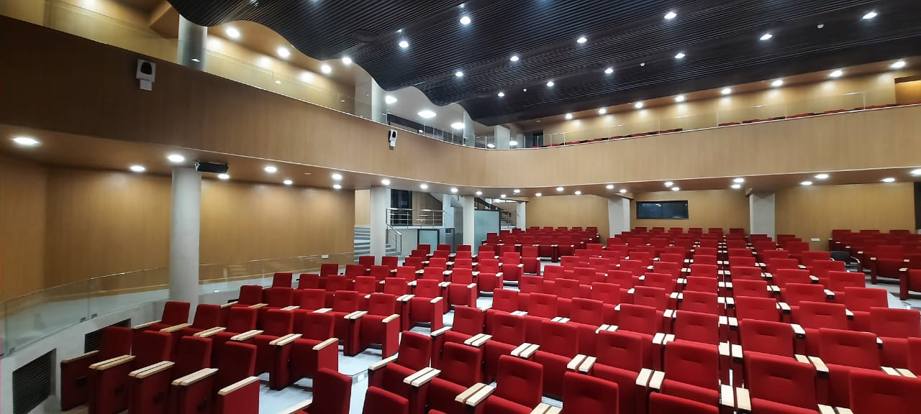
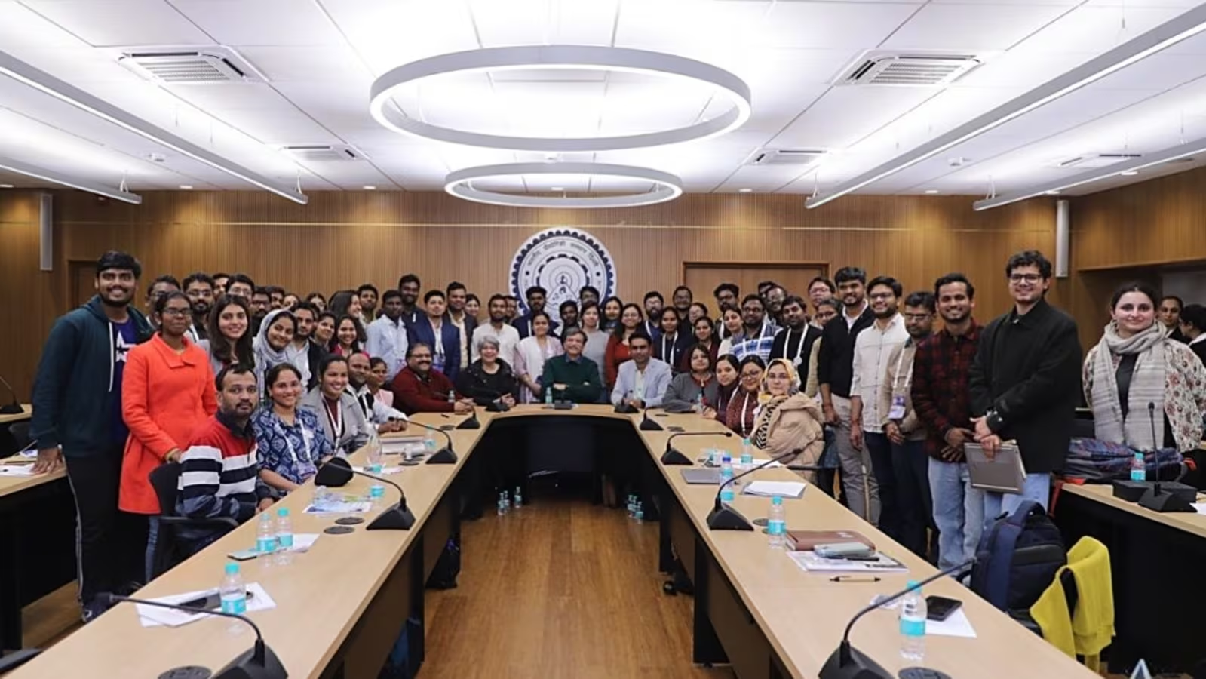
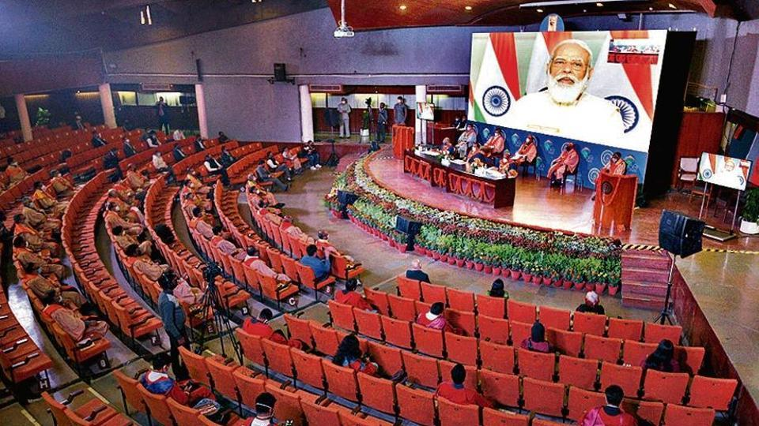
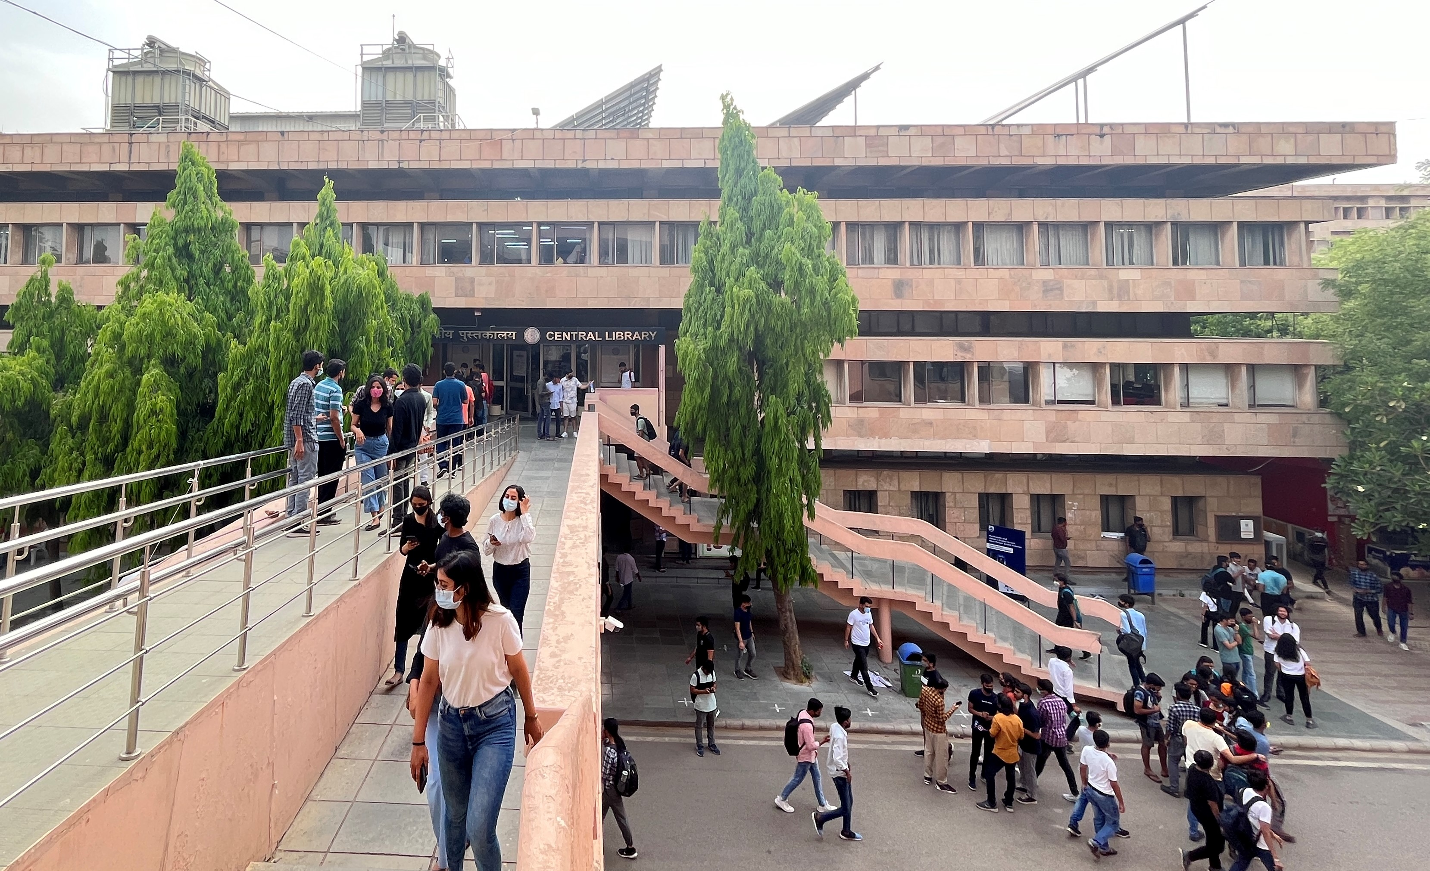
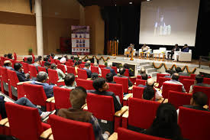
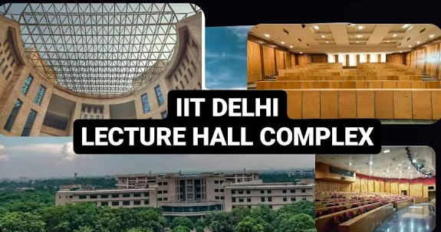
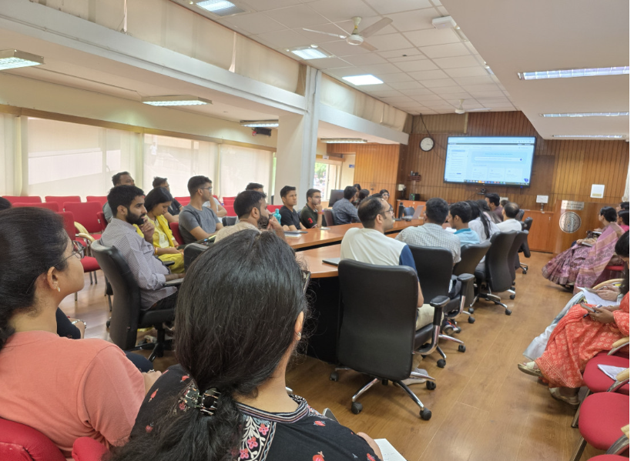
Proposed Venue, Spaces & Date
Date: October 10 – 11, 2026

Slide 10
Proposed Partners
IIT Delhi, as a premier institution and one of the top-ranked universities globally, has the required infrastructure, expertise, and organizational strength to host ETD 2026 independently, without the need for formal partners.
The Institute has successfully organized numerous large-scale international conferences, workshops, and academic events, and its centrally located main campus in New Delhi offers state-of-the-art facilities for hosting global delegates.
While formal partners are not required, IIT Delhi will actively seek guidance and voluntary support from leading LIS professionals and institutions in Delhi to ensure the success of the event.
In particular, guidance from Prof. Ramesh C. Gaur, and team of JNU New Delhi, who successfully hosted ETD 2015, will bring valuable experience and insight. This collective expertise, combined with IIT Delhi’s resources and leadership, guarantees the seamless organization of ETD 2026 at the highest international standards.

Slide 11
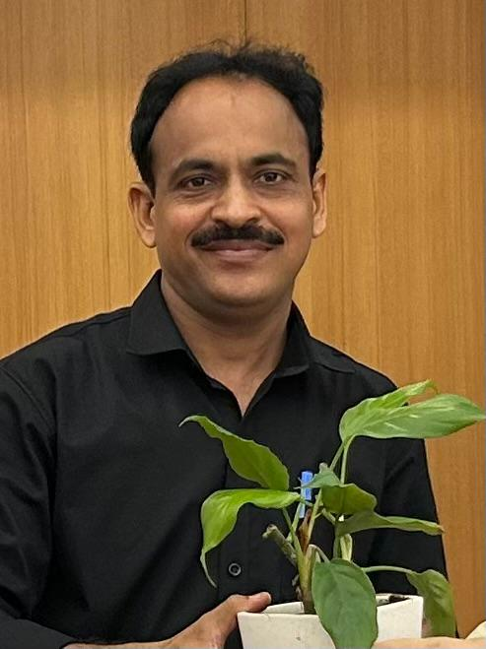
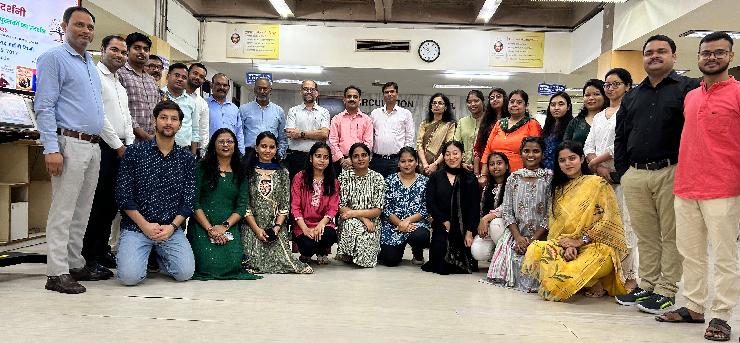
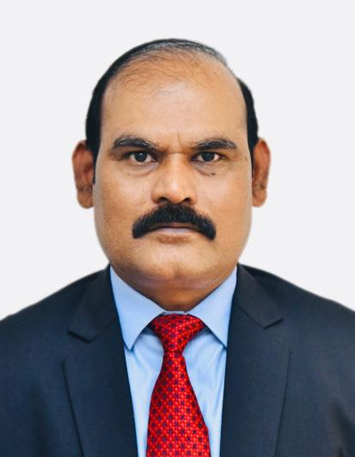
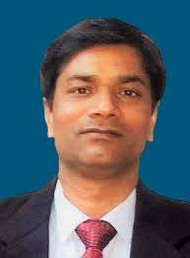
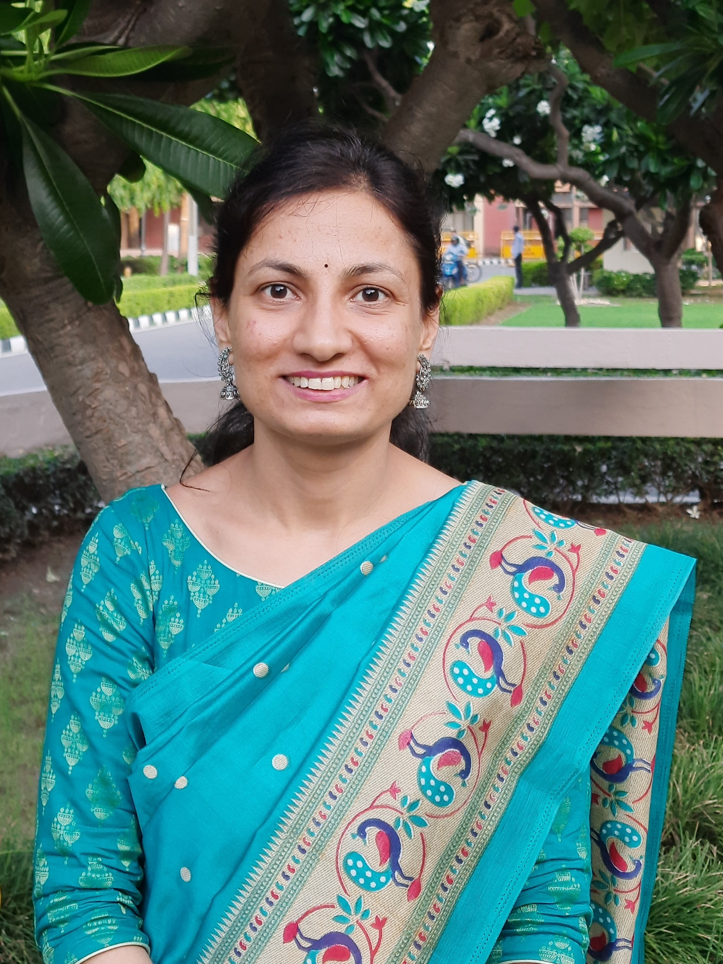
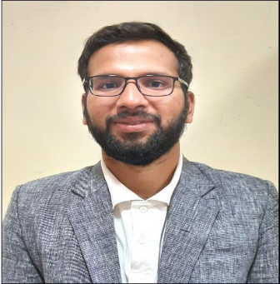
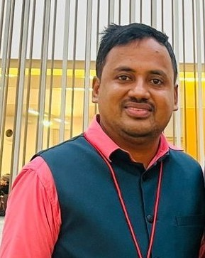
Dr. Neeraj Chaurasia
Deputy Librarian
e-mail: neerajkc@library.iitd.ac.in
Profile: https://library.iitd.ac.in/Neeraj-Kumar-Chaurasia
Dr. Shankar B. Chavan
Deputy Librarian
e-mail: shankar.chavan@library.iitd.ac.in
Profile: http://web.iitd.ernet.in/~shankar.chavan
Dr. Vijay Kumar Verma
Assistant Librarian (SG)
e-mail: vkverma@library.iitd.ac.in
Profile: https://library.iitd.ac.in/Vijay-Kumar-Verma
Dr. Vanita Khanchandani
Assistant Librarian (SG)
e-mail: vanita@library.iitd.ac.in
Profile: https://library.iitd.ac.in/Vanita-Khanchandani
Dr. Manu T R
Assistant Librarian
e-mail: manutr@library.iitd.ac.in
Profile: https://web.iitd.ac.in/~manutr/
Dr. Mohit Garg
Assistant Librarian (SS)
e-mail: gargmohit@library.iitd.ac.in
Profile: https://web.iitd.ac.in/~gargmohit
Dr. Nabi Hasan
Head Librarian, Central Library, IIT Delhi
e-mail: hodlibrary@admin.iitd.ac.in
Profile: https://web.iitd.ac.in/~hasan
https://library.iitd.ac.in/our-team
Thank You

