Slide 1

Enhancing ETD Topic Modeling: A Framework Integrating LLMs for Improved Digital Library Discovery
Pradyumna Upendra Dasu (Virginia Tech CS),
Satvik Chekuri (Virginia Tech CS),
William Ingram (Virginia Tech University Libraries)
Edward A. Fox (Virginia Tech CS)
The ETD 2025 Symposium – USETDA 2025 Conference
September 25, 2025
Virtual

Slide 2
Introduction
Data
Enhancing Data for Topic Modeling
Development and Enhancement of Topic Modeling
Results and Discussion
Conclusion and Future Work
OUTLINE

Slide 3
INTRODUCTION

Slide 4
Introduction – Context
The volume of scholarly content (e.g., research papers, ETDs) is growing rapidly, creating challenges in organization and accessibility.
Virginia Tech pioneered electronic theses and dissertations (ETDs), leading efforts for global accessibility.
1

Slide 5
Introduction – Motivation
Digital libraries face challenges in providing effective browsing, searching, and discovery mechanisms.
ETDs’ interdisciplinary nature and specialized vocabularies complicate content discovery.
Topic modeling could aid exploration and discovery.
2

Slide 6
Introduction – Problem Statement
Challenges:
Topic modeling should ensure semantic coherence and interpretability, especially in complex, heterogeneous datasets like ETDs.
Keyword-based representations lack contextual richness and fail to capture meaningful thematic relationships.
Proposed Solution:
Enhance topic modeling with Large Language Models (LLMs).
3

Slide 7

Introduction – Questions
How do custom preprocessing techniques and text enhancement impact topic modeling performance?
What are the advantages and limitations of traditional, neural, and transformer-based topic models for ETDs?
How effectively can LLMs enhance topic representations in ETDs?
5

Slide 8
LITERATURE REVIEW

Slide 9
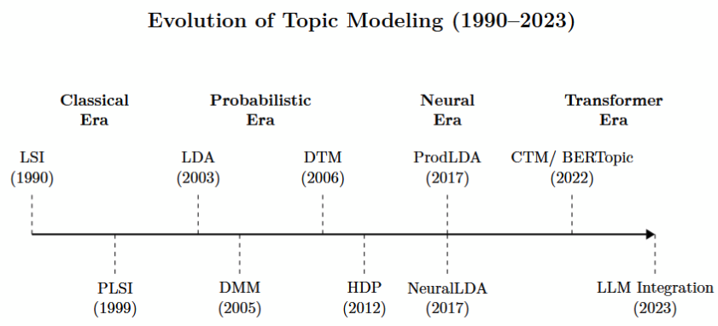
Evolution in Topic Modeling
LSI, PLSI: Introduced foundational methods but lacked scalability and flexibility.
LDA revolutionized with Dirichlet distributions, extended by HDP and DTM.
ProdLDA and NeuralLDA leveraged neural networks for better coherence.
BERTopic and CTM use contextual embeddings for advanced coherence.
6

Slide 10
Evaluation of Topic Models
Metrics:
Coherence: Measures semantic relatedness of words in a topic.
E.g., PMI, NPMI, CV (traditional coherence metrics), word-embedding based coherence.
Diversity: Ensures topics are distinct and non-overlapping.
Human Interpretability: Assessed through manual evaluations.
7

Slide 11
DATA

Slide 12
Dataset Overview
Purpose: Use ETD metadata for topic modeling and scalability testing.
Datasets:
Name | Number of Documents | Source | Use
Large ETD Dataset | 520,100 | ETDs from 42 U.S. Universities | Scalability validation
Curated ETD Dataset | 9,400 | Curated subset from Large ETD Dataset | Detailed experimentation
20 Newsgroups Dataset | 18,846 | Public NLP benchmark dataset | Text complexity comparison
8

Slide 13
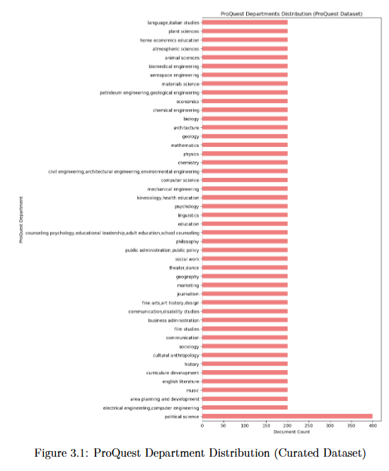
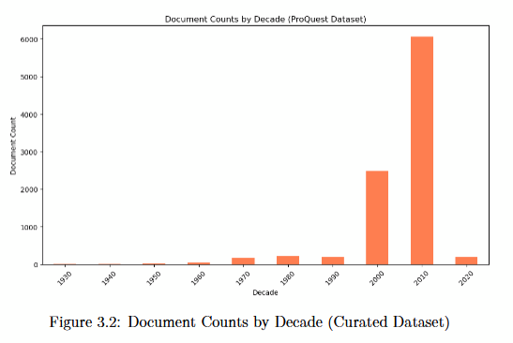
Curated ETD Dataset: Metadata Distribution
Department distribution:
Broad coverage across disciplines, e.g., political science, engineering, etc.
Decadal distribution:
Majority of documents are from the 2010s.
9

Slide 14
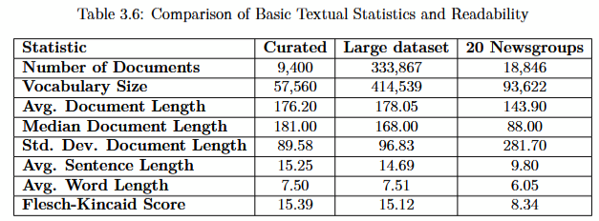
Comparison of Dataset Characteristics
Comparative metrics for Curated ETD, Large ETD, and 20 Newsgroups datasets:
Academic datasets are linguistically complex:
Curated/Large ETD:
High vocabulary size, long sentences, Flesch-Kincaid ~15.
20 Newsgroups:
Simpler language, Flesch-Kincaid ~8.3.
10

Slide 15
ENHANCING DATA FOR TOPIC MODELING

Slide 16
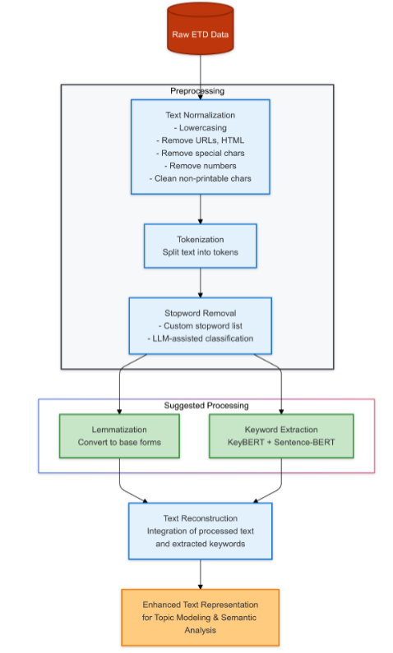
Preprocessing for ETD Data
Challenges with ETDs:
Complex academic writing with domain-specific terminology.
Goal: Prepare high-quality text inputs for topic modeling while preserving semantic richness.
Overview of Steps:
Text Normalization
Tokenization
Stopword Removal
Lemmatization
Text Enhancement
13

Slide 17
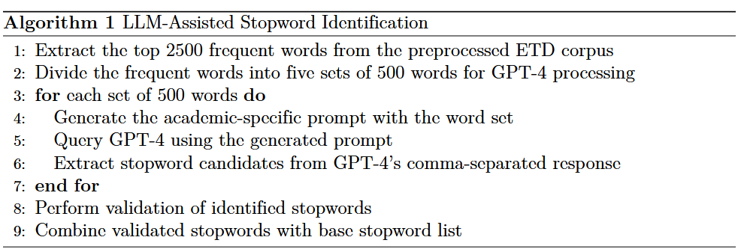
LLM-Assisted Stopword Removal
Generic Scope: Traditional lists (e.g., NLTK, Gensim) target general-purpose text.
Lack of Academic Context: Terms common in academic writing (e.g., "analysis","research", "thesis") remain unfiltered, adding noise to models.
Inadequate for Domain-Specific Needs: No adaptive process to handle nuanced academic vocabulary.
14

Slide 18
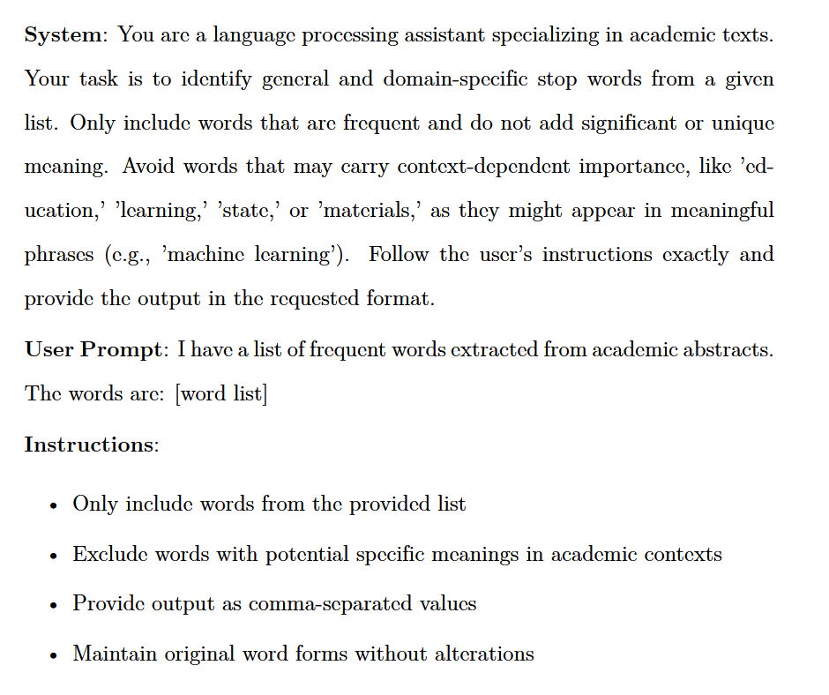
LLM-Assisted Stopword Removal - 2
Validation and Refinement:
Human-in-the-loop process ensured:
Academic-specific words like "study" and "research" were included in stopword list.
Important terms like "learning" or "image" were preserved.
Outcomes:
Enhanced Stopword List: 320 domain-specific stopwords added.
Stopword List Size: 1,086 refined stopwords that can be extended further.
Impact: Improved topic coherence by filtering irrelevant terms without losing semantic richness.
15

Slide 19
Enhanced Text Representation
What?
Combined title, abstract, and extracted keywords into a unified Enhanced Text field.
Performance:
Compared with Titles, Abstracts, (Title + Abstracts) and Keywords.
Metrics (BERTopic Coherence and Diversity):
CV Score: Enhanced Text: 0.778 > Abstracts: 0.717.
ETC Score: Enhanced Text: 0.746 > Abstracts: 0.675.
Outcome: Significantly improved topic coherence and interpretability.
16

Slide 20
DEVELOPMENT AND ENHANCEMENT OF TOPIC MODELING

Slide 21
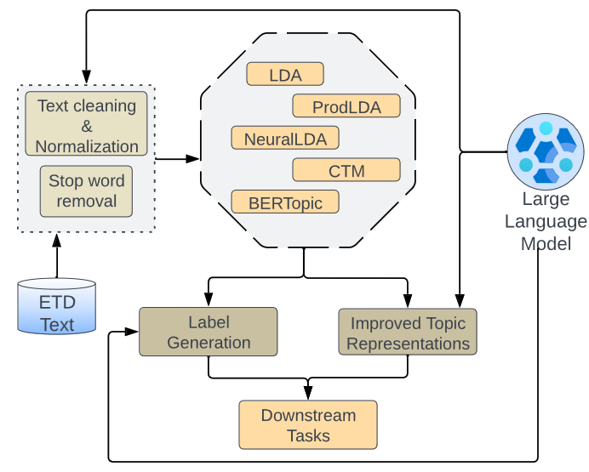
Topic Modeling Approaches
Early Model:
LDA: Interpretable but less context-aware.
Neural Models:
NeuralLDA, ProdLDA: Use neural networks for better topic coherence.
Contextual Models:
CTM: Adds contextual richness with BERT embeddings.
BERTopic: Uses clustering in embedding space for semantic coherence.
17

Slide 22
Evaluation Metrics
Coherence:
CV: Semantic consistency of top words in a topic.
NPMI: Frequency of top word co-occurrences.
Topic Diversity:
Distinct themes captured by each topic.
Embedding Coherence (WEPS)
Semantic similarity of keywords using word embeddings.
Purpose:
Comprehensive model evaluation.
Balance of traditional and embedding-based metrics.
18

Slide 23
BERTopic: The Best Performer
Performance:
Best coherence and diversity scores among all models.
Embedding Model:
bert-base-uncased:
cde-small-v1:
Why It Works:
Combines contextual embeddings with clustering for rich topic representations.
19

Slide 24
BERTopic: The Best Performer - 2
Remaining Problem:
Topic model outputs (keywords) can be ambiguous or unclear.
Impact:
Users struggle to understand and utilize topic representations effectively.
Solution:
Integrate Large Language Models (LLMs) to enhance interpretability.
20

Slide 25
Prompt Design for LLMs
System Prompt (Sets Context):
"You are an expert in topic modeling and natural language processing. Your task is to help interpret topic model outputs from BERTopic, maintaining consistency and clarity while providing meaningful insights. Consider the semantic relationships between words and their natural groupings when interpreting topics. Ensure all outputs are clear, concise, and academically appropriate."
Purpose of Prompts:
Tailored to generate three types of enhanced outputs:
Keyphrases: Highlight sub-themes in 6–7 concise phrases.
Labels: Summarize topics in 3–5 descriptive words.
Descriptions: Provide a 2–3 sentence overview connecting keywords.
21

Slide 26
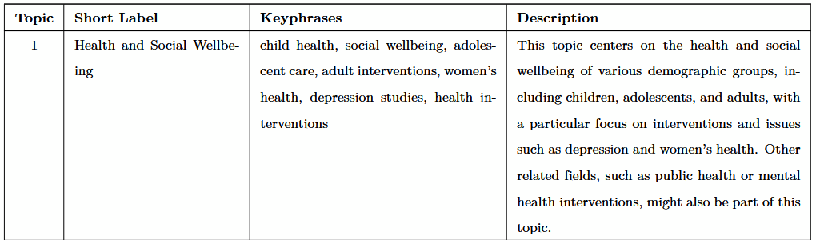
Prompt Design for LLMs - 2
Example Input Keywords:
["health", "child", "social", "participant", "woman", "adolescent", "adult", "intervention", "individual", "depression"]
22

Slide 27
Consolidated Prompt for LLMs
Why Use a Consolidated Prompt?
Combines the generation of keyphrases, labels, and descriptions in a single step.
Efficient for testing outputs across LLMs like GPT-4, Llama 3, and Mixtral.
LLM Platforms Used:
OpenAI API: For GPT-4 outputs.
Groq Playground: To test open-source models like Llama 3.1-70B and Mixtral-8x7B.
Language Models Used:
GPT-4o
Llama 3.1-70b
Llama 3.2-90b
Llama 3.2-3b
Mixtral-8x7B
23

Slide 28
Evaluating LLM-Enhanced Representations
Word Embedding-Based Centroid Similarity (WECS):
Measures alignment between LLM outputs and:
Original topic keywords.
Metadata categories (e.g., ProQuest category labels).
User Study:
Participants rate clarity, relevance, and accuracy of representations.
Representations ranked based on user preferences.
24

Slide 29
RESULTS AND DISCUSSION

Slide 30
Section Outline
Impact of Preprocessing
Comparison of Topic Modeling Approaches
LLM-Enhanced Results
25

Slide 31
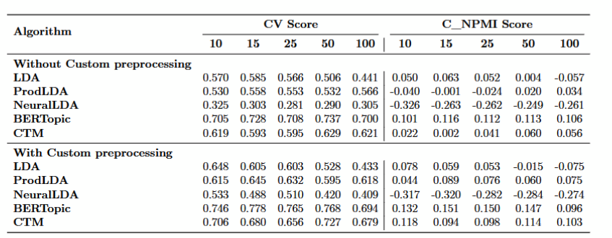
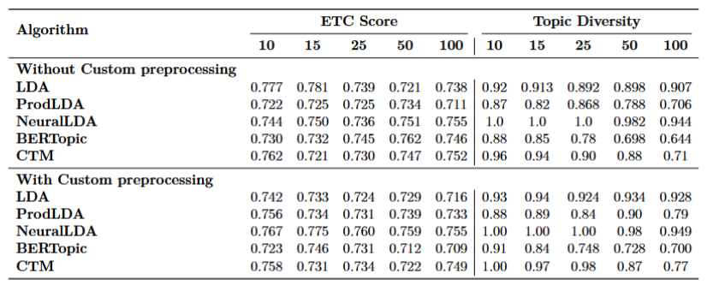
Impact of Preprocessing
Custom Pipeline Advantages:
Enhanced stopword list and text enrichment boosted coherence scores.
BERTopic: CV improved from 0.728 to 0.778 at k=15k.
27

Slide 32
Impact of Preprocessing - 2
Patterns Observed:
Preprocessing benefits were most significant at lower topic counts (k<50).
Coherence metrics (e.g., CV, NPMI) improved more than diversity.
Guidance for Applications:
Tailored preprocessing investments should align with the intended number of topics and application requirements.
Metrics improved with preprocessing:
CV Score: Significant improvement across models.
NPMI: Increased semantic alignment.
Topic Diversity: Minimal change.
Largest gains observed for BERTopic and CTM.
28

Slide 33
Performance of Topic Modeling Approaches
Key Insights:
BERTopic consistently outperformed other models in coherence (i.e., CV 0.694 - 0.746).
NeuralLDA showed moderate coherence scores but lagged in contextual understanding (i.e., CV 0.409 - 0.533).
LDA excelled in diversity, retaining broad topic coverage (>0.9).
30

Slide 34
Performance of Topic Modeling Approaches - 2
Trade-offs Identified:
BERTopic’s dense clustering prioritizes semantic richness but reduces diversity.
LDA’s statistical approach provides broader topics but lacks semantic nuances.
Ideal Use Cases:
BERTopic/CTM: Suitable for precise, interpretable topics (e.g., academic search tools).
LDA: Better for exploratory analysis where broad topic coverage is essential.
31

Slide 35
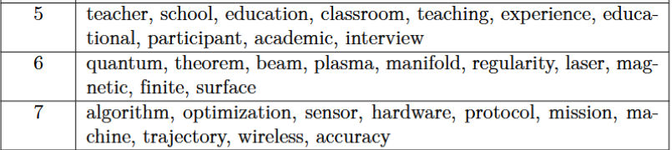
GPT-4 Enhanced Representations
Original BERTopic keywords challenge:
Raw keywords with limited context
Example: "teacher, school, education, classroom..."
Enhanced Three-Level Structure:
Short Labels: Clear, concise topic summaries
Keyphrases: Granular sub-themes
Descriptions: Rich context and scope
Prior to enhancement:
33

Slide 36
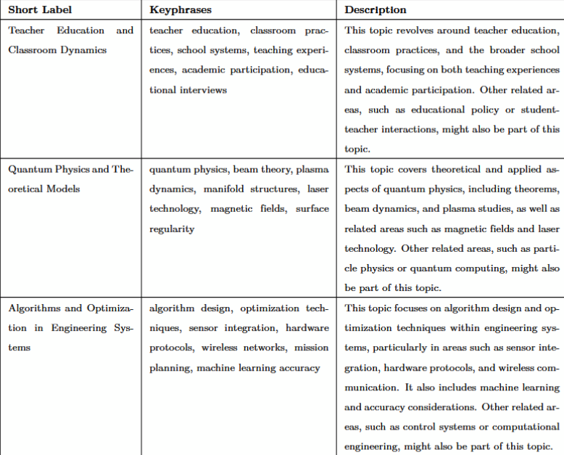
GPT-4 Enhanced Representations - 2
34

Slide 37
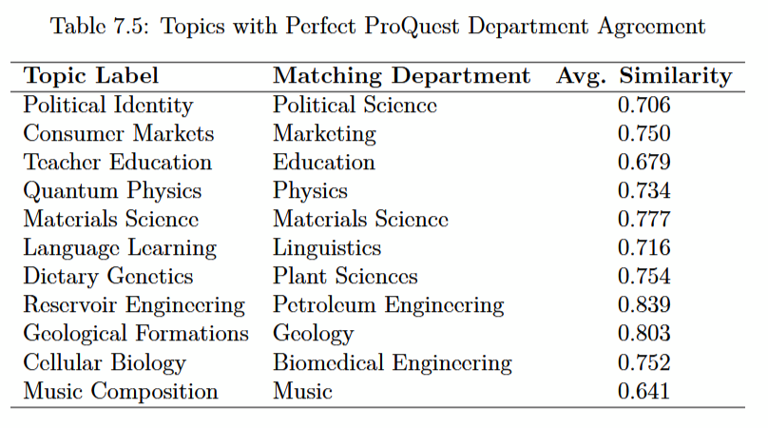
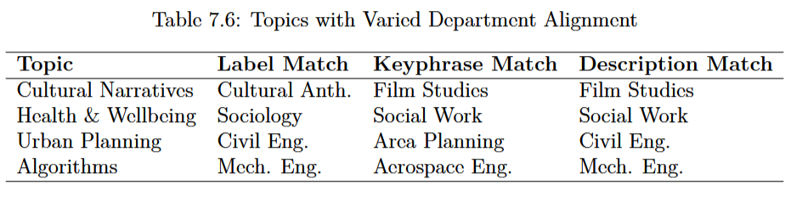
WECS Analysis of GPT-4 Generated Outputs
Perfect agreement occurs when all three topic representations consistently align with the same ProQuest department category
73.3% perfect agreement (11/15 topics)
Highest matches:
Geology (0.803)
Materials Science (0.777)
Political Identity (0.706)
35

Slide 38
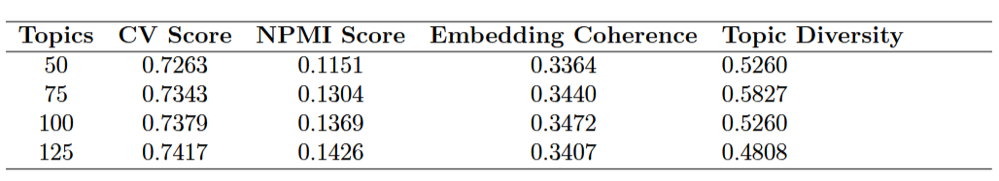
Scaling to 333,867 Documents
Performance Trends:
CV scores increased with higher topic counts (e.g., 0.726 to 0.741).
Diversity decreased from 0.5827 (75 topics) to 0.4808 (125 topics).
Embedding coherence remained low (∼0.34).
Challenges Identified:
K-means struggled to preserve diversity at scale.
Embeddings lacked nuance for academic relationships.
Practical Implications:
Topic modeling algorithms may not scale effectively without adaptation.
Need to balance computational efficiency with semantic quality.
36

Slide 39
USER STUDY

Slide 40
Overview
Objectives:
To evaluate the clarity, relevance, and accuracy of LLM-enhanced topic representations.
To understand user preferences across different representation types.
Study Design:
15 topics, 4 representation types (Keywords, Keyphrases, Labels, Descriptions).
Participants evaluated representations for 10 selected topics.
Participant Demographics:
Current: 7 participants (4 CS, 1 Biochemistry, 1 Civil Engineering, 1 Veterinary Science).
Target: 40 participants, including faculty, graduate students, and researchers.
37

Slide 41
Study Procedure
Topic Selection:
From 15 topics, participants selected 10 based on their expertise.
Evaluation Task:
Read two abstracts per topic.
Rated 4 representation types on clarity, relevance, and accuracy using a 3-point Likert scale.
Accuracy: Alignment with the given abstracts.
Clarity: Ease of understanding.
Relevance: Applicability to abstract content.
Ranked representations by overall effectiveness and clarity.
Qualitative Feedback:
Participants provided optional feedback on the study.
38

Slide 42
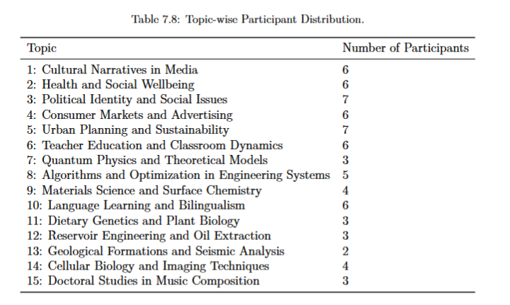
Participant Distribution and Topic Selection
39

Slide 43
Evaluation of Topic Representations
Performance Overview:
Keyphrases (KP):
Best overall performance; dominating in accuracy, clarity, and relevance across most topics (e.g., Health and Social Wellbeing, Materials Science and Surface Chemistry).
Labels (L):
Highly favored for relevance and clarity; providing concise and interpretable summaries (e.g., Political Identity and Social Issues).
Topic Descriptions (TD):
Strong in accuracy and clarity, especially for complex or abstract topics (e.g., Urban Planning and Sustainability, Quantum Physics and Theoretical Models).
Keywords (K):
Baseline representation; limited in performance due to lack of contextual depth and interpretability.
40

Slide 44
Ranking and Preferences
Category | Key Insights
Clearness | Labels are consistently clear, providing concise and interpretable information. Topic Descriptions often lack clarity due to verbosity and complexity.
Effectiveness | LLM representations excel in providing rich context and supporting deeper understanding. Keywords often fall short in effectiveness, lacking sufficient depth and contextual richness.
Takeaways:
Different representations excel in different contexts.
LLM-generated outputs provide clarity and depth beyond Keywords.
41

Slide 45
Limitations
Limitations:
Sample Size: Small (n=7); encouraging recruitment toward 40 participants.
Topic Coverage: Uneven participant distribution across topics.
Generalizability: Findings are directional but need validation with a larger, more diverse sample.
Next Steps:
Expand participant pool to achieve balanced topic coverage.
Investigate interdisciplinary preferences for topic representations.
Validate findings with faculty and researchers.
42

Slide 46
CONCLUSION AND FUTURE WORK

Slide 47
Concluding Remarks
Combining BERTopic with LLM enhancements improves interpretability and coherence in academic texts like ETDs, paving the way for advanced digital library tools.
Summary of Results:
Preprocessing improved coherence and diversity, with diminishing returns at higher topic counts.
BERTopic demonstrated superior coherence, while LDA maintained better topic diversity.
LLMs enhance interpretability and semantic alignment, with users favoring LLM-generated representations.
43

Slide 48
Future Work
User Studies: Broaden participant pool; compare STEM vs. non-STEM preferences.
Temporal Analysis: Analyze topic trends and interdisciplinary themes.
Real-Time Integration: Improve academic search and topic navigation.
Interactive Tools: Enable users to refine topics and improve model outputs.
44

Slide 49
Q&A

Slide 50

Large Image

