Slide 1


Developing Policy-Adjacent Language on AI-Use in Graduate Research
Drs. Greg Newton & Ruth Lu
Graduate College, Ohio University
USETDA ETD 2025 Symposium
September 26, 2025

Slide 2
Framing the Issue
Importance of theses/dissertations
Role of AI in academic writing
Why policy-adjacent language matters
Notes:
Theses and dissertations push the boundaries of the current literature and they are often the original contribution to a field. They represent a lot of things: graduate students’ ability to conduct research, synthize knowledge, and communicate findings. These documents—electronic theses and dissertations (ETDs) often become part of the academic and publication records and used by future researchers, so the integrity of it all becomes important.
In recent years, AI tools are increasingly used in the writing process: various products are available from correcting grammatical errors to paraphrasing content and even drafting sections.
While these tools can be of great assistance, they also raise issues such as the questions of who is the true author? How do we ensure transparency in the use of AI? What constitutes acceptable assistance versus unethical authorship?
All of these questions lead to our topic of why policy-adjacent language matters

Slide 3
Policy vs. Guidelines
Definitions and implications
Benefits of flexible guidance
Risks of rigid policies
Why policy-adjacent language matters
Notes:
For policy-adjacent language, we sometimes refer to them as guidelines. As mentioned in the last slide, policy implies formal, enforceable rules—often with consequences for non-compliance.
Guidelines, on the other hand, are advisory. They offer direction, promote best practices, and encourage consistency. They also allow for interpretation and adaptation across disciplines and practical cases.
The benefits of having flexible guidance can include many. It can encourage innovation while maintaining integrity. It can be updated more easily as new tools and use cases emerge. It can also respect disciplinary differences—what’s appropriate in engineering may differ from what’s appropriate in philosophy. Guidelines also foster a culture of trust and shared responsibility rather than surveillance and enforcement.
The risks of rigid policies may create fear or confusion among students and faculty, stifle creativity and experimentation, lead to inconsistent enforcement or unintended consequences. In some cases, rigid policies may not keep pace with the technology, making them obsolete or irrelevant quickly.
And that’s why policy-adjacent language is a middle ground. It is not about avoiding structure, but giving it a flexible spin so it creates living language that can evolve, this language helps institutions to: 1) set expectations, 2) promote transparency, 3) respond quickly to emerging practices, 4) offer guidance without enforcement, 5) encourage ethical use while respecting disciplinary differences, and 6) build consensus without locking into premature rules.

Slide 4
Benchmarking Peer Institutions
University of Wisconsin: Responsible AI Use
Iowa State University: Generative AI in Research: Guidance FAQ
Ohio University: Gen AI in Teaching
Notes:
At this point, you might be thinking, “Wow, you’ve done a lot of homework to make the case for policy-adjacent language!”But the real question is: How are higher education institutions actually responding to AI use in graduate research?That’s what we’ve been exploring—through benchmarking, local initiatives, and real-world cases.The takeaway is clear: while formal policies are still emerging, many institutions are leaning into flexible, adaptive guidance that reflects the complexity and diversity of academic work.
Now we will share several examples of this from our peer universities, and here at OHIO.
- Effective and Responsible Use of AI in Research – UW Graduate School
Generative AI Guidance - Iowa State Research
https://www.ohio.edu/center-teaching-learning/teaching-learning-genai
https://www.ohio.edu/center-teaching-learning/instructor-resources/syllabus-guide

Slide 5
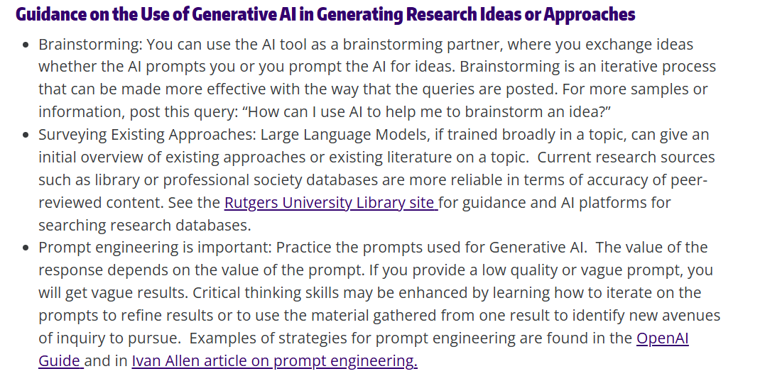
Benchmarking Peer Institutions
University of Wisconsin: Responsible AI Use

Slide 6
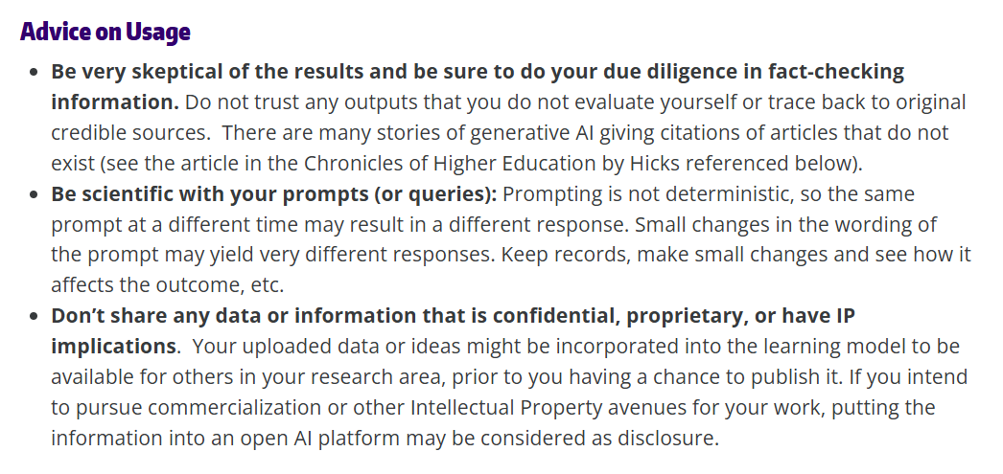
Benchmarking Peer Institutions
University of Wisconsin: Responsible AI Use
Notes:
Last bullet point: Co-Pilot in OU

Slide 7
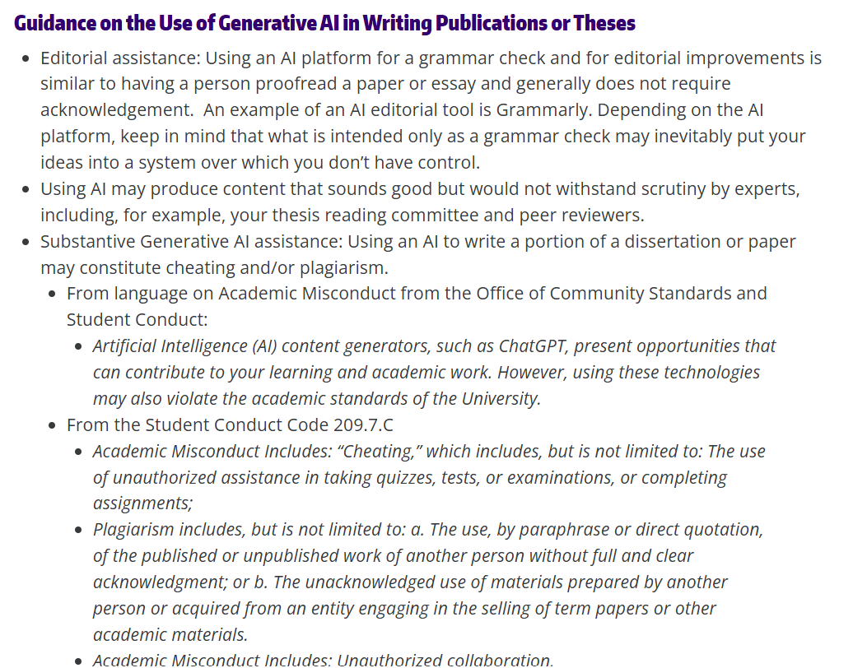
Benchmarking Peer Institutions
University of Wisconsin: Responsible AI Use
Notes:
Share examples from peer institutions and highlight practices that could inform OU Graduate College's approach:
- Effective and Responsible Use of AI in Research – UW Graduate School
Generative AI Guidance - Iowa State Research
https://www.ohio.edu/center-teaching-learning/teaching-learning-genai
https://www.ohio.edu/center-teaching-learning/instructor-resources/syllabus-guide

Slide 8
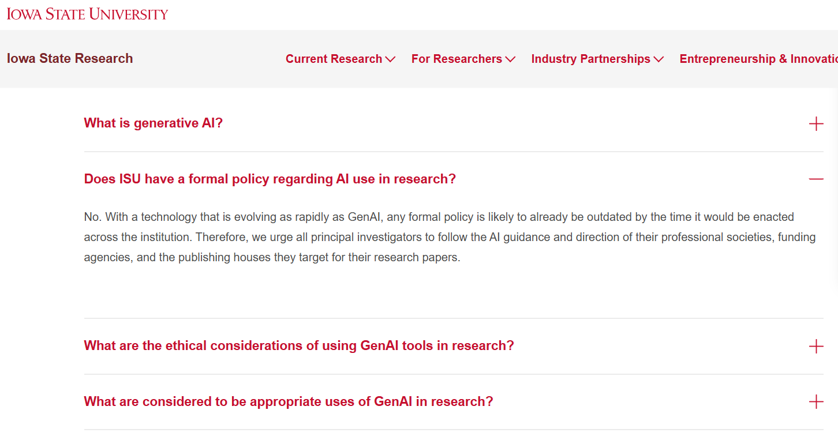
Benchmarking Peer Institutions
Iowa State University: Generative AI in Research: Guidance FAQ
Notes:
Kristin: “At Iowa State there is no policy on AI for theses and dissertations in our graduate handbook. Instead, we have been referring graduate students and graduate faculty to the guidance provided by the Vice President for Research, which references out to publishers' guidelines for authors.”

Slide 9
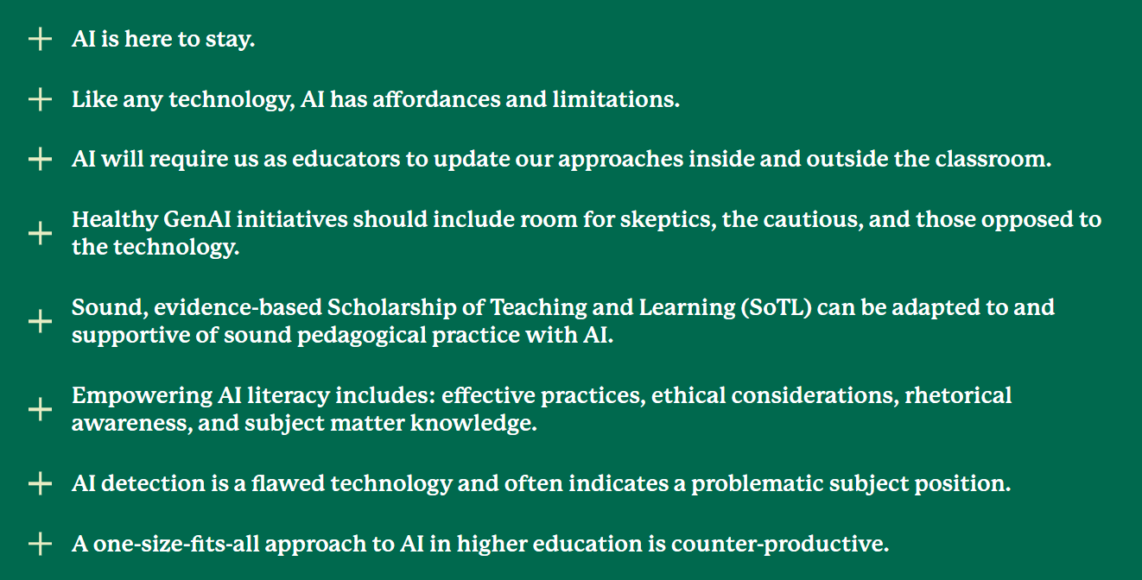
Benchmarking Peer Institutions
Ohio University: Gen AI in Teaching
Notes:
This is about teaching. The Center for Teaching, Learning, and Assessment (CTLA) offers foundational language around AI use that is broadly applicable and unlikely to change in the near future. These serve as valuable guideposts as we navigate evolving technologies.In addition to these general principles, CTLA also provides specific guidelines for syllabus development, which are available on their website and can help faculty incorporate AI-related expectations into their courses.
After reviewing both formal policy and policy-adjacent language related to generative AI, we took it upon ourselves to examine what has already been implemented at our institution.
This internal review helps us better understand current practices and informs our next steps in developing thoughtful, flexible guidance for graduate research.

Slide 10
Local Initiatives at OU
AI Symposium
AI@OU
Is AI Really Killing Creativity?
Notes:
Here we want to highlight two initiatives that was carried out campus wide last year in the conversation for GenAI use in research. 1) AI Symposium. 2) AI@OU.

Slide 11
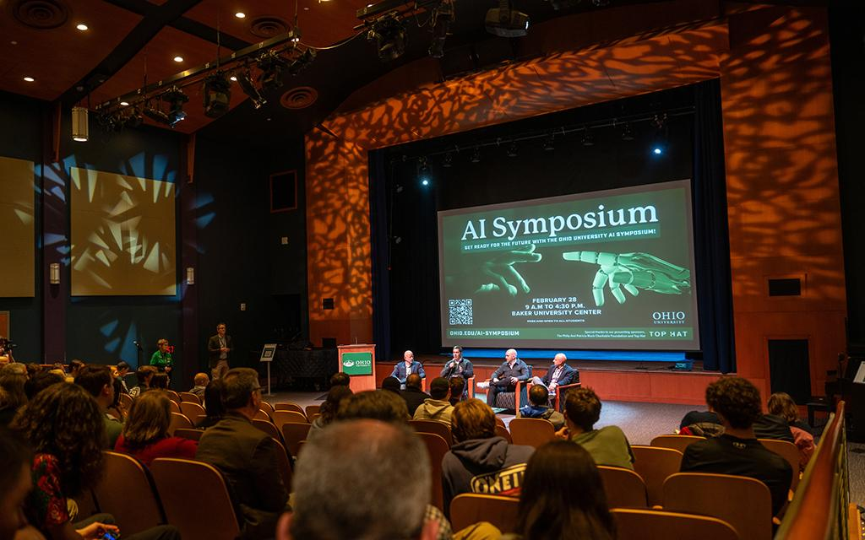
Local Initiatives at OU
AI Symposium
Notes:
Ohio University’s AI Symposium was designed to be a one-day conference that explored multiple facets of artificial intelligence and has brought together faculty, students, and staff across disciplines. OHIO invited keynote speakers around the globe to talk about the topics of 1) future-proofing your career in the age of automation and innovation, 2) the business applications of AI, 3) Beyond ChatGPT: How AI will transform business and your career.

Slide 12
You are entering maybe the weirdest timeline in human history.... You're going into this phase where all of this is new and being reinvented. That's actually an opportunity.
Paul Roetzer, founder and CEO of Marketing AI Institute, in the symposium keynote.
Notes:
One of the keynote speakers spoke on the significance of AI and his take is pretty futurist with optimism.

Slide 13
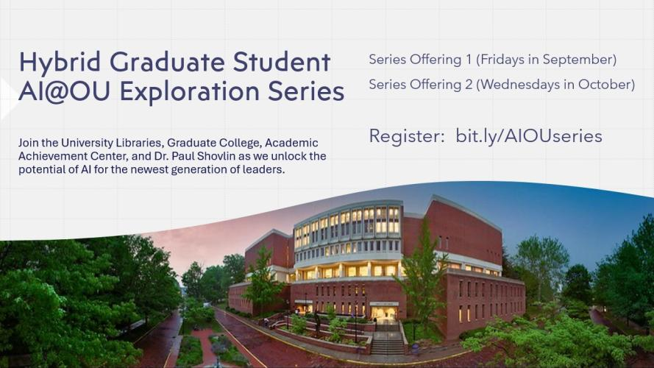
Local Initiatives at OU
AI@OU
Notes:
Another meaningful initiative was designed specifically for graduate students, with the Graduate College playing a key role in both the development and execution.These Exploration Series sessions were created for students interested in understanding how AI might impact their academic and professional work.The organizers intentionally curated a diverse set of topics, ranging from:Practical strategies for using AI effectively,To critical discussions about the ethical, social, and academic implications of these technologies.These sessions not only supported student learning but also helped surface questions and concerns that inform our broader efforts to develop policy-adjacent language.

Slide 14
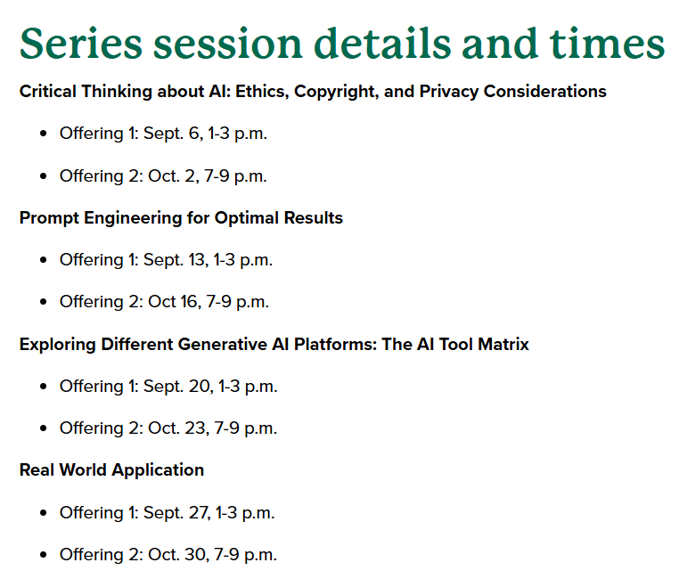
Local Initiatives at OU
AI@OU
Notes:
In conjunction with the Graduate Student AI@OU Exploration Series, the collaborative also established the AI@OU Canvas Community, where students were encouraged to cooperate, discuss, problem-solve, and share ideas and experiences concerning the rapidly changing technology and reach of AI. This online platform served as a hub for sharing resources, posing challenges and exploring the ethical implications of AI technology.
*highlight content in each of these sessions, or wait for questions*

Slide 15
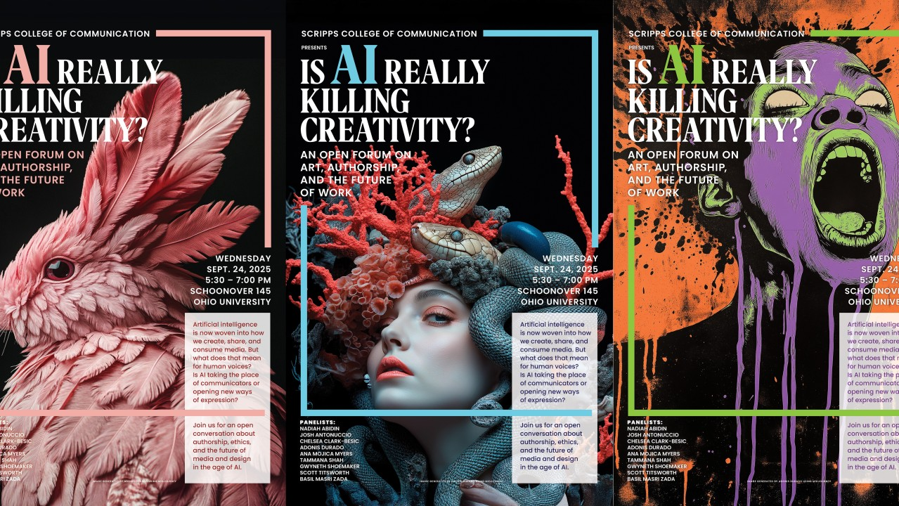
Local Initiatives at OU
Is AI Really Killing Creativity?
Notes:
*place flyers here

Slide 16
Real-World Questions on ETDs
Case Study: Integrating AI in Thesis Development
Dr. Newton’s student’s Dissertation
Notes:
Following the campus-wide, multi-unit collaborative efforts on generative AI, we began to see more nuanced and practical questions emerge—especially from communities like USETDA. One such question raised in the USETDA community highlights the need for clarity around AI use in thesis work, particularly when students are using AI tools in coursework that overlaps with dissertation writing. We also want to spotlight a compelling individual case: Dr. Newton’s doctoral student, who successfully defended their dissertation after incorporating AI tools into their research and writing process. These examples illustrate the real-world complexity of AI use in graduate research and reinforce the importance of developing thoughtful, policy-adjacent language that supports transparency, academic integrity, and innovation.

Slide 17

Real-World Questions on ETDs
Case Study: Integrating AI in Thesis Development
Background:
A faculty member at an institution reached out with a unique scenario involving the use of AI in thesis writing. A graduate student, enrolled in a Research Methods course, was given prior approval to begin drafting sections of their thesis as part of the class. The instructor had integrated AI tools into most course assignments, and the student utilized AI for tasks such as brainstorming and copy editing.
Notes:
Background: This case comes from a wonderful colleague whose institution had a student begin drafting parts of their thesis in a Research Methods course. The instructor had incorporated AI tools into most assignments, and the student used AI for brainstorming and copy editing. The student had prior approval to work on their thesis in this class, but the use of AI raised new questions.

Slide 18

Real-World Questions on ETDs
Case Study: Integrating AI in Thesis Development
Institutional Context:
Currently, the institution does not have an explicit policy regarding the use of AI in theses or dissertations. The thesis and dissertation handbook also lacks guidance on this topic.
Notes:
At this institution, there is currently no formal policy on AI use in theses or dissertations. The thesis/dissertation handbook does not address AI either, which is likely true for many of us. This raises the question: how do we handle emerging technologies when policy hasn’t caught up?

Slide 19
Real-World Questions on ETDs
Case Study: Integrating AI in Thesis Development
Discussion Points for ETD Community:
Does your institution have a formal policy or handbook guidance on the use of AI in theses/dissertations?
How would you approach this situation?
Should AI use be disclosed in the thesis (e.g., in the methodology or acknowledgments)?
What are the implications for authorship, originality, and academic integrity?
Notes:
Questions are captured in the slide.
These questions are quite important, and they reflect a growing need for clear, flexible guidance. It underscores the importance of policy-adjacent language—something that helps faculty and students navigate these situations with confidence. It also shows that institutions are looking to each other for models and collaboration.

Slide 20

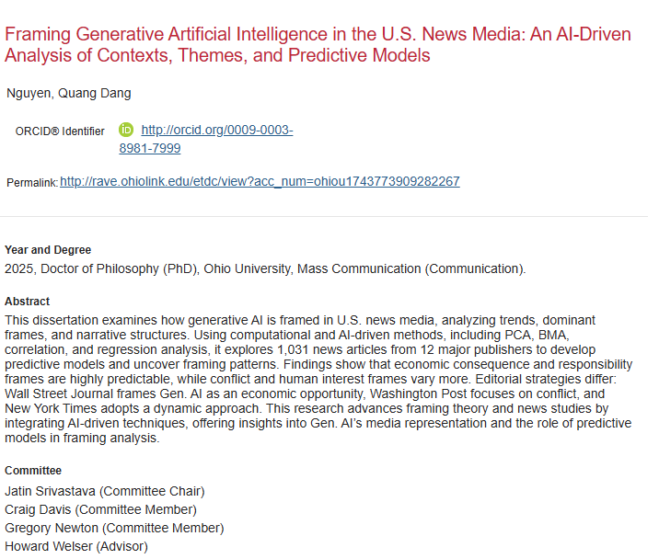
Real-World Questions on ETDs
Dr. Newton’s student’s Dissertation

Slide 21
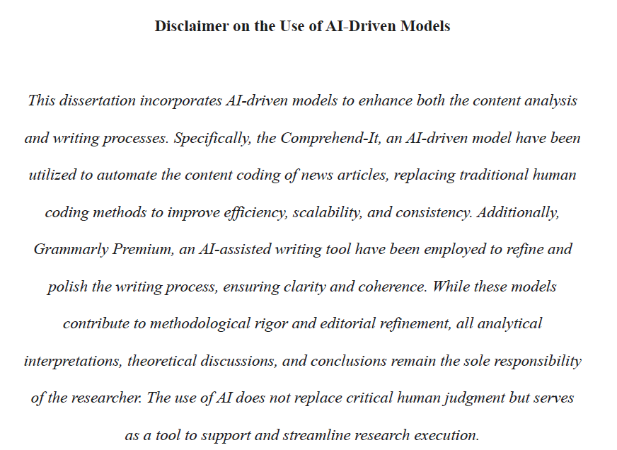
Real-World Questions on ETDs
Dr. Newton’s student’s Dissertation

Slide 22
Conclusion & Next Steps
Summary of key points
Framing the issue: Policy? Guidelines?
Benchmarking peer institutions on GenAI policy-adjacent language
Broad local initiatives at OU
Real-World Questions on ETDs
Invitation/Call to collaborate on Policy-Adjacent Language on AI-Use in Graduate Research with us!
Opening the floor for Questions
Notes:
Today, we’ve explored the evolving landscape of AI use in graduate research, framed by the keywords: policy-adjacent language on GenAI use for research.
We’ve benchmarked peer institutions and seen how others are navigating this space with flexible, policy-adjacent language.
At Ohio University, we’ve highlighted broad local initiatives—from CTLA’s foundational guidance to graduate-focused exploration series and campus-wide collaborations like AI@OU and Is AI Killing Creativity.
We’ve also examined real-world questions and cases, including feedback from the USETDA community and a successful dissertation defense involving Gen-AI.
So where do we go from here?
The path forward isn’t about rushing to formal policy—it’s about building shared language, collaborative frameworks, and responsive guidance.
We invite you to join us in shaping this conversation—whether through working groups, feedback, or cross-institutional collaboration.
Together, we can ensure that AI use in graduate research is ethical, transparent, and empowering for students and faculty alike.

Slide 23

Thank You!

