Slide 1
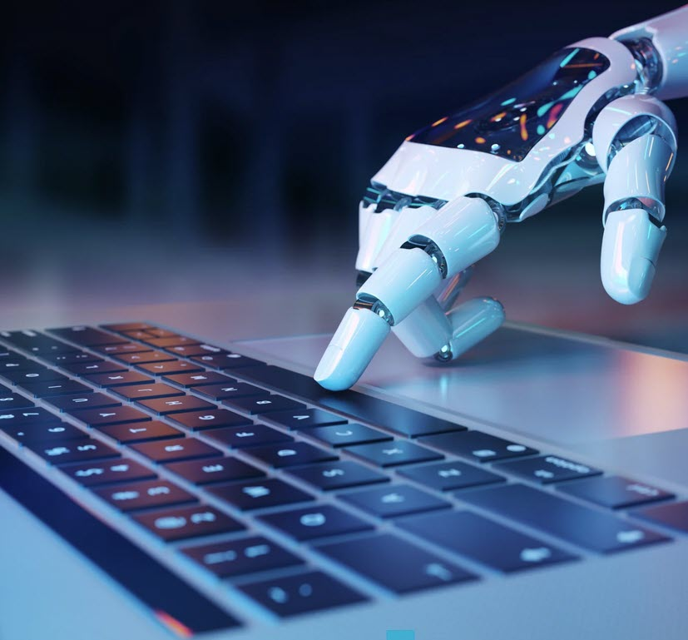
AI and Copyright
Does this affect theses and dissertations?
Who is responsible for checking the content?
Can AI affect the copyright?
Copyright and Artificial Intelligence, Part 2: Copyrightability
To qualify for copyright, the work must have human-generated content in addition to the AI-generated content. The Copyright Office will evaluate each submission on a case-by-case basis to determine if a work has enough human-generated content to warrant copyright protection.
Questions of the ability to copyright something with AI can be resolved utilizing existing laws, without the need for legislative change.
The use of AI tools to assist rather than substitute for human creativity does not preclude the resulting work from qualifying for copyright protection.
Copyright protects the original expression in a work created by a human author, even if the work also includes AI-generated material.
Notes:
Picture originally designed by Freepik. Some alterations have been made to the original picture.

Slide 2
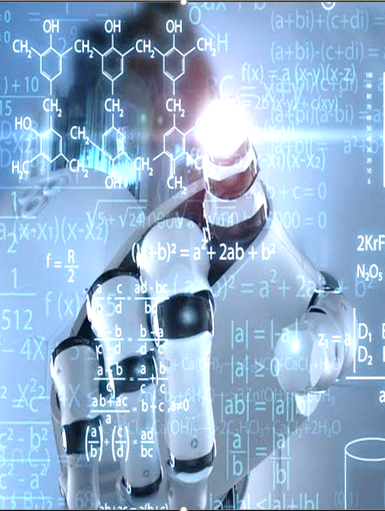

Sudowrite Jasper AI Paperpal Notion QuillBot Wordtune Thesis AI NotebookLM Perplexity AI
AI and Copyright
How can these be ethically used in a thesis or dissertation?
Brainstorming?
Streamlining a literature review?
Grammar checks?
Data analysis?
Content refinement?
What should it not replace?
Critical thinking
Original research
AI policies at various institutions:
Texas A&M Columbia U of Georgia U of Washington
U of Northern Colorado Illinois State
Notes:
Picture originally designed by Freepik. Some alterations have been made to the original picture.

