Slide 1

Enhancing Layout Understanding via Human-in-the-Loop: A User Study on PDF-to-HTML Conversion for Long Documents
Chenyu Mao and Edward A. Fox
ETD 2025, the 28th International Symposium on Electronic Theses and Dissertations (ETDs) and USETDA 2025, the 15th National US Conference on ETDs --- September 25-26, 2025 (Virtual)
Based on VT CS MS Thesis at https://hdl.handle.net/10919/125076
Available at http://fox.cs.vt.edu/talks/2025/20250926ETD2025MaoFox.pptx

Slide 2
Outline
Acknowledgements
Overview
Problem Situation
Solution Scenario
Approach
ETD Analysis/Parsing
ETD Labeling/Annotation
Human-in-the-loop ETD Improvement Tool
User Study
Summary
Discussion

Slide 3
*Acknowledgements
Thesis Committee: Chair: Edward A. Fox
Members: Sang Won Lee, Yan Chen
Related Funding: Institute of Museum and Library Services (IMLS) LG-256638-OLS-24 and LG-256694-OLS-24
Prior Related Dissertation
Aman Ahuja. “Analyzing and Navigating Electronic Theses and Dissertations”, PhD defense 12 June 2023, Virginia Tech, Computer Science, with demonstration of HTML results and related user manual, http://hdl.handle.net/10919/115817, winner of 2023 Innovative ETD Award (https://www.youtube.com/watch?v=cvu0hgoy2I0&list=PLkkCGJAzvhIiPSMdnMnr6or6QzUdiLPVT&index=26&pp=iAQB)

Slide 4
Acknowledgements - 2
Co-authors on related publications:
Aman Ahuja, Alan Devera, and Edward Alan Fox. Parsing Electronic Theses and Dissertations Using Object Detection. In T. Ghosal, S. Blanco-Cuaresma, A. Accomazzi, R. M. Patton, F. Grezes, and T. Allen, eds., Proceedings of the First Workshop on Information Extraction from Scientific Publications (WIESP 2022), with AACL-IJCNLP 2022, pages 121–130, Taipei and Online, November 2022. https://ui.adsabs.harvard.edu/WIESP/2022/Schedule.
Aman Ahuja, Kevin Dinh, Brian Dinh, William A. Ingram, and Edward A. Fox. A New Annotation Method and Dataset for Layout Analysis of Long Documents. In Proceedings of the 3rd International Workshop on Scientific Knowledge: Representation, Discovery, and Assessment (Sci-K 2023), Companion Proceedings of ACM Web Conference 2023, pages 834–842, April 30 - May 4

Slide 5
*Overview
Make ETDs Accessible for Screen Readers and for Locating Elements
Human-in-the-loop to Fix AI Errors
System for Accessing, Fixing, and Improving Training
User Study of Systems’ Usability, Quality Improvement

Slide 6
*Problem Situation
Need for: Screen Reader for ETDs in PDF
ETD Browser
ETD Categories
Types of Errors — Wrong Label, Flawed Element
WL: wrong label or missing bounding box
FE: missing/duplicated/irrelevant words, inaccurate bounding box
Due to:
Long and complex documents
Diverse styles and formats
Specialized content and elements

Slide 7
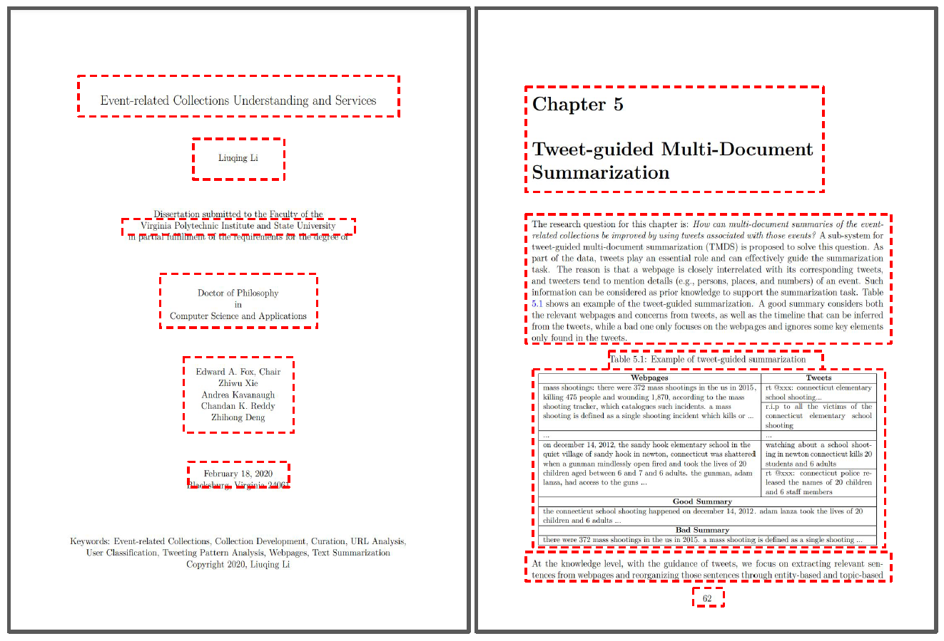
Need for: Screen Reader for ETDs in PDF

Slide 8
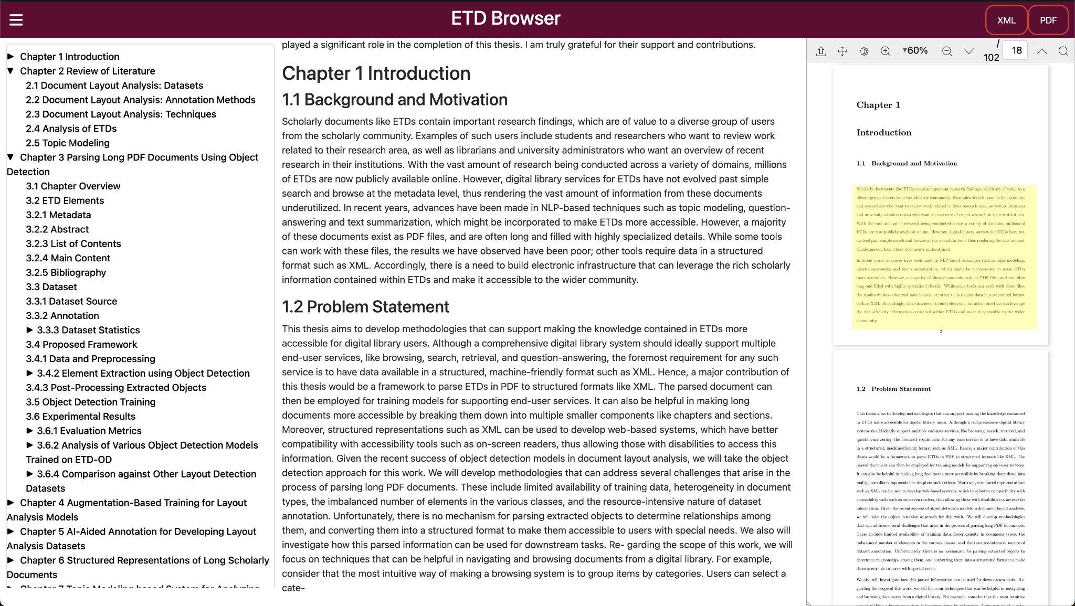

Slide 9
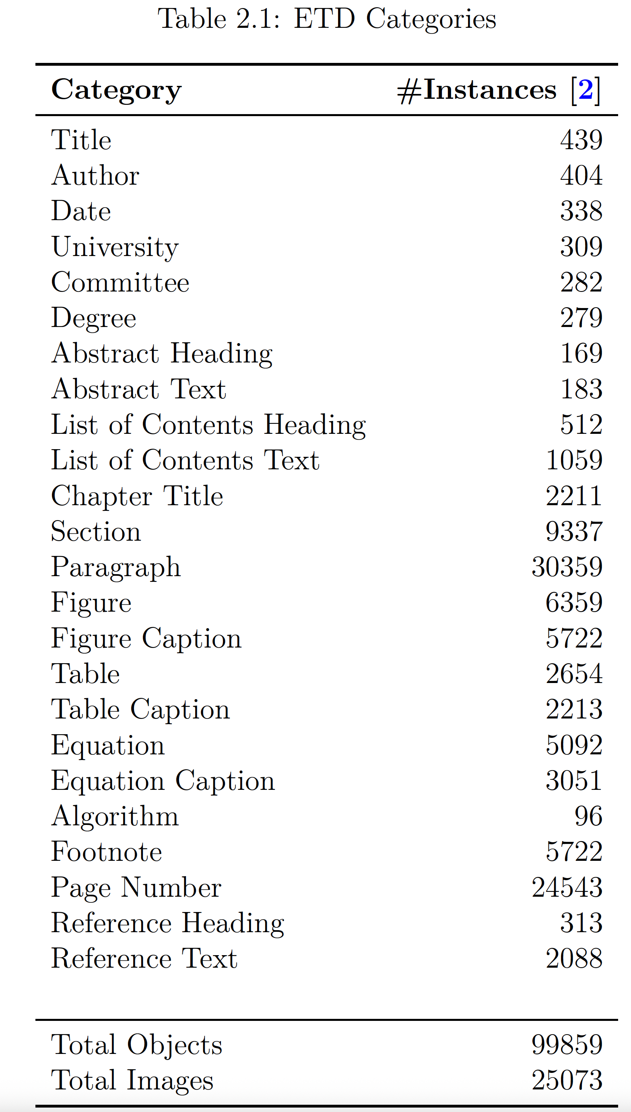
ETD Categories
From a sample of 200 ETDs (out of 500K):
Counts of occurrences of each type of document element, generated through analysis by an early ETD object detection system (see Acknowledgements re Sci-K 2023).

Slide 10
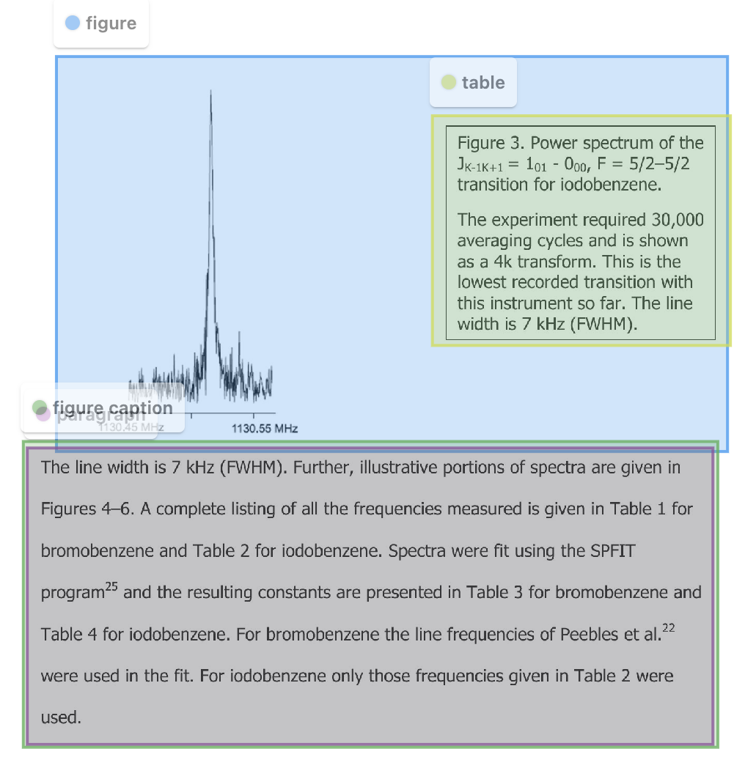
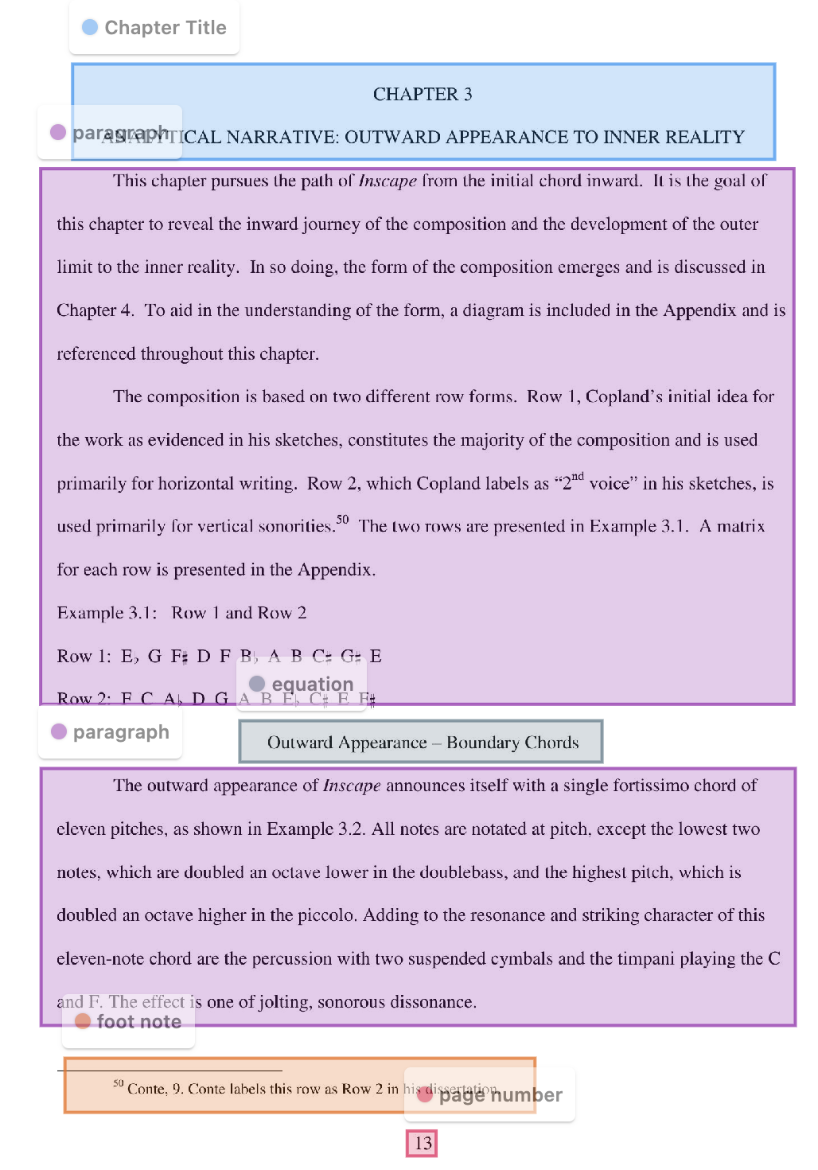
Wrong Labels (WL)

Slide 11
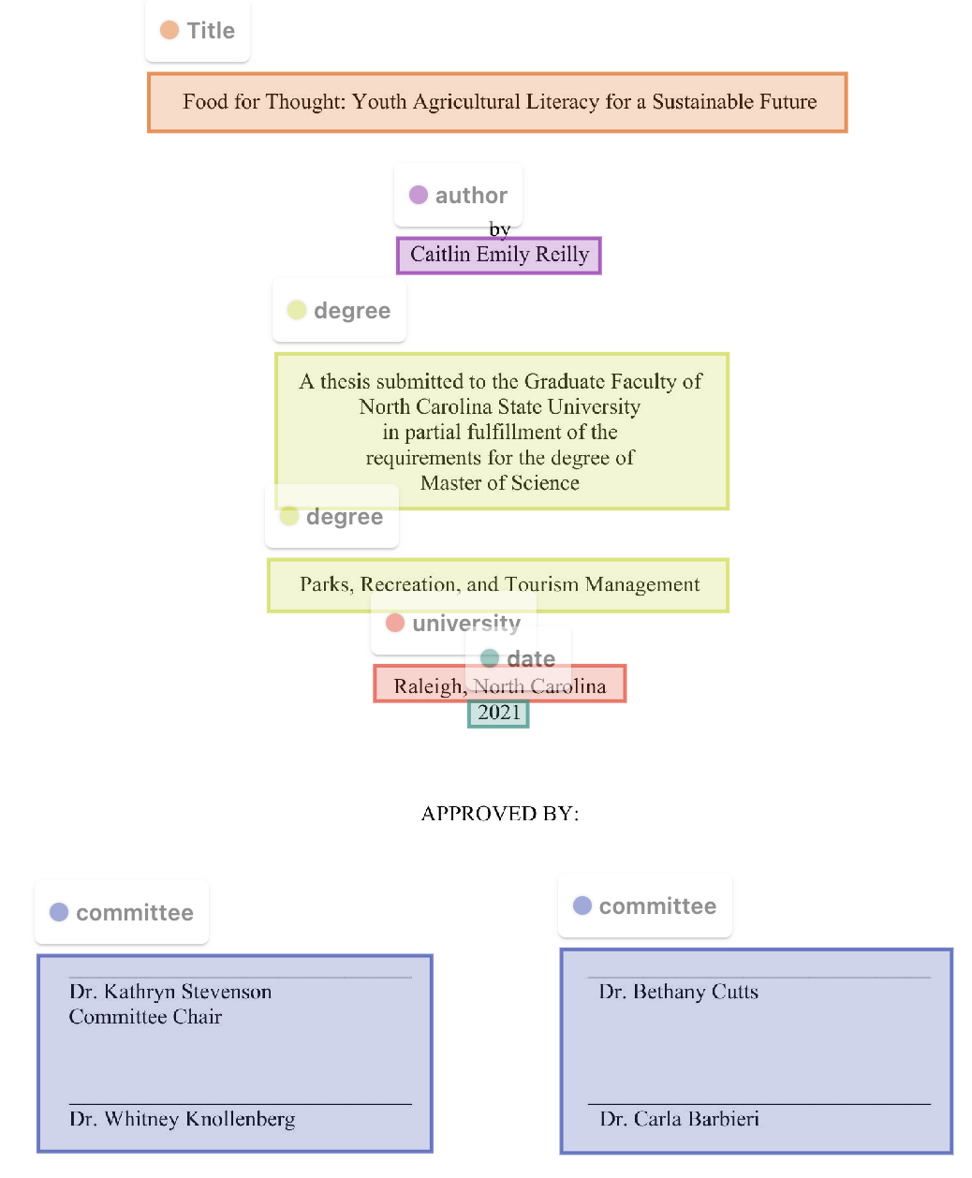
Flawed Elements (FE)

Slide 12
*Solution Scenario
Implement Currently Best Object Detection System
Train on Related Documents and then on ETDs
Encourage Use of Tool
With Object Detection System as “Back-End”
With Usable “UI/Front-end” (Like that Discussed Herein)
Users Each Fix a Document of Interest to Them
Fixes from Such Users are Collected and Used to Improve Further Object Detection

Slide 13
*Approach
Architecture of Human-in-the-loop ETD Improvement Tool
Dataset for User Study

Slide 14
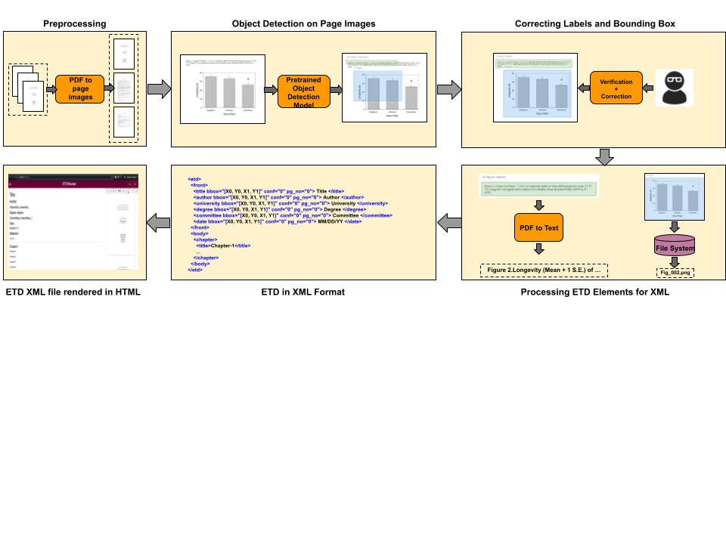
Human-in-the-loop ETD Improvement Tool

Slide 15
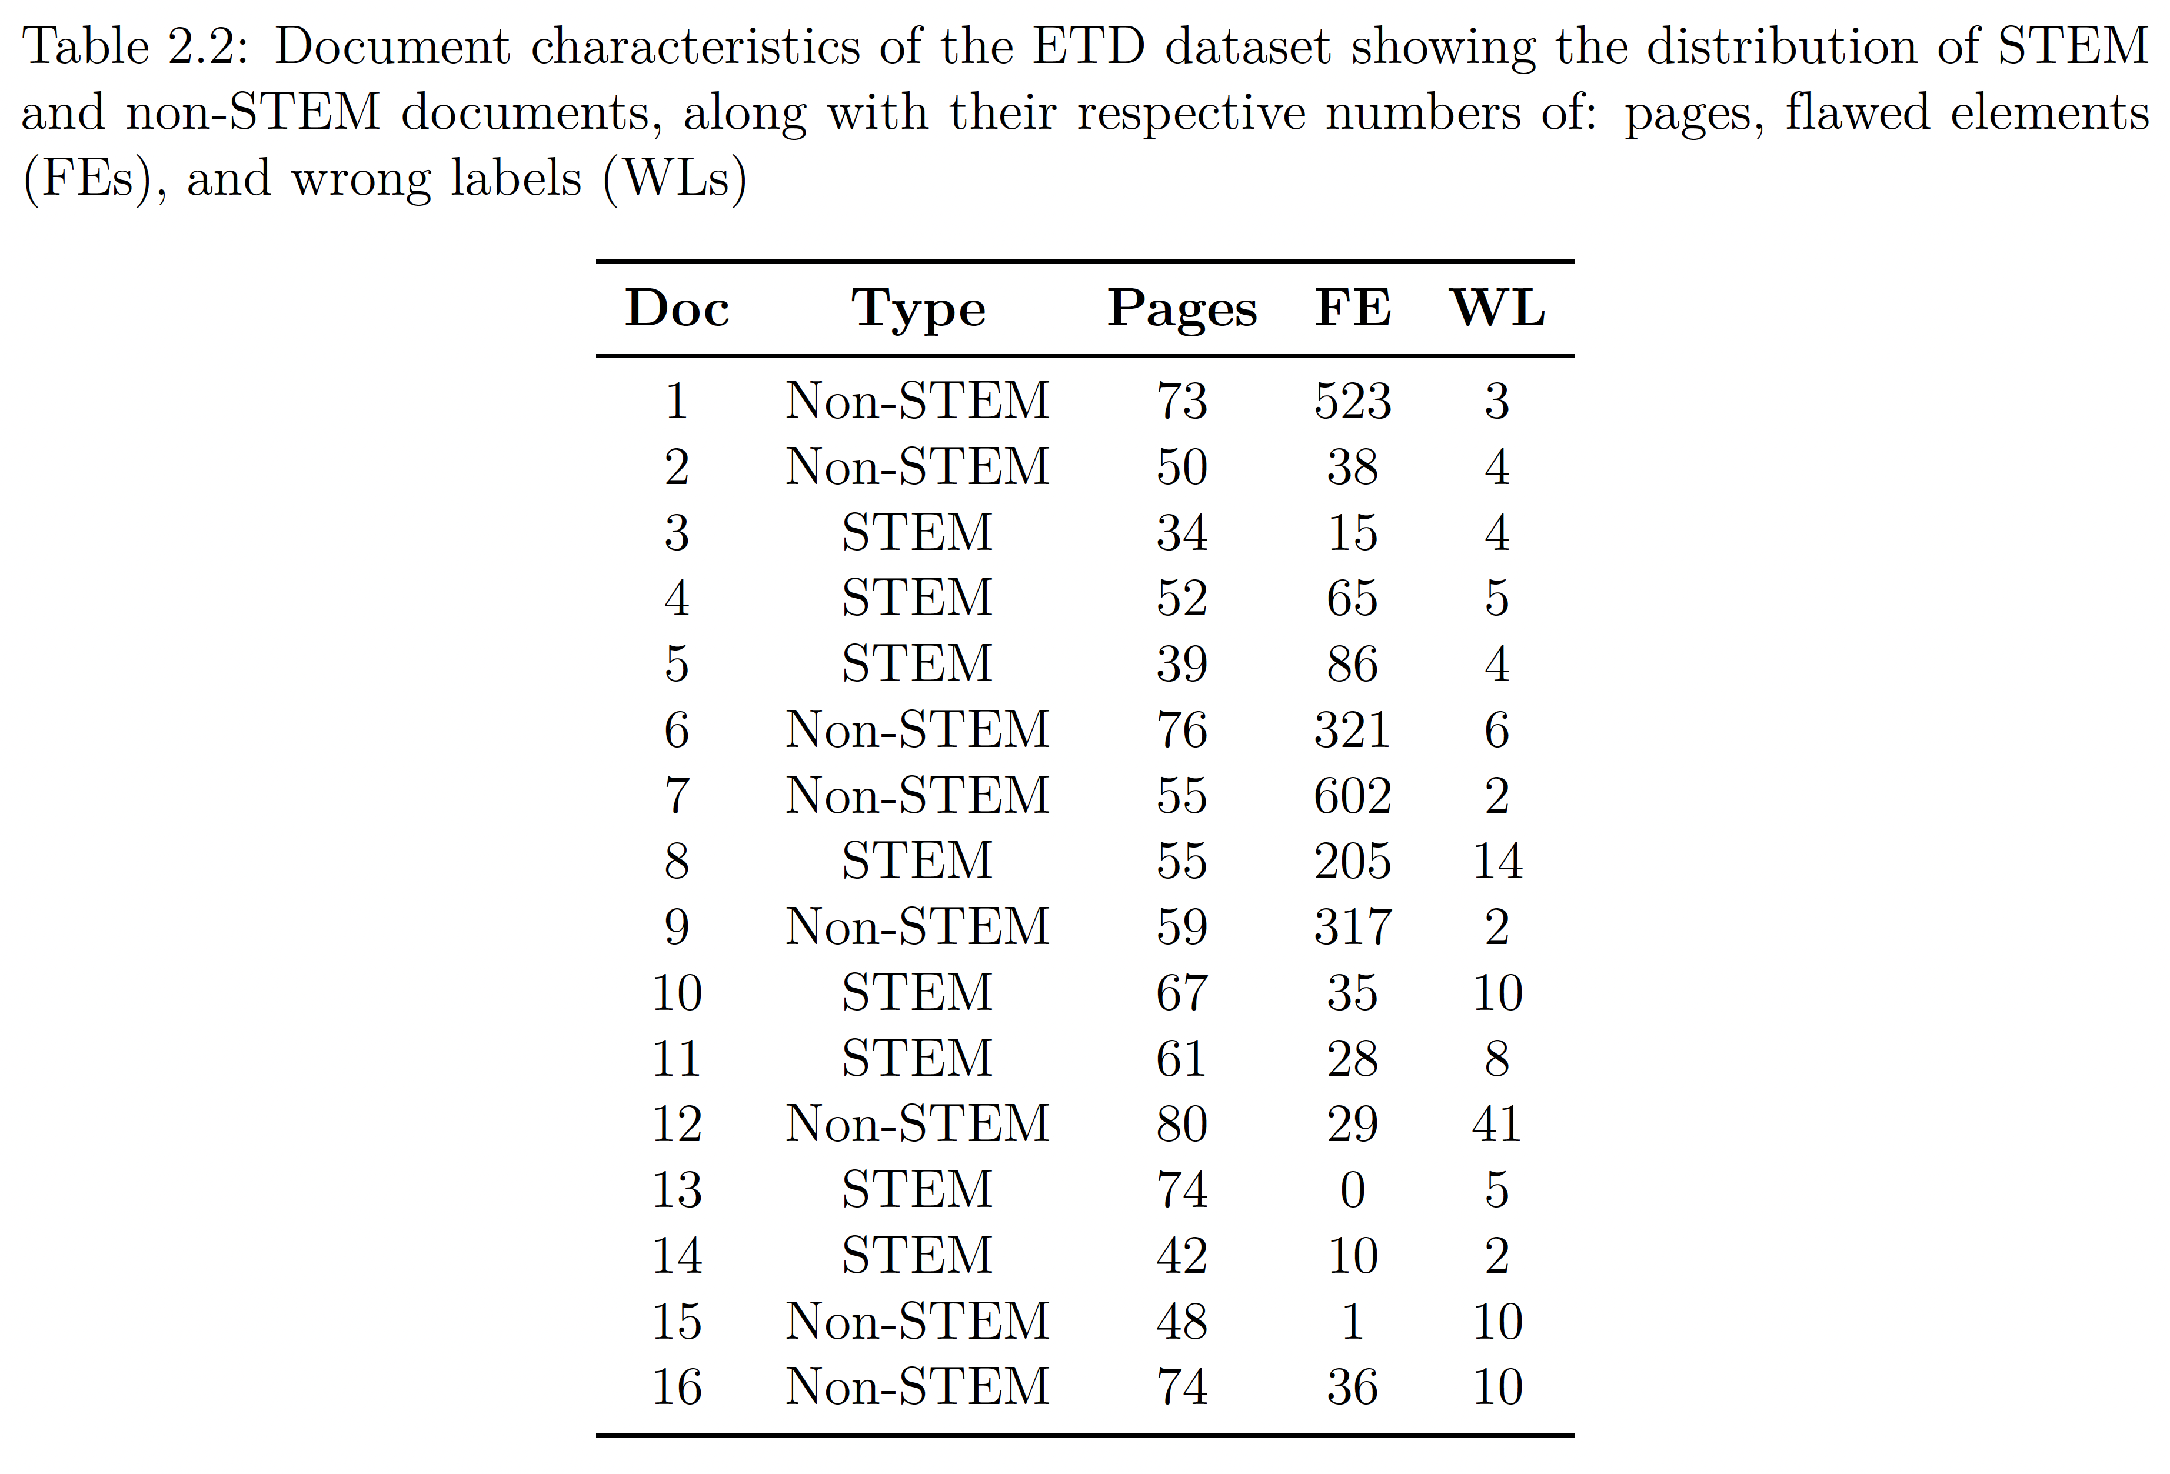
Dataset for User Study

Slide 16
*ETD Analysis/Parsing
Select AI Model
Upload ETD
ETD Browser (applied to analyzed ETD)

Slide 17

Select AI Model

Slide 18
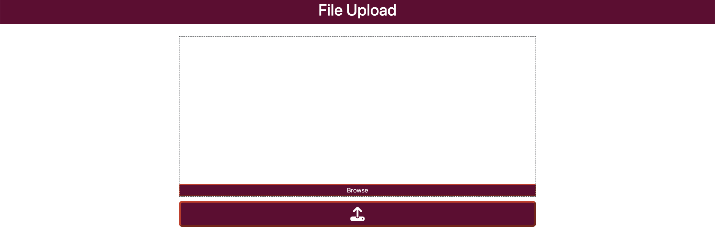
Upload ETD

Slide 19
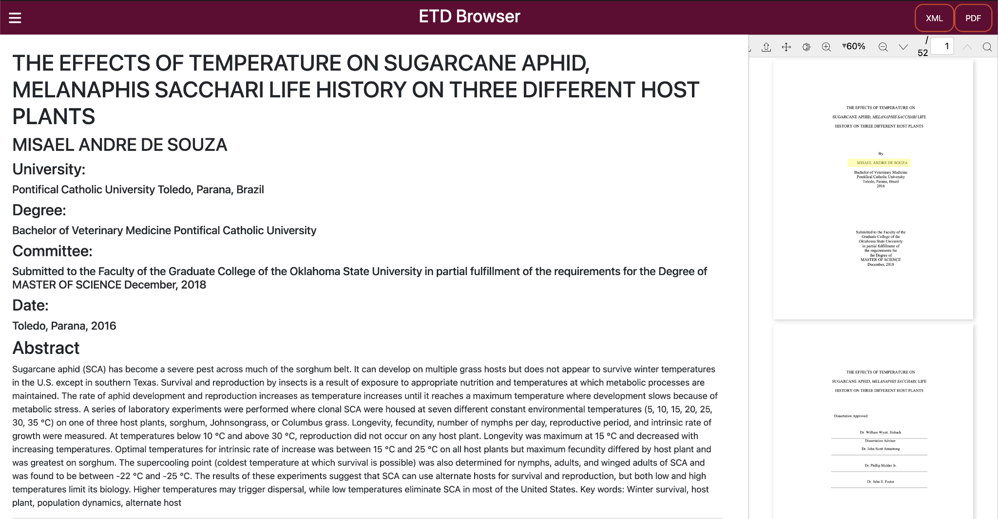

Slide 20
*ETD Labeling/Annotation
Upload Amount: Batch vs. Single
Select File(s) to Upload
Specify Categories (in YAML)
Select AI Object Detection Model
Object Detection Correction Example
Download Results

Slide 21
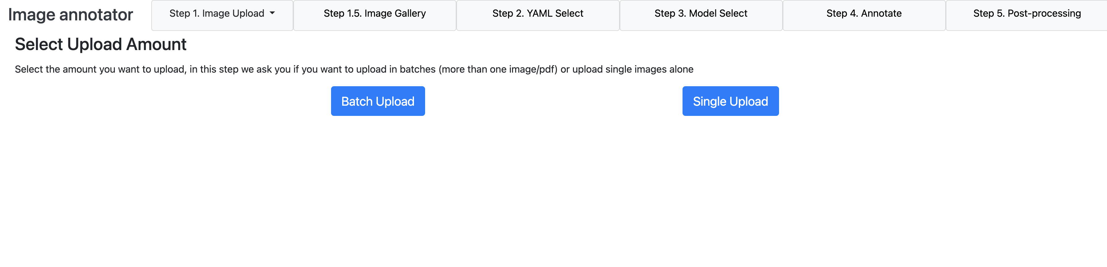
Upload Amount: Batch vs. Single

Slide 22
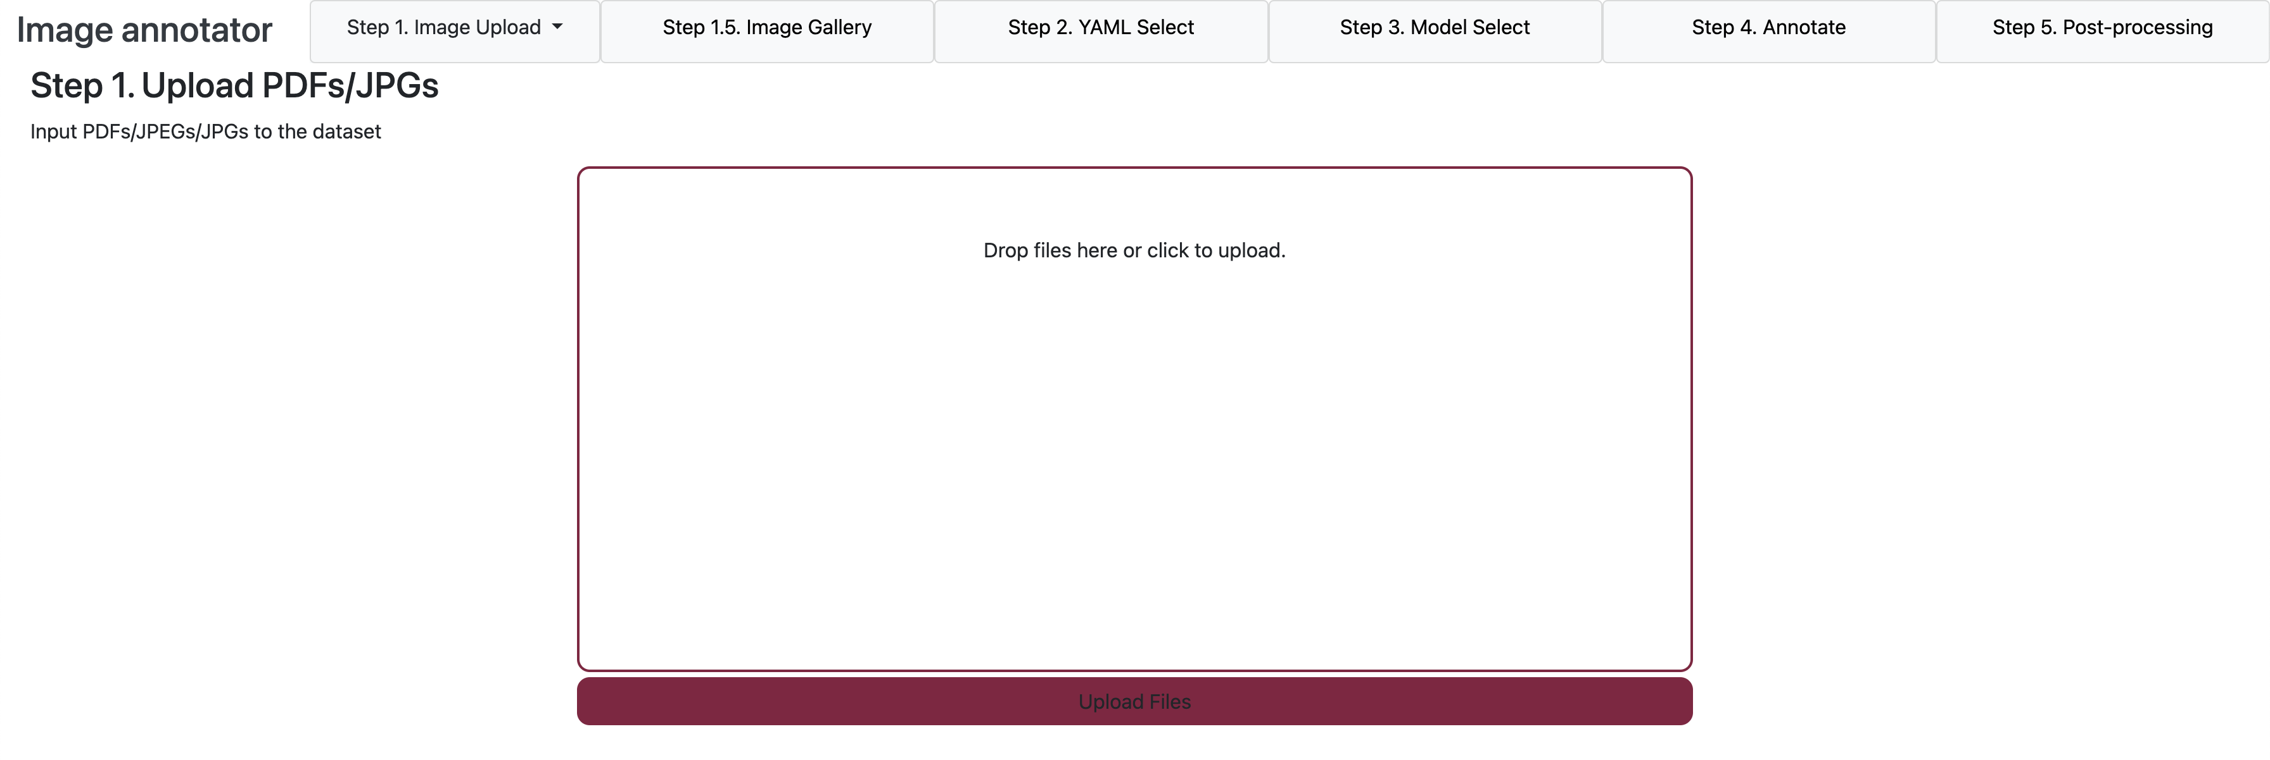
Select File(s) to Upload

Slide 23
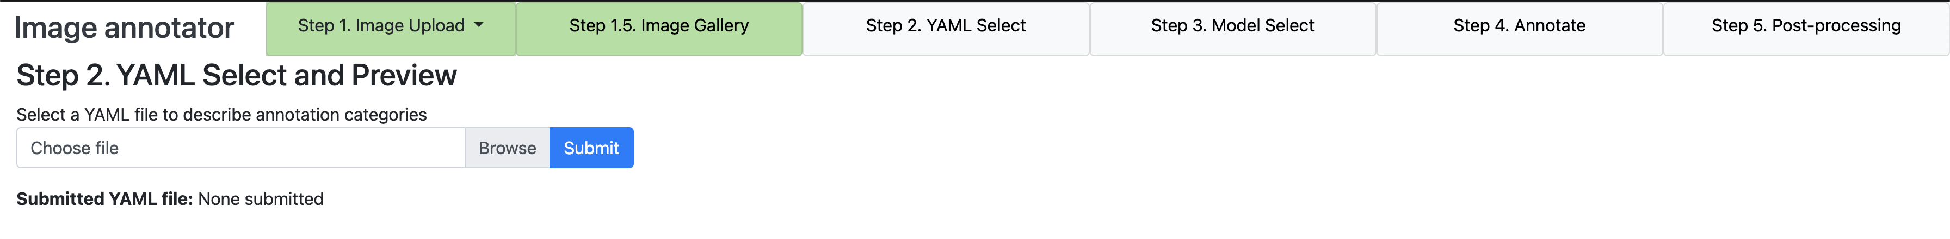
Specify Categories (in YAML)

Slide 24
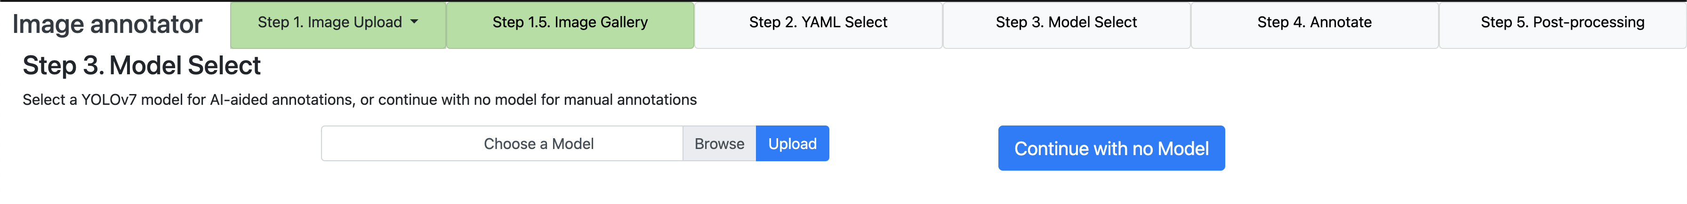
Select AI Object Detection Model

Slide 25
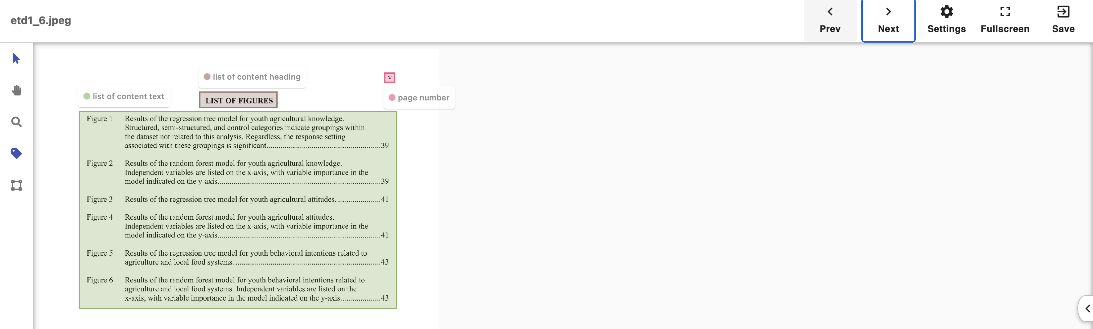
Object Detection Correction Example

Slide 26
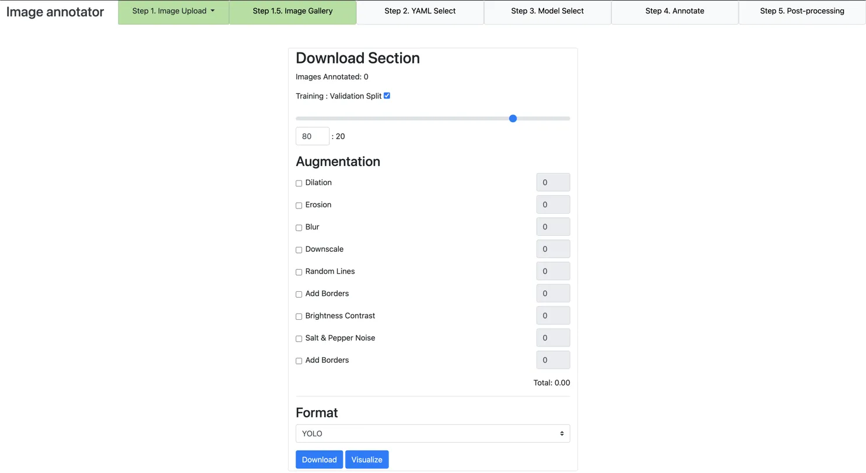
Download Results

Slide 27
*Human-in-the-loop ETD Improvement Tool
Human-in-the-loop ETD Improvement Tool
Select Upload Amount
Upload PDFs/JPGs
Annotation Page
Visualize with ETD Browser
Download for Post-processing

Slide 28
Human-in-the-loop ETD Improvement Tool

Slide 29
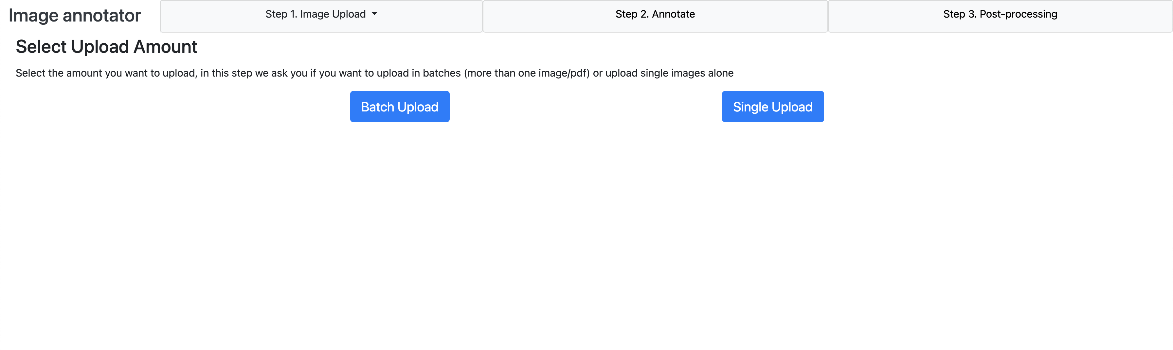
Select Upload Amount

Slide 30
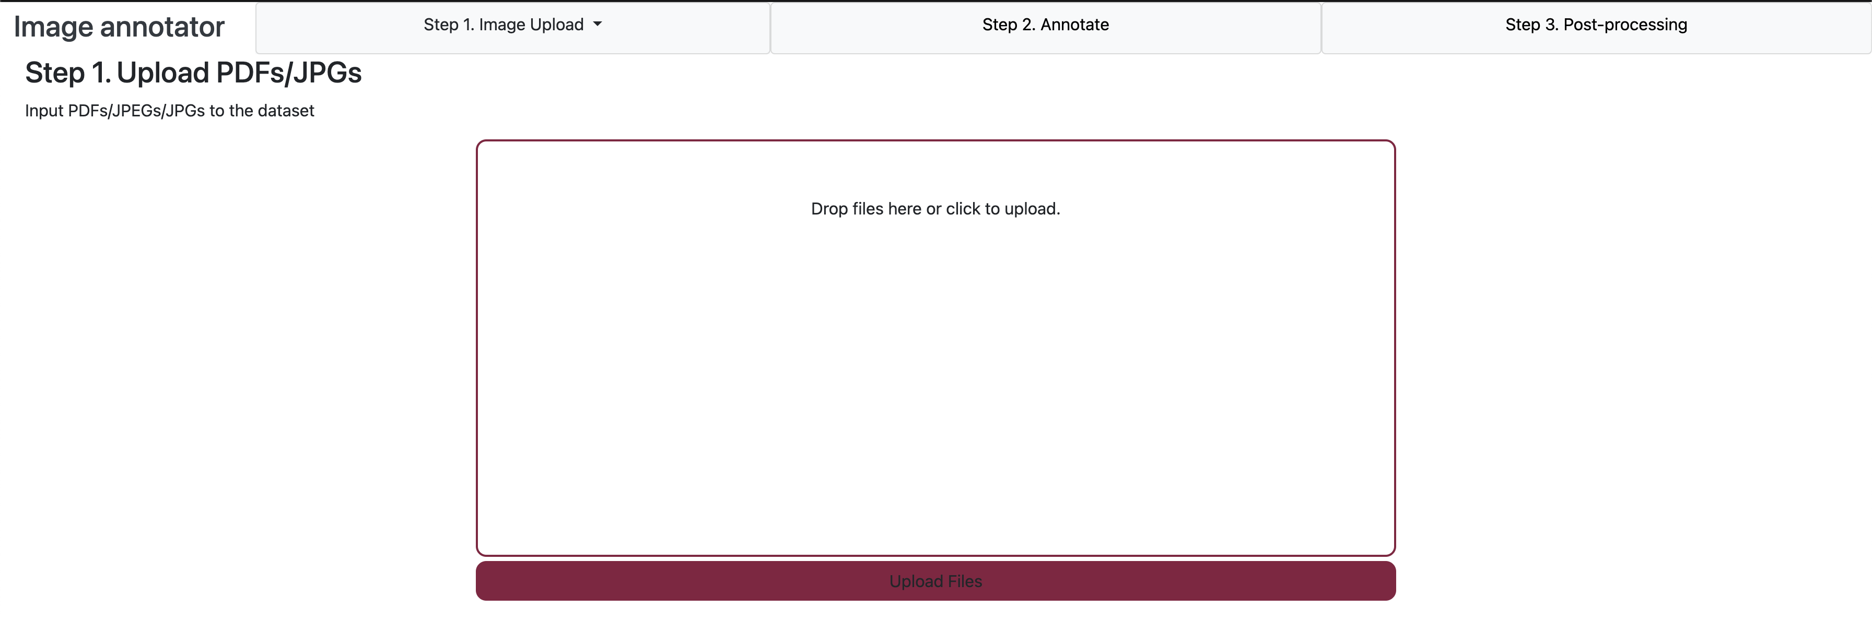
Upload PDFs/JPGs

Slide 31
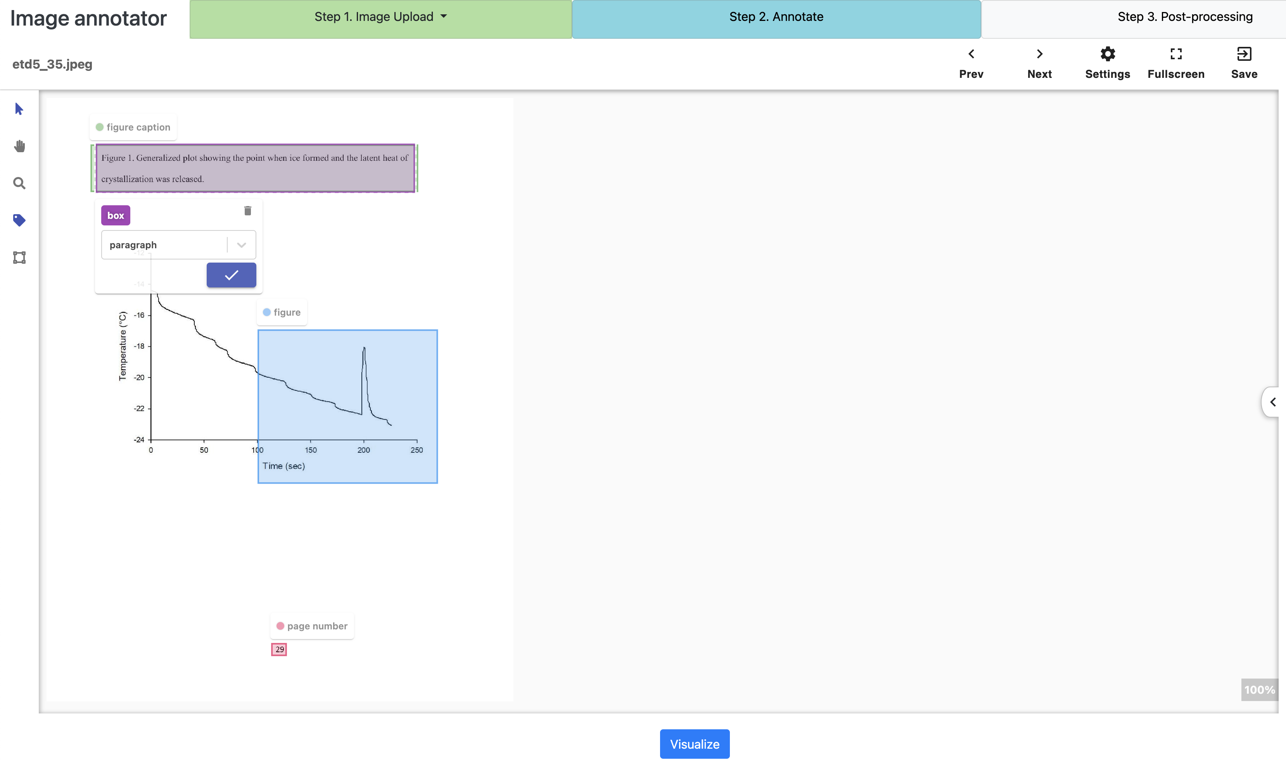
Annotation Page

Slide 32

Visualize with ETD Browser

Slide 33
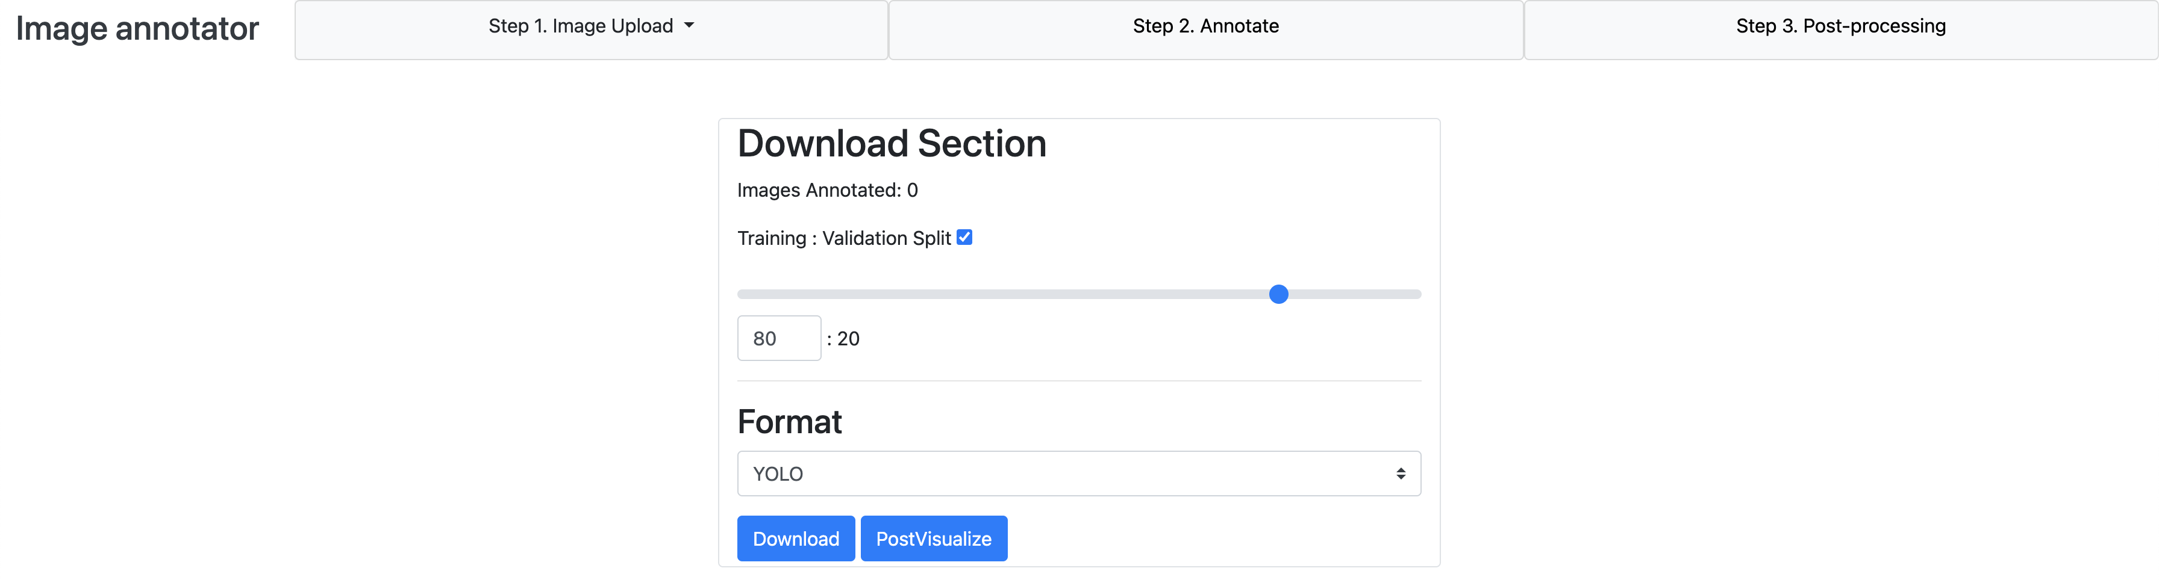
Download for Post-processing

Slide 34
*User Study
Hypotheses
Study Design
Study Setting
Overall Results
Hypotheses and Related Results
Limitations
Future Work

Slide 35



Hypotheses
Manual correction will lead to the identification of many problems with the current system and its object detection model.
Higher user satisfaction scores will be positively correlated with perceived ease of use.
Users with more significant academic experience and domain-specific knowledge will perform better at our task.

Slide 36
Study Design
Annotation
Demographics
Annotation
Post-Survey
Gender
Academic Status
Major
Familiarity of ETDs
Time spent to annotate 4 ETDs
Number of Wrong Labels
Number of Flawed Elements
Time spent to annotate 4 ETDs
Number of Wrong Labels
Number of Flawed Elements
Ratings of Usability via Likert scale
Feedback

Slide 37
Study Setting
IRB approved, preceded by pilot study (2 participants)
Participants:
8 (4 STEM and 4 Non-STEM), all from VT community
ETDs:
16 (8 STEM and 8 Non-STEM), randomly selected from ETD pool (2010~2021)
Groups:
4; each group has 2 participants (STEM and Non-STEM)
Each participant was given 4 ETDs (2 STEM and 2 Non-STEM).

Slide 38
Overall Results
Errors After Correction by Groups’
Errors Before Correction
First Participant
Second Participant
etd_idx | FE | WL | FE(P1) | WL(P1) | FE(P2) | WL(P2) | AVG correction rate (FE) | AVG correction rate (WL)
1 | 523 | 3 | 3 | 1 | 3 | 0 | 99.43 | 83.33
2 | 38 | 4 | 0 | 0 | 0 | 0 | 100 | 100
3 | 15 | 4 | 6 | 0 | 2 | 0 | 73.33 | 100
4 | 50 | 5 | 50 | 5 | 0 | 3 | 50 | 20
5 | 86 | 4 | 0 | 0 | 0 | 0 | 100 | 100
6 | 321 | 6 | 37 | 1 | 0 | 2 | 94.24 | 75
7 | 602 | 2 | 2 | 1 | 35 | 1 | 96.93 | 50
8 | 205 | 14 | 34 | 1 | 2 | 0 | 91.22 | 96.43
9 | 317 | 2 | 0 | 1 | 0 | 0 | 100 | 75
10 | 35 | 10 | 3 | 1 | 2 | 0 | 92.86 | 95
11 | 63 | 8 | 31 | 2 | 2 | 0 | 73.81 | 87.5
12 | 29 | 41 | 32 | 21 | 2 | 0 | 41.38 | 74.39
13 | 0 | 5 | 0 | 2 | 0 | 2 | N/A | 60
14 | 10 | 2 | 4 | 0 | 2 | 0 | 70 | 100
15 | 1 | 10 | 1 | 0 | 0 | 0 | 50 | 100
16 | 36 | 10 | 1 | 5 | 0 | 1 | 98.61 | 70

Slide 39
Hypothesis 1: Manual correction will lead to the identification of many problems with the current system and its object recognition model.

Slide 40
H1 Results
etd_idx | Type | No. Pages | Avg. FE Correction (%) | Avg. WL Correction (%)
1 | Non-STEM | 73 | 99 | 83
2 | Non-STEM | 50 | 100 | 100
3 | STEM | 34 | 73 | 100
4 | STEM | 52 | 50 | 20
5 | STEM | 39 | 100 | 100
6 | Non-STEM | 76 | 94 | 75
7 | Non-STEM | 55 | 97 | 50
8 | STEM | 55 | 91 | 96
9 | Non-STEM | 59 | 100 | 75
10 | STEM | 67 | 93 | 95
11 | STEM | 61 | 73 | 88
12 | Non-STEM | 80 | 41 | 74
13 | STEM | 74 | N/A | 60
14 | STEM | 42 | 70 | 100
15 | Non-STEM | 48 | 50 | 100
16 | Non-STEM | 74 | 99 | 70
 |  | STEM Average (%) | 78.6 | 85.6
 |  | Non-STEM Average (%) | 85 | 78.4
 |  | Overall Average (%) | 82 | 81.7
Notes:
Non-parametric t-tests,

Slide 41
Hypothesis 2: Higher user satisfaction scores will be positively correlated with perceived ease of use.

Slide 42
User Experience Dimensions
 | Statement | Dimension
D1 | The system was easy to learn and use | System Learnability
D2 | I felt comfortable using the toolbar to correct errors | Toolbar Error Correction
D3 | I was able to complete tasks without needing assistance | Task Completion Independence
D4 | I was able to correct most of the errors (e.g., labels or text alignment) without difficulty. | Error Correction Ease
D5 | I encountered minimal disruptions or technical issues while using the system. | Technical Issues

Slide 43
User Experience Dimension Correlations
Dimension | D4 | D1 | D2 | D3 | D5
D4. Error Correction Ease | 1
D1. System Learnability | 0.620* | 1
D2. Toolbar Error Correction | 0.297 | 0.872** | 1
D3. Task Completion Independence | 0.163 | 0.823** | 0.805** | 1
D5. Technical Issues | 0.637* | 0.754** | 0.519* | 0.708** | 1

Slide 44
Hypothesis 3: Users with more significant academic experience and domain-specific knowledge will perform better at our task.

Slide 45
Performance in Correction Tasks: Major and Familiarity Insights
Major | Avg Time | Flawed Element Correction (%) | Wrong Label Correction (%)
STEM | 23.19 | 67.03 | 72.91
Non-STEM | 15.31 | 96.05 | 90.21
Familiarity Level | Count | Avg FE (%) | Avg WL (%)
Level 2 | 2 | 75.43 | 73.75
Level 3 | 3 | 85.5 | 80.83
Level 4 | 3 | 81.66 | 87.5

Slide 46

Performance in Correction Tasks: Major and Familiarity Insights
General text-processing abilities vs. domain-specific technical knowledge
Logical and technical details vs. content and form

Slide 47
Limitations
Limited Sample Size (N = 8)
Participant Background Representativeness
System Complexity and User Training
Model Generalization Limitations

Slide 48
Future Work
Add measures like System Usability Scale (SUS)
Have more participants and broader representation
Further improve the user interface
Extend to more and different types of documents (e.g., PowerPoint)

Slide 49
*Summary
Acknowledgements
Overview
Problem Situation
Solution Scenario
Approach
ETD Analysis/Parsing
ETD Labeling/Annotation
Human-in-the-loop ETD Improvement Tool
User Study
Summary
Discussion

Slide 50
Thank you! Questions? fox@vt.edu Chenyu Mao <mchenyu@vt.edu>
*Discussion

