Slide 1
Aix-Marseille Université theses legal deposit 13/07/16 –ETD 2016, Lille AC LAMBOTTE

Slide 2
1- Institutional background

Slide 3
Dates…
2010: electronic format for Aix-Marseille 2 doctoral theses legal deposit
2011: electronic format for Aix-Marseille 1 and 3 doctoral theses legal deposit
2012: Merging of Aix-Marseille universities
2014: Apogée connected to STEP / STEP and STAR connected
2015: theses files controlled by supervisors

Slide 4
… and figures
12 doctoral schools in all disciplines (social sciences; languages; literature; arts; health; sciences; law and political sciences; economics).
Ca. 3,500 PhD students.
2013: 695 theses catalogued in STAR.
2014: 615 theses catalogued in STAR.

Slide 5
2- Workflow

Slide 6
Before the defense
Administrative data registered in APOGÉE (the students registering software) are retrieved by STEP and by a « guichet », i.e. a dedicated website enabling to submit theses electronically.
When the defense date is registered in APOGÉE, the uploading space for the file is rendered automatically available on the « guichet »
An e-mail is automatically sent to the PhD student requesting the PhD file upload
Uploading of the PhD file : one PDF file
Abstracts and keywords are filled in by the PhD student

Slide 7
« Le guichet »: dedicated website to submit theses electronically

Slide 13
Before the defense
If the file is not uploaded: automatic reminders are sent
« contrat de diffusion d’une thèse soutenue » : the PhD student fills out this form with the access conditions he agrees to

Slide 14
After the theses defense
PhD supervisors are sent hyperlinks for approval of the PhD files:
Approval
Minor corrections required: the author is given one month to upload a new file
Corrections required : the author is given three months to upload a new file
Files and data are exported from the website into STAR by ABES webservice

Slide 15
Proofreading
The legal documents (« contrat de diffusion » et « avis du jury sur la diffusion ») are given to the university libraries
Cataloguing (validation en rôle « NOVAL »)
Proofreading by the theses coordinator (validation en rôle « VALID »)

Slide 16
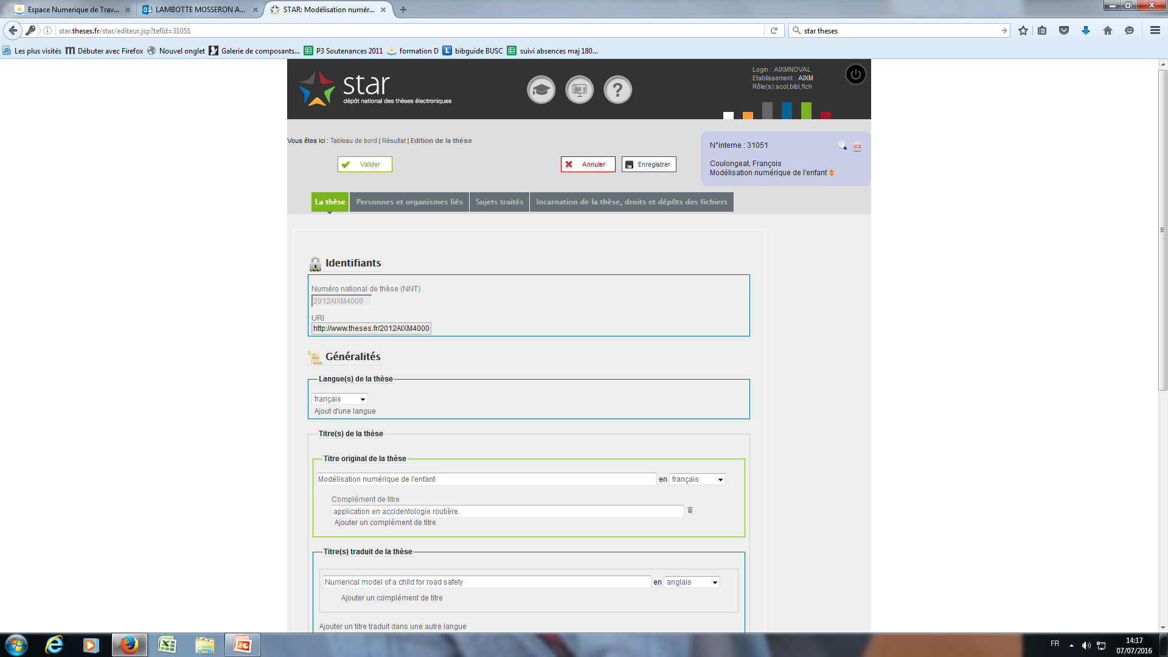
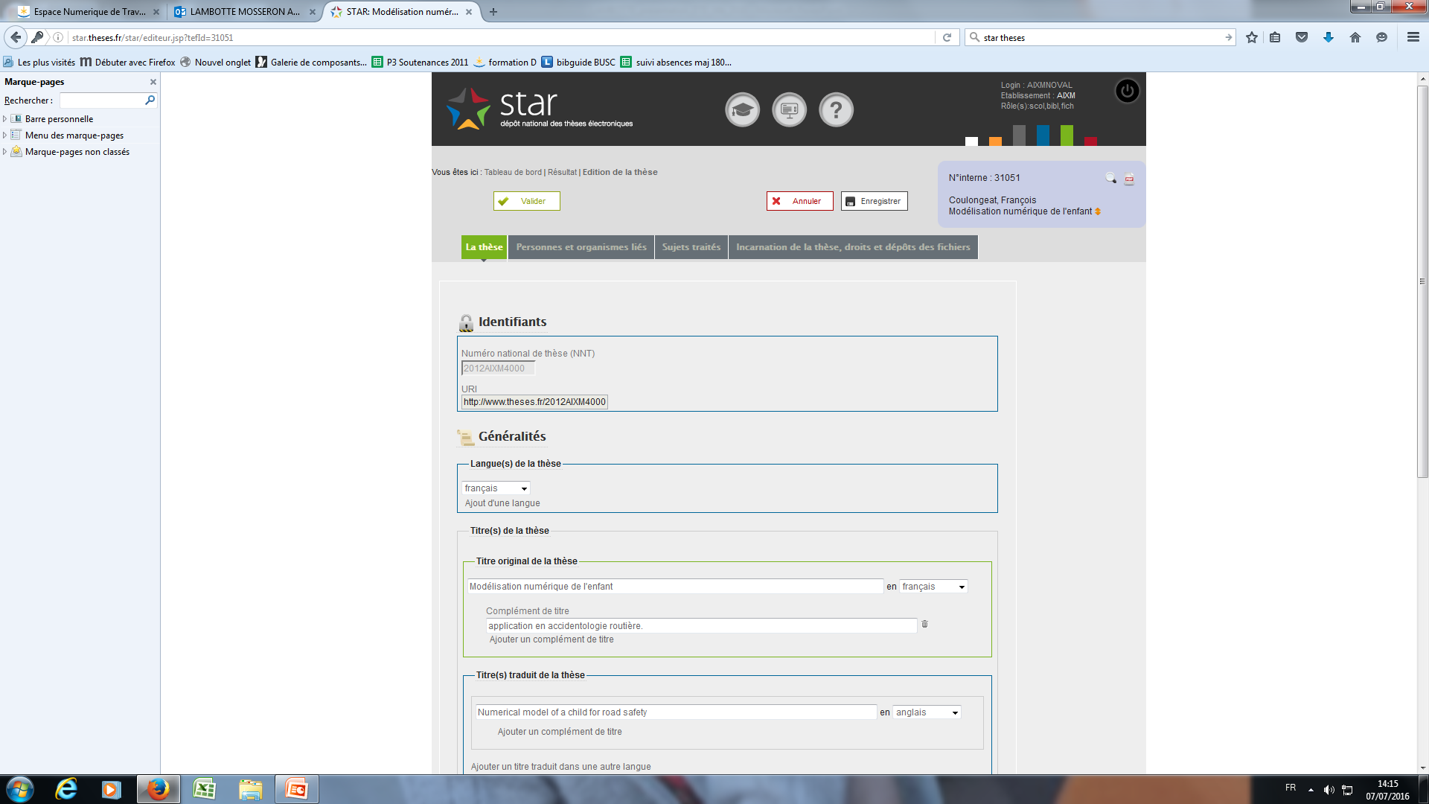

Slide 20
Access
The archived file and the available one are identical
Intranet : the files are on a university server
Internet : the files are on ABES server

Slide 21
Dissemination
The PhD file is archived at the CINES (Centre informatique national de l’enseignement supérieur)
Bibliographic record in the French academic libraries online catalogue SUDOC (and in AMU libraries online catalogue KOHA)
Bibliographic record on the website theses.fr
If the author has agreed to an internet diffusion the file can be retrieved on theses.fr

Slide 22
2014 Theses

Slide 23
3- Perspectives

Slide 24
A user-friendly website
Making the « guichet » more user-friendly :
For the PhD students to find all the needed information
For the university administrators to follow the workflow of the file deposit easily.

Slide 25
Thank you!
anne-celine.lambotte-mosseron@univ-amu.fr

